Slide 2
Engaging Discussion Online
V. LeAnn Krosnick and Sarah Rutland
Center for eLearning, Cleveland State University

Slide 3
Introductions
V. LeAnn Krosnick, Sr. Instructional Designer
Sarah Rutland, Manager, Quality Assurance and Sr. Instructional Designer

Slide 4
Outline
Discussions within bigger picture
Set Clear Expectations
Clarify your role
Engaging Discussion Considerations
Group Discussions
Rubric Examples
Sharing Your Experience
Q & A

Slide 5
Discussions
within the bigger picture
Notes:
These are the various forms of communication in an online course. We're going to hone in on this slice - discussions and how to really engage your students. Maybe you are new to this and considering how I can incorporate meaningful discussions in my course, or you have discussion currently, but are looking for ways to improve the level of engagement? we'll cover both today...

Slide 6
Clarify Your Role
Tell students how you will interact/what to expect from you
You set the tone
How will you maintain instructor presence?
Students will model your behavior. Quote posts, kindly ask for references, etc
Notes:
Clarify your role - How will you maintain instructor presence?
How will you interact, what to expect
You set tone, students may follow your interactions
if you quote some of text from post you’re responding to they will likely model your behavior
Tying to clear expectations - if you do expect at least reference to article simply reinforce it in your interactions with them - As you begin reading students' posts, kindly prompt them to provide the page number, quote, or the title of the article to which they are reacting (e.g., "Good point, Sam—what's the page number for this quote?").

Slide 7
You Set the Tone

Slide 8
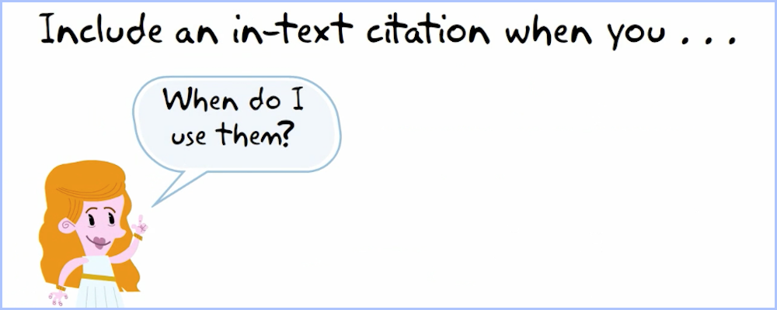
Set Clear Expectations
Keep in mind you have to read all posts
Be clear that all posts have to be meaningful
RUBRICS
Students want you to interact on their substance rather than grammar/syntax
Don’t need to hold discussions to higher standard than F2F discussions
Notes:
-don’t need to hold discussions to higher standard than your f2f discussions - don’t require MLA/APA citations etc
-- higher level may require less posts - grad students tend to do more than minimum, or contribute more fully

Slide 9
Engaging Discussion Considerations
Draft questions that guide discussion toward specific learning objectives
Ask Qs you care about vs important but you dread reading
Make Qs open-ended
Ask multiple Qs within the prompt to stimulate discussion (grading on quality of reply over quantity of questions answered)

Slide 10
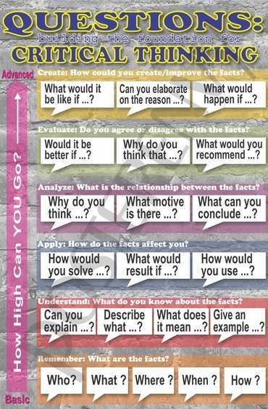
Engaging Discussion Considerations
Use Bloom’s Taxonomy to draft questions

Slide 11
Engaging Discussion Considerations
Application to students' lives, careers, goals, etc?
(Scaffold discussions to build on knowledge, reach a goal)
Module 1: Health & Academic Success
Module 2: Mental Health & Academic Success
Module 3: Healthy Lifestyles & Academic Success
Module 4: Preventing Risks & Academic Success
Healthy Lifestyles
Module8: Preparing for the Future & Academic Success
Scaffolded Discussions
Judith Ausherman
HED 210

Slide 12
Engaging Discussion Considerations
Provide more than one resource to respond to
Pamela Smith, CEL 609 Leading School Reform
Notes:
- can also look at 461

Slide 13
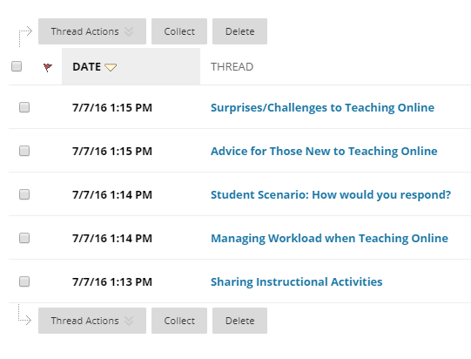
Engaging Discussion Considerations
Differentiating Instruction
(Student choice)
Select 2 of these to discuss
Center for eLearning
Faculty Online Teaching and Design
Notes:
If you have more than fifteen students, consider creating discussion groups or increasing the number of questions students may choose from. It will be easier for your students to stay on top of the discussion as they won't feel that they have to read everything everybody posts.
Can give example of this from FOTD faculty challenges/advice questions
Student-led or moderated discussions (does this support your objectives?)

Slide 14
Engaging Discussion Considerations
Student Moderated Discussions
SWK 508 Sec 501 George Tsagaris
Notes:
Student-led or moderated discussions (does this support your objectives?)

Slide 15
Group Discussions
Group Discussions - Closed
(Internal to each group)
Self-Select vs Assigned
Closed vs Open Groups
Notes:
If you have more than fifteen students, consider creating discussion groups or increasing the number of questions students may choose from. It will be easier for your students to stay on top of the discussion as they won't feel that they have to read everything everybody posts.

Slide 16
Group Discussions
Group Discussions – Open
(learning from each other)
Post in assigned group, review other group discussions
Judith Ausherman
HED 473/573

Slide 17
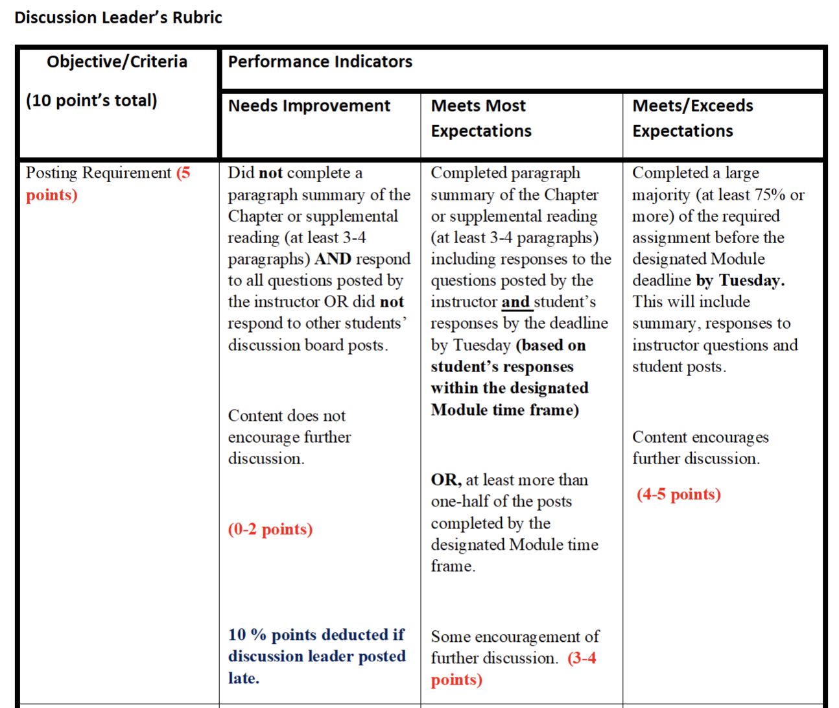
Rubric Example
SWK 508 Discussion Rubric
Notes:
Examples will be posted on the Keep Teaching Site w/ recording link.

Slide 18
What's Your Experience?

Slide 19
Contact Us
Center for eLearning
elearning@csuohio.edu
216-687-3960
24/7 Technical Support: (216) 687-5050, Option #2
Email us
Sarah, s.rutland@csuohio.edu
LeAnn, v.krosnick@csuohio.edu

