Slide 1
Planning for Course Continuity
Caryn Lanzo and Sarah Rutland
Center for eLearning, Cleveland State University

Slide 3
Introduction
Caryn Lanzo, Director, Center for eLearning
Sarah Rutland, Manager, Quality Assurance and Sr. Instructional Designer
Get more help:
https://www.csuohio.edu/keep-teaching
Center for eLearning, (216) 687-3960; elearning@csuohio.edu

Slide 4
Course Continuity: Shift to Online Learning
Course Design
Course Facilitation
Learning Objectives
Instructor Presence
Content Presentation
Instructional Activities
Assessment of Student Learning
Community Building
Student Support
Communication
Lectures
PowerPoints
Videos
Readings
Discussions
Short Quizzes
Self checks
Assignments
Assessments
Papers
Email
Discussions
Announcements
Discussions
Feedback
FAQs
Collaborate/Zoom
Resources

Slide 5
Course Continuity: Shift to Online Learning
Plan / Adapt for course design
Communicate

Slide 6
Course Continuity: Shift to Online Learning Plan/Adapt
Syllabus: What needs to change?
Due dates
Communication
Assignments
Expectations
Divide your course content into smaller units (for example, weekly)
What are the learning outcomes that students should achieve for each week (unit)
Content
Instructional Activities
Assignments/Assessments

Slide 7
Course Continuity: Shift to Online Learning Tips
Choose tools you are comfortable with. You can do a lot with a few tools.
If you have large exams or papers that constitute a large percentage of students grade, consider creating smaller, more frequent exams or scaffolding material to build up to a larger assignment or paper.
Establish a pattern in your course so it becomes familiar to your students.
Create clear instructions and expectations for students.

Slide 8
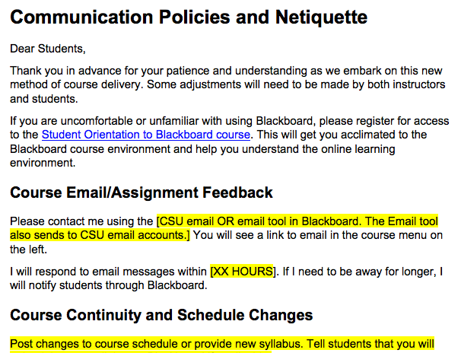
Course Continuity: Shift to Online Learning
Communicate
Early & often
Establish a pattern
Set clear expectations
Communication Policies and Course Netiquette template
Consider your load
FAQs, General Q’s Discussion

Slide 9
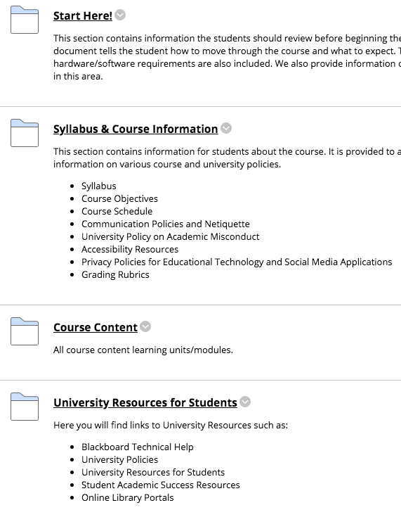
Course Continuity: Shift to Online Learning
CSU Template
CSU Template Request Form

Slide 10
Course Continuity: Shift to Online Learning
Existing Blackboard content
Course Copy Request Form
Blackboard getting started
Intro to Teaching with Blackboard (Self-Paced Course)
Quick Start Guide
Keep Teaching Website
Blackboard Help
Blackboard Help for Instructors

Slide 11
Contact Us
Center for eLearning
elearning@csuohio.edu
216-687-3960
24/7 Support: (216) 687-5050, Option #2

Slide 12
Questions

