Slide 2
Ally for Blackboard
Presenters: Heather Caprette & cliff maslovsky
Notes:
Contact info: Heather Caprette, h.Caprette@csuohio.edu, 216-802-3142; Jeff Dell, j.dell@csuohio.edu, 216-875-9938.

Slide 3
What is Ally?
Checks for accessibility of content you load into your online course
Gives instructions for how you can improve the accessibility of your content
It generates alternative formats of the content that you load
Electronic Braille (brf), mp3 audio file, HTML, ePub, OCR PDF, Tagged PDF for Word docs, BeeLine Reader
Has Accessibility Report feature for seeing problem content within your course
Notes:
Alternative format chart at https://help.blackboard.com/Ally/Ally_for_LMS/Student/Alternative_Formats?utm_medium=Ally&utm_campaign=Product_link&utm_content=Student
The electronic braille alternative creates a BRF file that can be read on a refreshable Braille display (RBD), other Braille reading devices, or within a Braille software like Duxbury. BRF will carry spelling, punctuation, and format of text.
Mp3 can be used while commuting, eyes tired, low vision or blindness.
ePub format reflows for the mobile device a student is on. Can highlight content, take notes, text to speech, adjust contrast or text size.
BeeLine Reader shows text in gradients of red, black and blue within an HTML version of the document. Helps students with a lot of reading and those who can loose focus easily – dyslexia, ADHD, low vision.
Under Course Tools there is an Accessibility Report for the whole course which shows the issues found in the course content. You can click through to go to a document and fix it at that point.

Slide 4
Overview for Instructors
We’ll watch the Blackboard video called “Overview for Instructors for Ally for Learning Management Systems” together. You can also go to https://youtu.be/CnuM8NFvu_M in your browser to view. (1:28)
Notes:
https://youtu.be/CnuM8NFvu_M

Slide 5
View File Accessibility with Ally in Blackboard Learn
We’ll watch the Blackboard video called “View Go to File Accessibility with Ally in Blackboard Learn” together. You can also go to https://youtu.be/Ik_-ECvVWYs in your browser to view. (1:06)
Notes:
https://youtu.be/Ik_-ECvVWYs

Slide 6
How Students Access Alternative Formats
We’ll watch the Blackboard video called “Ally for Students in Blackboard Learn” together. You can also go to https://youtu.be/tOORcSEjtJU in your browser to view. (45 seconds)
Notes:
https://youtu.be/tOORcSEjtJU

Slide 7
Ally Tips
For Word and PPT, the alternative formats are: Electronic Braille (BRF), ePub, tagged PDF, HTML, .mp3 audio
It does OCR on PDFs that are images of text, but could have some problems. It especially has trouble creating correctly tagged PDFs.
It doesn’t produce a tagged PDF from a Searchable Text PDF
The more accessible the original document, the more accessible the Ally alternative format
It’s accessibility checker won’t catch everything, e.g. if you don’t apply headings semantically, such as applying H1 to all headings. Alt text could be way off.
It’s best to learn how to format accessibly from a course or online references

Slide 8
Planning for Accessibility - 1
Leave Word and PowerPoint documents in original format when practical. Word and PPT are more easily modified for accommodation. If you start with a Word or PowerPoint formatted properly for accessibility, a PDF conversion will be more accessible.
Use our library’s Permalink as a Blackboard Web Link instead of copying a paper article on a xerox machine and posting a PDF image of the text in the course.

Slide 9
Design for People with Blindness or Low Vision - 1
Don’t use color alone to convey meaning, such as putting important information in red text only. Use Strong or Emphasis Styles in Word. Asterisks *, or “Important:” in front of text.
Use Descriptive Text for links, such as “Student Code of Conduct,” not “https://www.csuohio.edu/sites/default/files/StudentCodeOfConduct.pdf,” or “For the Student Code of Conduct, click here.” Link text should be meaningful when taken out of context.
Alternative text for non-text elements
A photograph may have short alternative text that conveys what the image conveys and fits your context. Complex charts or illustrations would need longer descriptions.
Flourishes can be marked as decorative – check box for this.
Notes:
The DiagramCenter.org has guidelines on how to write alternative text for complex images. Keep alt text brief and context-specific.

Slide 10
Good vs. Bad Alt Text – example 1
Which alt text is best?
“Westminster.png”
“Photo of Westminster”
“Four boats traveling on the Thames river with the Palace of Westminster and Big Ben in the background”
Notes:
Answer is 3.

Slide 11
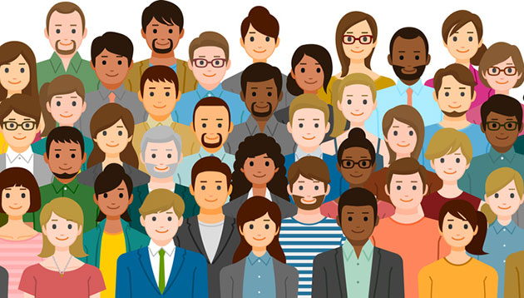
Good vs. Bad Alt Text – example 2
This image was copied from a Google Image Search and pasted into PowerPoint. Which alt text should you use?
“Image result for diverse group of people”
“Diverse group of people”
“Image of diverse group of people”
Notes:
Answer is 2.

Slide 12
Good vs. Bad Alt Text – example 3
Which is the best alt text?
“https://gallica.bnf.fr/ark:/12148/btv1b103025148/”
“Civillians and soldiers shooting, while the sky is filled with black smoke and the Bastille is on fire in the background. https://gallica.bnf.fr/ark:/12148/btv1b103025148/”
Notes:
Answer is 2.

Slide 13
Good vs. Bad Alt Text – example 4
Which is best alt text?
Causes of the deforestation of the Amazon, 2000 – 2005
Chart that shows the causes of deforestation in the Amazon between 2000 and 2005. 'Cattle ranches' are shown as the biggest cause of deforestation (60%), followed by 'small-scale, subsistence agriculture' (33%) and 'logging, legal and illegal' (6%). 'Large-scale commercial agriculture' is the smallest cause of deforestation with 1%
Notes:
Answer is 2. If the summary is long, put a short description of the chart in the Alt Text Description field, and put text directing them to look in the Notes area of the PowerPoint for the slide or at the text below the image in a Word doc for the longer text description.

Slide 14
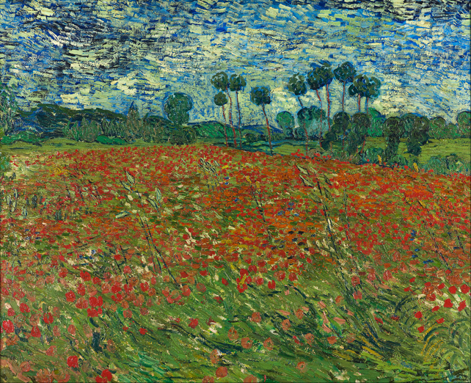
Alt Text According to Context
Which description is appropriate for a history class vs. an art class?
A painting by Van Gogh in Post-Impressionism using dramatic brush strokes. It shows a field with poppies in the foreground, trees in the background and dark skies.
A field covered with poppies. Poppies have become a symbol of remembrance for World War I.
Notes:
Both are good alt text. #1 can be used in an art class, and #2 in a history class.

Slide 15
Design for People with Blindness or Low Vision - 2
Text must pass contrast guidelines against background – Use Colour Contrast Analyser to check. Regular text needs to be 4.5:1 ratio.
Mark your visual headings with heading styles or tags
In Word, use Word Heading Styles, In HTML use <h1> through <h6> tags, use heading tags in a PDF
Tables should be simplified & have their header cells marked as headings. This does not mean applying Heading Styles, but formatting the header row to “Repeat as header row at the top of each page.” Don’t combine information that should be in two separate tables. Don’t use merged, split or empty cells.
Notes:
Semantic headings created in Word documents by using the Heading 1 through Heading 6 styles can not only help students who use screen readers, but anyone needing a document outline or Table of Contents to help them find and jump to specific information. With proper formatting of headings with Word styles, an author can create a Table of Contents in Word under the References > Table of Contents menu. When these Word documents are saved as HTML or if they are converted to PDF, the formatting creates logical tagging.
Creating simple tables with a table header row formatted to “Repeat as a Header at the top of each page” in Word will produce <th> elements if the document is saved as HTML or PDF. Screen readers read the table header cells before the associated data cell to provide meaning.
Leaving our documents in editable format, will allow people with low vision, or disability associated with age and/or eye strain to enlarge text size and change font color to enhance contrast. Not all older or overworked students will seek documentation of this disability. By not saving your Word documents as a PDF and then requiring a password to prevent editing in Acrobat DC, you make your document more accessible.

Slide 16
Word Heading Styles
Notes:
Evaluation Methods is highlighted and then Heading 2 is selected to apply it.

Slide 17
How to Appy Table Header Row

Slide 18
Which Table Structure is Correct?
Notes:
The borders of cells and table are outlined in black. The table on the left could be separated into two tables, one on Evaluation Methods and another on Grading Scale. It is also only 4 cells and one row. Poor design.
Table on the right is properly formatted.

Slide 19
Designing for People with Blindness or Low Vision – 4
When providing videos, features like Descriptive Audio may need to be considered
If doing Lecture Capture providing PPT files for students to reference
Give direction which includes names of controls or other meaningful context (No Click Here)
Provided PowerPoint files can have added description for graphics in Notes Pane

Slide 20
Design for People who are Deaf or Hard of Hearing
Have your videos available by the end of the current semester, for the next semester, for captioning
Clean high quality source for audio
Provide transcripts for all audio. Quality Matters accepts transcripts (2 pt standard). You could write a transcript and read from it while recording. They want audio descriptions included for any non-verbalized information included.
Provide captions and educationally relevant descriptions for visual only parts of video
Captions and Transcripts benefit non-native English speakers, students needing to study in a quiet environment, as well as native English speaking students who need to search for a particular subject within the video for studying
How to take advantage of Youtube’s captioning capabilities – corrected .srt can be downloaded and added to Tegrity
Notes:
Synchronized captions with a prerecorded video are required to meet WCAG 2.0 standard at A level. Audio descriptions could be present, except when the media is an alternative for text in the image. https://www.w3.org/TR/2008/REC-WCAG20-20081211/#media-equiv-captions
Synchronized captions with live recordings meets level AA. Audio descriptions for all synchronized prerecorded video (even alternatives for images of text) meets level AA also. Sign language with prerecorded media is provided meets level AAA.
Gotranscript.com

Slide 21
Designing for Deaf and Hard of Hearing -2
Providing PPT files for these students can:
Give reference to fill in gaps for word recognition
Enable faster note taking
Give necessary language to American Sign Language interpreters or transcriptionists

