Slide 1
“There and back again” an academic’s tale
Ilya Yaroslavsky, Ph.D.
Assistant Professor
Department of Psychology

Slide 2
Things to think about…
Yourself –Interests, Values, Strengths & Weaknesses
Your audience – Academic Job Selection
Your story – Crafting a compelling
Cover Letter
Teaching Statement
Research Statement
Curriculum Vitae
The story there-after

Slide 3
Things to think about…yourself
Basic questions you should consider:
Why do you want to pursue a job in academia?
Where do you fall along the teaching – research continuum?
What are your personal values?
What are you professional strengths and weaknesses?
Answers to these questions will guide your audience, selection and your remaining time in grad. school.

Slide 4
Things to think about…your audience
There are three basic types of academic institutions
Academic Medical Centers
Research Focused Institutions
Teaching Focused Institutions
Where to find information on positions?
Professional periodicals & websites (Chronicle of Higher Education, HigherEdJob, APA, APS)
Professional Listservs & Wiki pages (psychjobs wiki; academicjobs wiki)
(Wells, Schofielfd, Clerkin, & Sheets, 2013)

Slide 5
Things to think about…your story
Regardless of the type of institution that is of interest to you, your mantra should be…
“get more publications, independent teaching & mentoring experience”
This mantra will help you tell a coherent story about:
your budding research program & research potential
your passion for teaching & mentorship
why your letter writers should write glowing letters of recommendation
(Wells, Schofielfd, Clerkin, & Sheets, 2013)

Slide 6
Things to think about…your story
in a Cover Letter
Synthesize your background, research, teaching, & mentoring experience in 1-2 pages.
Main goals:
Promote yourself
Promote your fit with the job
This is the “book cover” of your story, and your chance to make a first impression.
(Wells, Schofielfd, Clerkin, & Sheets, 2013)

Slide 7
Things to think about…your story
in a Teaching Statement
Synthesize your teaching philosophy & teaching experience into a coherent 1-2 page document.
Main goals:
Provide evidence of teaching experience
Provide evidence of pedagogical competence
Provide evidence of cultural competence
This is the most important chapter of your story for Teaching Focused Institutions.
(Wells, Schofielfd, Clerkin, & Sheets, 2013)

Slide 8
Things to think about…your story
in a Research Statement
Synthesize your research experience & products into a coherent, programmatic body of work in 2-3 pages.
Main goals:
Provide evidence of research potential
Provide feasibility & future direction of your program
Provide a plan to integrate student training*
This is the most important chapter of your story for Academic Medical Centers & Research Focused Institutions.
(Wells, Schofielfd, Clerkin, & Sheets, 2013)

Slide 9
Things to think about…your story
in a Curriculum Vitae
Present your teaching, research, and perhaps service experience in a clear, organized, and professional manner.
Main goals:
Provide easy means for search committee to find information
Taylor organization of information to fit with institution type
Do not pad your CV with manuscripts in preparation, etc.
Well organized CVs may leave the committee with a favorable impression.
(Wells, Schofielfd, Clerkin, & Sheets, 2013)

Slide 10
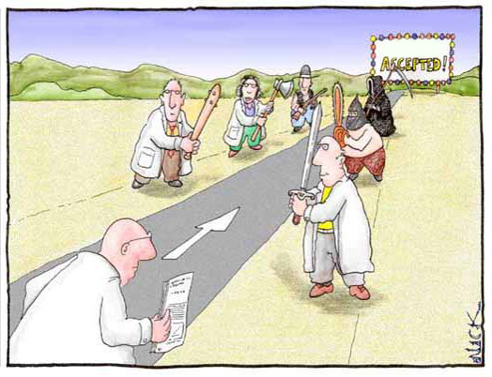
Things to think about…the story there-after
Successful reviews of your applications mean:
Telephone interviews
On-campus interviews - Job talks that include Teaching & Research presentations
Job offers mean:
Negotiations
Tough choices
(Wells, Schofielfd, Clerkin, & Sheets, 2013)

Slide 11
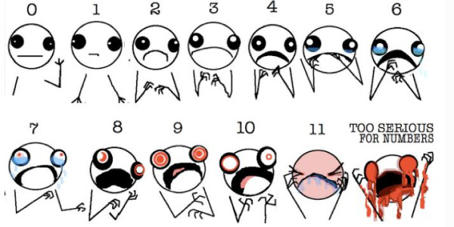
OK, I am now really freaked out…
It’s OK…take slow…deep…diaphragmatic breaths…
consider buttressing the weaknesses in your application during a post-doctoral fellowship.

