Slide 1
Using Course Design and Discussion boards to foster student learning in online courses
Marnie Rodriguez
Senior College Lecturer
Criminology, Anthropology, and sociology
Notes:
LAUNCH POLL 1

Slide 2
Opening question:
If you have taught an online course before, what has been the biggest challenge?
Please type your answer in the Zoom chat.

Slide 3
Opening question:
If you have taken an online course before, what has been the biggest challenge?
Please type your answer in the Zoom chat.

Slide 4
Goal
To improve student engagement in online courses and facilitate deeper learning

Slide 5
Learning objectives
After this webinar you will be able to:
Incorporate some best practices in course design to help students stay on track
Develop discussion board assignments to keep students engaged with the course
Provide useful feedback to students in a manageable way
Notes:
FEEL FREE TO POST QUESTIONS IN THE CHAT OR INDICATE THAT YOU HAVE A QUESTION. LEANN WILL MONITOR

Slide 6
Special thanks
Center for E-Learning
Center for Faculty Excellence
CSU faculty
Notes:
LAUNCH POLL RE: FOTD

Slide 7
Face-to-Face Vs. OnLINE

Slide 8
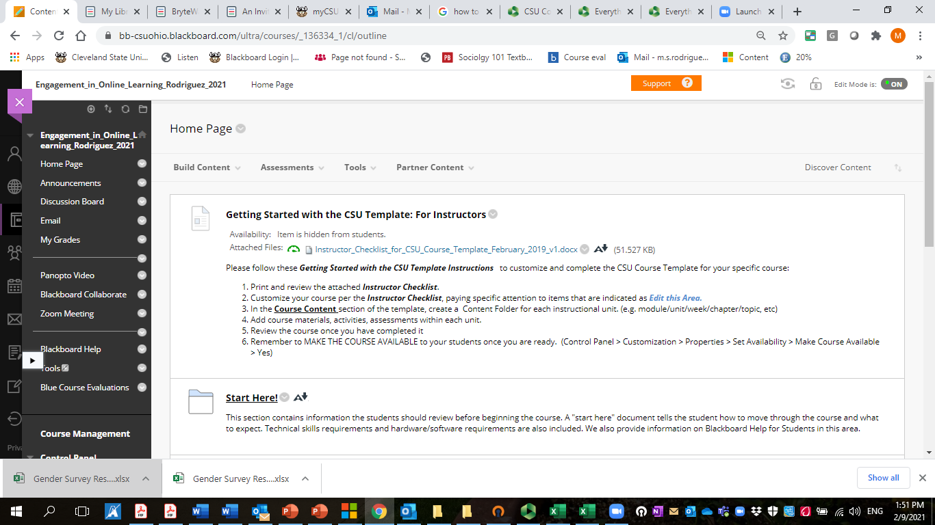
Course design Tip #1: CSU Blackboard template
Request form: https://www.csuohio.edu/center-for-elearning/csu-course-template
Click on the thumbnail for a quick tour.
Notes:
LAUNCH POLL TEMPLATE

Slide 9
Course design Tip #2: Learning modules/folders
This Photo by Unknown Author is licensed under CC BY-NC

Slide 10
Course design Tip #3: consistent deadlines
Days of the week, for example:
Quizzes due Friday
Homework due Sunday
Exams on Monday
Submission time (11:59 PM EST, 9:00 AM EST, etc.)

Slide 11
To learn more about online course design:
Online Teaching and Design (FOTD) course: https://www.csuohio.edu/center-for-elearning/faculty-online-teaching-and-design-course
Sunday, May 9th - Sunday, May 16th (1 Week - Online, Accelerated)

Slide 12
Discussion board assignments

Slide 13
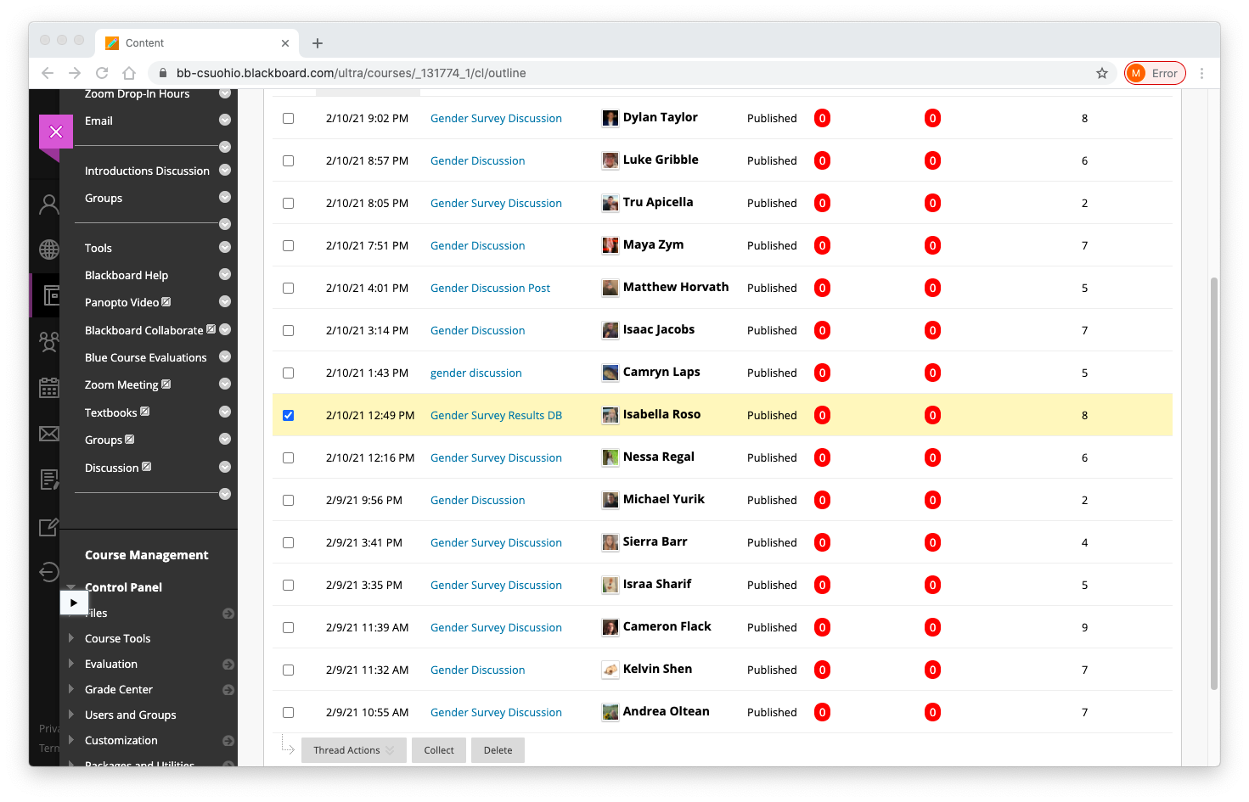
Discussion board Tip #1: know Your purpose and communicate it
Online Discussion Assignments
encourage engagement with the course materials
foster connections between students
facilitate collaborative learning
Click thumbnail for video to students re: discussions

Slide 14
Discussion board Tip #2: Ways to encourage student engagement
Have multiple deadlines- Avoid the “post and run” phenomenon
Initial post, Responses, Follow-up
Create smaller groups within a class
Write prompts that allow for diversity of responses
Allow students to connect with their experiences

Slide 15
CHOICE applications Prompt option 1: SOC 201
Recall that systems organized around privilege feature dominance, centeredness, and are identified with the privileged group. Select one of the popular films above and answer the following:
Which social groups (i.e. whites, people of color, men, women) have more creative power in the production process as writers, directors, and producers? You can use IMDB.com to find the data for this analysis. You need to provide evidence from your analysis (number of writers, directors, producers) to support your answer. Do your results support dominance based on privileged groups? Why?
Which social groups (race, gender, sexuality, social class etc.) does the film center on in terms of main characters? You can use IMDB for this analysis. You need to provide evidence from your analysis (numbers of main characters in various racial, gender, sexuality, or social class groups) to support your answer. Do your results suggest a system organized around privilege or not? Why?
Activity 1: Systems of Privilege and Media
Here is a list of the top 10 films from 2019:
Avengers: Endgame
The Lion King
Toy Story 4
Frozen 2
Captain Marvel
Star Wars: Episode IX – The Rise of Skywalker
Spider-Man: Far from Home
Aladdin
Joker
It Chapter Two
Notes:
GENERATES INTEREST DUE TO POPULAR MOVIE CONTENT
GENERATES DIVERSITY B/C STUDENTS TALK ABOUT DIFFERENT FILMS- COMPARE/CONTRAST RESULTS

Slide 16
CHOICE applications Prompt OPTION 2: SOC 201
Activity 2: Reflection on McIntosh's List and Beyond
Review this document: Privilege Activity.docx Then address the following:
1. Write a reflective essay (at least one paragraph) on at least two forms of privilege noted in the privilege activity document.
2. What might one do change any of the unearned advantages listed in the document?
3. Come up with two other specific examples of privilege based on the social locations represented in the document or another social location. These examples must be different from the ones in McIntosh's article or the privilege activity document.
Notes:
DIVERSITY OF RESPONSES- SOME REFLECT ON THE PIECE GENERALLY, OTHERS FOCUS MORE INWARD ON THEMSELVES

Slide 17
CHOICE applications Prompt option 3: SOC 201
Activity 3: Privilege from the Headlines
Find a current event or news story that reflects privilege.
Describe the event and post an article or other media source reporting the event.
Explain how the event/news story illustrates privilege.
Notes:
STUDENTS MAKE CONNECTIONS BETWEEN COURSE MATERIAL AND OUTSIDE WORLD
DIVERSITY OF RESPONSES DUE TO OPEN-ENDED QUESTION

Slide 18
Given scenario Prompt: SOC 353
You are interested in studying students’ transition to CSU, particularly their satisfaction with their first-year experience at CSU, how they felt about themselves related to the transition, and sources of support utilized by students during their first year at CSU. You also are interested in whether experiences differ depending on whether the student entered CSU right out of high school, right after completing an associate’s degree, or later as a non-traditional student.
Which interview method would you select for your study (Semi-Structured Interview, Unstructured Interview, or Focus Group Interview)? Why would you choose this strategy?
Write a list of 6-10 open-ended questions that could be used in a qualitative interview on this subject. Questions can include follow-up questions.
Where would you propose to conduct the interviews? Why?
Consider the issue of interviewer effect. Do you think any of your background characteristics might have an impact on interview responses? Why or why not?
Notes:
STUDENTS CAN SEE THAT THERE ARE MULTIPLE WAYS TO DO RESEARCH;
ALSO CAN LEARN FROM CLASSMATES

Slide 19
Open-ended topic/structured response SOC 353
Initial Post
Address the following in an initial post. The research questions you write for this assignment can be ones you have written for a previous assignment or they can be new.
Write a research question that would best be addressed using a cross-sectional design. Why would a cross-sectional study be appropriate?
Write a research question that would be best addressed using a longitudinal design.
For the longitudinal research question addressed in question 2, would you propose a trend study or a panel design? Why would a panel or trend study be more appropriate?
Responses
Read your classmates posts and respond to a minimum of two. Your response must address at least one of the following two questions:
What would be the advantages and disadvantages of your classmates' proposed cross-sectional study for addressing the research question?
What would be the advantages and disadvantages of your classmates' proposed trend or panel design for addressing the research question?
In your response, you may also ask classmates for clarification, give feedback on the research questions, or propose alternative designs with supporting evidence.
Notes:
STUDENTS CAN CHOOSE QUESTION RELEVANT TO THEM- GENERATES INTERST AND DIVERSITY OF RESPONSES
RESPONSES ARE SPECIFIC– MUST CRITIQUE ONE ANOTHER

Slide 20
Discussion board tip #3: strategies for providing feedback
Challenges | Solutions (hopefully!)
Time consuming to facilitate | Don’t need to respond to every student Follow-up discussion posts
Labor-intensive to grade | Provide general feedback via summary Use simple rubrics

Slide 21
discussion board rubric

Slide 22
To learn more:
CSU Center for E-Learning:
Best practices in Online Teaching online course
Faculty Online Teaching and Design course https://www.csuohio.edu/center-for-elearning/faculty-online-teaching-and-design-course
CSU Center for Faculty Excellence Book Discussions:
Flipped Learning by Robert Talbert (2017)
Small Teaching by James Lang (2013)
Small Teaching Online by Flower Darby with James Lang (2019)
Quick Guidebook:
Johnson, Aaron. 2013. Excellent Online Teaching: Effective Strategies for a Successful Semester Online.

Slide 23
Questions?

Slide 24
Wrap-up
What’s one key take-away that you might use in an upcoming course?
Or
What’s one thing you do in your courses to help solve some of the issues addressed in this webinar?
Share in the chat ☺

