Slide 1
RSO Treasurer Training
Presenter: Dan Lenhart, Marketing & Web Specialist
Student Center 343 Center for Campus Engagement d.lenhart@csuohio.edu

Slide 2
By the end of this training, Treasurers should know…
Basics of being an RSO
Timelines of when to submit requests
Fiscal policies
University purchasing policies
Travel policies
Fundraising procedures
How to create an allocation and expenditure request
How to deposit funds

Slide 3
Main Contact for all financial questions
Contact the Student Affairs Budget Officer for all financial questions:
Maureen Spreng studentorgfinance@csuohio.edu

Slide 4
Recognized Student Organizations
RSOs will have 4 officers (President, Vice President, Treasurer and Secretary) and a CSU faculty or staff advisor.
Eligibility to apply for funding from allocating General Fee Units
Eligibility to reserve space on campus
Eligibility to request to hold student organization events on campus
Use of an Agency Account
Unlimited web space and file storage through the CSU VikesConnect System
Eligibility to request an organization banner be hung in the Student Center Atrium
Eligibility to utilize CSU duplicating (printing) services, as supported by RSO funds

Slide 5
Organization Membership & Officer Eligibility
Students who wish to hold officer positions must meet the following eligibility requirements:
Undergraduate Students must:
Currently be enrolled for at least six (6) term credits at Cleveland State University
Have a 2.0 or greater GPA for the most recent Fall or Spring term
Have a 2.0 or greater cumulative GPA
Graduate, Law, and PhD students must be in good standing with their respective programs.
CSU students in their first semester at CSU are eligible to hold officer positions if they are currently enrolled in at least six (6) term credits at Cleveland State University.

Slide 6
Emerging Organization Status
An Emerging Organization status applies currently recognized organizations that fall below Recognized Student Organization status because they have at least two, but less than four, individual students eligible to fill the officer positions. Emerging Organizations must have a CSU faculty/staff advisor.
RSOs that transition to Emerging Organization status may be active for the single semester in which they fall below RSO status.
Eligible to request to participate in Student Organization Fairs, and tabling in the InnerLink, as well as have a VikesConnect page.
Emerging Organizations are ineligible to utilize any other RSO privileges.

Slide 7
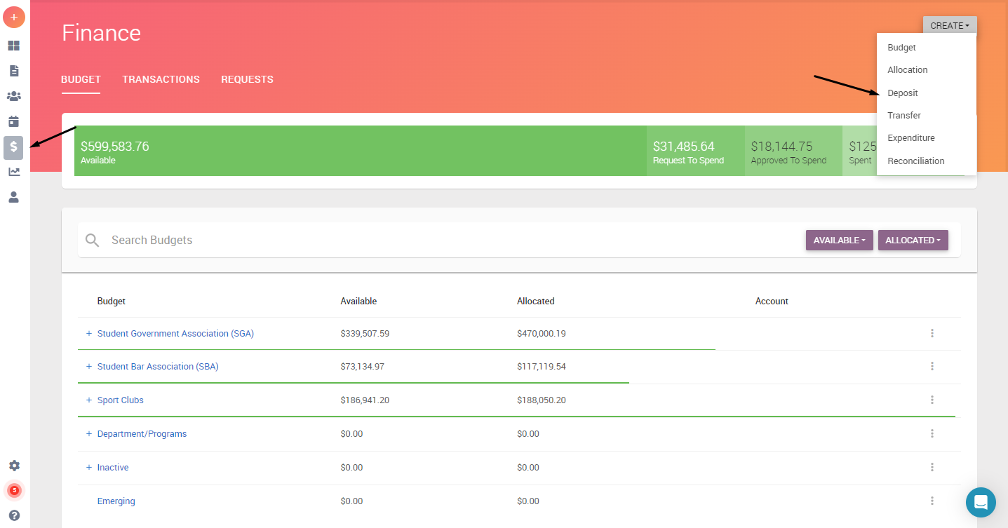
VikesConnect Finance Tool
Not connected to CSU accounting system
Used as a way to track all expenses and deposits
Reconciliations are done by budget officer
Deposits are part of finance tool.

Slide 8
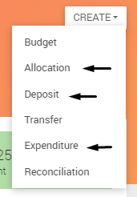
Finance Forms for Treasurers
Treasurers will only use three forms in the Finance Tool
Allocation: To be used when requesting money from a funding body
Deposit: Use when depositing money into agency account
Expenditure: Use when purchasing or reimbursing

Slide 9
Explore your organizations Finance tool (Only Treasurers and Presidents can use the Finance tool)
Accounts
Agency Account
Funds roll over
Number avail to officers in Details
Allocating Body Funding Account
Funds are swept

Slide 10
Financial Request Timelines:
Event Requests - Travel : 45 business days prior to departure
Event Requests : 45 business days to 5 business days based on classification type
Payment - Purchase Requests : 45 business days for contractual payments to 30 business days for all other purchase requests.
Reimbursement - Purchase Requests : No later than 10 business days after purchase or return from travel

Slide 11
Explore your organizations Finance tool (Only Treasurers can use the Finance tool)
Allocation Requests
Complete all required fields
Can combine multiple needs into one request
Documentation must be submitted to support your request
Application deadlines
SGA will release their schedule. Found on the SGA VikesConnect page.
SBA open all year until the funds run out.
SCC have a separate allocating process (do not use budget requests)

Slide 12
Explore your organizations Finance tool (Only Treasurers can use the Finance tool)
Expenditure Requests (Payment & Reimbursement)
Using Agency Account funds vs Approved Budget funds
Notify your advisor through email every time you submit a purchase request.

Slide 13
Expenditure Requests (Spending)
For Promotional Items, use one of the three IUC vendors
For online orders, do not place them yourself. Submit request with information and we will make the purchase for you
If you need to make a purchase at a store, remember to request a tax exemption form, CSU will not reimburse state of Ohio sales tax.
Pay close attention to Food policies for on-campus food consumption.
Less than $300 use any food vendor
$301 to $749, use Viking Food Co. Catering or Rascal House
Above $750, use Viking Food Co. Catering
Need to have catering waiver, & proof of insurance for exceptions
If you need to increase any catering orders, check with budget officer first.
All items ordered will be shipped to CSU, not individual’s homes

Slide 14
Expenditure Requests (Reimbursements)
CSU will not reimburse for state of Ohio sales tax.
CSU will not reimburse for any purchases made on Amazon or Apple websites.
If you need to make a purchase at a store, remember to request a tax exemption form, CSU will not reimburse state of Ohio sales tax.
If purchasing multiple items at a store, you submit only ONE request to reimburse.
If payment was made using credit/debit card, a copy of the card used, showing the name & last four digits on the card, must also be attached. The name on the statement/card must match the person receiving the reimbursement.
Reimbursements which are paid for by funding awards must be submitted within 5 business days after an event and 10 days after travel.

Slide 15
Organization Travel
Submit travel request via the Event tool in VikesConnect at least 45 days in advance of travel.
You must meet with our budget officer after submitting the request.
All travel forms MUST be completed prior to travel.
Emergency contact list MUST be submitted
Do NOT make your own travel arrangements. Our budget officer will do this.
This includes transportation (incl. rental cars), accommodations, conference fees, etc.
Each traveler must keep all receipts for reimbursement
Food receipts must list what was ordered. CSU does not reimburse for alcohol.
All reimbursements are submitted as purchase requests and done so at least 10 business days after travel is complete

Slide 16
Events on Campus
Check CSU calendar on Conference Services website for room availability
Any contracts must be submitted at least 45 days in advance of event
Follow Classification Timelines for all events (found both in RSO manual and event request form)
Schedule event carefully if you are requesting funding. RSOs should secure funding first before making event arrangements
Consider additional costs
Set-up fees
Equipment fees
Housekeeping fees
Security fees
Pay attention to cancellation policies

Slide 17
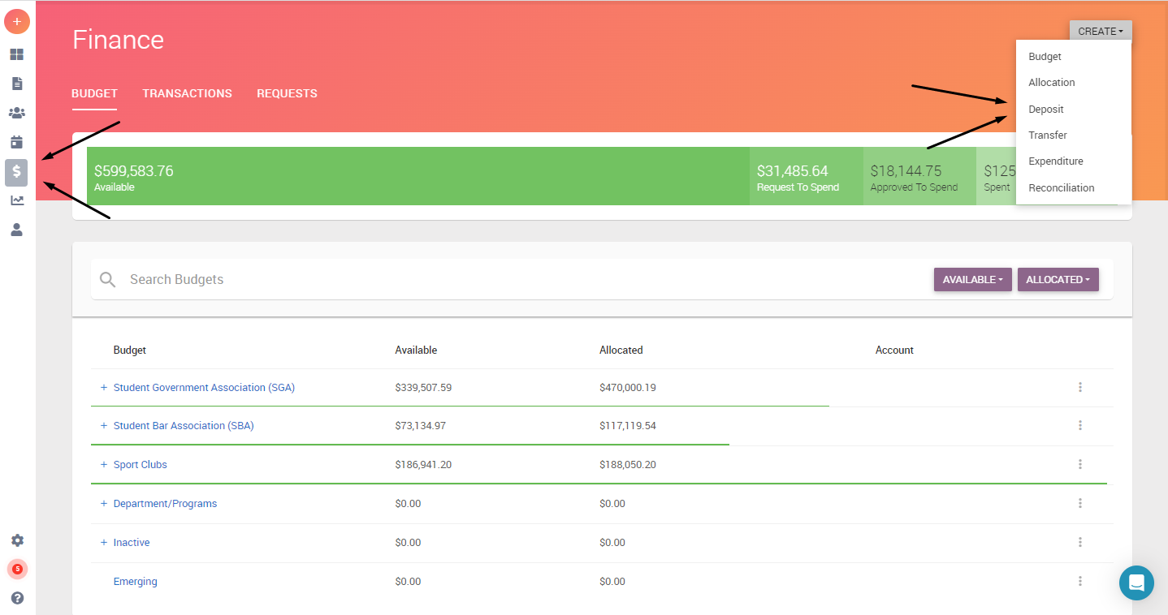
Agency Account Deposits
Create your deposit using the Finance Tool in VikesConnect
Link to Budget Officer’s calendar is in the form: : https://calendly.com/2063661-1
Make an appointment with Budget Officer and bring cash and checks for deposit

Slide 18
ShopNet
ShopNet is used by Cleveland State University departments to allow customers to select and pay for a variety of items on the web using their credit card. Recognized CSU student organizations may submit a request to set up a ShopNet item to accept payments for things such as organization dues, application fees, event entrance fees or other organization items.
For instructions on requesting set-up and details on using, go to: https://www.csuohio.edu/services-for-students/shopnet

Slide 19
Fundraising Activities
Please check with CCE at studentorgs@csuohio.edu before you conduct your fundraiser to ensure you are following policies.
No form of gambling activities (50/50 raffles, games of chance, squares, etc.) are not permitted for RSOs unless they are considered a nonprofit organization by the IRS. CSU is NOT a 501 (c) (3) organization. It is a state institution.
All money raised must be deposited within 24 hours, unless the fundraiser is held on a weekend. In that case, money is deposited that Monday. Complete the deposit request form in VikesConnect.
Organizations must use ShopNet to accept credit/debit card payments.
Bake Sales are permitted. Follow CSU policies regarding food sales on campus.
Sales of items from outside companies is not permitted.

Slide 20
Financial Request Timelines:
Event Requests - Travel : 45 business days prior to departure
Event Requests : 45 business days to 5 business days based on classification type
Payment - Purchase Requests : 45 business days for contractual payments to 30 business days for all other purchase requests.
Reimbursement - Purchase Requests : No later than 10 business days after purchase or return from travel

Slide 21
Reminders
Use your CSU email account to conduct business
CSU does not pay state of Ohio sales tax. Individuals will not be reimbursed for sales tax. Ask for tax exemption form
Do not place orders with an IUC vendor. Only ask for a quote.
Do not place online orders or make travel arrangements.
Do not take money directly to cashier’s office for deposit.
No reimbursements for travel will be made without proper paperwork completed prior to travel.
Plan in advance.

Slide 22
Questions
Please email us at studentorgs@csuohio.edu with any questions.

