Slide 2
Provost’s Teaching Summit May 7th, 2020
Presented by the
Center for Faculty Excellence
Joanne Goodell, Director
Allison Negron, Coordinator

Slide 3
Agenda
1:00 - Virtual Posters & Reflections in Action Available
4:00 - Welcome from the Center for Faculty Excellence
4:05 - Provost's Remarks
4:25 - 2018-20 Teaching Enhancement Award updates
4:45 – 2019-2021 Teaching Enhancement Awardees previews
4:55 - Textbook Hero Award
5:00 - Summit concludes

Slide 4
By the Numbers
Book Discussions/ Faculty Learning Communities (FLC)
Gateway Courses FLC, Fall 2019, 14 participants; Spring 2020, 12 participants. Goodell and McLennan
Inclusive Teaching FLC, Fall 2019, 18 participants. Goodell
Flipped Learning, Spring 2020, 7 participants. Goodell and Schultz-Bergin
Teaching with Desirable Difficulties, Spring 2020, 9 participants. Goodell and Rutherford
52 unique participants
9 faculty participated in more than one group!

Slide 5
By the Numbers
Workshops
369 people attended at least 1
Dr. Yung-Tse Hung (Civil Engineering) 40
Dr. Eddie Lam (HHP) 11
Workshop and Learning Community Facilitators
24 facilitators
Joanne Goodell - 7
Mandi Goodsett - 6

Slide 6
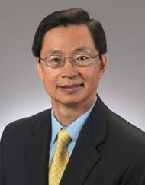
Dr. Jianping Zhu, Provost

Slide 7
Teaching Enhancement Awards
Two awards per year
Summer stipends for two years
Year 1 - Planning
Year 2 - Implementation, evaluation and reporting
Focus on large enrollment Gen. Ed. classes
Improve achievement, completion and retention

Slide 8
2018-2020 TEA Award History
Ancient World History to 1300 AD
Kelly Wrenhaven
Associate Professor
Shelley Rose
Associate Professor
Meshack Owino
Associate Professor

Slide 9
Course Innovations and Goals
Team-taught (3 instructors, 5 weeks each): sole team-taught History course
OER Textbook ($0 cost to students)
Project Based Learning (students chose the format of their projects in line with their own personal strengths and experience)
Emphasis upon student engagement and success

Slide 10
Presentation Talking Points
Open Educational Resource (course textbook): Kelly Wrenhaven
Project Based Learning: Shelley Rose
Student Success - outcomes and future plans for success: Kelly Wrenhaven and Shelley Rose

Slide 11
OER Textbook Screenshots (via Pressbooks)
Notes:
Students identified the source material as a strength for this course (easily accessible and pertinent to course topics)

Slide 12
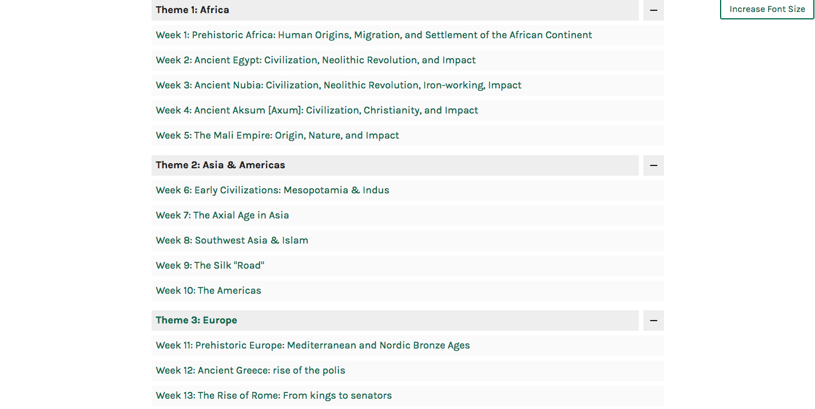
Notes:
Three themes with subtopics (weekly subjects)

Slide 13
Notes:
Example of a weekly topic with readings

Slide 14
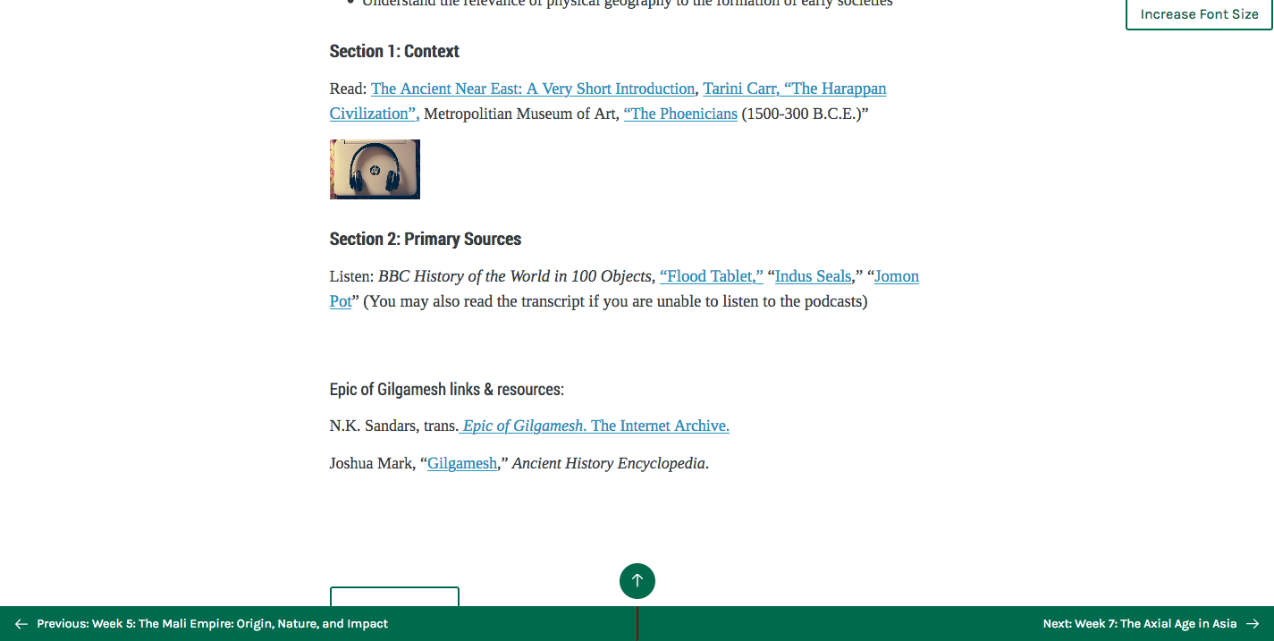
Notes:
Readings are all available online (via CSU library catalogue; via BBC; via other internet sources)

Slide 15
Project Based Learning (PBL)
Information Literacy GenEd built on diverse assessments rather than essay writing- often referred to in history as an “unessay”
Literature/Epic Project based learning (PBL) Assignment:
Students completed a literature project on one of three ancient epics such as the Illiad, Sundiata, or The Epic of Gilgamesh. Each instructor supervised ⅓ of the students with an even distribution of first-year students.
Formative assessments were research plan and individual meetings with instructor.
Assignment Instructions & Rubric available at https://bit.ly/103PBLAssign

Slide 16
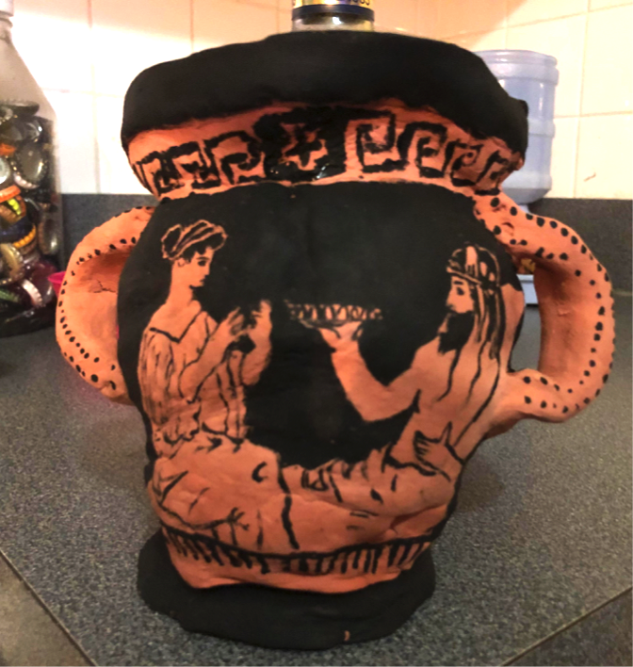
PBL Example #1: Greek Art
This student chose Greek art as her primary source focus
She studied books on Greek pottery
She visited the Cleveland Museum of Art
She created a pot based upon the myth of Dionysos and Persephone

Slide 17
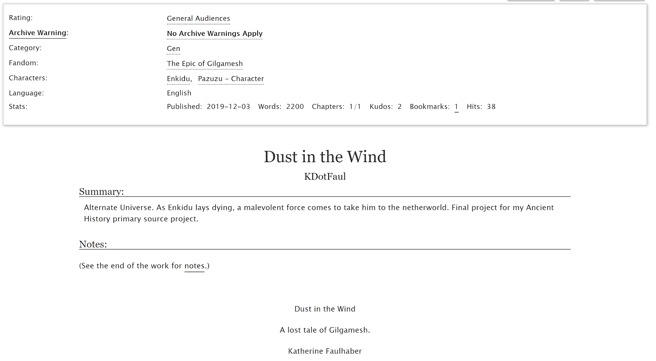
PBL Example #2: Fanfiction
Katherine Faulhaber- Dust in the Wind: A Lost Tale of Gilgamesh
A new chapter for the Epic of Gilgamesh based on the format of fanfiction
Student read the epic and did additional research to craft this narrative
Published the finished product on a fanfiction site.

Slide 18
PBL Example #3: Lesson Plan

Slide 19
PBL #3 (cont’d): Lesson Plan

Slide 20
PBL and Student Success
 | Projects | Essays
A- to A | 13 | 5
B- to B+ | 3 | 2
C to C+ | 2 | 2
D | 0 | 1
F | 1 | 2
n= | 19 | 12
Preliminary Conclusions
Project Based Learning fostered a higher rate of success for students who chose projects
Formative assessments increased student confidence & performance on final product
“Choice and Voice” in the final product led to increased student engagement
Need longitudinal data from future classes to confirm impact and expand dataset
Summary
95% of students who chose projects earned a C or above
75% of students who wrote essays earned a C or above
Notes:
9 students did not complete a project
DFW = 13
Or 95 % earned C or above
75% earned C or above

Slide 21
Enrollment & Success Rate
46 / 50 students (92% enrollment)
DFW rate: mid-range for HIS survey courses in Fall 19
Poor grades linked to poor attendance; those who attended regularly typically earned higher grades
Student evaluations: low response rate (7/46): too low to utilize
Sum: Good start for a new course with a novel structure; course began in the mid-range of the departmental norm for freshmen surveys (History)

Slide 22
2018-2020 TEA Award Philosophy and Comparative Religion
Redesigning Introduction to Philosophy
Michael Wiitala
Assistant College Lecturer
Marcus Schultz-Bergin
Assistant College Lecturer

Slide 23
PHL 101: Course Description
An elementary survey of leading themes, thinkers, movements, branches, and problems in philosophy
General Education course that satisfies the Arts and Humanities General Education requirement (GE08)
The vast majority of enrolled students take the course to fill that requirement

Slide 24
Primary Challenges
As with many “Gen Ed” courses, there are three basic “types” of students
Those already interested and eager to learn more
Those uninterested and only willing to do the minimum
Those unsure whether they are interested and of the amount of work they are willing to do
Our goal has been to design a course that
Challenges students who are already interested
Does not alienate students who only want to pass
Piques the interest of students who are unsure

Slide 25
Previous Course Structure
Traditional grading scheme
Students are given identical assignments and can put in more or less effort
However, students can feel their grade is outside of their control, which ultimately decreases motivation
Traditional lecture-based course design
Presents the same information to all students
Nearly impossible to challenge advanced students without leaving other students behind

Slide 26
Changes Made
Specification grading scheme
Assignments are pass/fail (or “pass”/“not yet”)
Assignments have clear specifications that must be met in order to pass
Main Benefits
Reduces stress for students
Expectations are clear
By eliminating partial credit, students will tend to hand in higher-quality work
Gives students ownership over their grade in the course

Slide 27
Changes Made
Team-based Learning course design
Permanent teams are formed by instructor to ensure diversity
Students complete pre-class reading assignments
Class-time is spent practicing applying the concepts and ideas they read about with their peers
Main Benefits
More advanced students can explain what they’ve learned to their team, further cementing their own understanding
Less advanced students can ask questions and learn from their team
All students learn important teamwork skills

Slide 28
Evaluation
We are evaluating the efficacy of our proposal in three major ways:
Quantitative student satisfaction surveys
The “Overall Evaluation of the Course” scores in the university administered student course evaluations prior to and after our interventions
The DFW rate prior to and after our interventions

Slide 29
Student Surveys: Team-Based Learning
Spring 2019-2020

Slide 30
Student Surveys: Specification Grading
Spring 2019-2020

Slide 31
Scores from CSU SEI Surveys
Our prediction was that after implementing TBL and Specification Grading, the overall evaluation of the course would rise to 4.5 or higher
4.7
4.1
Lecture-based
(Fall ‘15 – ’17)
Team-based
(Spr ‘19 – Fall ‘19)

Slide 32
2019-2021 TEA Accounting
Partnering Accounting & Excel
Heidi Meier
Associate Dean, Professor & Chair
Dan Kaminsky
Associate College Lecturer
Jan Rose
Instructor

Slide 33
SUMMARY OF PROJECT
Beginning Fall 2020 we will offer (in one section of ACT 222)
a revised course that includes all the required elements for Ohio Transfer Assurance (TAG)
while giving students exposure to Excel activities
and the opportunity to take the Microsoft Office Excel 2016 Certification Exam (MOS)

Slide 34
Sample Excel project
Proven Budget analysis Excel project

Slide 35
Sample Excel project
Proven Variance analysis Excel
Project

Slide 36
SUMMARY OF PROJECT
Passing the MOS exam is a great achievement in a competitive job market. Certification is often a criteria for hiring.
Other Universities already offer certification within their existing courses such as Sorrell College of Business, Troy University (Alabama)
All business students can take the MOS basic exam
All accounting majors can take the MOS Expert exam

Slide 37
TEACHING STRATEGY
Dan - registered instructor M/W at 4:30
Primary author of syllabus
Coordinate guest speakers on Excel benefits
Daily lessons of ACT 222 material, using Excel whenever possible
MOS Exam proctor
Verify the download and installation of software
Coordinate lab schedule for exam

Slide 38
ASSESSMENT STRATEGY
Semester grade in ACT 222 will consist of points for CONNECT assignments, CONNECT quizzes and CONNECT Exams plus Excel projects
Students can choose to take the MOS certification exam in lieu of the comprehensive final
Final exam grade based on MOS exam plus bonus
Passing is 70% to earn the certification
MOS exam is 50 minutes, 35 questions

Slide 39
EVALUATION STRATEGY
Number of students who elect to take MOS exam
The MOS exam is optional
Poll mid term: how many plan to take?
Number of students who earn the certification
Passing is 70%
Other scores noted and compared to CONNECT performance
Students can re-take the exam

Slide 40
EVALUATION STRATEGY
Polling at midpoint and end of semester for student feedback (using Apply Excel assignment as knowledge baseline)
Track certified students
Poll them the following semester regarding their skills
Performance in other classes that require Excel skills
Did they land a job because of the certification?

Slide 41
NEXT STEPS and ISSUES
Certiport
Agreement for authorized testing center
500 license $4,680; start August 1?
Testing facilities: Lab classroom, remote?
Technical support
Fall 2020 on line status
Future classes: common syllabus, testing center etc.

Slide 42
2019-2021 TEA BGES
Testing for Long-term Improved Learning in a Large Lecture Course
Shamone Gore Panter
Assistant College Lecturer
Emily Rauschert
Assistant Professor
Ralph Gibson
Professor

Slide 43
Setting: Bio 202, second semester intro bio
http://blog.cleveland.com/
Notes:
About 400 students a year, larger lectures of 160,60, 140, 30
Higher DFW course
Talk about our TEA project and other innovations ongoing in the class

Slide 44
Content heaviness mandated by TAG
I. EVOLUTION SLOs
1. Describe the evidence for evolution.*† (time on topic: %)
2. Identify the evolutionary processes that lead to adaptation and biological diversity.*† (time on topic: %)
3. Describe the evidence that endosymbiotic events resulted in the evolution of eukaryotic cells from prokaryotic ancestors. (time on topic: %)
4. Correlate the processes and results of scientific inquiry with the remodeling of animal phylogenetic relationships. (time on topic: %)
5. Explain how genomic comparisons allow phylogenetic relationships to be determined. (time on topic: %)
II. STRUCTURE AND FUNCTION SLOs
1. Relate levels of biological organization from cells, the basic unit of life, to the organism and the relationship of structure to function at all levels of biological organization. (time on topic: %)
2. Explain the basic structures and fundamental processes of life at the molecular, cellular, and organismal levels. (time on topic: %)
3. Recognize cells as the basic unit of life in all living organisms; compare and contrast the differences between prokaryotic and eukaryotic cells.*† (time on topic: %)
4. Compare plant and animal cell structure and function, including their respective organelles and other components*† (time on topic: %)
5. Describe the general organization of the animal body and vascular plants.* (time on topic: %)
6. Describe and contrast reproduction and development in plant and animal systems. (time on topic: %)
7. Compare the structure of nutrient procurement and processing systems in plants and animals. (time on topic: %)
8. Describe the structure and function of the nervous system, the musculo-skeletal system, the respiratory system, and the mechanisms of internal transport and regulation in various organisms.* (time on topic: %)
9. Explain differences in structure and function among the major invertebrate and vertebrate clades in terms of nutrition, life history, and evolutionary relationships. (time on topic: %)
III. INFORMATION FLOW, EXCHANGE, AND STORAGE SLOs
1. Outline the fundamentals of the endocrine system at the systemic level.* (II) (time on topic: %)
2. Describe basic processes of infectious disease and defense against infection. (time on topic: %)
IV. PATHWAYS AND TRANSFORMATIONS OF ENERGY AND MATTER SLOs
1. Explain how energy moves through an ecosystem.* (time on topic: %)
V. SYSTEMS SLOs
1. Explain how regulatory mechanisms at the level of the whole organism ensure balance in living systems that interact continuously with their environments; compare regulatory mechanisms within and across species.* (III) (time on topic: %)
2. Describe the relationship between life forms and their environment and ecosystems. (time on topic: %)
3. Describe the different types of relationships that exist between living organisms.* (time on topic: %)
4. Explain how populations grow and how this can be described mathematically. (time on topic: %)
5. Describe the basic principles of conservation biology. (time on topic: %)
6. Describe and explain various types of animal behavior.* (time on topic: %)
7. Describe advantages and disadvantages of social behavior. (time on topic: %)
CORE COMPETENCIES: VI. PERSPECTIVES IN BIOLOGY SLOs (Demonstrated within the relevant concepts)
1. Describe representative historical developments and perspectives in biology, including contributions of significant figures and underrepresented groups, and the evolution of theories in biology. (time on topic: %)
2. Compare costs and benefits of preserving endangered species and protecting the environment. (time on topic: %)
3. Apply knowledge learned from the classroom with real life situations. (time on topic: %)
VII. PRACTICES IN BIOLOGY SLOs (Demonstrated within the relevant concepts)
1. Illustrate the scientific method through analysis of major biological discoveries. (time on topic: %)
2. Characterize the scientific method and its limitations in the search for answers to biological questions. (time on topic: %)
3. Document the solution to scientific problems through collection and analysis of experimental data and the preparation of scientific reports. (time on topic: %)
4. Collect, organize, analyze, interpret, and present quantitative and qualitative data and incorporate them into the broader context of biological knowledge.* (time on topic: %)
a. Demonstrate the ability to make precise measurements.
b. Demonstrate basic microscopy skills. †
c. Demonstrate safe and proper use of experimental techniques and tools/instruments.
d. Use biological specimens to explain the relationship between structure and function.
5. Utilize current research literature, online information, and information related to scientific and biological issues in the mass media in written and oral reports.* (VI) (time on topic: %)
Notes:
State mandated course objectives (not learning objectives for a class)

Slide 45
Many students need to recognize that they must study smarter/more early in the semester
Notes:
Performance varies widely
25-90 raw scores
Broad flat distribution
Has been like this for a long time
Students usually panic after two midterms, at which point it’s too late

Slide 46
Increased exam frequency
https://www.sigarch.org/
Notes:
Going from 3 midterms to quizzes every other week

Slide 47
Group testing
https://www.facultyfocus.com/
Notes:
Some quizzes will be group tests

Slide 48
Scenario-based learning
https://www.health.org.uk/journal-articles
Notes:
New peer-reviewed journal articles will serve as basis for question sets. We will summarize at level of students, and they can read it several days in advance.
Mention assessment

Slide 49
2019-2020 Textbook Hero Award
Presented by:
Mandi Goodsett
Performing Arts & Humanities Librarian, Open Educational Resources (OER) Advisor
Atia Najjar
SGA Representative - OER Committee

Slide 50
2019-20 Textbook Hero Award
Dr. Kathy Curnow
Associate Professor
Art & Design
Congratulations!

Slide 51
Thank You
To everyone for joining us today
Our campus partners for helping transition our event online
Interim Vice Provost John Holcomb and his staff for all their support this year
Provost Jianping Zhu for sponsoring the event and supporting the CFE this year.

Slide 52
Additional Thanks
Chris Rennison | Center for Instructional Technology & Distance Learning | Production, Recruitment, Web development, CFE Reflection in Action Series
Alex Barni | Center for Instructional Technology & Distance Learning | Recruitment, Audio editing, CFE Reflection in Action Series
Mandi Goodsett | Michael Schwartz Library | Consultation on Creative Commons Licensure
Barb Loomis | Michael Schwartz Library | Consultation on Engaged Scholarship
Marsha Miles | Michael Schwartz Library | Consultation on Engaged Scholarship
Mark Hackett | Center for Instructional Technology & Distance Learning | Videoconferencing consultation
Val Isom | Center for Instructional Technology & Distance Learning | Transcription, CFE Reflection in Action Series
Matt Harmon | Center for Instructional Technology & Distance Learning | Transcription, CFE Reflection in Action Series
Mark Lindhurst | Center for Instructional Technology & Distance Learning | Interviewer, CFE Reflection in Action Series
Shelley Rose | History | Omeka & Digital Collections consultation
Allison Negron | Center for Faculty Excellence | Event Planning, Coordination & Communication

