Slide 1
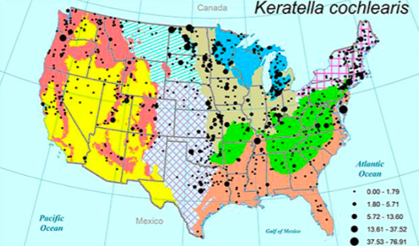
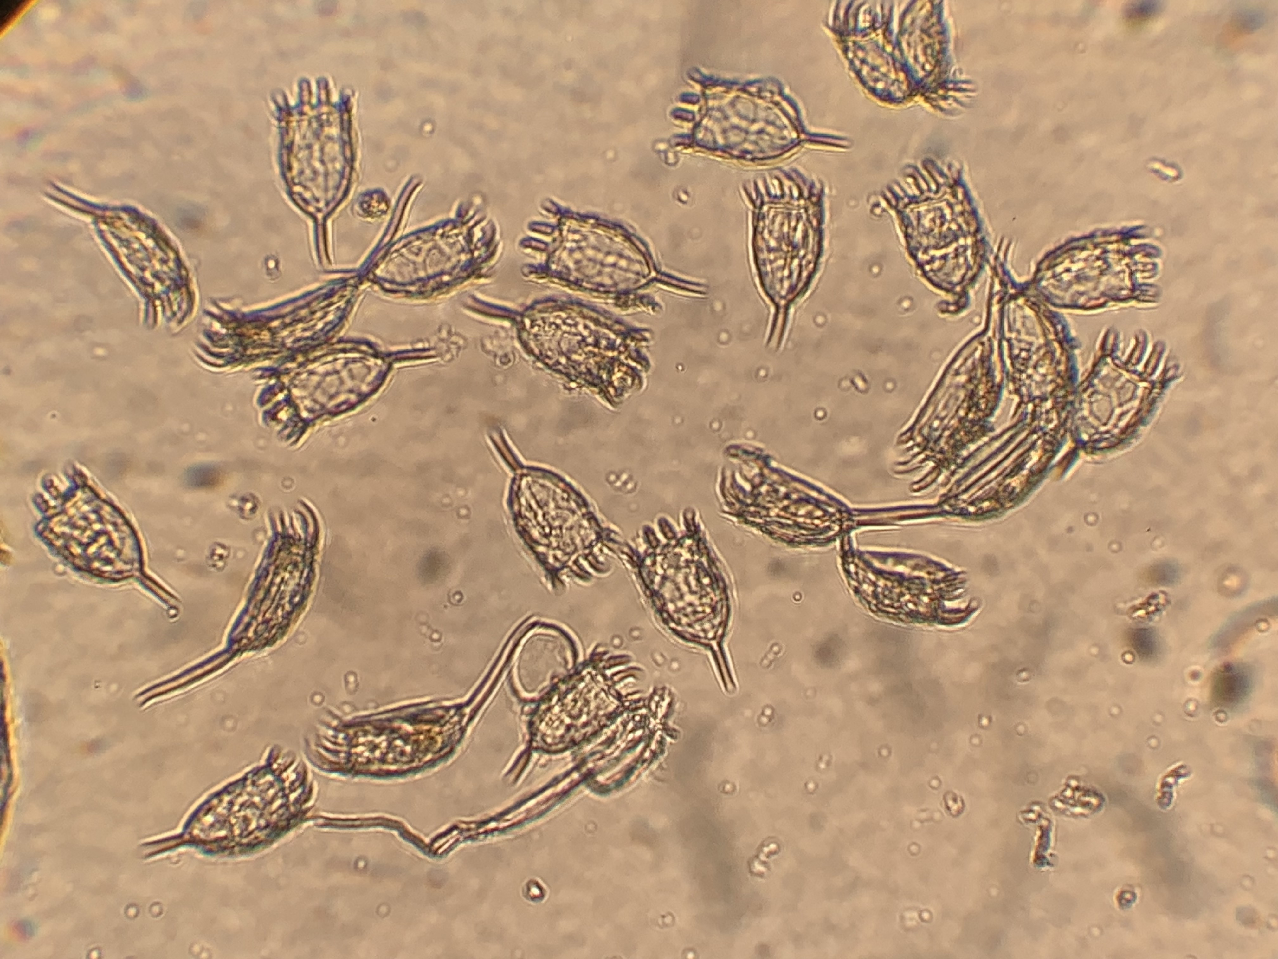
The Evolution and Morphological Change of Keratella cochlearis
Dervisevic, Semra; Tausz, Claudia; Wolin, Julie
Biological, Geological, & Environmental Science, Cleveland State University, Cleveland, OH
Abstract
Methods
Conclusions
Organisms in the phylum Rotifera are vital for freshwater environments; they have a short development time, fast turnover, high production, circulate organic matter, and aid in energy transfer (Li, Cheng, & Chen, 2005). However, they are becoming increasingly difficult to characterize by molecular studies due to cryptic genetic differences that are not reflected in their morphology. This is due to the sensitivity based on responses to environmental parameters such as water temperature and chemical cues from predators (Stemberger & Gilbert 1984, Green 2005). This arises the need to identify the presence and geographic distribution of cryptic species complexes; this study reports findings across the U.S from collected samples by the National Lakes Assessment in 2017. Keratella cochlearis were first isolated from these samples, washed off with TE buffer, had their DNA extracted, and then sent to Functional Biosciences for their DNA to be amplified through a PCR and then Sanger sequenced. The expected results include that those sites with higher densities and larger shapes to have undergo evolution and thus have more abundant cryptic species complexes present (Chen et al., 2012).
Hypothesis:
In lakes, ponds, and reservoirs that have less regulated water quality there will be higher rates of evolution and more cryptic species complexes present in the DNA of Keratella cochlearis.
The first step of each sample was to isolate the individual species using straight 0.2mm extra fine tip micro-tweezers.
Once each sample contained 50 individual isolated K. cochlearis, they were transferred to a 1.5 mL centrifuge tube using a glass pipette.
The next step was to “wash off” the ethanol that was used to preserve the samples using a TE buffer made from 0.5 M pH 8.0 EDTA solution and 0.5 M pH 8.0 Tri-Cl.
All tubes were drawn down to 0.1 microliters as a standard starting point, and then 1,000 microliters of the TE buffer were added to each sample.
They were vortexed three separate times for five seconds each and were left settling for 48 hours before restarting the process two more times.
The TE buffer was then removed, and 0.1 mL of each sample was drawn up and transferred into 0.2 mL PCR tubes.
Once the tubes had evaporated to less than 2mm, the extraction began: 24 microliters of Instagene 6% Chelex was added to each sample tube along with 1 microliters of Proteinase K.
The tubes were centrifuged at 12,000 RPM at 2 minutes.
Samples were then sent off to Functional Biosciences to have their extracted DNA amplified and replicated through a PCR.
The DNA is then sequenced, and results are reported back.
When results return, phylogenetic reconstructions will be created and analyzed to identify cryptic species complexes across the samples.
Figure 2. The distribution of K. cochlearis in the nine ecoregions of the U.S.
The points are representative of where the samples were taken. The size of the point represents the biomass of the sample, in micrograms of dry weight per liter (from Tausz et al., 2019).
Due to rotifers short life cycles and quick response to environmental conditions, they can be used as biological indicators of water quality. After isolating, extracting, and sequencing Keratella cochlearis DNA, specific cryptic species complexes can be reported and analyzed for phylogenetic reconstructions. Due to the time constraint of the eight-week research only the expected results can be discussed.
Higher densities and larger body forms (called loricas) of K. cochleaeris indicate that the body of water has experienced eutrophication due to warmer temperatures. Eutrophication is an ongoing issue in certain areas of the U.S. Eutrophication can proliferate algal blooms and deplete oxygen levels which are toxic to the environment and kill the aquatic organisms (NOAA, 2021). This process occurs when the environment becomes enriched with nutrients (from agriculture practices and products). This study highlights the importance of climate action as it pertains to using the data to show the evolution and morphological change of K. cochlearis—a highly sensitive aquatic organism.
Figure 1. Isolated K. cochlearis under an inverted microscope with a 100X lens view. This picture was taken from sample site 10008 in New Jersey.
Introduction
Acknowledgements
The purpose of identifying the presence and geographic distribution of cryptic species complexes is necessary for the context of water quality. The evolution of rotifers can showcase how environmental parameters are altered. This is prevalent under recent conditions with increasing use of agriculture practices and products, land use alterations (deforestation leading to urban areas), and the magnification of climate change effects.
I would like to express my gratitude towards my advisor, Dr. Julie Wolin, and her PhD student, Claudia Tausz, for their help and support along this research journey. I would also like to thank the McNair Program and the USRA for funding and giving me the opportunity to do research.
Funding: McNair Scholars Program & Undergraduate Summer Research Award Program

