Slide 1
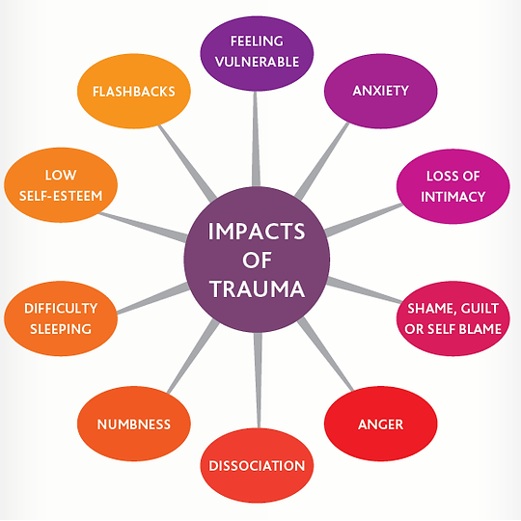
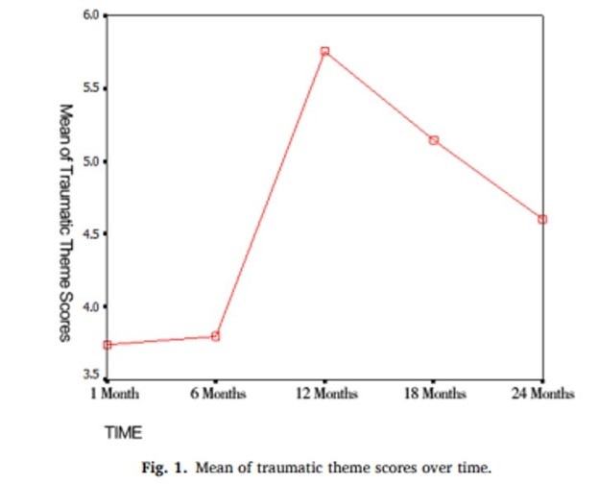
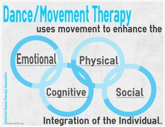

Dance/Movement Therapy: Trauma
Pinckney, Sadie and Stone, DeAndra M
Department of Theatre & Dance, Cleveland State University, Cleveland, OH
Abstract
The use of Dance Movement Therapy through the lens of trauma amongst African American adolescents has been groundbreaking. This is especially important as society aims to bridge the gap amongst African American adolescence and privileged adolescents. However, there is a further need to develop effective modes and methods of treating underprivileged youth. This project aimed to develop a thorough Healing in Motion Program designed specifically for African American adolescents in America. The primary methods were experiential learning, Dance Movement Therapy-informed techniques, and creative activities. The program guides facilitators through ten modules of content. It is designed to be replicated in order to measure its effectiveness. Over the course of a 10-week period, adolescents would be assessed before, during, and after the program. By the end of the 10-week period, adolescents show improvement in self-concept, self-esteem, and self-awareness.
On September 25, 2008, an 8.0 magnitude earthquake hit China killing over 69,000 people, injuring over 17,000 and leaving 3 million children severely affected. This event is evidence of post-disaster trauma and/or Post-Traumatic Stress Disorder. Trauma scores at 1-6 months were significantly lower than at 12, 18, and 24 months after the earthquake. The adolescents suffered the most mental trauma at approximately 12-18 months after the earthquake , as shown above in figure 1.
Trauma is a distressing event or series of events, such as abuse, a bad accident, sexual violence, combat, natural disaster., etc. Trauma is an emotional response to such event(s). Adolescents who experience traumatic events can suffer major impact that will be imbedded in their life course and affect their self-identity because they are in the growth period.
Goodman (2013) defines transgenerational trauma (also called intergenerational, multigenerational, or historical trauma) as a disbursement of trauma from one generation to another. Coyle (2014) relates this trauma to "[...] a genocide of a people, where some major event is aimed at a particular group because of their status as an oppressed group."
Summary
10-week program development
30 adolescent participants
Exploration of self-esteem, awareness, health, financial literacy, education, etc.
Body-Based opening ritual for each module
Experimental learning experience
Conclusions
Underrepresented communities are in desperate need of program developments such as Healing in Motion
Addressing the past can help better understand and treat present day issues
.Trauma effects may not show up immediately but over a length of time
Dance/Movement Therapy aids adolescents in the process of healing to become well and whole
Acknowledgements
Thank you to Cleveland State University, The McNair Program, and Dr. Reyes-Rodriguez, Program Director.
Funding: McNair Scholars Program
The American Dance Therapy Association (ADA) defines dance/movement therapy as the psychotherapeutic use of movement in a process that furthers the emotional, cognitive, social, and physical integration of the individual (ADTA, 2016).
Another layer of this research project shines a light on Dr. Dr. DeGruy’s Post Traumatic Slave Syndrome (PTSS) theory in which “establishes a timeline depicting a progression of traumatic actions that were carried forward from the trans-Atlantic slave trade into future generations both overtly and subliminally” (Campbell, 2019).

