Slide 1
Using the Group Tools in Blackboard

Slide 3
Engaging Students in Blackboard Discussions
Microphone Muted
Chat Panel
Today’s Presenters:
LeAnn Krosnick, Sr. Instructional Designer
Sarah Rutland, QA Manager/Sr. Instructional Designer

Slide 4
Blackboard Groups
Introduction
Tools
Example
Best Practices
Group Q & A

Slide 5
Introduction to Groups
Groups of students with access to their own collaborative space.
Notes:
Purpose: Propose problem solutions, develop a project or paper, or submit assignments where team collaboration is beneficial and teams can divide up the work and use individual strengths to come together and solve problem and deliver solution.
Benefits:
Breaks down the work of large projects
Leverages individual talents for the good of the group
Teaches teamwork and leadership
Share out to whole group
Challenges:
Assigning groups
Lack of participation/motivation
Grading
Unequal workload

Slide 6
Blackboard Groups
Introduction
Tools
Example
Best Practices
Group Q & A

Slide 7
Blackboard Group Tools
Group Discussion Board allows groups members to participate in threaded discussions
Send Email sends an email message to selected group members or to the entire group
Collaborate Ultra allows group members to use Chat and Virtual Classroom to collaborate synchronously
File Exchange is a place where students and faculty members can upload documents

Slide 8
Blackboard Group Tools
Group Journal allows group members to share thoughts with each other and the course instructor
Group Wiki allows group members to create and edit each other’s content
Group Blog allows group members to post reflections and comments
Group Tasks can be used to organize group projects and activities

Slide 9
Blackboard Groups
Introduction
Tools
Example
Best Practices
Group Q & A

Slide 10
Example Group
Project teams to provide final presentation and recommendation of learning management software.

Slide 11
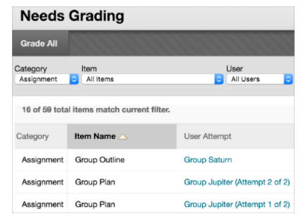
Grading Group Assignments
Available in Needs Grading after assignment has been submitted by one group member.

Slide 12
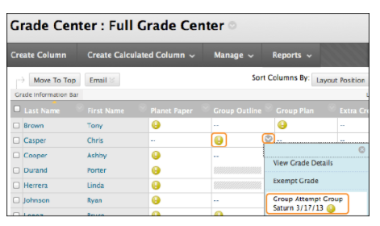
Grading Group Assignments
Available in Full Grade Center Grading after assignment has been submitted by one group member.

Slide 13
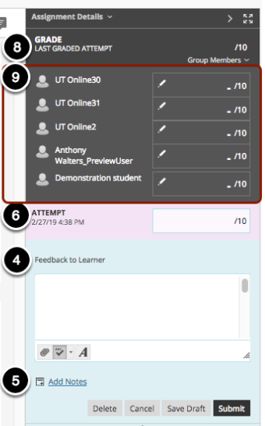
Grading Group Assignments
Individual grades can be overwritten

Slide 14
Blackboard Groups
Introduction
Tools
Example
Best Practices
Group Q & A
Tips for Effective Group Collaboration in Blackboard, (2012, Jason Rhode - NIU)

Slide 15
Best Practices for Group Collaboration
Rationale
Gets all students involved
Team building
Simulates real-world environment
Encourages leadership skills

Slide 16
Best Practices for Group Collaboration
Challenges
Student attitude toward group work
Group membership/member withdrawal
Lack of team skills
The free rider
Wide variance of student abilities
Assessments

Slide 17
Best Practices for Group Collaboration
Forming Groups
Be very clear in the purpose for groups in your course
Size of groups
Assigning membership
Notes:
PURPOSE: Discussions – break into smaller groups
Group projects
SIZE: think of potential drops
Roles they will have
Small enough for active role
4-5 good number
ASSIGNING:
Have they worked together in the past
How and who they would like to work with
Discussion Forum-look for them to share preferences
No promises = feel as though they have input
Give the group ability to make decision to manage membership
Groups based on skills
Survey who has skills
Language = do you have students who have traveled
Students with management experience
Cross-functional teams (engineering, business, etc.)

Slide 18
Best Practices for Group Collaboration
Group Expectations
Be clear in expectations for participation
Break projects into milestones/stages
Ask members to create and agree to a group charter
Suggest roles that members can assume
Show them an example of final project
Notes:
Leader, recorder, fact checker, summarizer,

Slide 19
Best Practices for Group Collaboration
Monitoring Group Progress
Peer assess each other’s participation at several stages
Drop-in on group discussions to gauge how they are doing
Communicate with group members periodically to check-in and provide reminders
Notes:
At milestones – quiz with short answer NAME, RATE PARTICIPATION 1-5, RATE CONTRIBUTIONS, COMMENT
DISCUSSIONS NOT PARTICIPATING BUT CHECK TO SEE HOW ITS GOING

Slide 20
Best Practices for Group Collaboration
Assessing Group Work
Rubric for how groups/projects will be assessed
Assess in stages rather than just final deliverable
Be prepared for free riders
Assess both group and individual contributions
Notes:
Remove points as needed, penalize
Journaling
Some type of assessment in blackboard
https://www.cmu.edu/teaching/assessment/examples/courselevel-bycollege/hss/tools/jeria.pdf
Carnegie Mellon

Slide 21
Stage One
Skills & experience survey, preferred team members
Stage Two
Group Charter
Peer Evaluation
Stage Three
Project Plan
Peer Evaluation
Stage Four
Group Report Draft
Peer Evaluation
Stage Five
Group Final Report
Group Presentation
Peer Evaluation
Group Project Sample Schedule

Slide 22
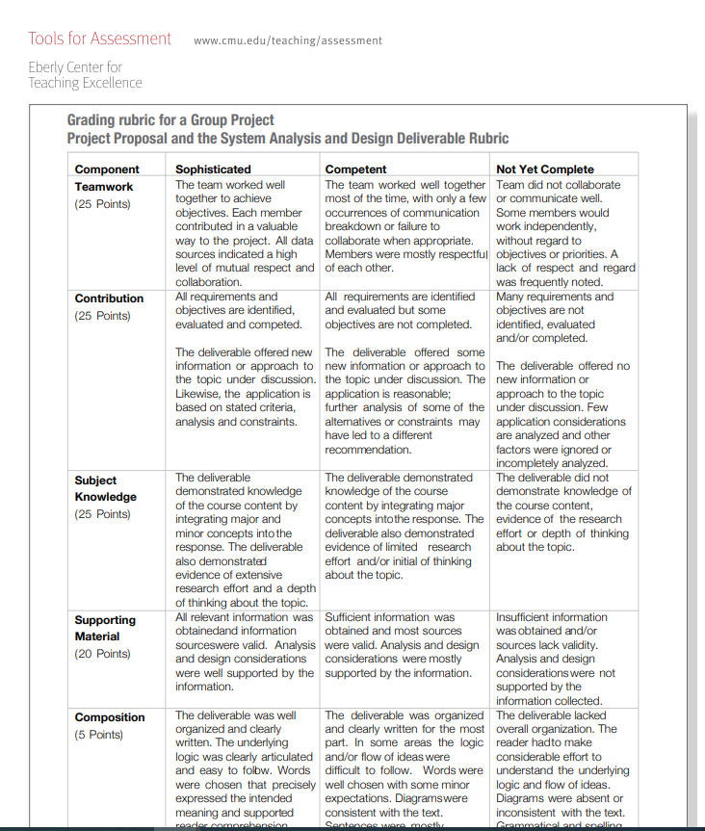
Group Project Sample Rubric

Slide 23
Groups Q & A

