Slide 1
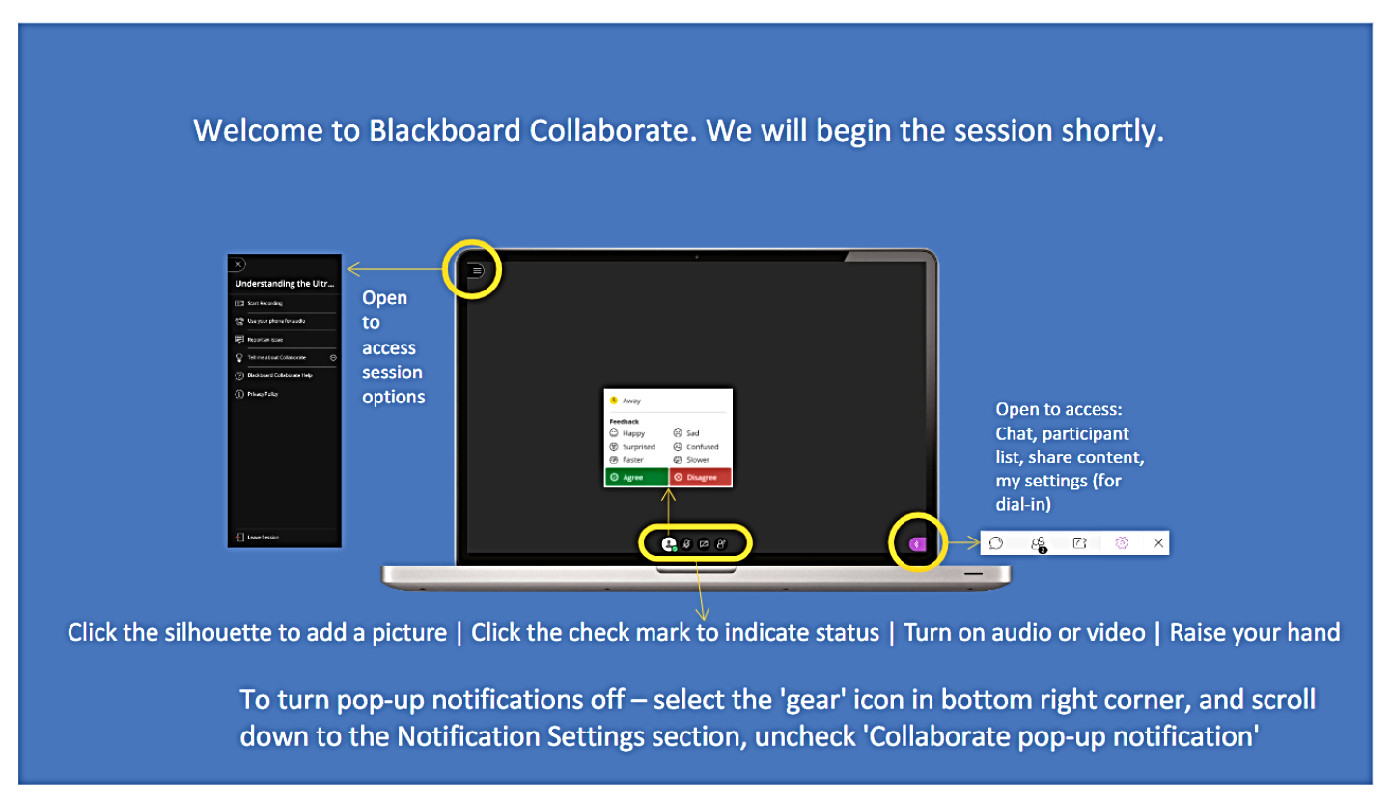

Slide 2
Panopto Basics
Samantha Kissel and Cliff Maslovsky

Slide 3
Getting Help
Get more help at
  https://www.csuohio.edu/center-for-elearning/panopto-lecture-capture
  Getting Started with Panopto folder
  Panopto Course

Slide 4
Accessing Panopto
Click Panopto on the left hand side
You will be taken to the Panopto Content area
Notes:
Hidden during presentation

Slide 5
Uploading a Video
Click Create
Click Upload Media
Upload video
Notes:
Hidden during presentation

Slide 6
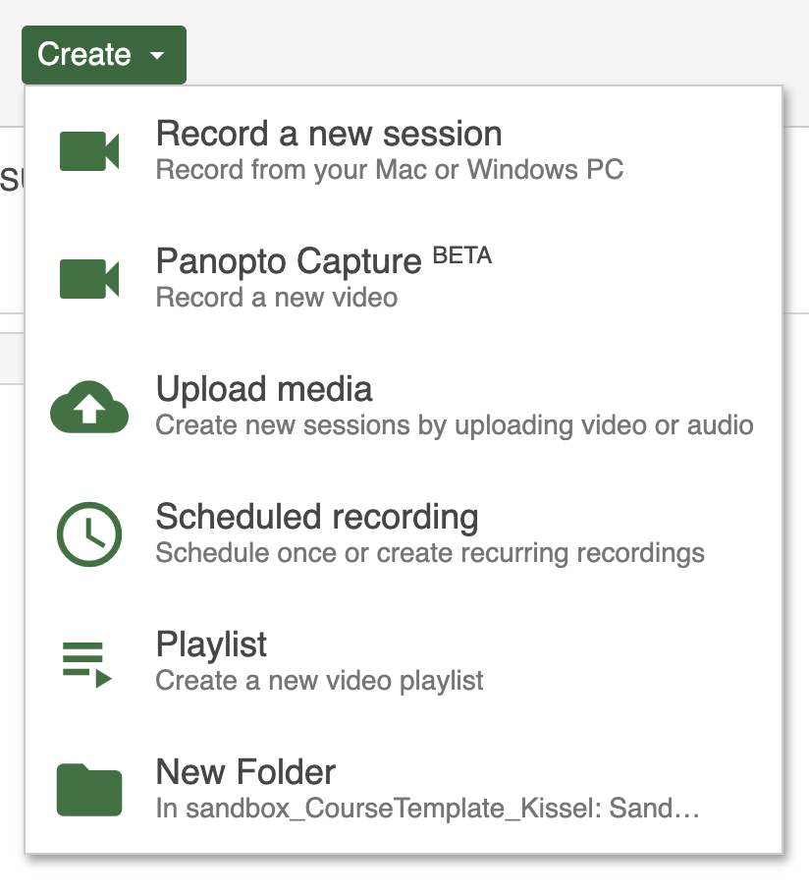
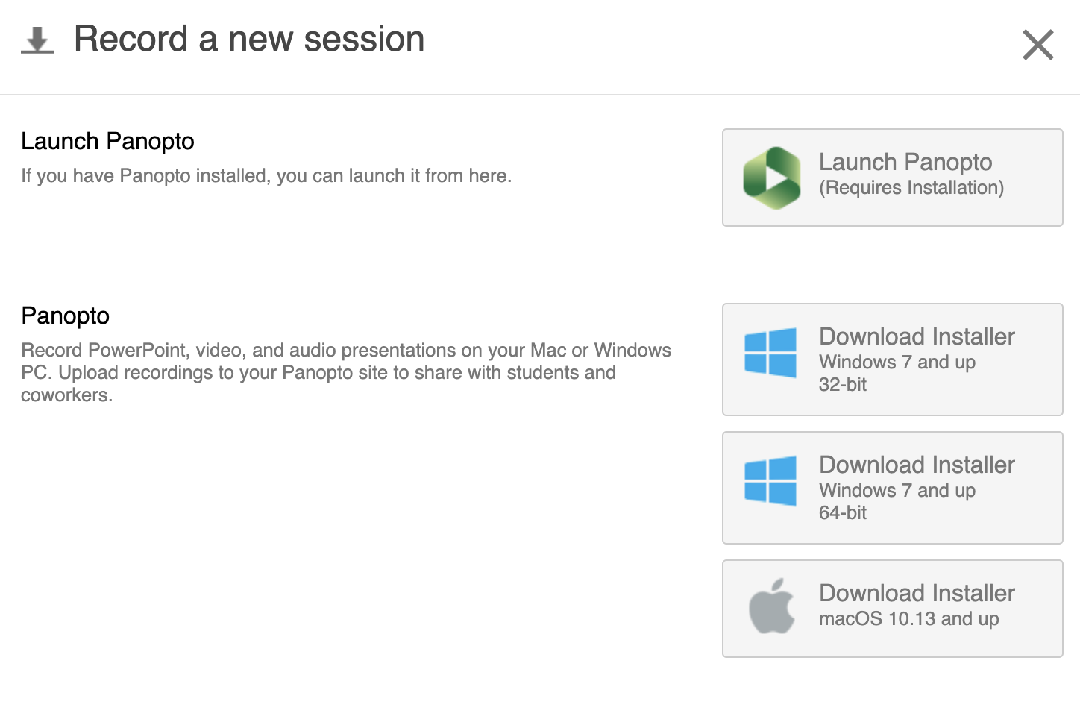
Installing Panopto
Click Create
Click Download Panopto

Slide 7
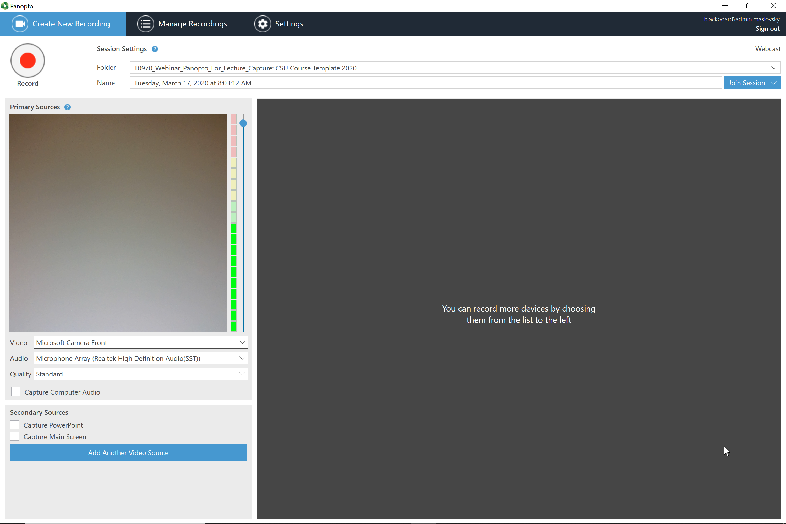

Slide 8
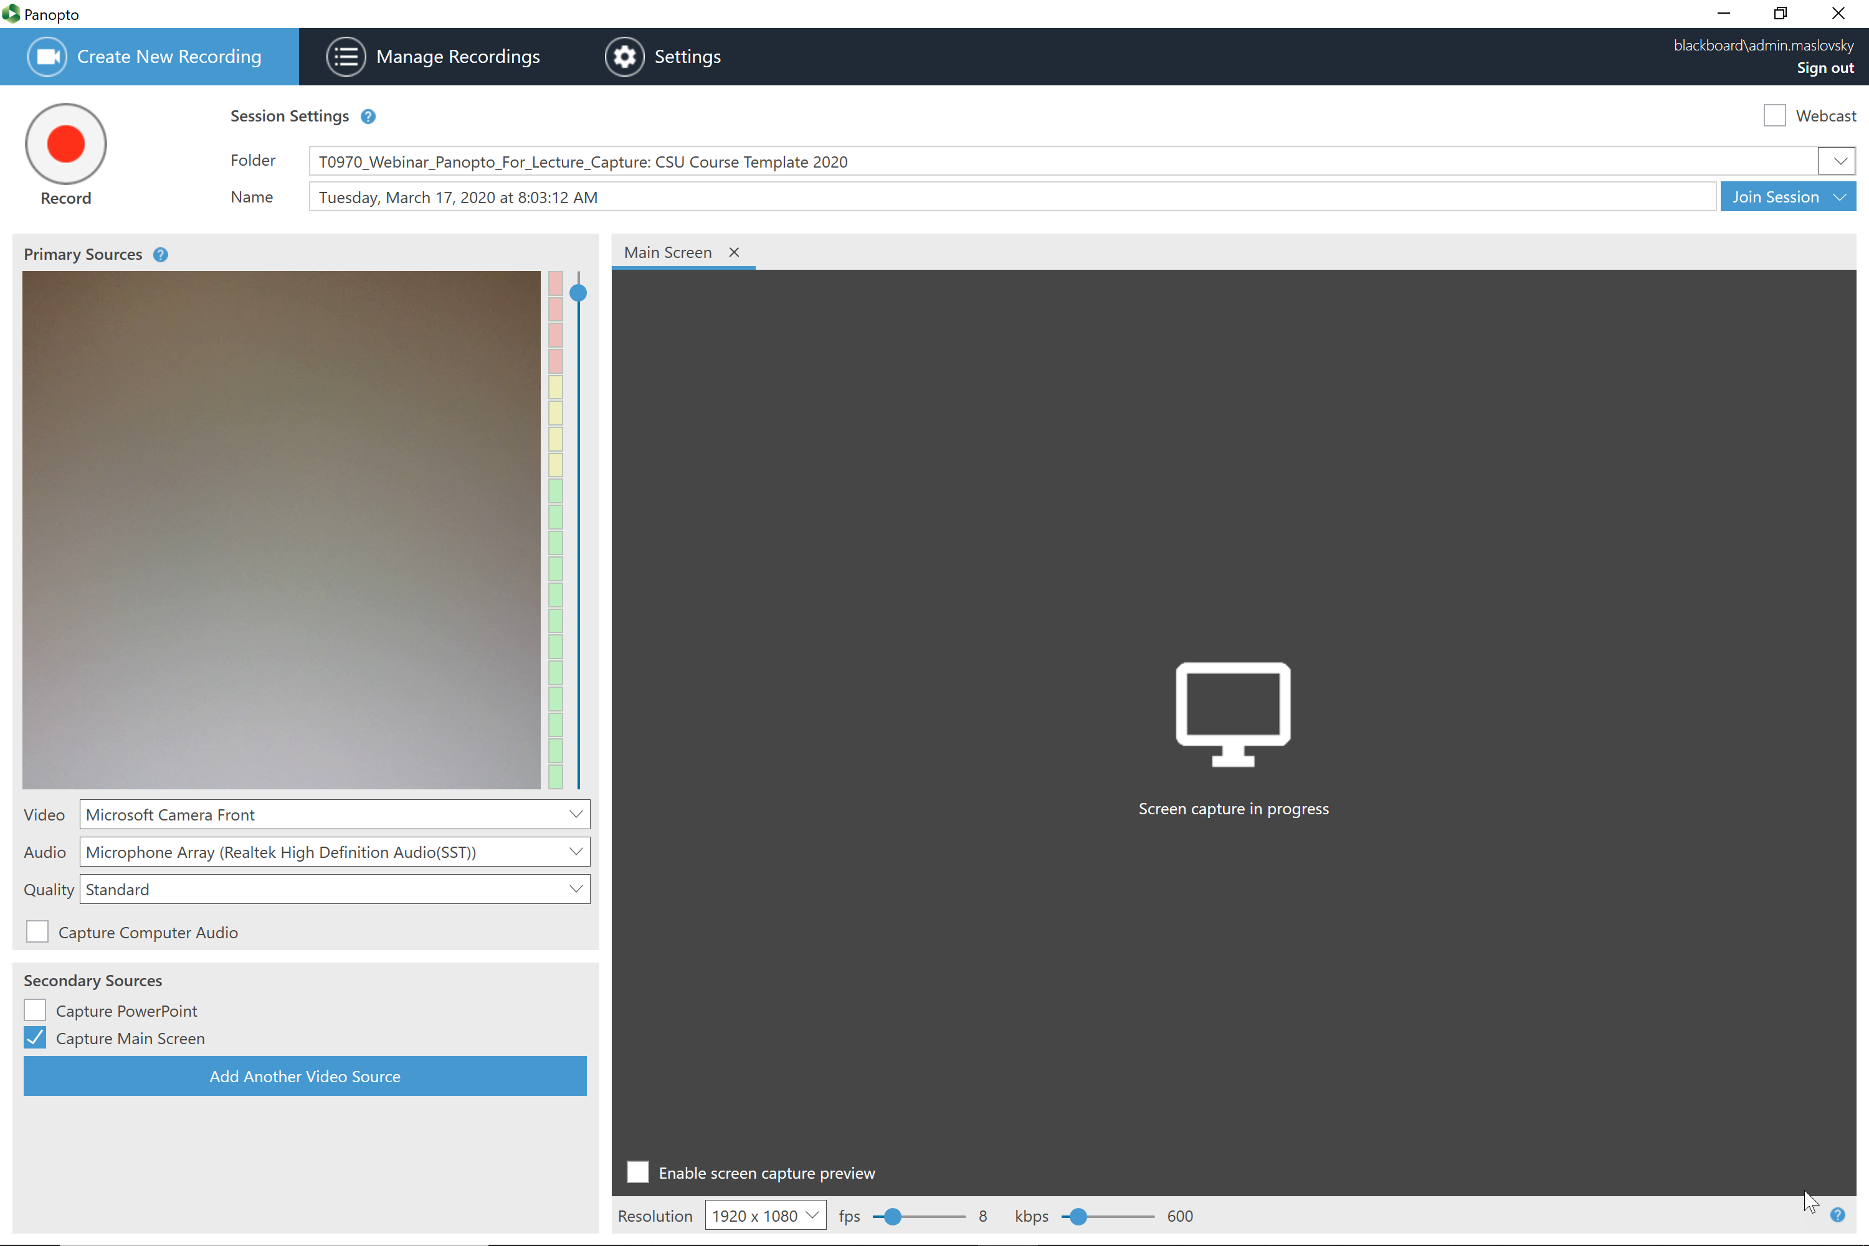

Slide 9
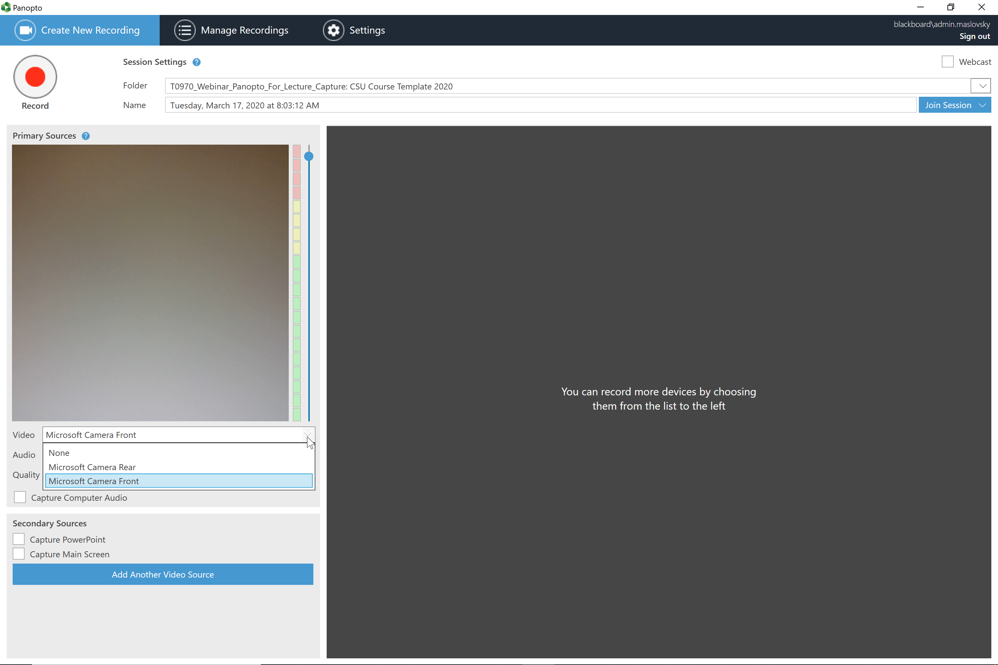

Slide 10
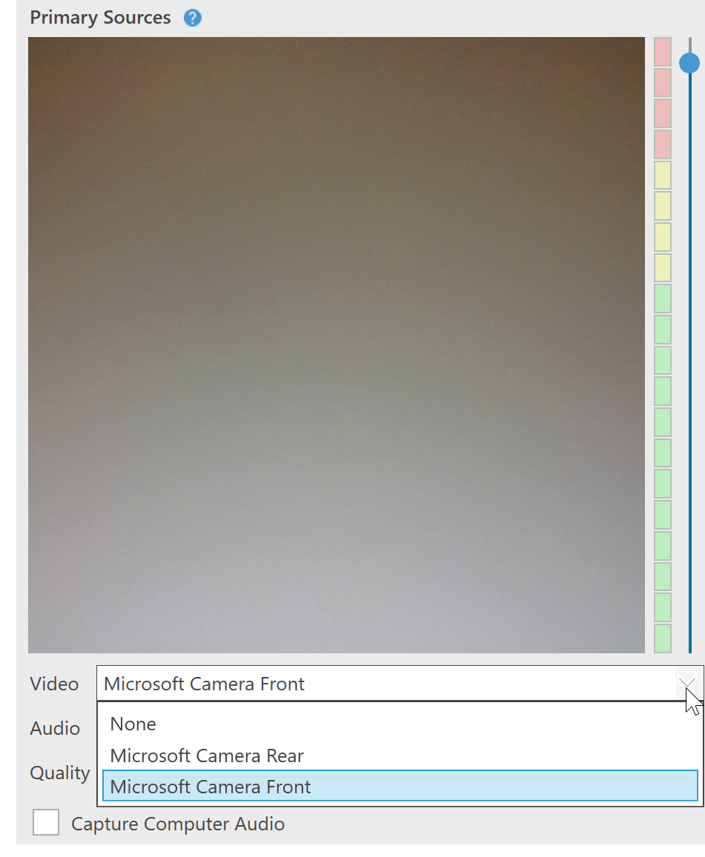

Slide 11
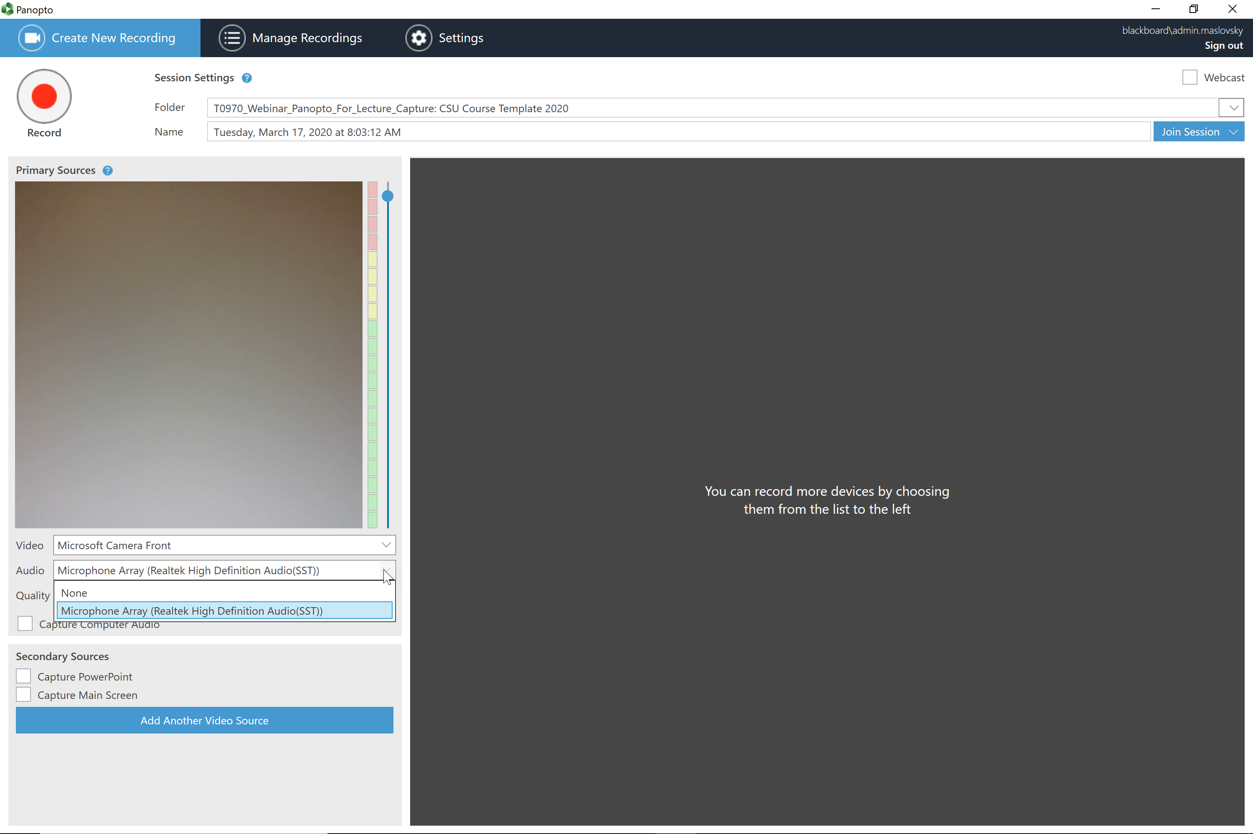

Slide 12
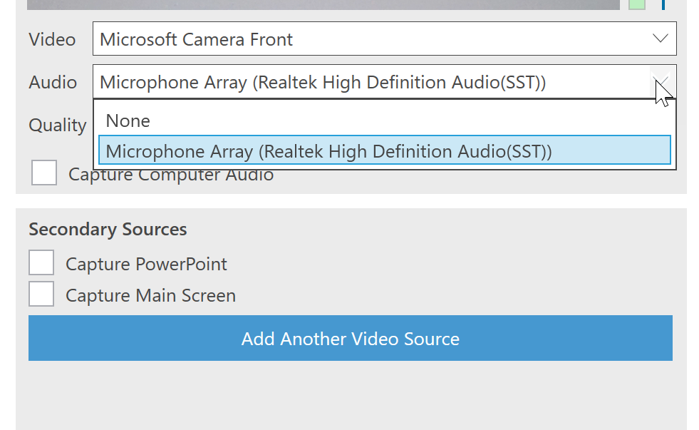

Slide 13
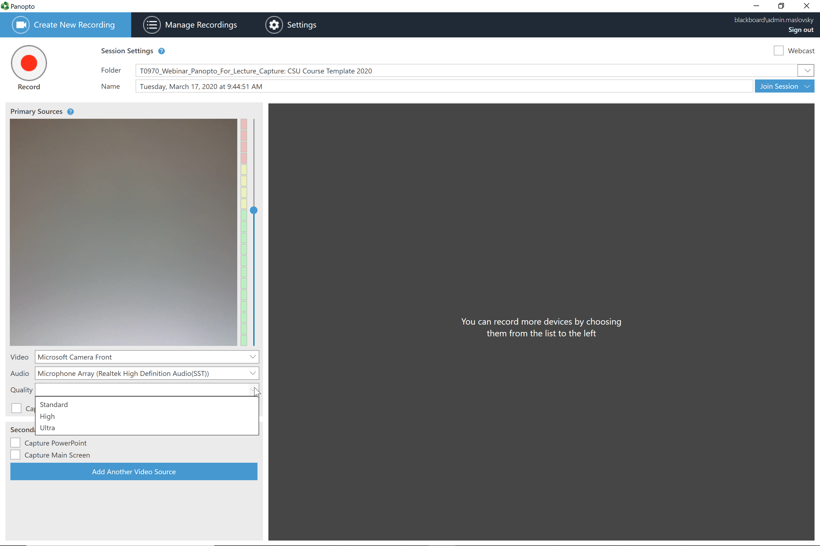

Slide 14
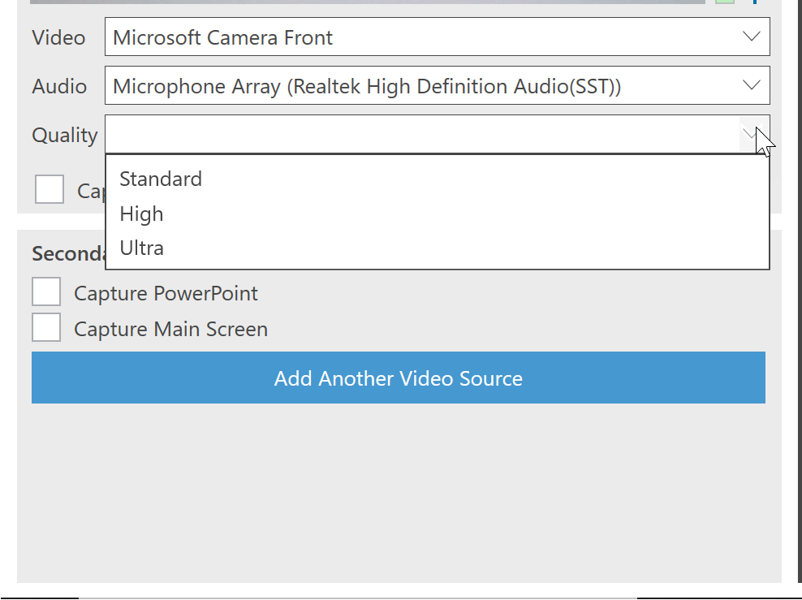

Slide 15
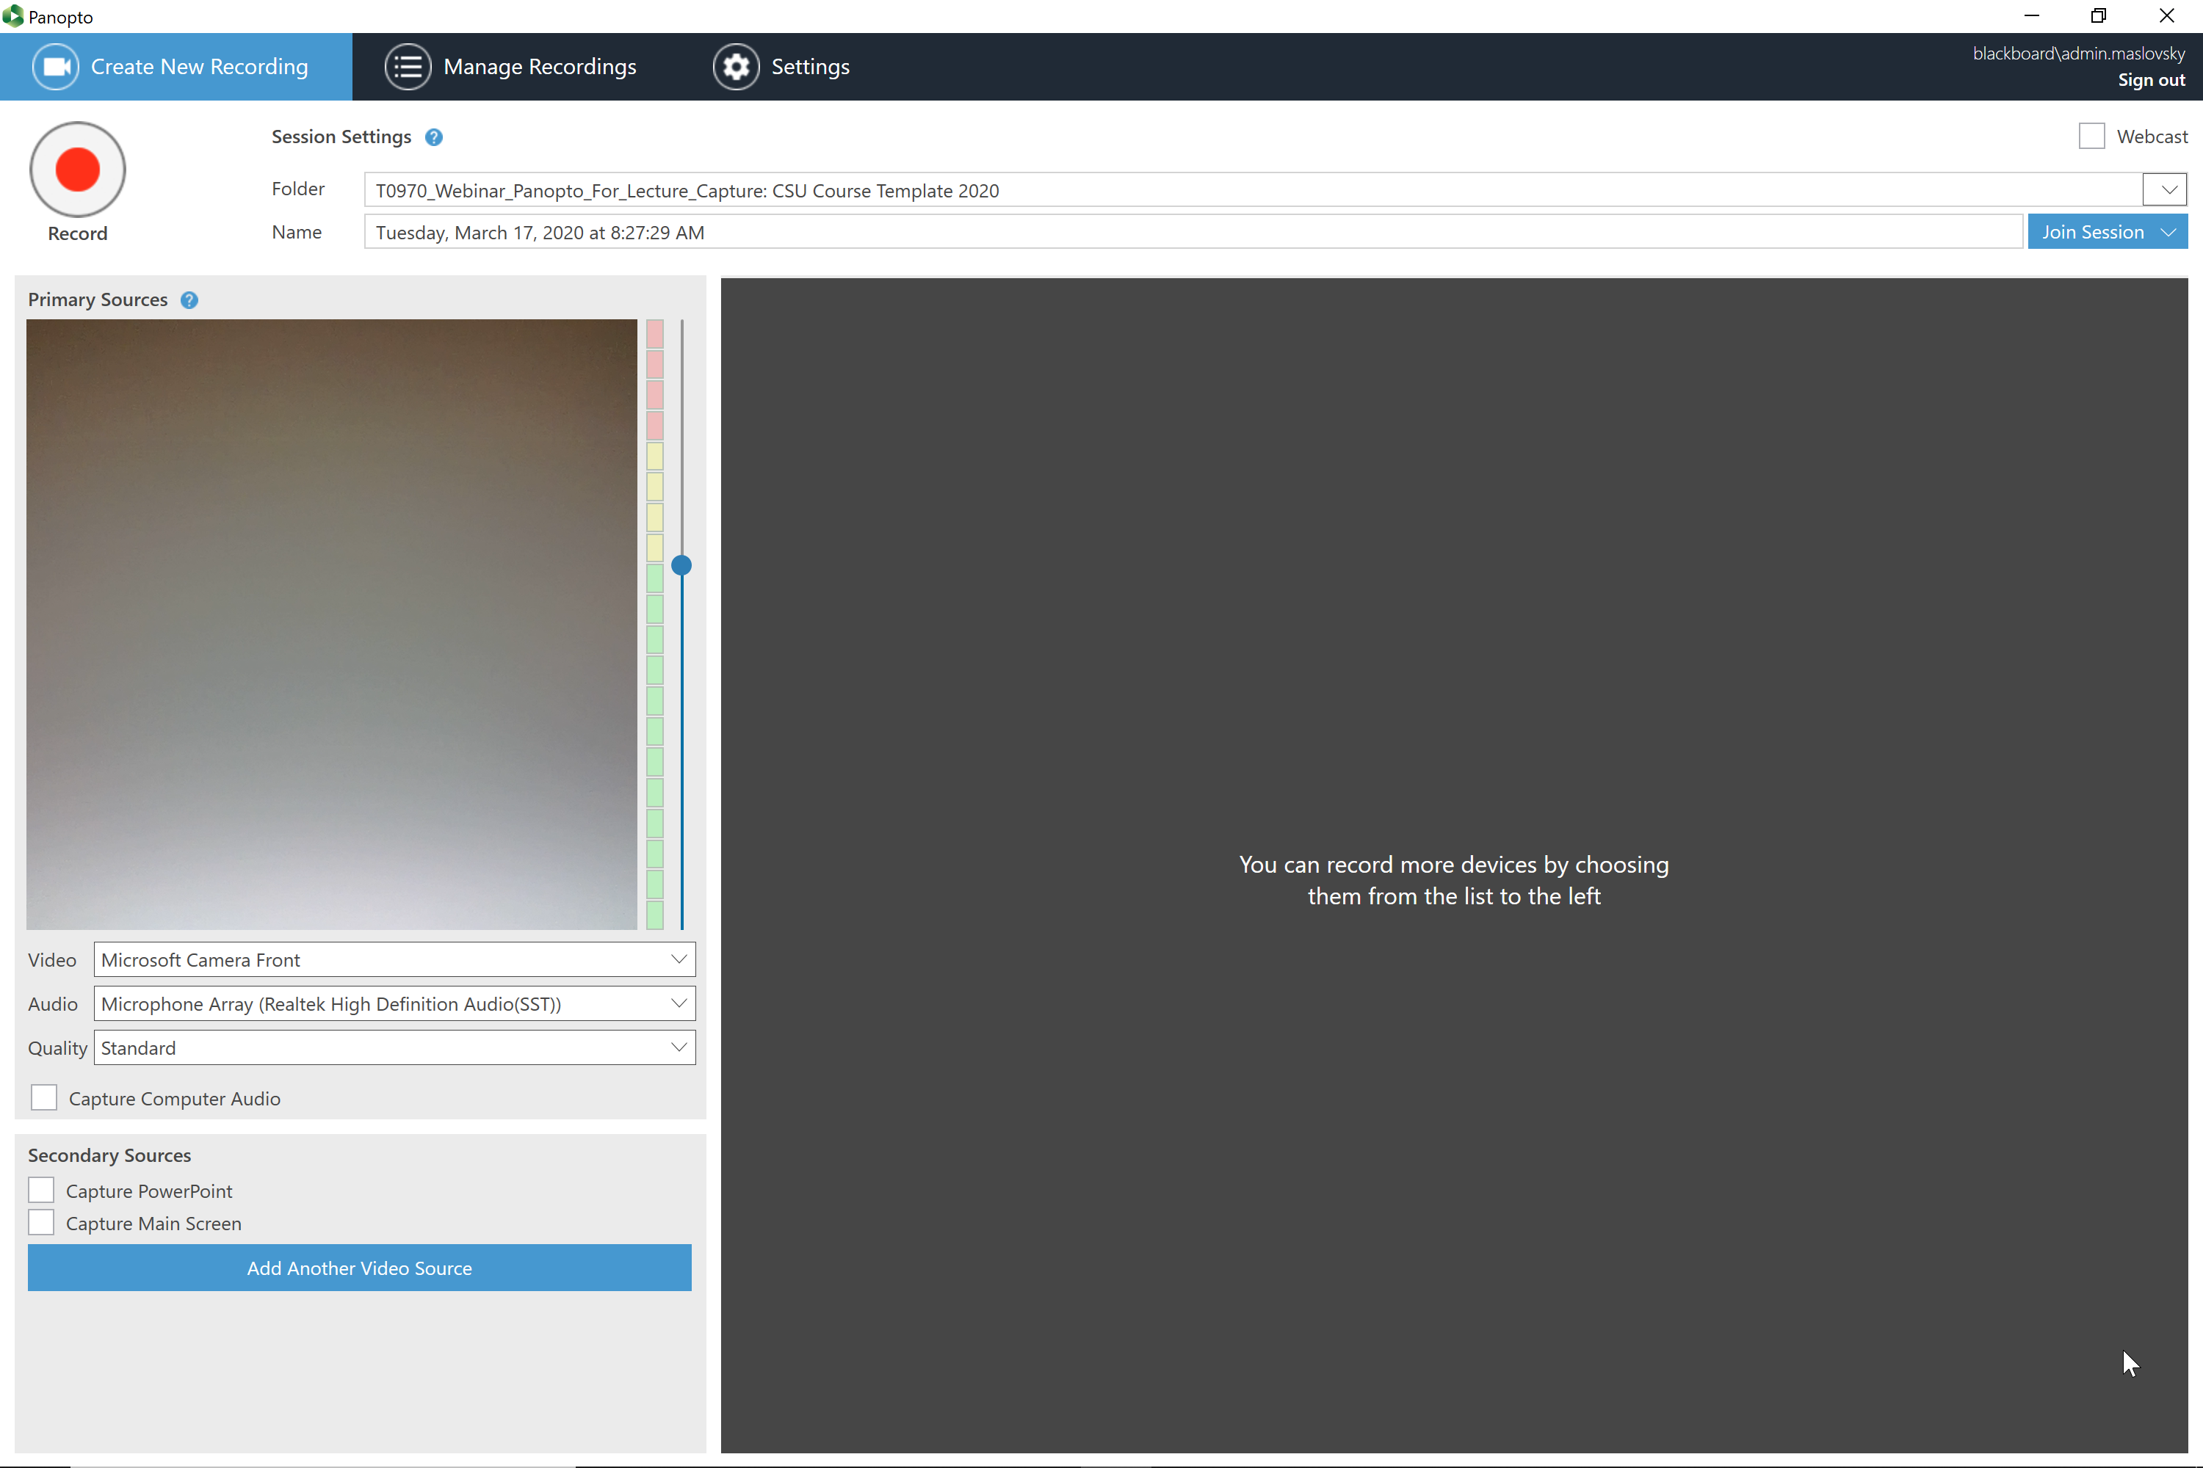

Slide 16
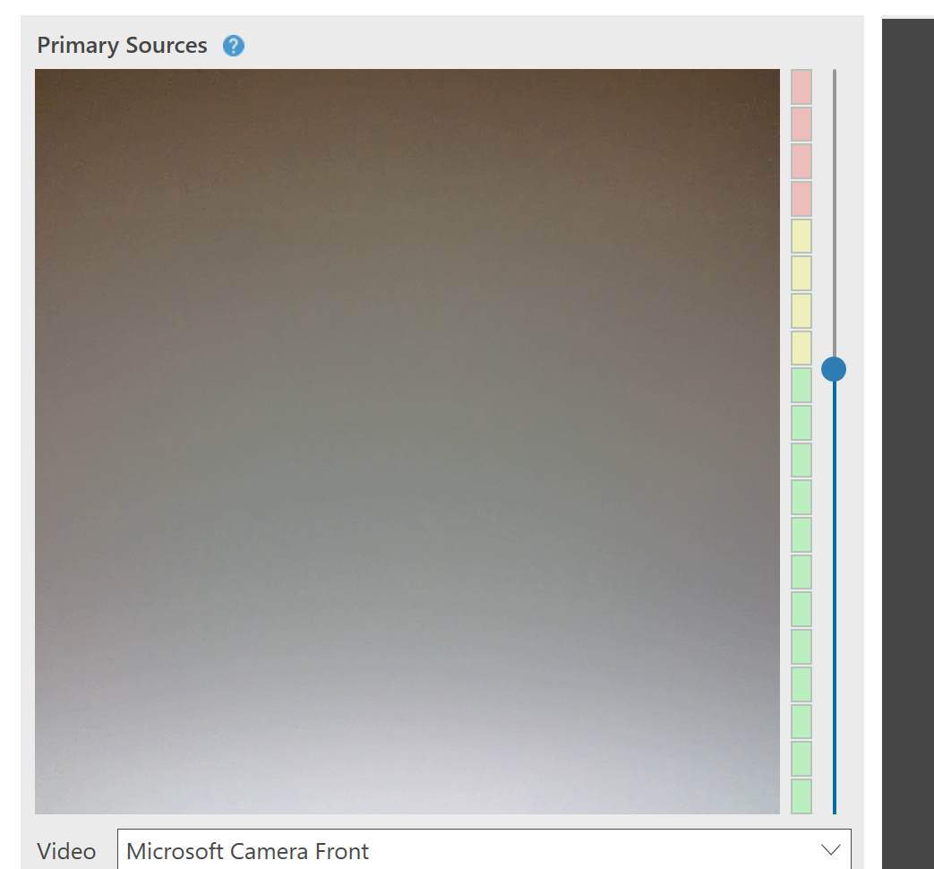

Slide 17


Slide 18
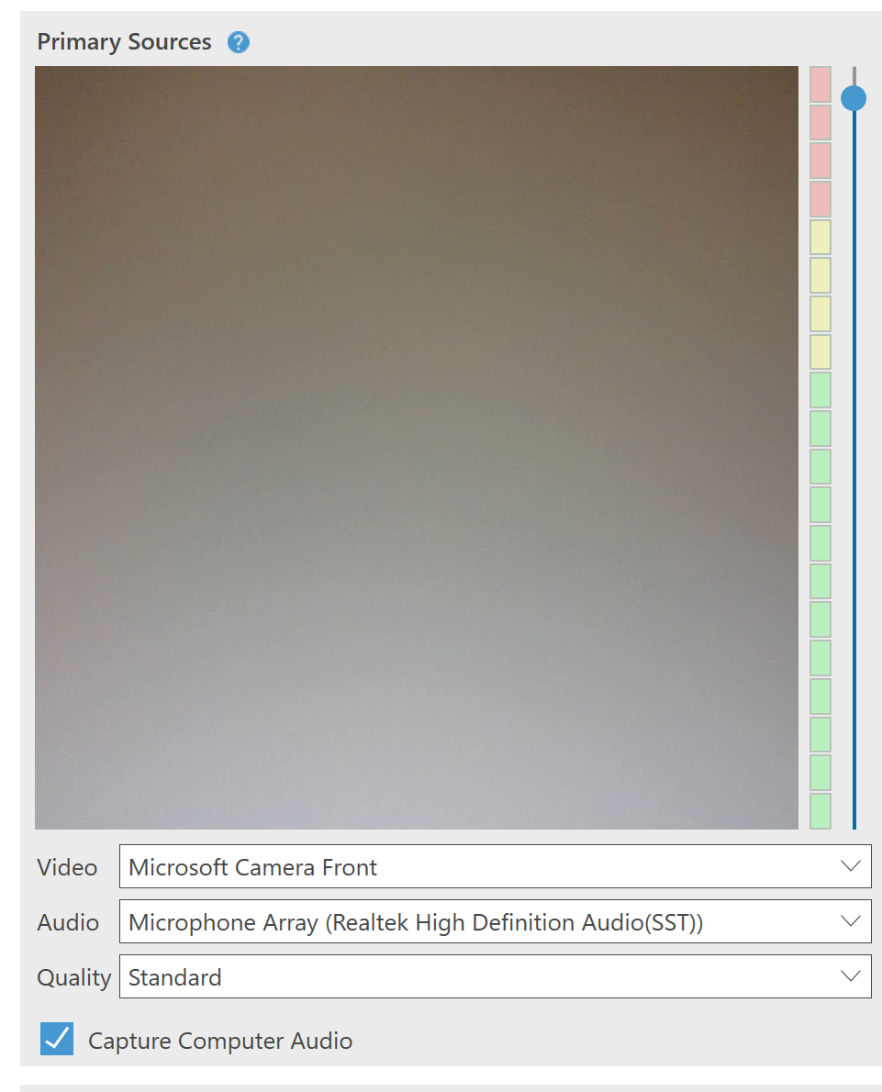

Slide 19


Slide 20
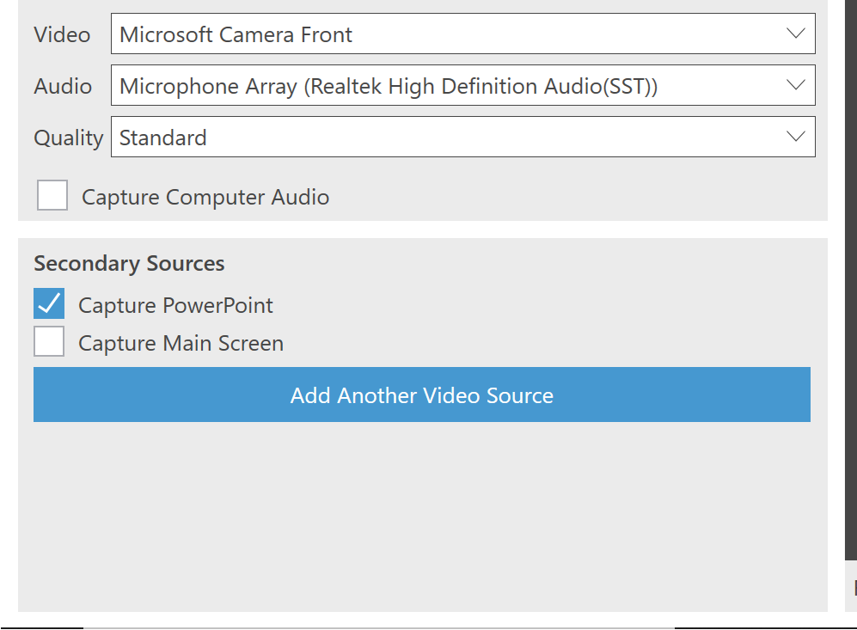

Slide 22
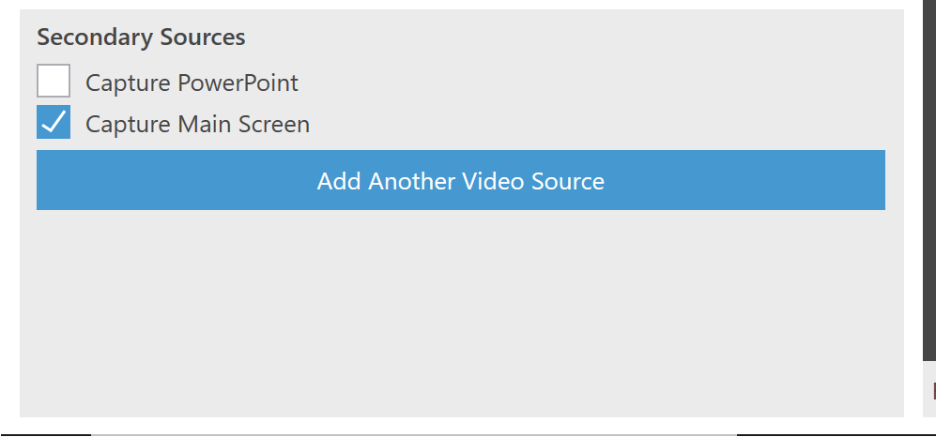

Slide 24
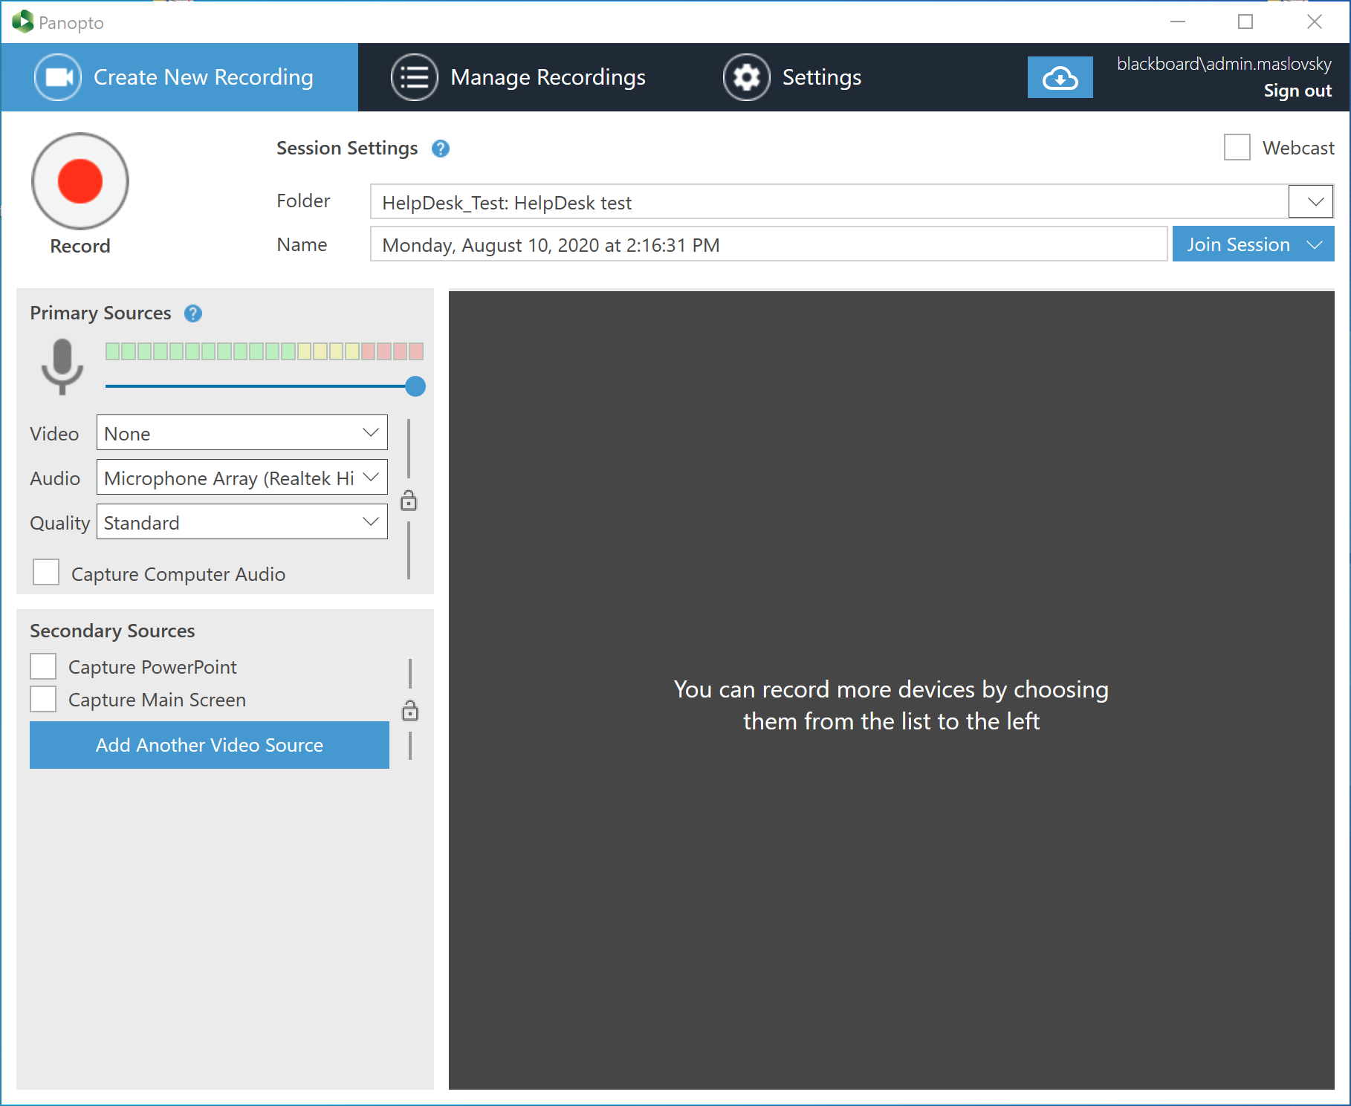

Slide 26
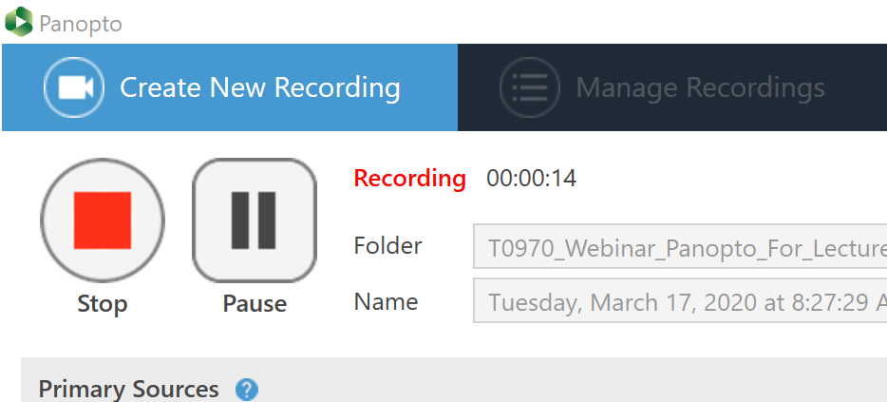

Slide 27
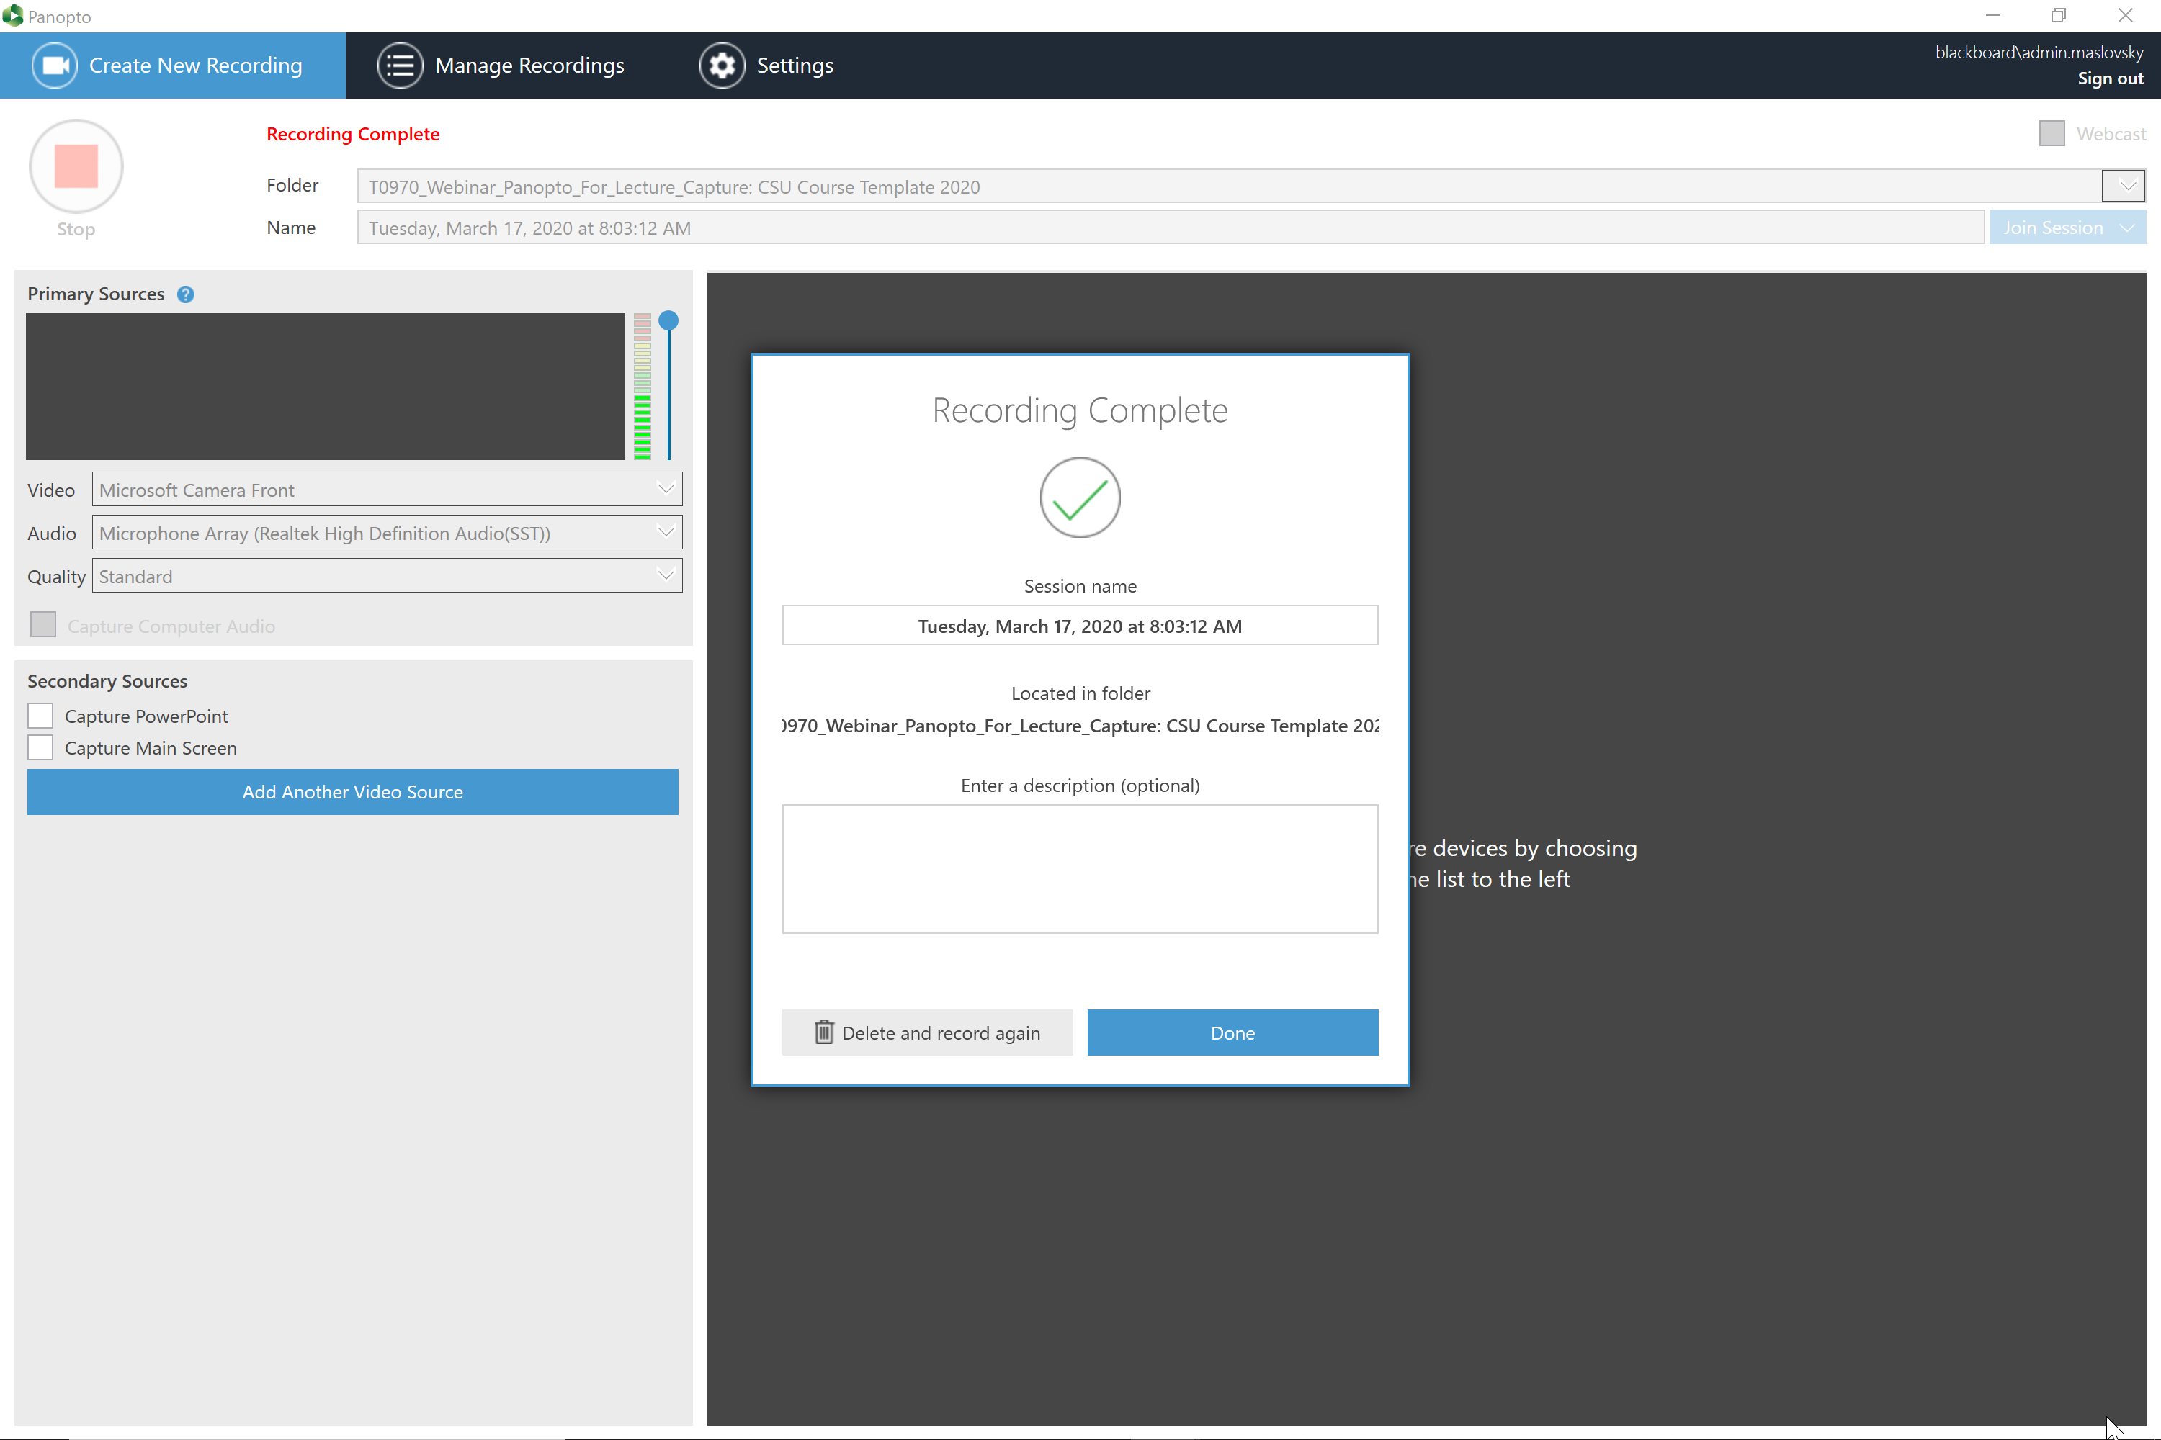

Slide 28
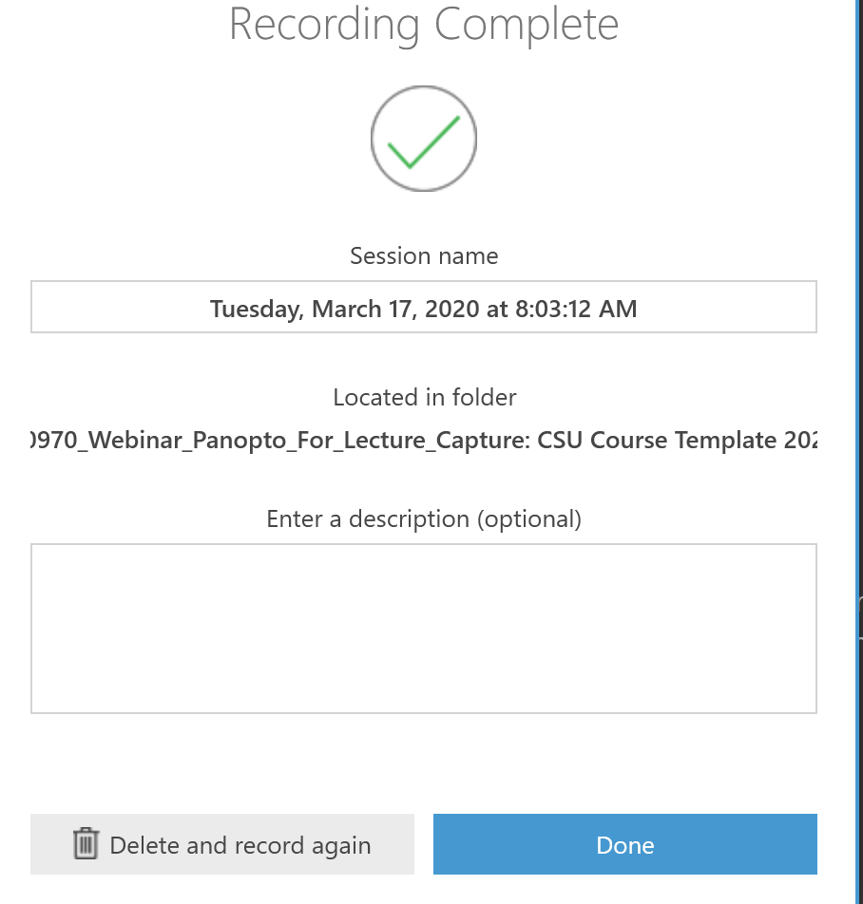

Slide 29
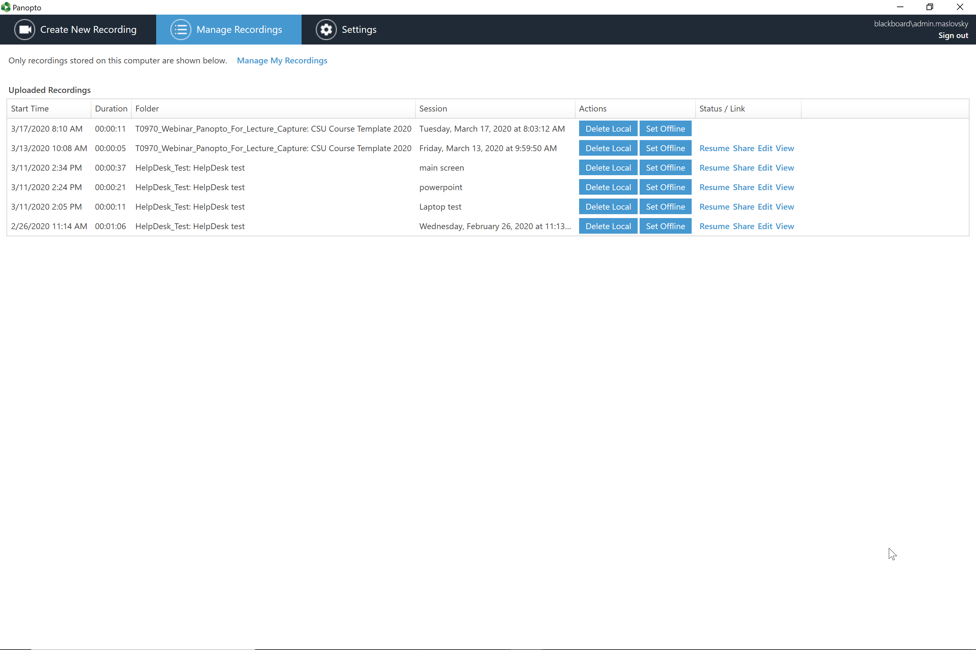

Slide 30
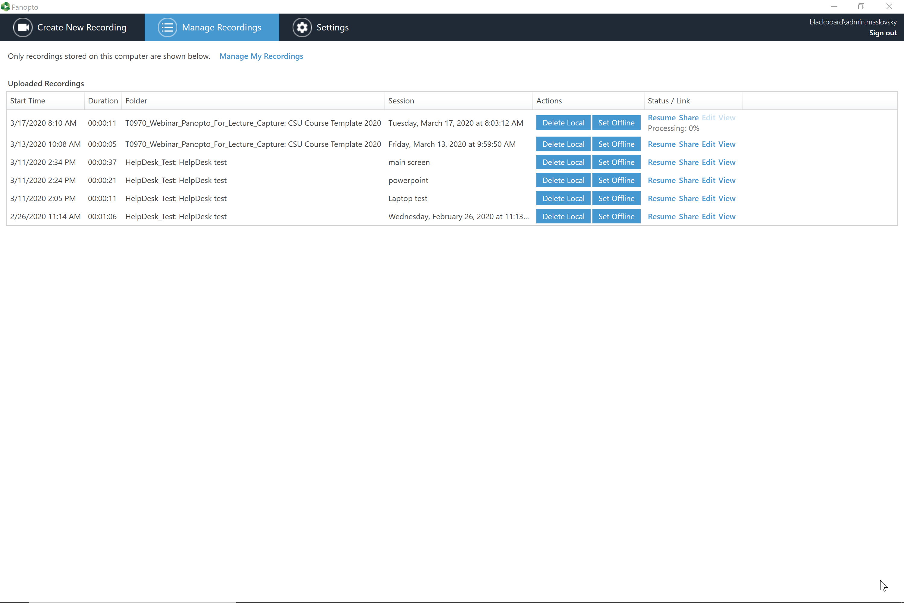

Slide 31


Slide 32
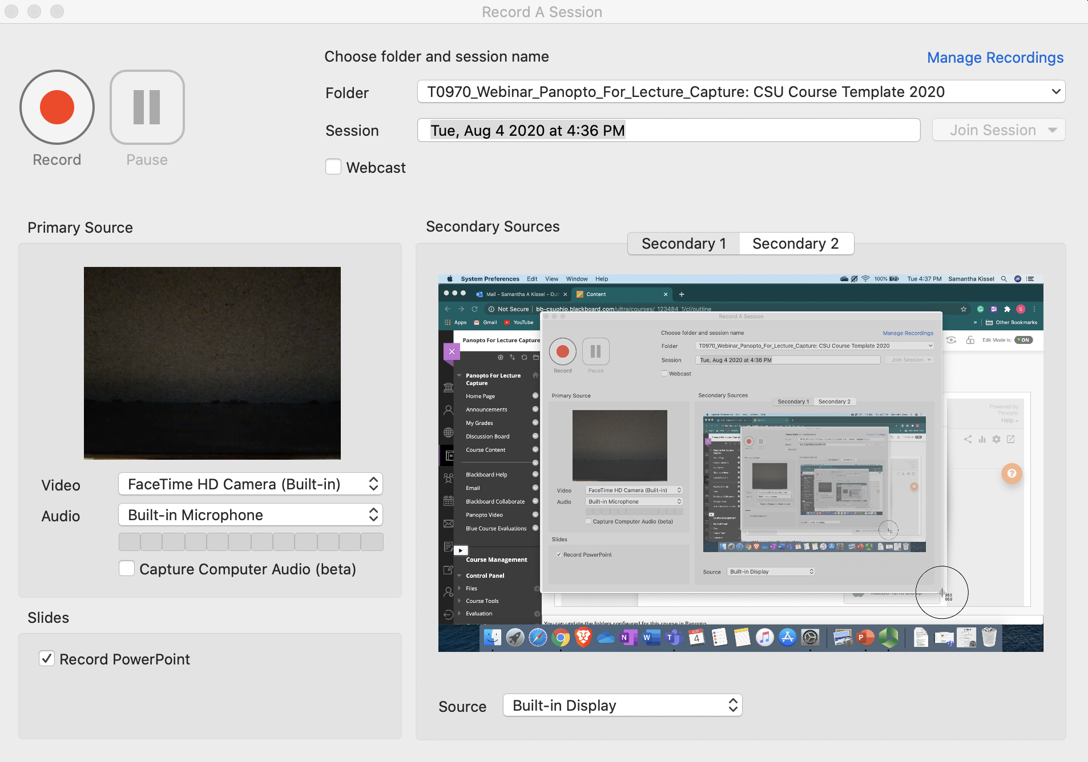
Mac
Version
Use Source : Built-in Display for screen capture
Secondary 1 & 2 > for multiple monitor use

Slide 33
Panopto web capture

Slide 34
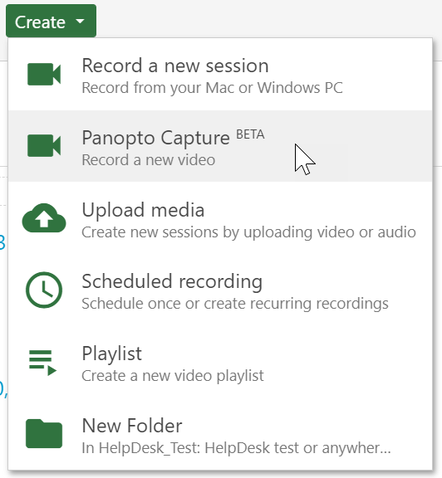

Slide 35
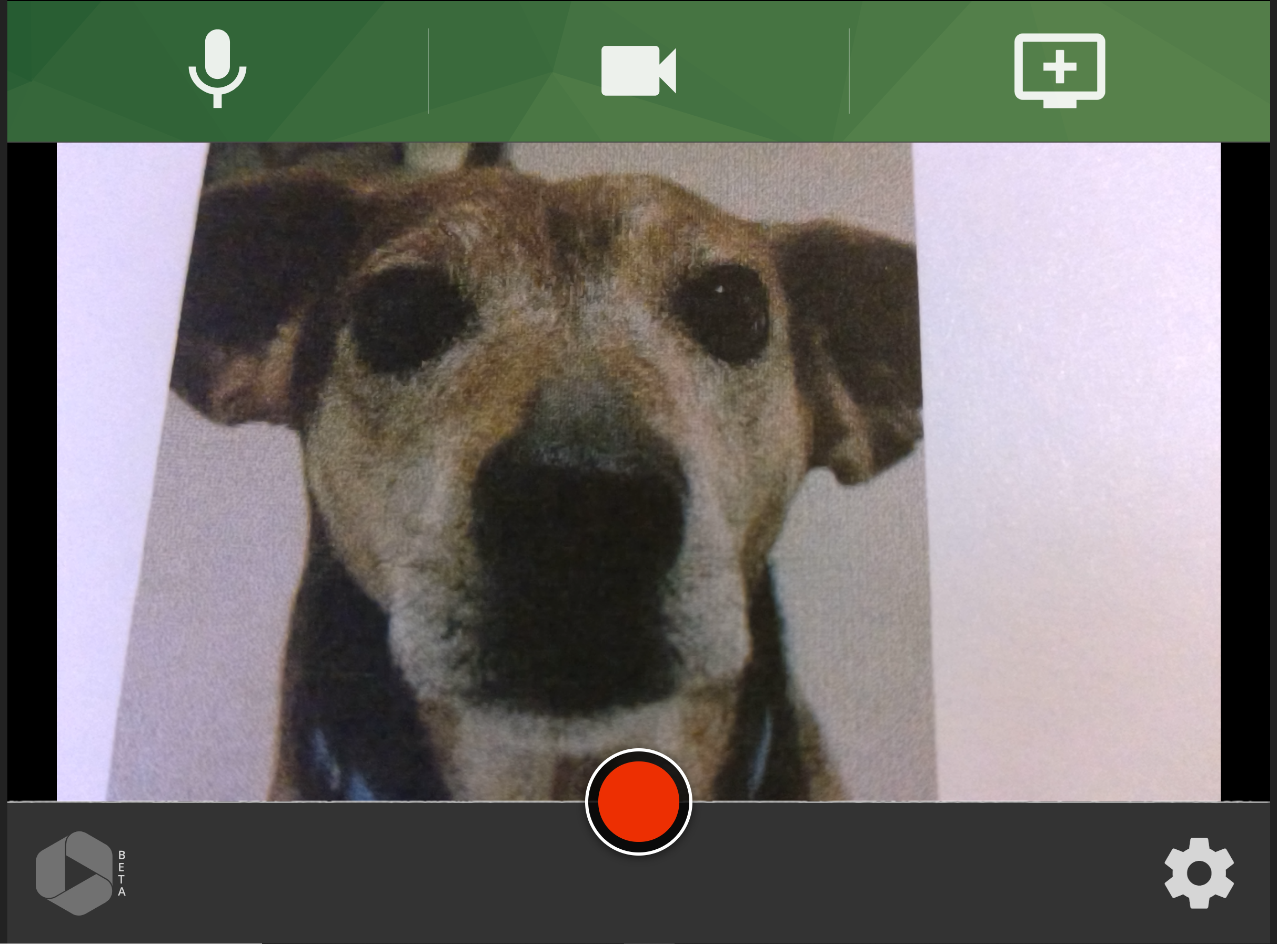

Slide 36
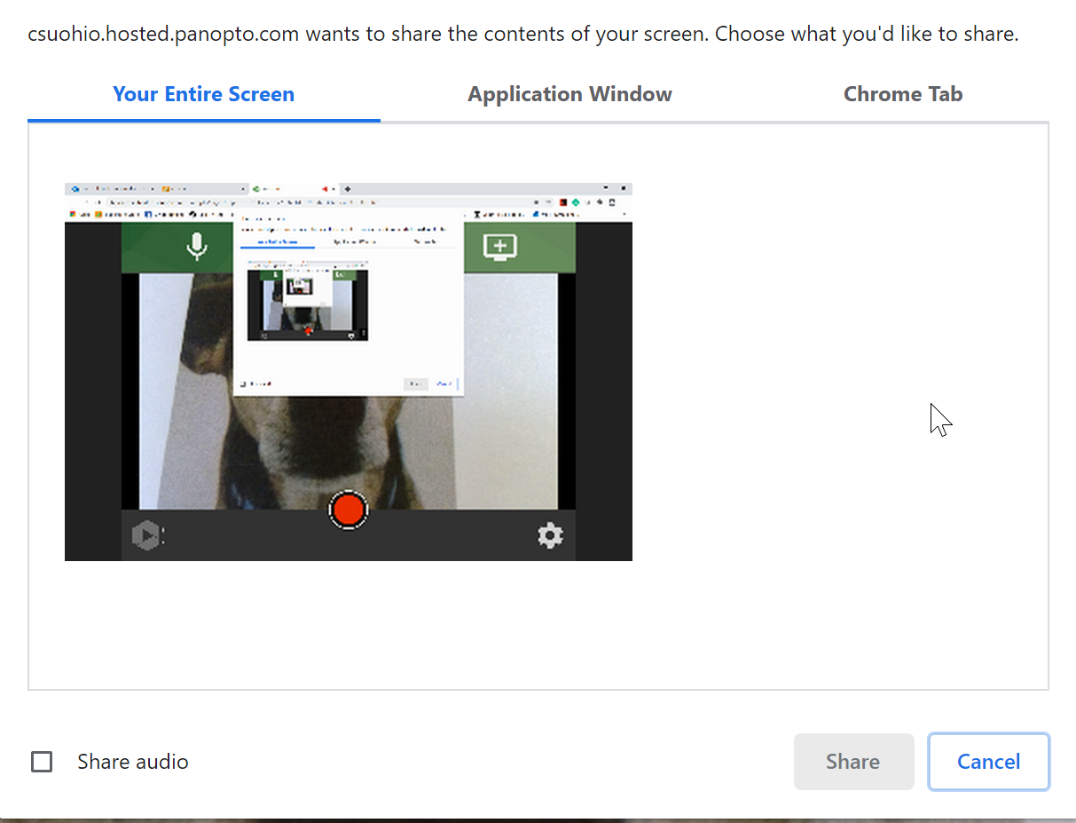

Slide 37
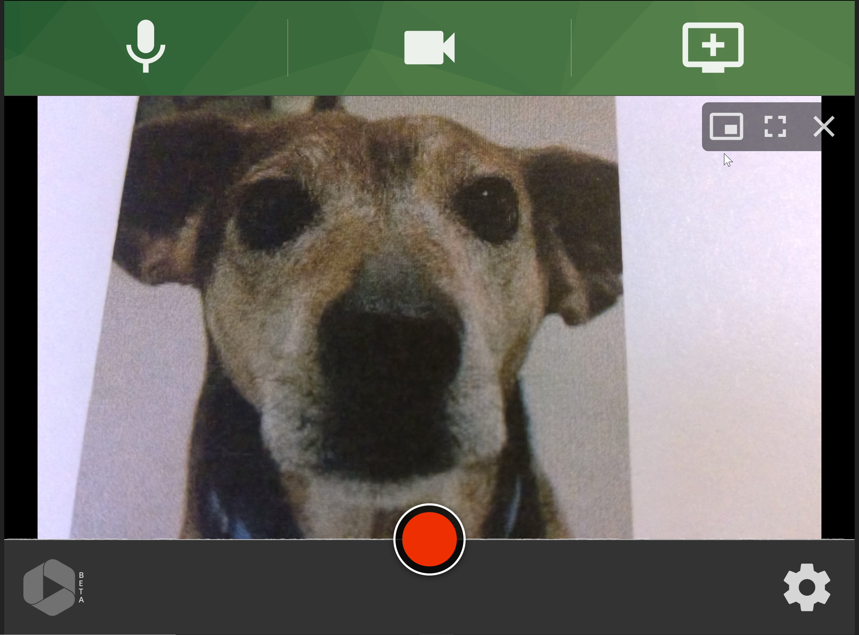

Slide 38
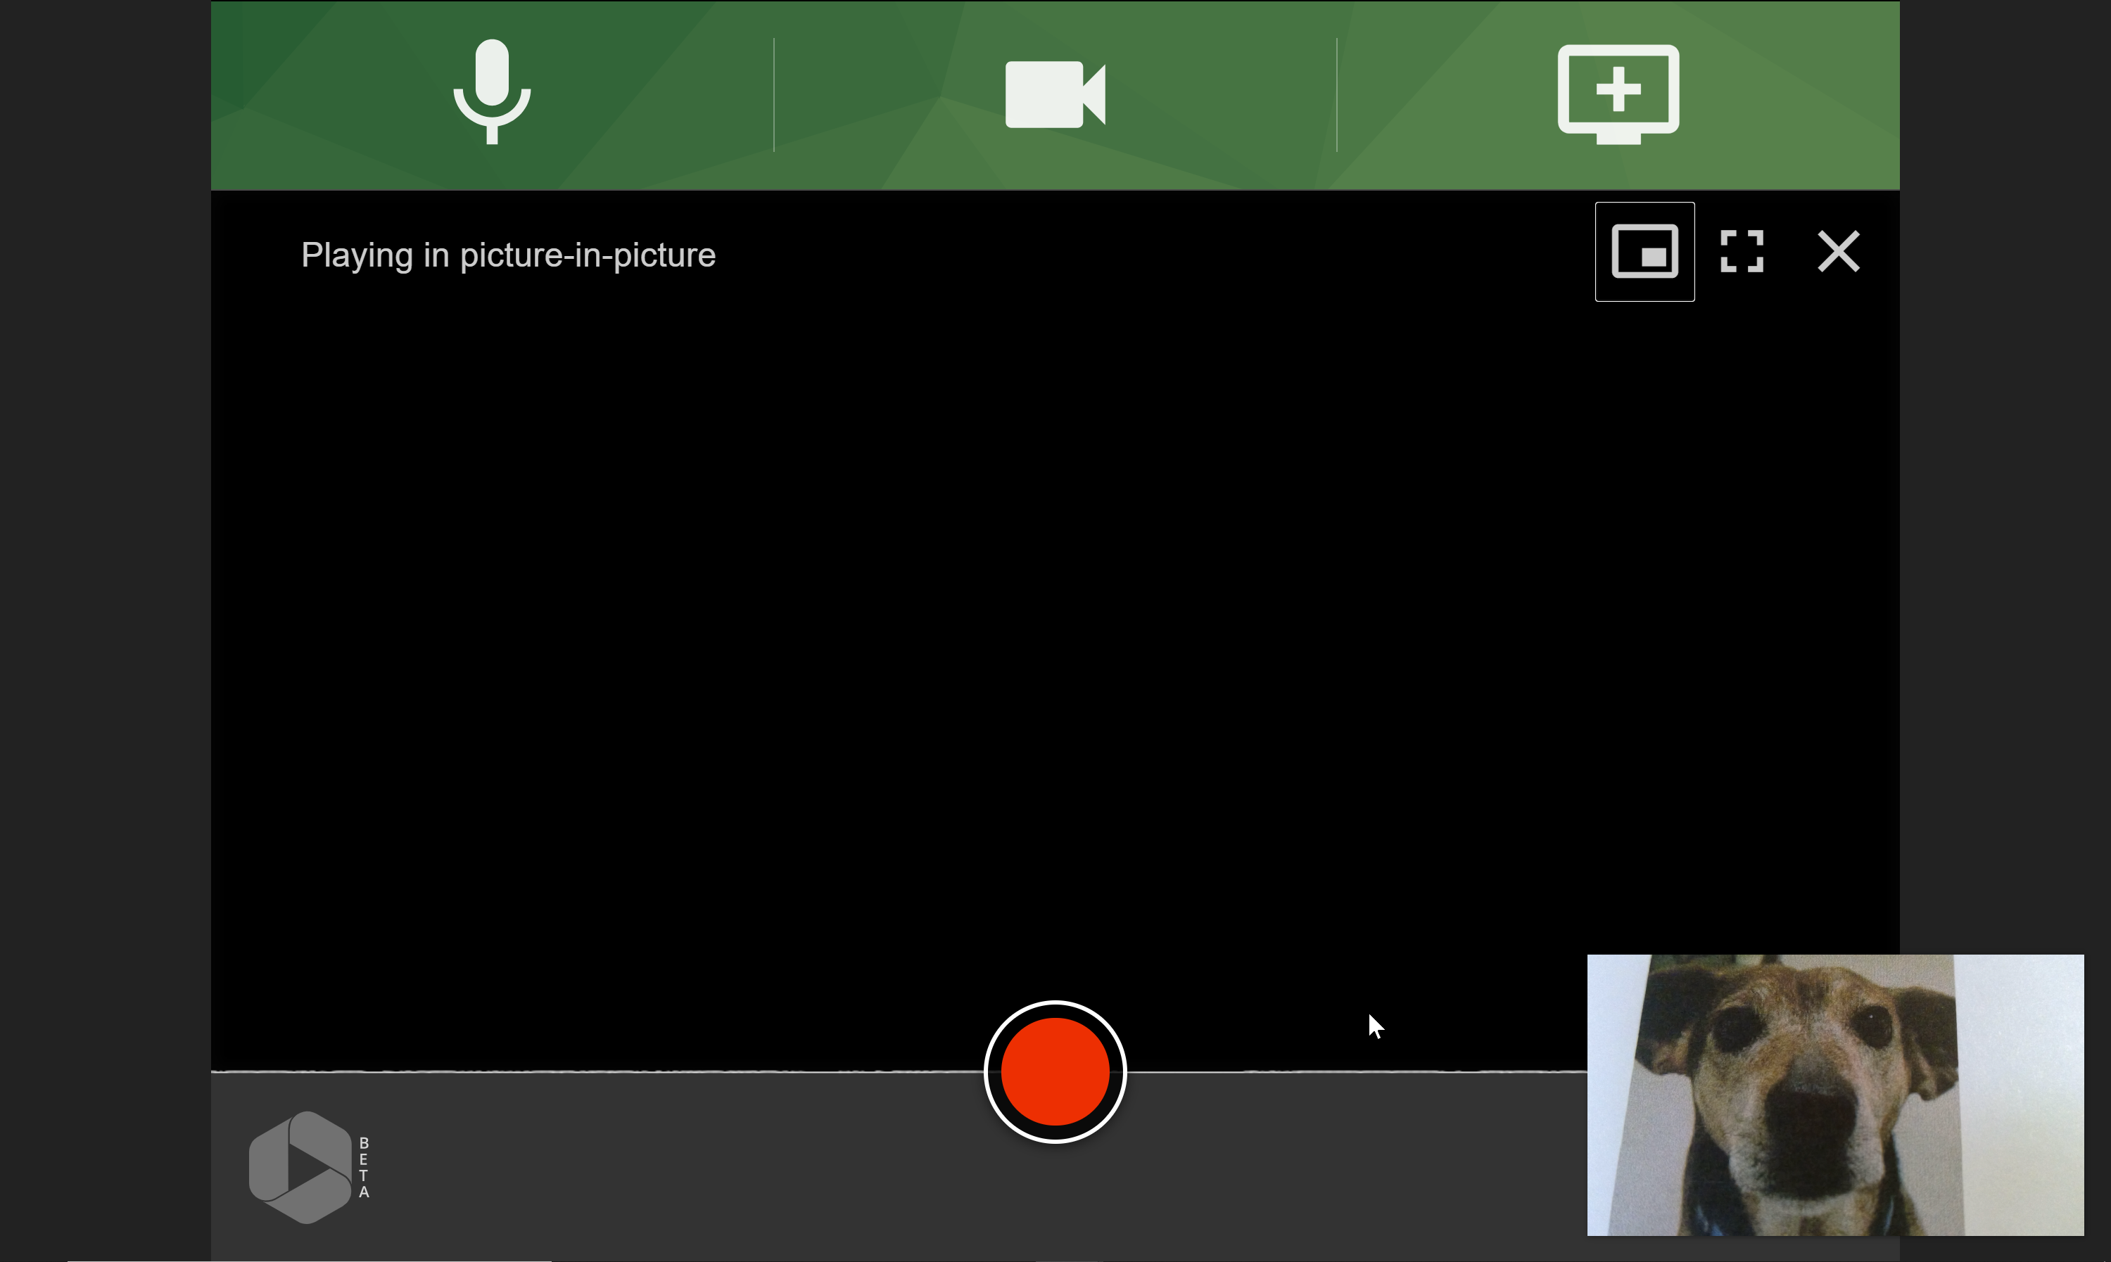

Slide 39
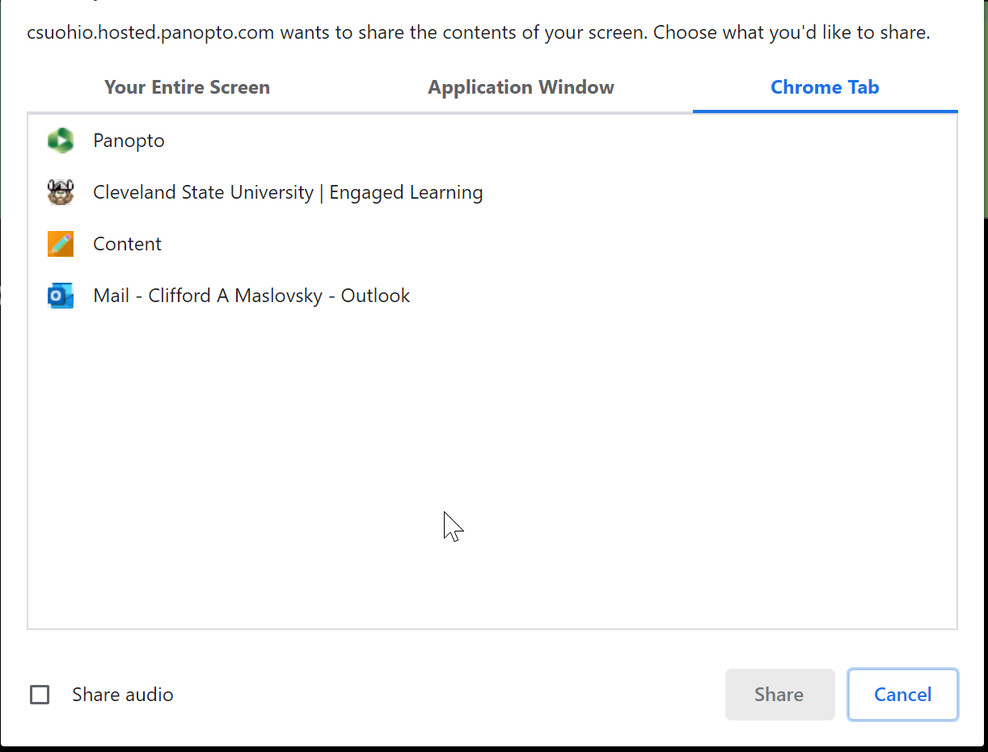

Slide 40
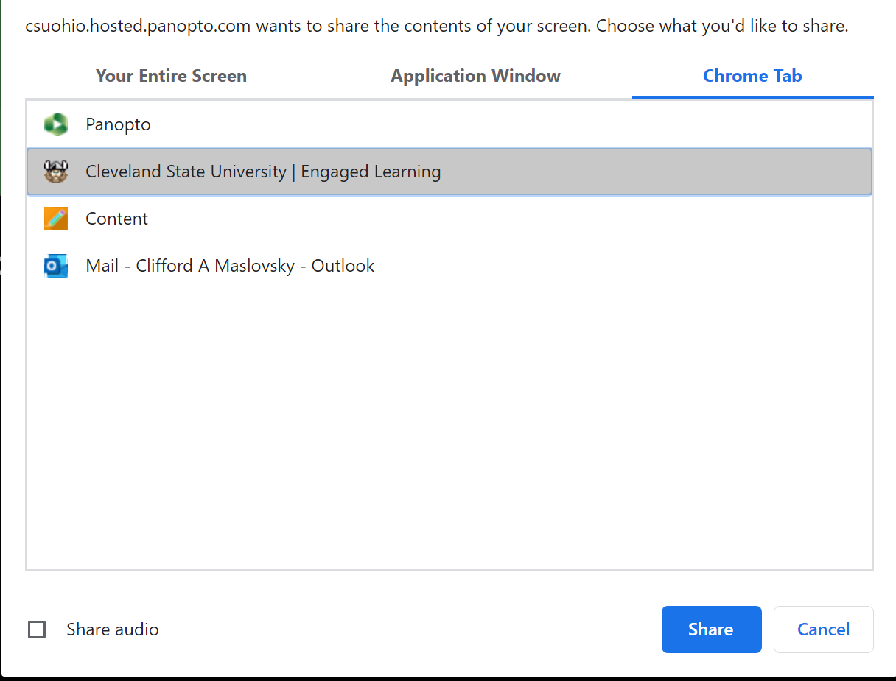

Slide 41
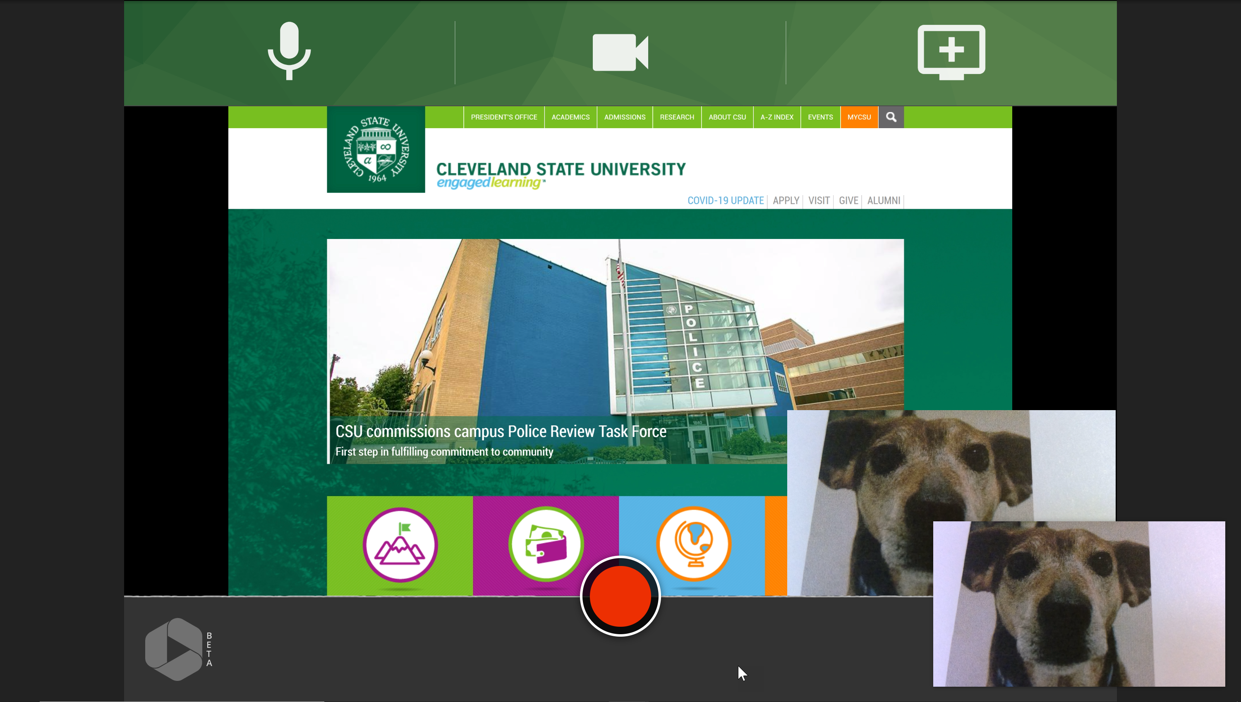

Slide 42
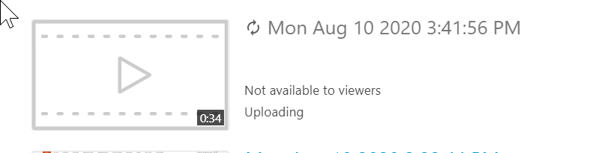

Slide 43
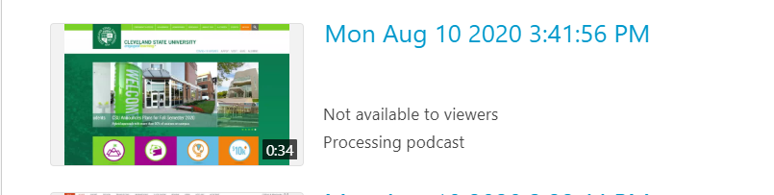

Slide 44
Embedding Videos &
Video Assignments

Slide 45
Embedding a Video
Go to your course content area and navigate to where you want your video
Build Content > Mashups > Panopto Video Embed
You will be taken to an area where you can choose from videos already created
Can also upload or record if your video is not there
If your video is in another course select the drop down arrow and pick your class
Insert Video
Notes:
Hidden during presentation

Slide 46
Creating a Panopto Assignment
Creating an assignment that is linked to Blackboard’s Grade Book
  https://support.panopto.com/s/article/Assignment-Submission-Workflow-in-Blackboard
Creating an assignment folder that is not linked to Blackboard’s Grade Book
  https://support.panopto.com/s/article/Use-Assignment-Folders-for-Student-Recordings
Notes:
Hidden during presentation

Slide 47
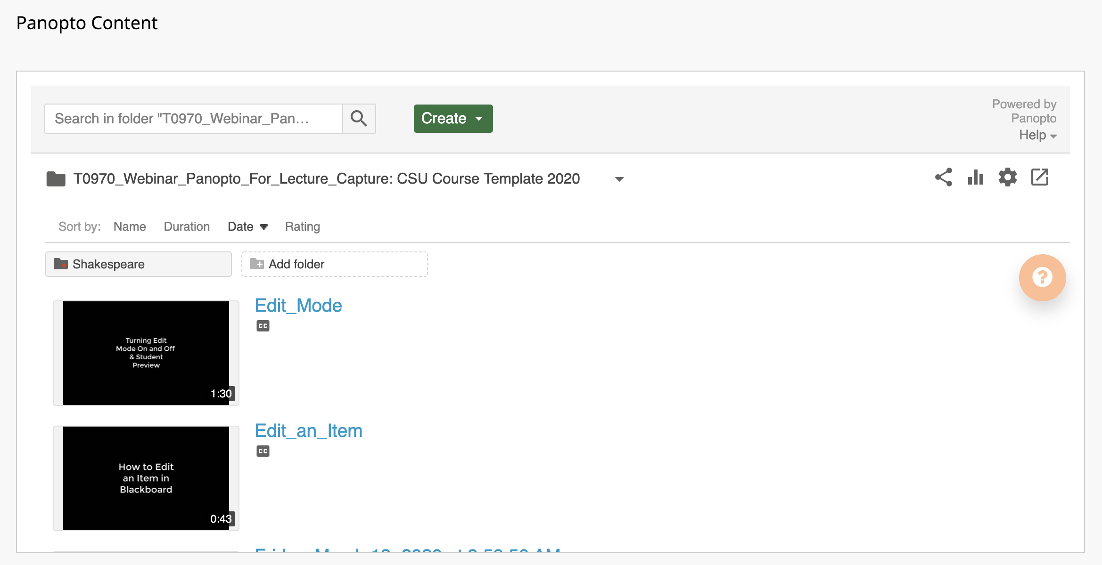
Video Tutorials

Slide 48
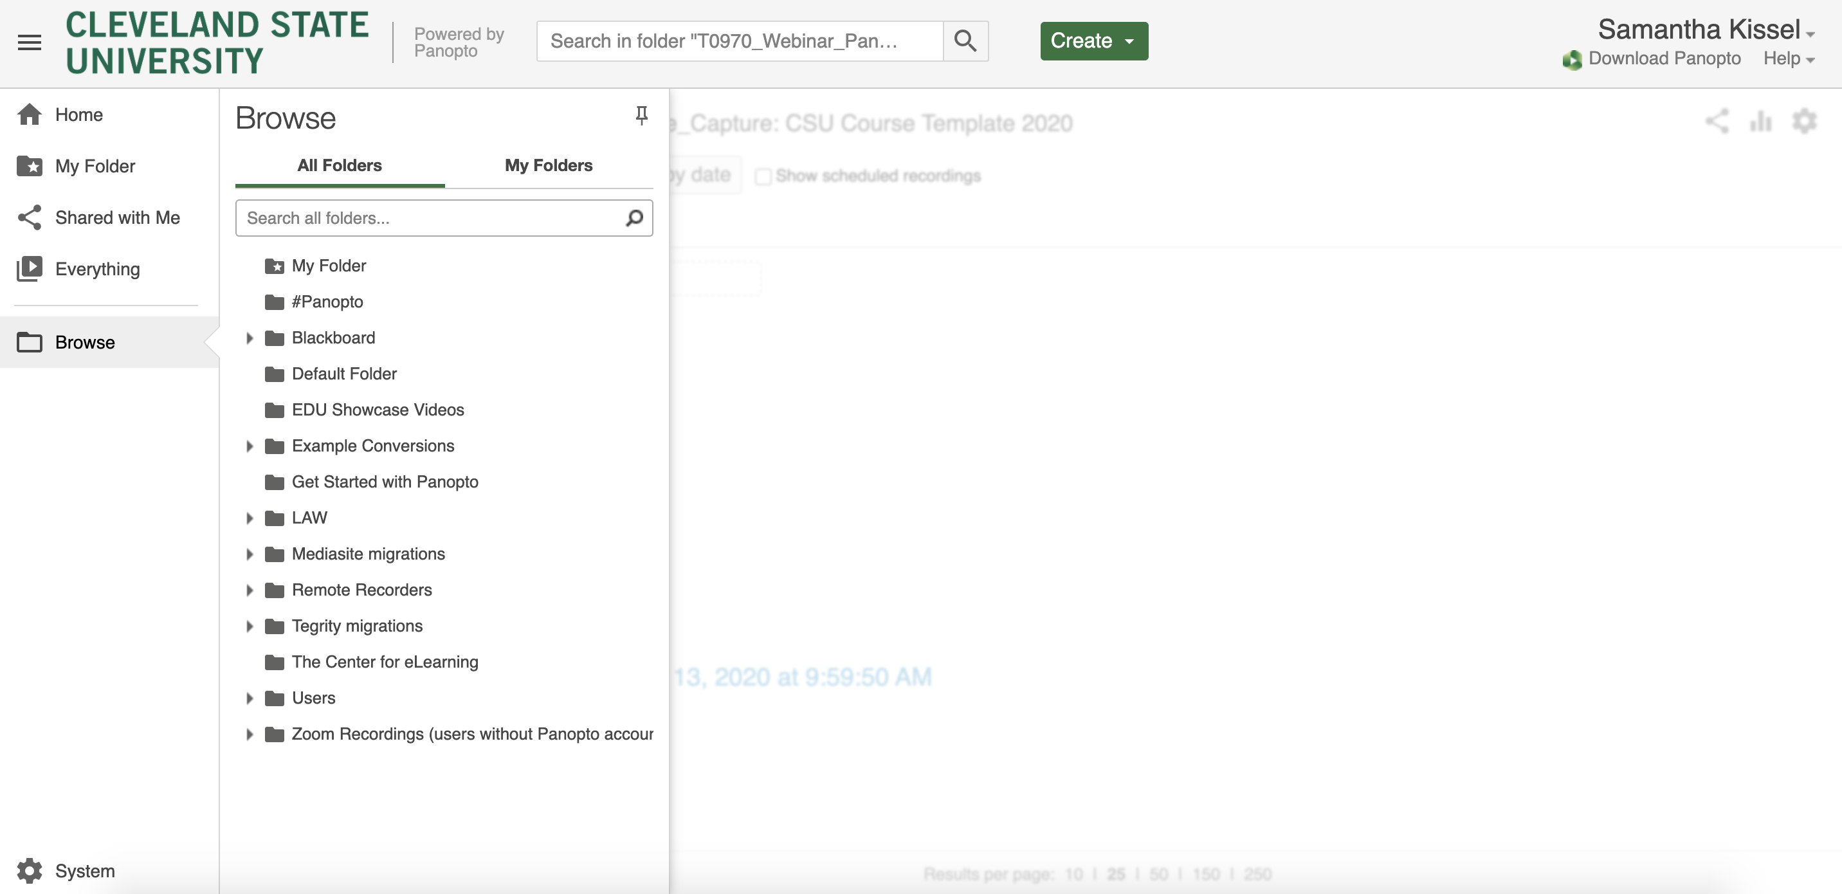

Slide 49
Any questions?

