Slide 2
Panopto Basics
Samantha Kissel and Cliff Maslovsky

Slide 3
Introduction
Both of us are Online Course and Materials Developers
Get more help at
https://www.csuohio.edu/center-for-elearning/panopto-lecture-capture
Getting Started with Panopto folder

Slide 4
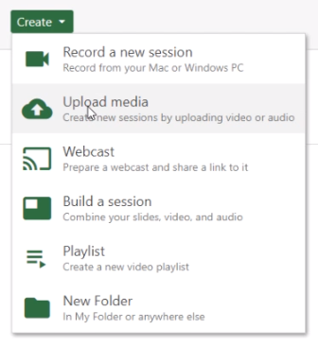
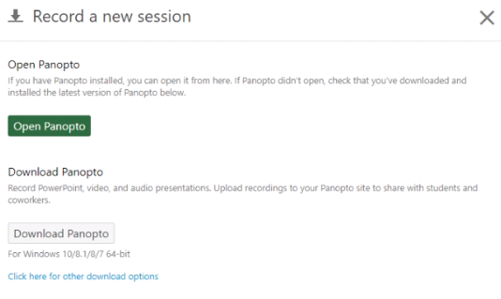
Installing Panopto
Click Create
Click Download Panopto

