Slide 1
New Faculty Orientation Blackboard and Online Teaching
Caryn Lanzo, Director
Center for eLearning, Cleveland State University

Slide 2
Outline of Topics
Introduction and where to get help
Getting started with Blackboard Teaching
Accessing Blackboard and Learning More
The CSU Template
Communicating with Students in Blackboard
Making Course Content Available
Creating Assignments and Assessments
Synchronous Sessions
Panopto

Slide 3
Introduction
Caryn Lanzo, Director, Center for eLearning
Get more help:
https://www.csuohio.edu/keep-teaching
https://www.csuohio.edu/center-for-elearning
Center for eLearning, (216) 687-3960; elearning@csuohio.edu

Slide 4
Getting started with Blackboard Teaching
Plan: Chunk your content into smaller bits to deliver online – create weekly modules or modules by chapter, etc.
Consider your time and workload when developing your course.
Choose tools you are comfortable with. You can do a lot with a few tools.
If you have large exams or papers that constitute a large percentage of students’ grade, consider creating smaller, more frequent exams or scaffolding material to build up to a larger assignment or paper.
Establish a pattern in your course so it becomes familiar to your students.
Create clear instructions and expectations for students.

Slide 5
Accessing and Using Blackboard
Login to Blackboard with your CSU ID@csuohio.edu and CampusNet password at https://www.csuohio.edu/center-for-elearning/blackboard-login. You can also find the link to Blackboard in the A to Z index on the MyCSU Homepage.
Existing Blackboard content
Course Copy Request Form
Blackboard getting started
Intro to Teaching with Blackboard (Self-Paced Course)
Quick Start Guide
Keep Teaching Website
Blackboard Help
Blackboard Help for Instructors

Slide 6
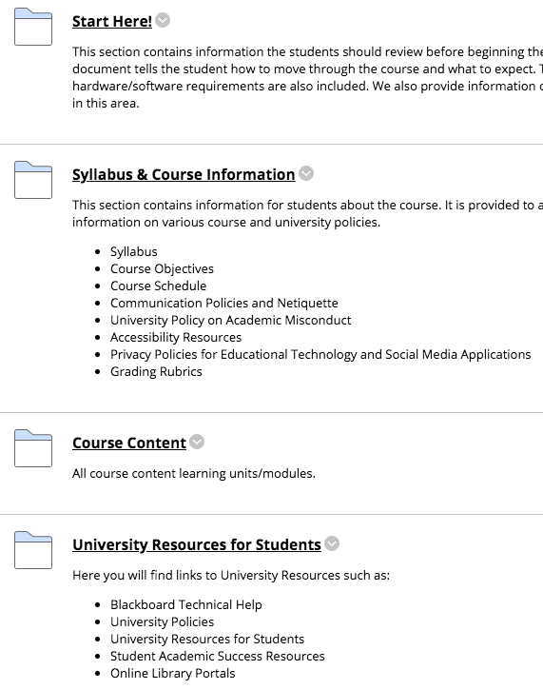
The CSU Template
CSU Template
CSU Template Request Form

Slide 7
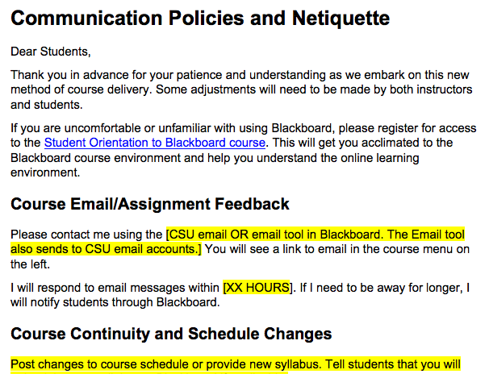
Communicating with Students in Blackboard
Communicate
Early & often
Establish a pattern
Set clear expectations
Communication Policies and Course Netiquette template

Slide 8
Communicating with Students in Blackboard
How to Send an Announcement
How to Send Email
How to Create a Discussion Board

Slide 9
Making Course Content Available Online
Select course from Courses menu
Turn on edit mode
Add course content using the action menu
Edit course content using the edit menu to the right of each item.
Create a content folder
Create an item
Add a weblink

Slide 10
Creating Assignments and Assessments in Blackboard
Create Assignment
Turnitin Assignments
Safeassign Assignments
Create Tests and Surveys in Blackboard
Request help with test creation

Slide 11
Synchronous Sessions
Blackboard Collaborate
Zoom
Best Practices for Synchronous Sessions
FERPA Consent Related to Classroom Recordings

Slide 12
Lecture Capture with Panopto
Faculty tutorial and Instructional Videos

Slide 13
Contact Us
Center for eLearning
elearning@csuohio.edu
216-687-3960
24/7 Support: (216) 687-5050, Option #2

Slide 14
Questions

