Slide 1
Kronos 8.1 Workforce Time Keeper
Cleveland State University
Approving time

Slide 2
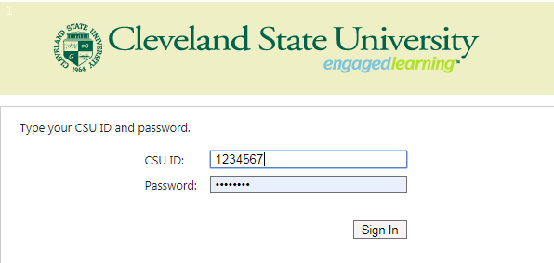
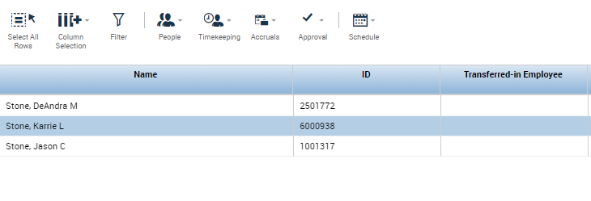
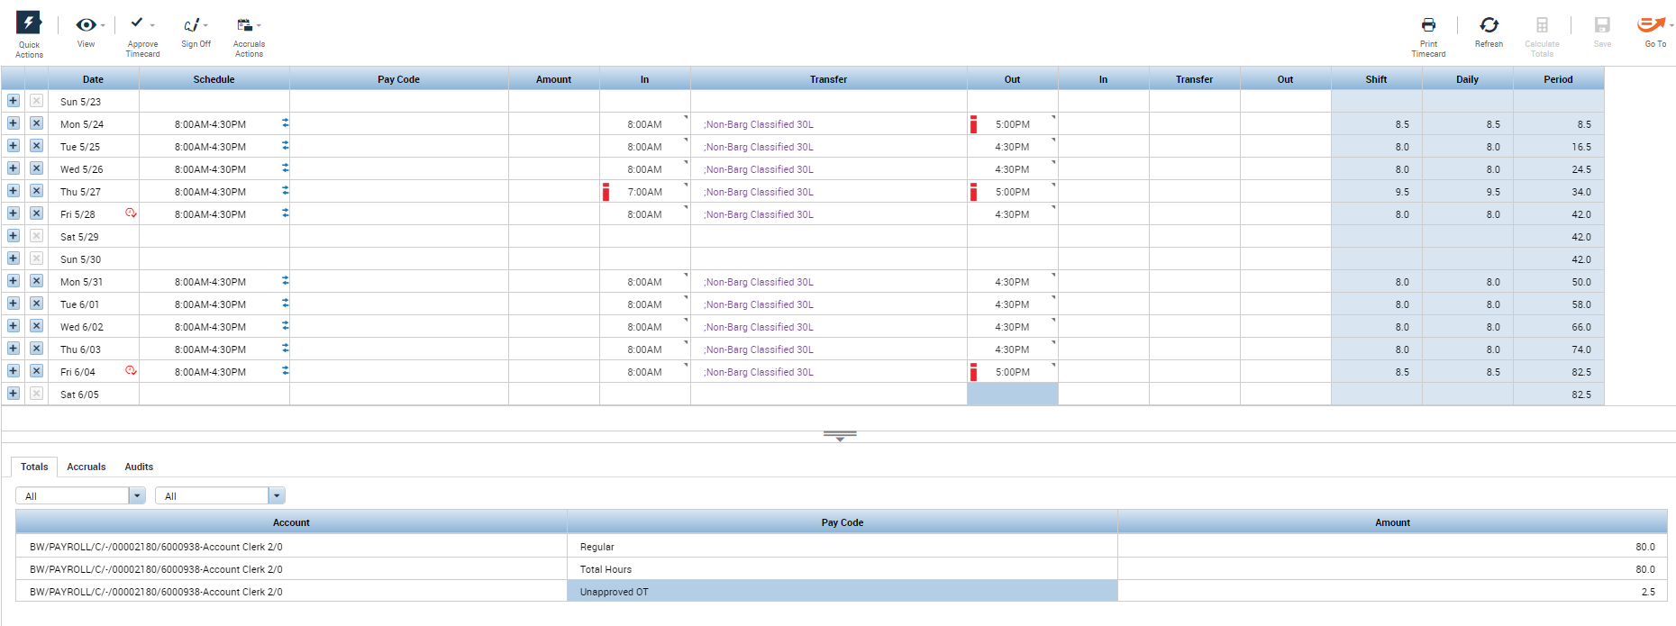
myTime
Approving Timesheets
Log on to myTime.
Open your web browser, navigate to CSUOHIO.EDU, and click the MYCSU tab.
Click on Employee Self-Service in the blue column and select myTime.
Enter your CSU ID and password, then click the Sign In box.
3
1
4
Supervisors/Managers
Upon login in, you will see your list of employees
Click on employee you want to approve to view timecard
3. If timecard is correct, click approve timecard, if employee has overtime, you will need to approve or move to comp time

Slide 3
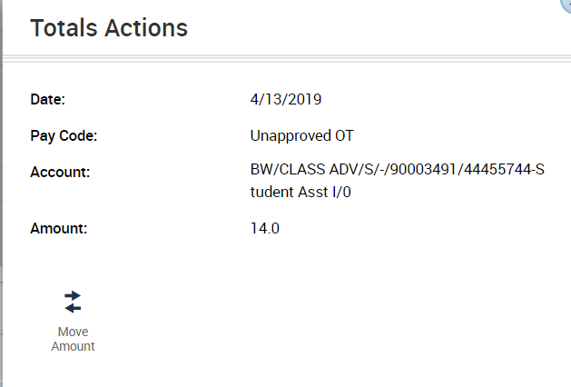
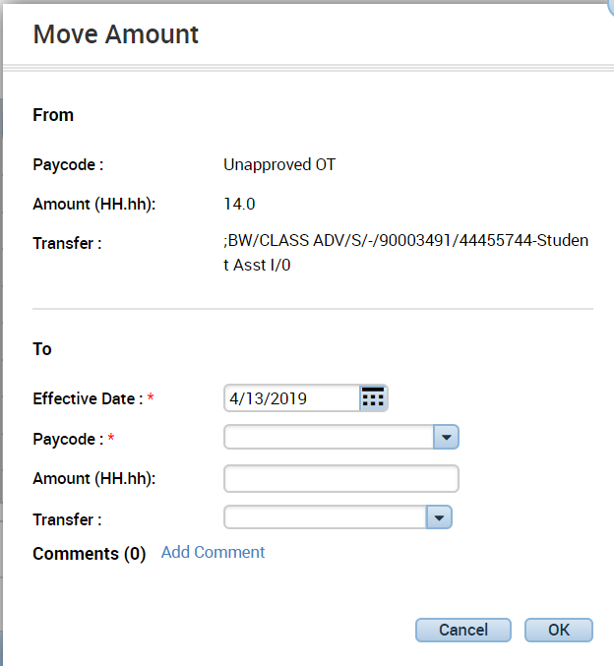
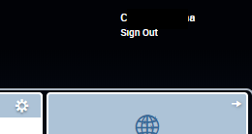
myTime
Moving unapproved time
Enter Employee ID on Quickfind-CSU
3
Double click on the employee, you should see all hours employee worked for the week.
*The red marks beside each time indicates either a early or late punch in or out.
Go to bottom on timecard, and select Unapproved OT, then right click on mouse.
(you may need to maximize screen by clicking this button at right top of screen)
When the total actions window opens, click move amount.
Once the second window opens, enter the effective date, pay code you desire to move the unapproved time to, the amount of hours, and the transfer account.
Then Click OK
*Paycode and Transfer include drop down options*
Upon Completion, when you view the employees totals, you will see the hours moved to “Paycode” you selected.
Upon verifying, click “Save and Exit”.
1
4
Exit myTime.
Click the Sign Out link below your name in the top right corner.

Slide 4
Notes: If you need to make edits to timecards, to change in or out punches, click on the date and time you want to correct, add correction and click save. To add punches, click on the day and add in and/or out punches.

