Slide 1

Increasing Connection in Remote F2F and Online Courses
Lessons and Strategies
Reinhild Boehme, LISW-S
School of Social Work, Cleveland State University
r.f.boehme@csuohio.edu

Slide 2
What We know...
Connection is everything!
Our students will learn from us if we matter to them, if what we teach them is relevant for them, and if they know that we care about them.

Slide 3

It's not like that...
If we think that all we need to do put the learning content into a nice box (Blackboard) and then wait for our students to open it, we have probably missed the mark.
This Photo by Unknown author is licensed under CC BY-SA.

Slide 4

Objections?
BB content for this week.
But they are adults, they should know that they have to follow the material week to week and submit their assignments!
I have no idea where to go...
This Photo by Unknown author is licensed under CC BY-SA-NC.

Slide 5
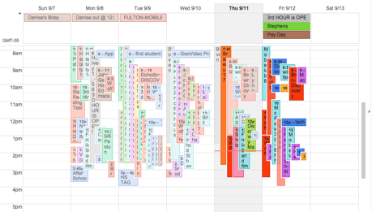
It's a Tsunami! (of assignments and content)
This Photo by Unknown author is licensed under CC BY-SA-NC.

Slide 6


Organizational skills – Normally learned over time!
You must acquire and use all these skills today!

Slide 7

Lessons Learned
Remote F2F

Slide 8

Everything Needs a STructure
Welcome and Check-In: Greet students by name.
Be inclusive of those off-camera.
Opening activity: Be Here Now. Video/Short Targeted Breakout Group
Very short review: Last week (Infographic)
Attendance
Main content/lecture - broken up by at least one breakout group and/or video.
What worked? Feedback and reminders.
Short check in after class, connection opportunity.

Slide 9
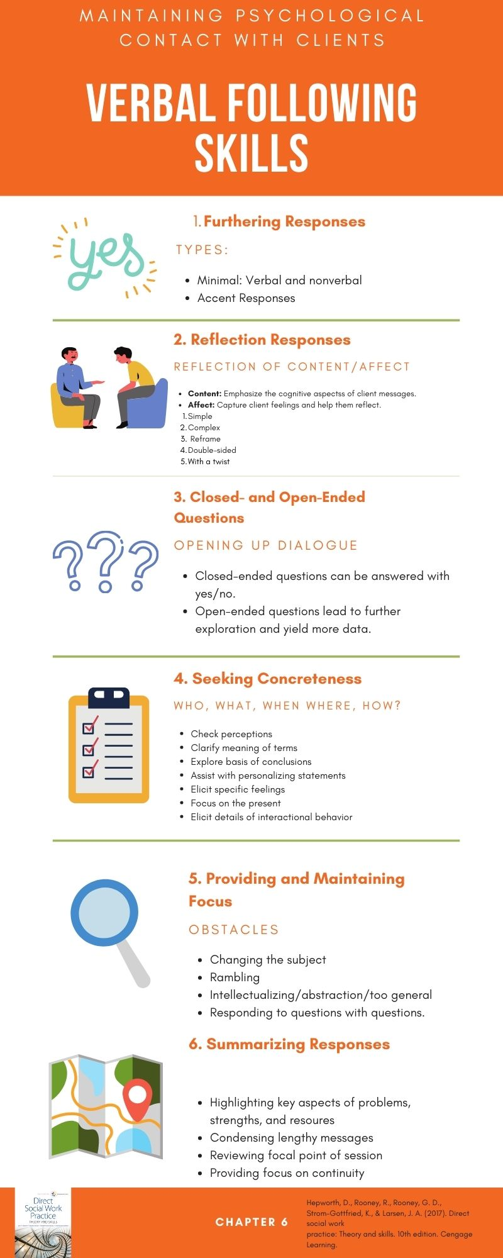
Make it visual, engage student with the content with specific tasks that are relevant to them.

Slide 10

Attendance Issues
Detect and Connect
A friendly check-in gives the message that the professor cares about you and wants you to succeed.
It's not a gotcha, it's a lifeline.

Slide 11

Use Experiential Learning in breakout Groups
Don't forget to use inclusive images.
After a short video about a standardized screening tool for suicide risk, ask students to role play the screening assigning a specific situation.
What does it feel like to engage in this type of screening?
What do I have to look out for?

Slide 12

Feedback Matters
When students provide constructive feedback, inasmuch as this is possible, integrate this feedback as quickly as possible sending the message (once again), that your students matter to you.
Could you send out weekly reminders about what is due?

Slide 13
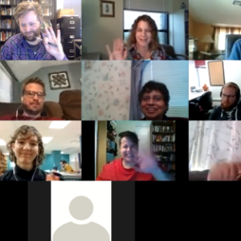
Connect now!
Offer short virtual connection opportunities after class. This allows students who need to connect with their instructor a built-in opportunity to do so and it also helps the instructor gauge "class mood."
This Photo by Unknown author is licensed under CC BY-SA.

Slide 14
Lessons Learned
Online

Slide 15
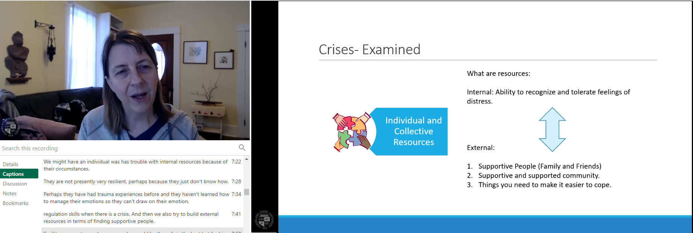
Where is my Professor?
Weekly video lectures bringing the content to life, making it relevant also build instructor-student connection.

Slide 16
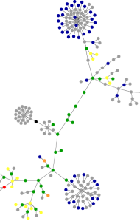
Where are my peers?
Create meaningful video assignments. Students can prepare and present content together via Zoom to foster experiential learning.
Beware of student schedules. Embody patience with each other and the process of connecting for the purpose of completing an assignment. Assist!
This Photo by Unknown author is licensed under CC BY-NC.

Slide 17

Everything Needs a Predictable Structure
Patterns are good.
Every week there will be the same or similar course components or assignments giving students the confidence to know that they know what is expected of them.
This Photo by Unknown author is licensed under CC BY-SA.

Slide 18
More is not always Better
Yes, there should be lots of opportunities to engage with the materials and each other.
However, more assignments do not automatically translate into more learning.

Slide 19
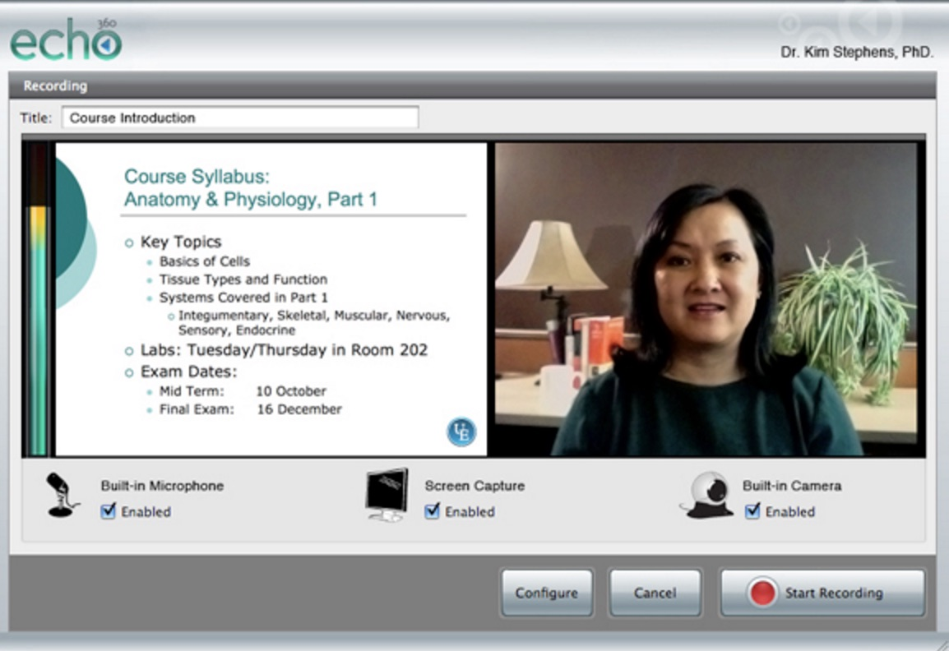
Experiential Learning = Meaningful assignments
This Photo by Unknown author is licensed under CC BY-SA-NC.

Slide 20
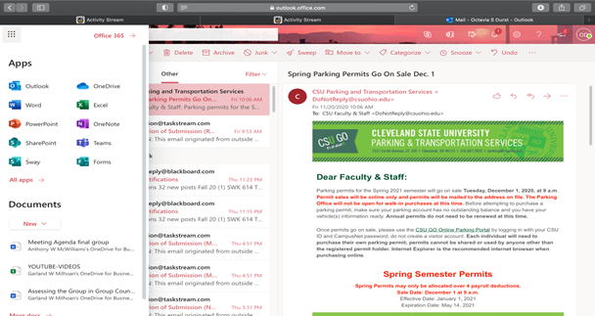
Spell it out!

Slide 21
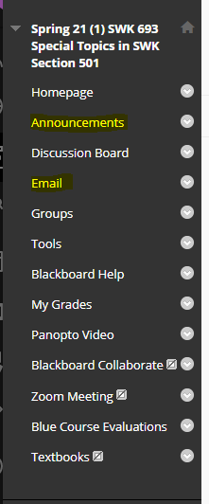
Say it Twice, Then Repeat
Weekly announcements help students keep up to date.
Some students don't read those. Send the information by e-mail, also.
Publish another announcement/send another e-mail shortly before something is due.

Slide 22
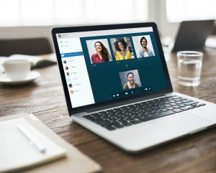
Virtual Office Hours
Three to five per semester (in addition/concurrent with regular virtual office hours), timed a week or two before major assignments.
This Photo by Unknown author is licensed under CC BY-NC-ND.

Slide 23

Emphasize Learning Community
This means responding to e-mails as quickly as possible always with the aim of building better connection to foster learning. The message always is: We are in this together.
Similar questions? Create an announcement/email.

Slide 24

Comfort with Discomfort
It's a Life Skill!

