Slide 1

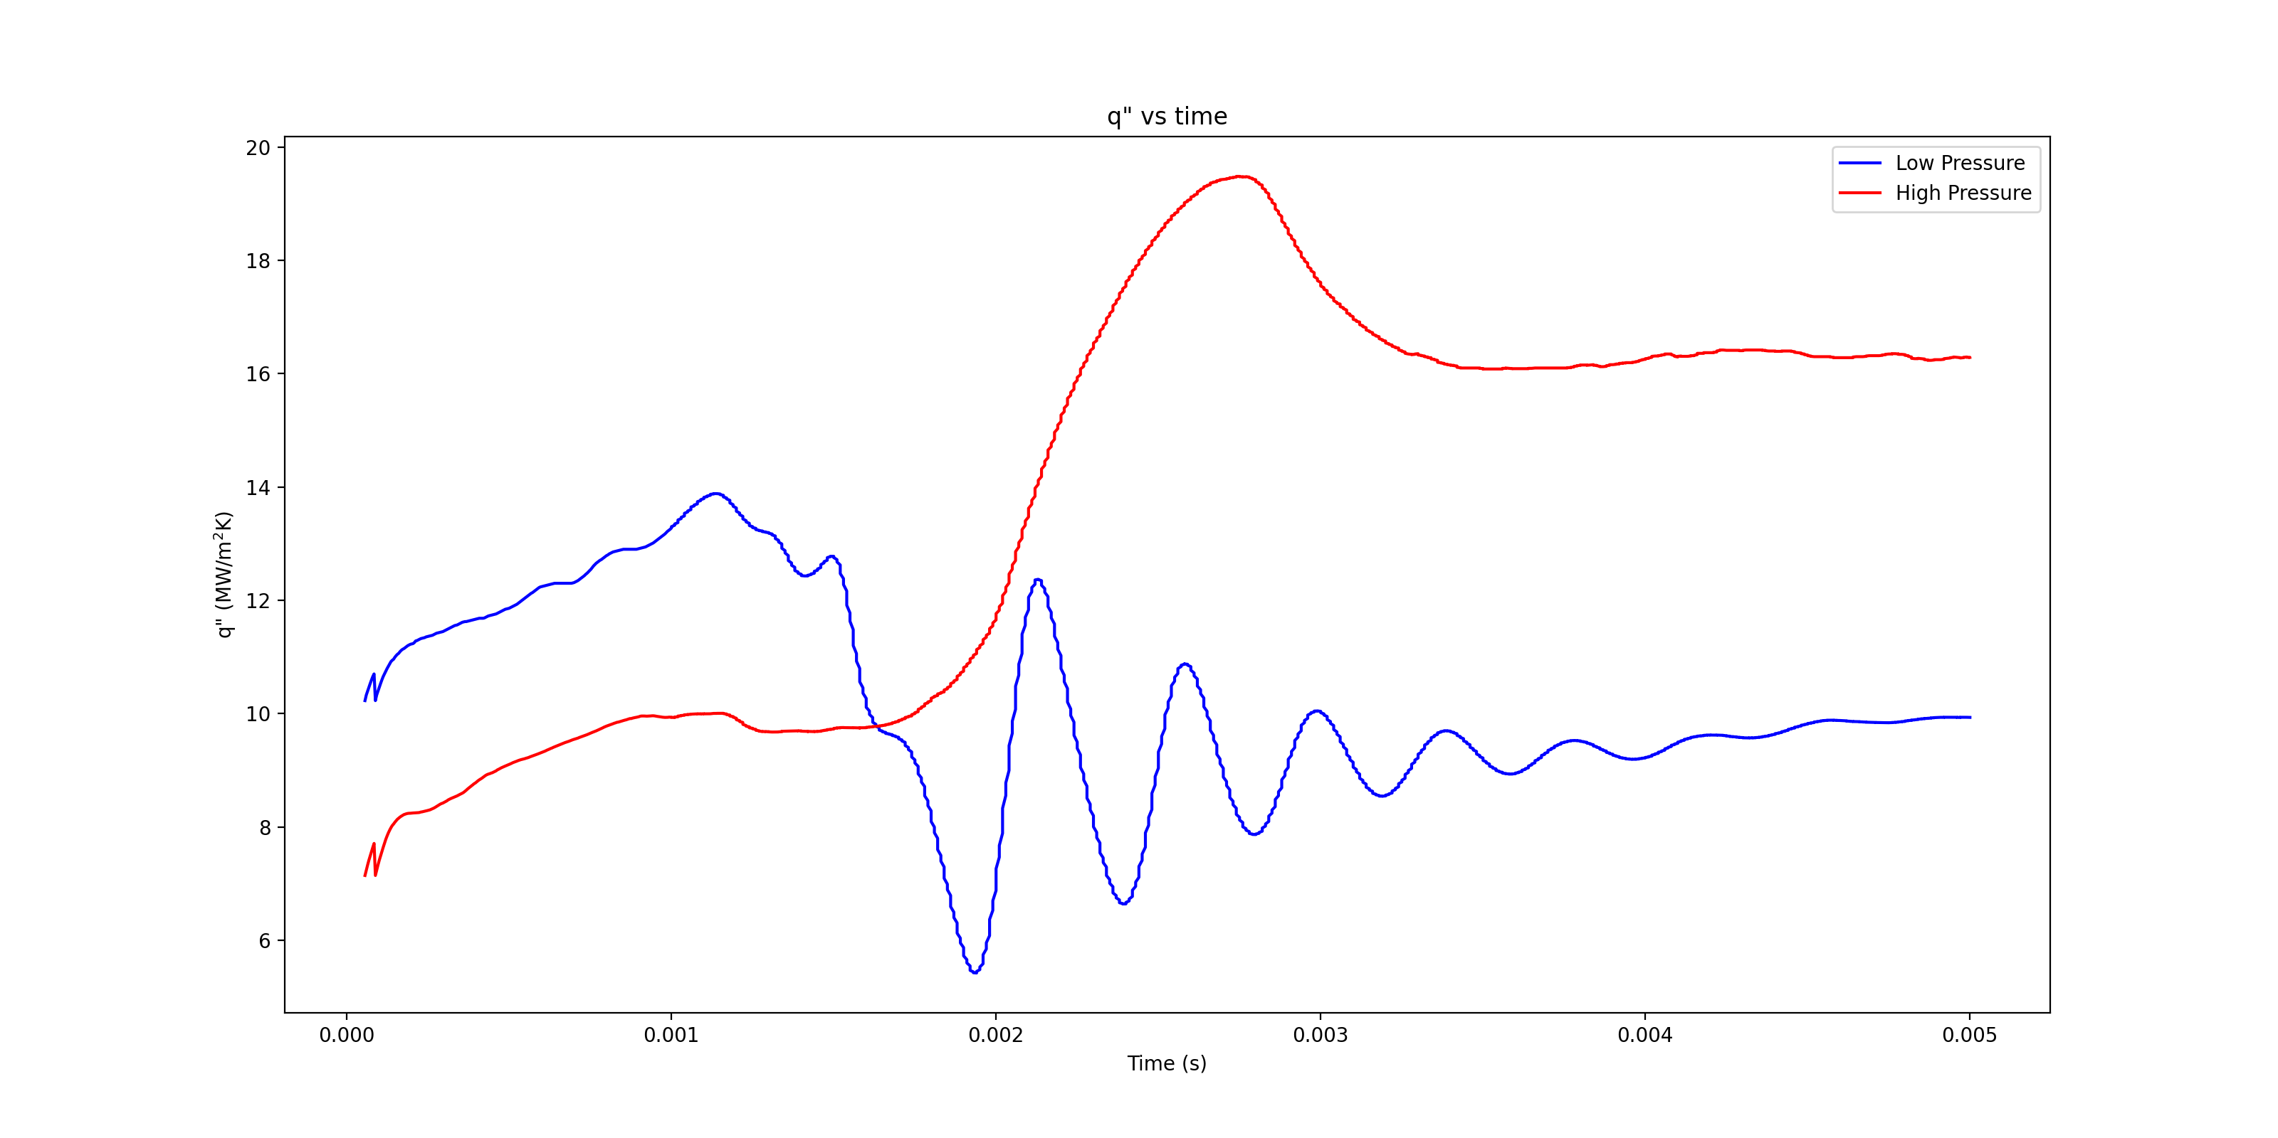

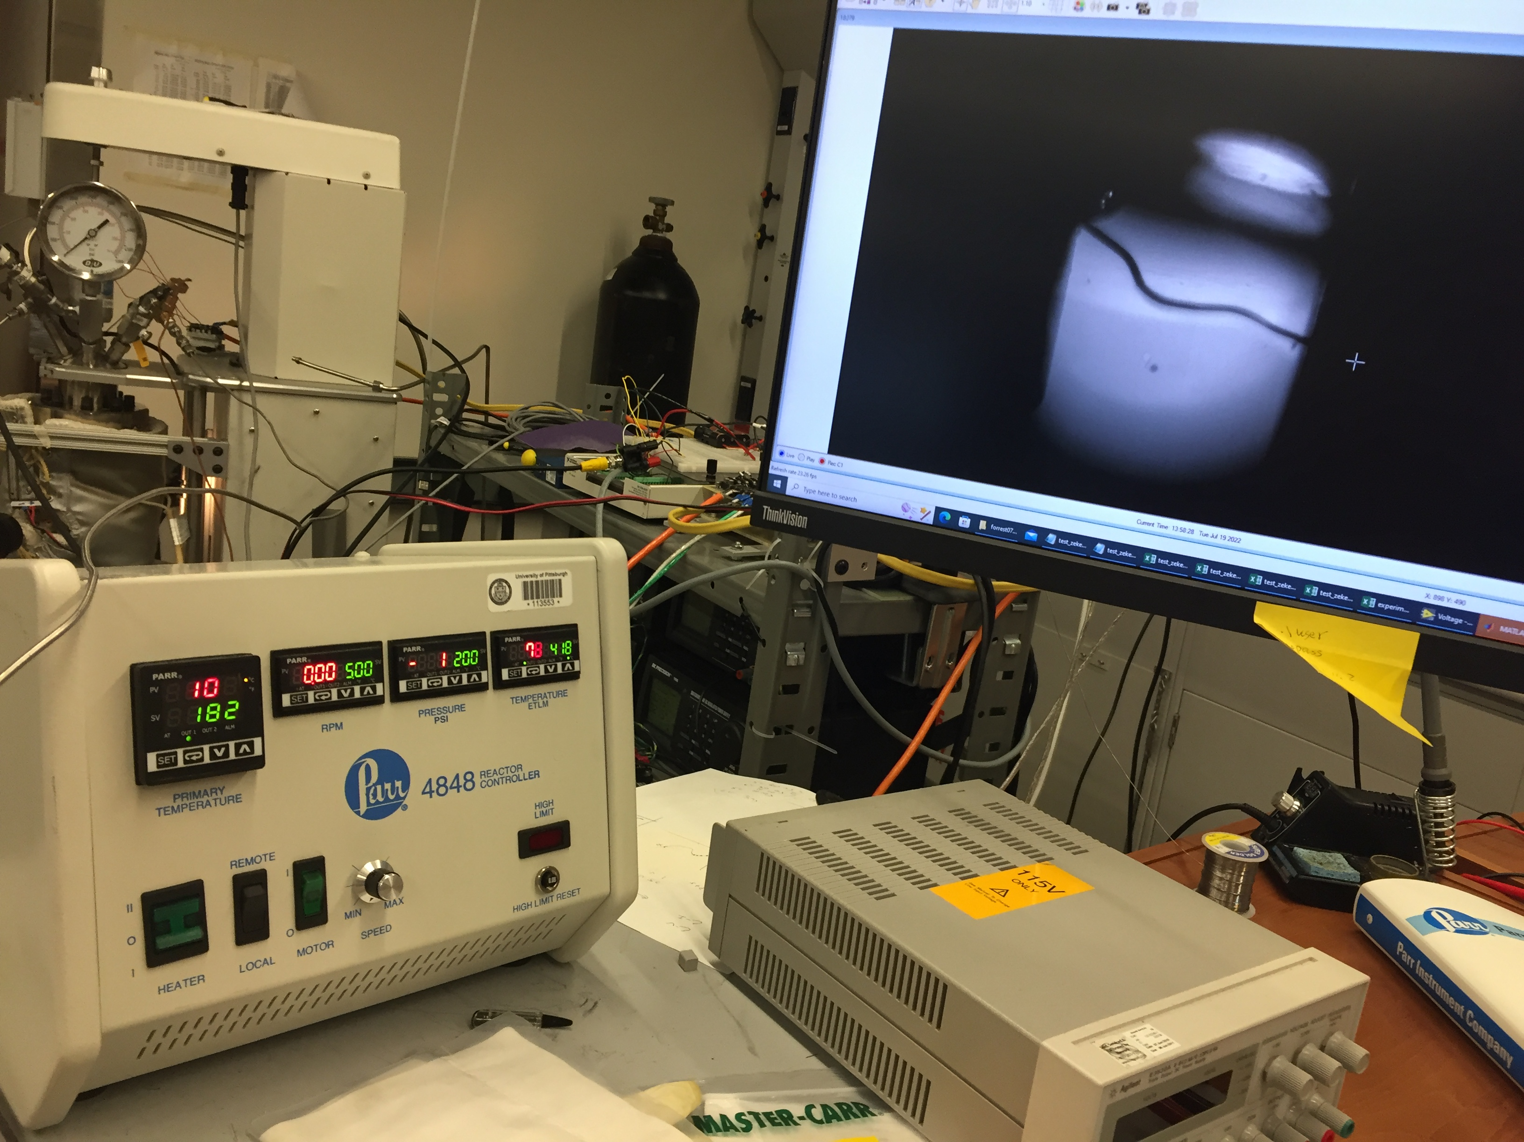
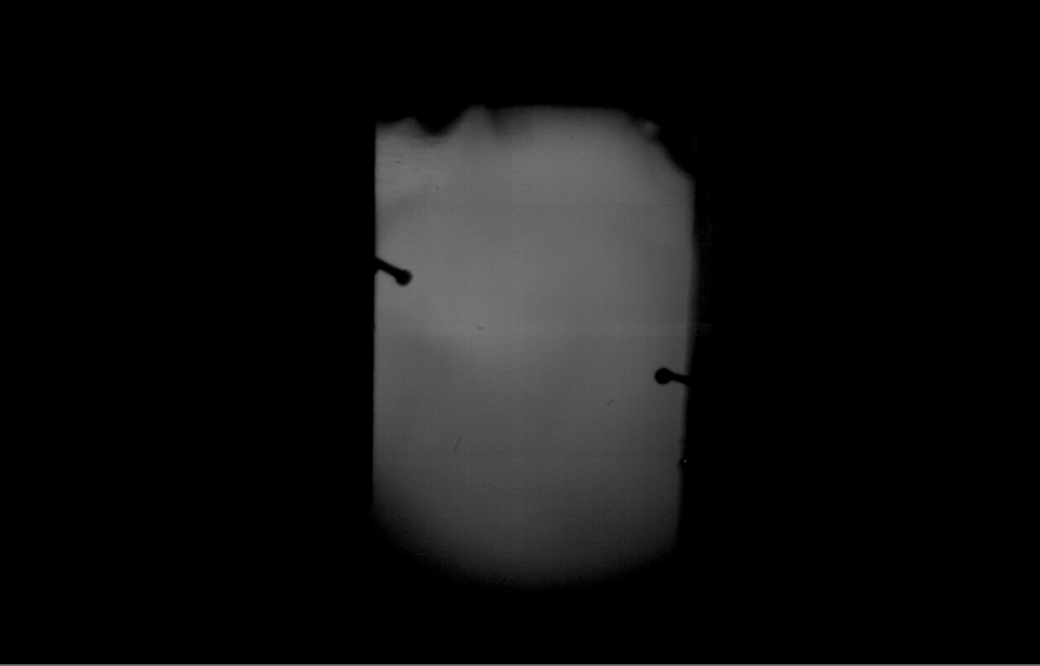
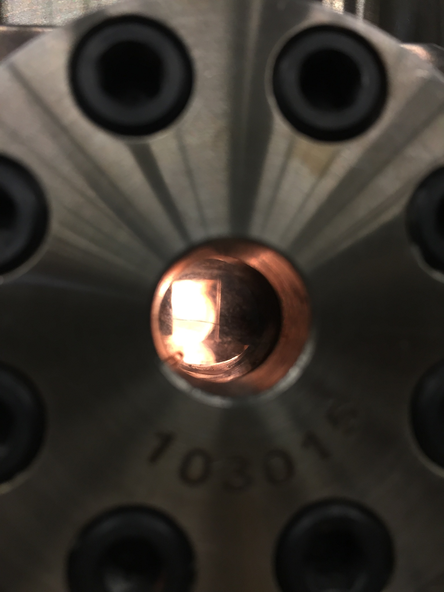
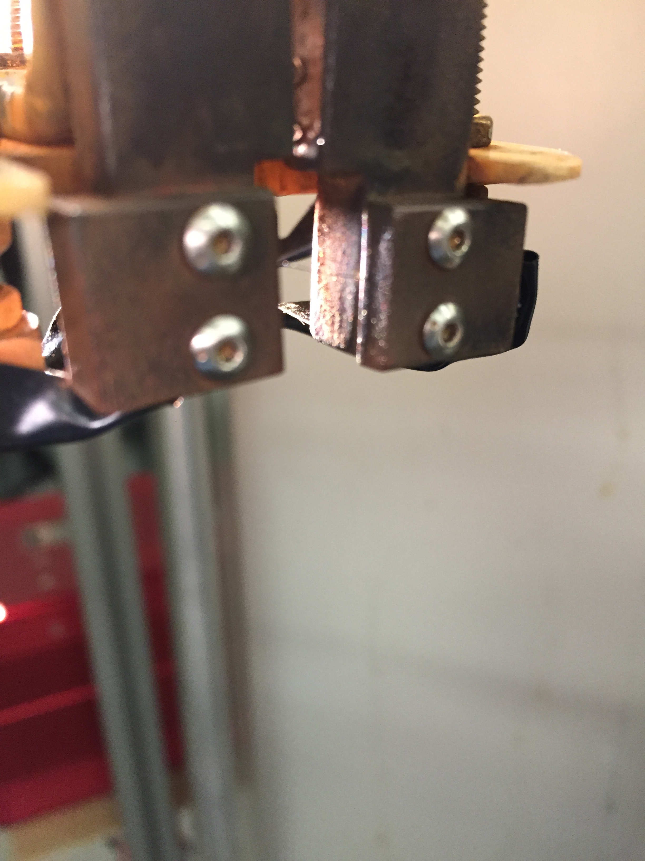
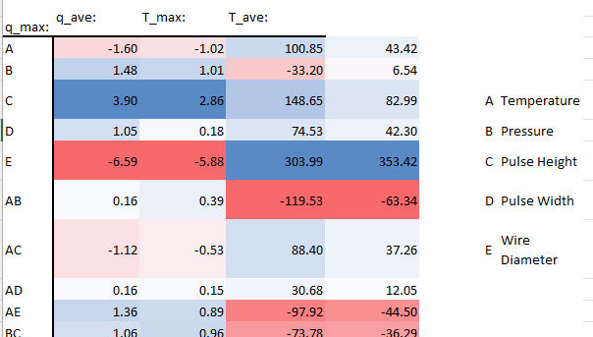
Pool Boiling: Adventures in Heat Transfer Enhancement and Nuclear Power Cooling
Osborn, Forrest; Villarreal, Ezekiel; Dr. Heng Ban
Department of Mechanical and Material Science, University of Pittsburgh, Pittsburgh, PA
Abstract
The researchers used joule heating was used to generate and measure heat transfer from a platinum wire inside a pressurized vessel of water. Voltage, current, and duration were varied to achieve transient boiling along a wire of approximately 10 mm in length. The ambient temperature of the water was varied between approximately 50 C and 100 C. Pressure was compared between atmospheric and approximately 69psi. Constant voltages of 5 V and 8 V were used to heat the wire for between 5ms to 30ms and the current was allowed to vary during the pulse. A slow-motion camera was also used to capture images of the resulting bubbles during the pulse. Temperature, voltage, and current data was collected and analyzed to produce boiling curves of transient boiling behavior. A 2k factorial analysis was used to analyze the impact of the 5 parameters studied/considered. An increase in the rate of heat transfer was observed during some of the tests. Plots resembling a mechanical vibrations mass-damper system were also observed and are presented as a possible analogous explanation of the behavior.
Figure 3. Boiling (above) current sent through thin wire to boil water inside reactor vessel. In many cases, the wire would briefly glow as this happened.
Figure 1. Methods. Heat transfer rate vs time data was collected by sending a short electrical pulse through a small wire. The blue line above appeared often during the experiment variations and the red line also occurred multiple times. Both results are highly repeatable
Figure 4. Burnout. (below)sending too much power through the wire resulted in the wire burning up under the water. our data.
Summary
.Increases in pressure resulted in higher heat flux.
.Possible behavioral resemblance to Mass-Damper Oscillation systems
Conclusions
.Wire diameter and power pulse height were found to have the greatest influence on heat transfer rate
.Temperature and pressure had a synergistic impact on temperature but not heat transfer
Acknowledgements
I wish to thank Dr. Alison Hake for offering useful feedback on my write-up and work.
The MTL lab at the University of Pittsburgh provided the use of the equipment and space to perform the experiments.
Funding: McNair Scholars Program
Figure 1. Parr front panel and wire photo. Temperature inside vessel and pressure displayed on Parr panel.
Figure 2. Vessel window and electrodes. Shown (left) viewport on the pressure vessel. The thin platinum wire can be seen against the backlighting. (right) The electrodes with faint image of wire between the electrodes.
Table 1. 2k factor analysis. Parameters analyzed using 2k factorial analysis

Slide 2
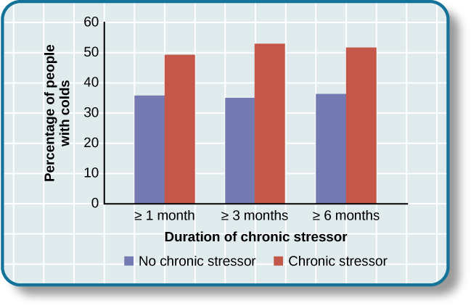
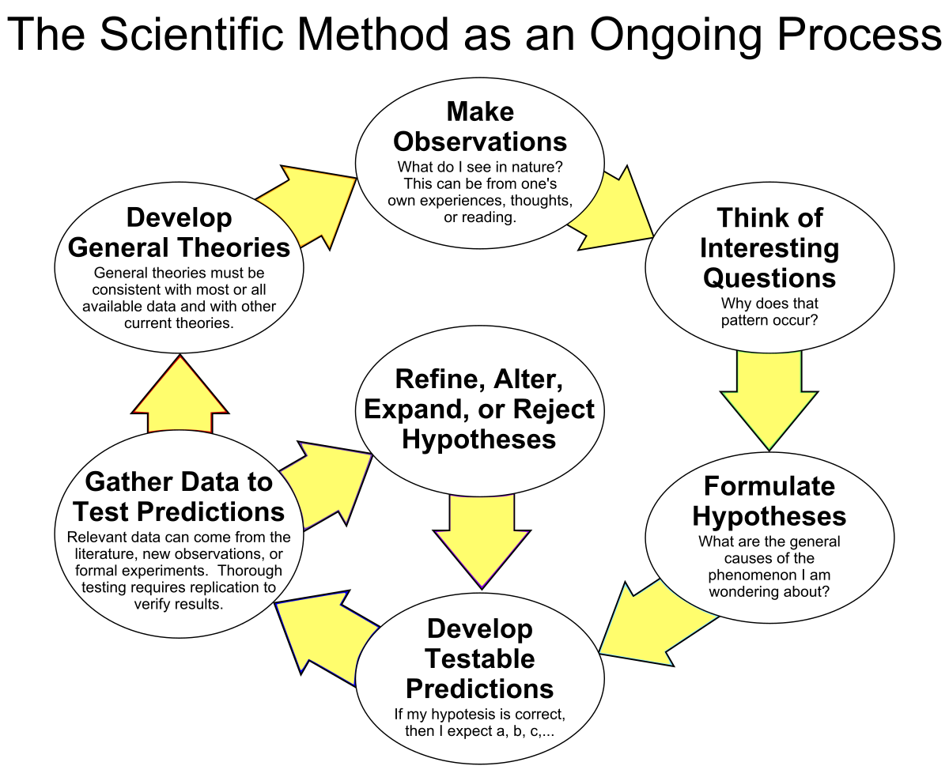


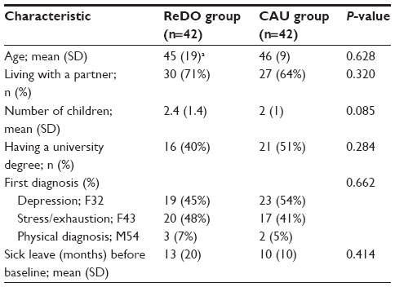
Tittle uses largest font (60)
Authors are in italics, your name underlined; 2nd largest font (48)
This is where your tittle goes
Your Last Name, Your name; other author’s Last Name, Name; Mentor
Department, Institution, City, Two letter state abbreviation
Authors departments 2nd largest font (48). If from different institutions or Dpts list all and create legend (* and **)
University Logo
Abstract
Text of your abstract goes here (250 characters or less).
.
.
.
.
.
.
.
.
.
.
.
Methods
Text 3rd largest font (36). Tittle of the section in bold
This Photo by Unknown Author is licensed under CC BY
Figure x. Name of the figure. Your figure legend should be concise and allow the reader reach their own understanding. Figure legends offer observations, not conclusions. You can use diagrams, tables, graphs, pictures, etc. This should be your data.
Figure x. Methods. Use a schematic or an image that best describes your methodology. Your figure legend should be concise and allow the reader reach their own understanding. Figure legends offer observations, not conclusions. You can use diagrams, tables, etc. You can also use figures from published papers but provide references.
Introduction
Summary
Bulletes with points to summarize
.
.
.
.
Conclusions
Bullets with Key Conclusions
.
.
.
.
Acknowledgements
List the people who help you with the research (including other team members, lab members, librarians, office personnel, etc. You don’t necessarily have to Acknowledge the mentor since they are authors (akin to thanking yourself) but you can do it.
Funding: McNair Scholars Program
Results
Figure 1. Name of the figure. The first figures of your posters can be used as an introduction to help the audience understand the topic you are researching. Your figure legend should be concise and allow the reader reach their own understanding. Figure legends offer observations, not conclusions. You can use diagrams, tables, etc. You can also use figures from published papers but provide references.
This Photo by Unknown Author is licensed under CC BY-NC
Figure x. Name of the figure. Your figure legend should be concise and allow the reader reach their own understanding. Figure legends offer observations, not conclusions. You can use diagrams, tables, graphs, pictures, etc. This should be your data.
Legend text uses the smallest font (28). Tittle of the section in bold.

