Slide 1
Tools of Engagement
Using Blackboard Discussion Forums & Zoom Breakout Rooms to Enhance the Social Element in Your Remote Classroom
(without overdoing it)
Maria Gigante Assistant Professor of Practice CSU School of Film & Media Arts

Slide 3
Tool Box
Discussion Forum (Blackboard)
Breakout Rooms (Zoom)

Slide 4
Discussion Forums
Main focus
The “trusty screwdriver” of remote learning tools (at least mine)
How to use it better (so you don’t strip the screws)

Slide 5
Then and Now
Submitted this proposal in August 2020, based on SP20 (triage!)
Then (SP20): Discussion Forums = ☺
Now (SP21): Discussion Forums = 😐
How to bring it back to ☺

Slide 6
Building Community in a Remote Environment
Inspiration: The Social Element why it matters to me
Personal experience and findings
“Research:” Student Testimonials
What I’ve learned: My Take-Aways

Slide 7
The Social Element
SP20: Quarantine, Isolation, Change = Mental Struggles
FA20: Remote Becomes the New Normal, Students & Faculty are adapting, but still no end in sight = Mental Struggles & Overwhelm
SP21: Adaptation has Settled in = Student Overwhelm is Strong!

Slide 8
How Best To Engage Virtually?
In the quest to build a robust remote learning experience and social engagement with students, we need to understand how they’re receiving it.
GOAL: Find the middle ground: Use, don’t abuse!

Slide 9
The Other Side of the Screen
Where are the students at?
What works for them, and what is problematic?
Their advice to us…

Slide 10
Student Testimonials…
2nd Year

Slide 11
Just. Too. Much.
“Last semester I had one class that required weekly posts; this semester 4 out of 5 of my classes require weekly posts, or more. I think lot of professors think that since we’re not meeting, they need to assign tons of discussion forums to make up for that. But it ends up being very artificial, and overwhelming because of all the deadlines.”

Slide 12
Wait, Don’t Replace
“I think Discussion Forums are a bit counter-intuitive. It’s more effective to try to have an in-class discussion, even if it is on Zoom. Even if students are not speaking, they’re still listening and engaged, more so than just quickly writing something down to meet a deadline. I understand that Professors get frustrated by staring at a room full of silent students, but really, if you just give us a few more seconds, someone will speak up. There is just a bit of a digital delay for us.”

Slide 13
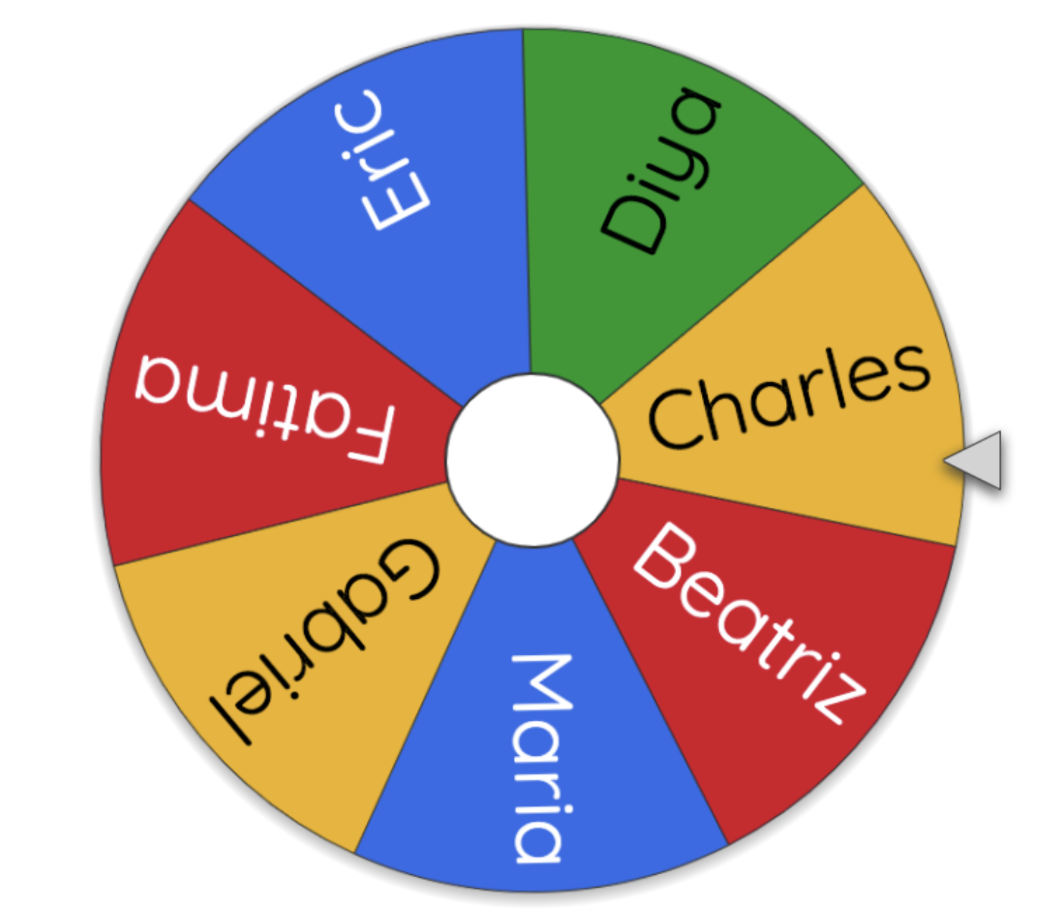
Wheel of Names
Students won’t talk? No one raises their hand? Try Wheel of Names! https://wheelofnames.com/

Slide 14
Lost At Sea
“I took a film studies class that was entirely online and each week we had to write a 500 word post on some elaborate topic that I had to basically teach myself, and that I barely understood. In one week. Are you kidding me? I hate Discussion Forums.”

Slide 15
Jammed Up Workflow
“I’ve noticed that a lot of people don’t even write their main post until the last minute. So if you’re requiring students to respond, sometimes we’re all waiting until the day before for people to actually post, so that we can respond. Our grade shouldn’t depend on waiting for others to do their work.”

Slide 16
Empty Words
“Because I don’t always feel like I understand things as well as other students, when I have to respond to others this is usually me: “Great job! I agree! Nice work.” That’s me being lazy, or at least not knowing what else to say.”

Slide 17
But it gets better…

Slide 18
Middle Ground
“I feel like at first, professors realized they had a new tool that they had access to, and was like “Cool, let’s use this.” And I felt the same way, too! But then, the more and more they relied on it, the more it just felt like extra work tacked on.
But I think there is a middle ground, though. Somewhere in between. But I don’t think any of the classes I’ve been in have found where that is.”

Slide 19
Free Form
“In one of my classes, the professor assigns a topic of discussion, but we can respond however we want. This often allows students to go off on tangents and I love that. I’m always reading stuff that I’d never thought of and then I respond and say, ”Hey dude, I totally didn’t see it that way.” And the professor gives us two weeks to do it – so come on, you have no reason not to get it done.”

Slide 20
Being Seen
“I think it’s really important to have the professor respond to your posts, to engage with the students to make sure they’re learning and growing. It’s great to be able to have that exchange with them.
Also, if you’re making a Discussion Forum, please don’t make them disappear after a certain point! Sometimes I am not able to read what the professor wrote in response to my post because the forum disappears after the deadline.”

Slide 21
Open and Easy
“This semester I’m taking a poetry workshop and I absolutely love the discussion forum. All you have to do is whenever you write something, you upload it to the appropriate forum, and you’re supposed to respond to 2 of your classmates. But I – and I think all of us at this point – respond to many more, because we’re just so excited to read each other’s work. I really like being able to engage with people on my own time and not having it be so deadline heavy.”

Slide 22
Discussion Forum: How to “Be Best”
Quality over quantity
Use them strategically, and specifically (per your field)
Allow students some freedom
A great tool for self-expression, thought-sharing and creativity
Make it a fun place, a place they want to hang out (and respond to others)
Mix up your content (don’t always ask for the same thing)
Make sure there is quality communication happening

Slide 23
Zoom Breakout Rooms
Gets students talking in a group
Auto-assign, manual, or student select
Give specific directive – what do you want them to talk about?
Well-suited for exercises or projects (i.e. in film, script table reads)
Less well-suited for “discuss the reading” – instead, provide specific questions to lead them.

Slide 24
Good Uses for Breakout Rooms
Group project meetings
Exercises or group assignments
Answer questions as group
Film: Script Table Reads

Slide 25
Breakout Rooms: The Set Up
Manually or Automatically assign students into a group
Or, choose “let participant choose”
If you need to add or make changes, click on “recreate”

Slide 26
Breakout Rooms: Clarify Expectations
Clear directions:
What are you asking them to do?
What should they report on?
Who will report? All? One person?
How long will they have to work in the breakout room?

Slide 27
Remote Learning: It’s Fluid
As remote teaching evolves, use of applications and tools will evolve
Students adapt and outgrow quickly – check in with them from time to time
What worked well in FA20 won’t necessarily working well in SP21
As instructors become more tech-savvy and comfortable with remote instruction, student workload seems to increase, and cause overwhelm and burnout

