Slide 1
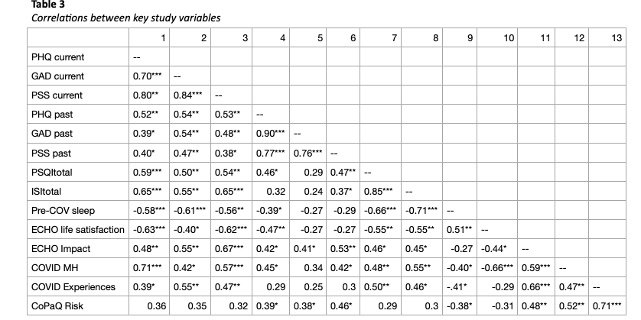
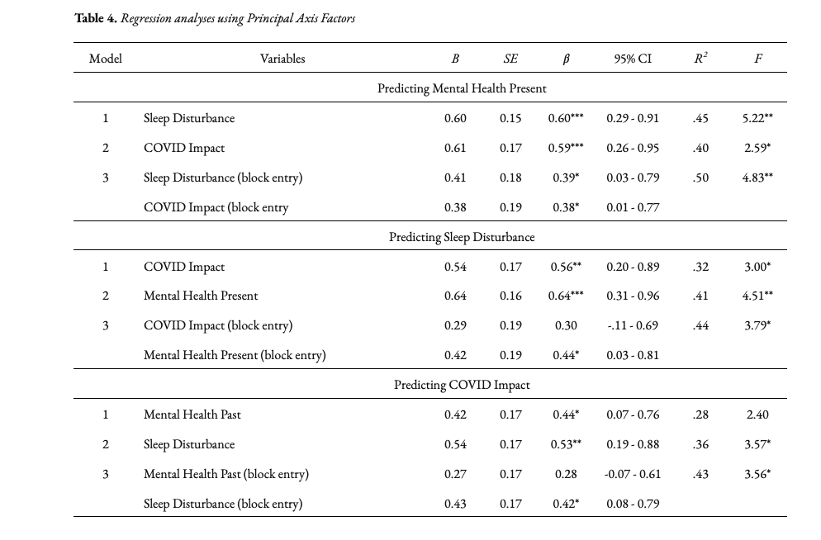
Understanding the Role of Sleep on Emerging Adult Mental Health in the COVID-19 Pandemic Dywayne Johnson, B.A., & Kathleen W. Reardon, Ph.D. Multimethod Assessment of Personality and Psychopathology (MAPP) Lab Cleveland State University
Introduction
The Critical Role of Sleep
Past research has shown that sleep is deeply connected to mental health (Samji et al., 2021).
Sleep and Mental Health
One study examined the prevalence rate of perceived stress among college students at 43.7% (Wang et al., 2020).
Sleep Disruption and Mental Health in the COVID-19 Pandemic
Scientific studies reported recent cases of mental health problems have significantly increased since the start of the Covid-19 global pandemic.
Wang et al. (2021) found stress is a commonly known indicator that causes individuals to feel anxious and depressed during the pandemic.
Objectives
Hypothesis 1a: Emerging adults who report higher rates of sleep quality are less likely to report symptoms of anxiety or depression.
Hypothesis 1b: Emerging adults who report lower rates of current stress are also less likely to report symptoms of anxiety or depression.
Hypothesis 2a: Emerging adults who report being strongly impacted by the COVID-19 pandemic are more likely to show an increase in mental health symptoms when comparing current functioning to pre-pandemic symptoms.
Hypothesis 2b: Emerging adults who report the impacts of the COVID-19 pandemic are more likely to endorse higher rates of stress and sleep disruption.
Methods
Measures con’t.
Impact of COVID-19
Effects of COVID-19 Outbreak-Adult- Environmental Influences on Child Health Outcomes (ECHO).
COVID-19 and Mental Health Impacts.
COVID-19 Pandemic Mental health Questionnaire (CoPaQ).
Discussion
Finally, although a history of mental health problems may predispose individuals to experience more of an impact from the COVID-19 pandemic, the current experience of sleep problems was a stronger contributor.
Sleep hygiene indicates that young adults must have reported poor sleep quality by having trouble falling asleep or maintaining sleep (Peach et al., 2016).
The current study could provide further research whether applying physical training would predict sleep improvement and stress reactivity(Cavalcanti et al., 2021).
The current study shall expand further investigation by using music as an objective instrument that predicts better sleep quality(Harmat et al., 2008; Lund et al., 2020).
Finally, the current study could provide more evidence that sleep patterns determine personality traits in young adults (Knížková, K, 2016; Gaur et al., 2021; Stephan et al., 2018; Khanwani, G., 2019).
Conclusion
Taken together, the present study highlights the critical role that sleep problems play in emerging adulthood by exacerbating other problems individuals may be experiencing, thus creating a negative feedback loop that leads to more severe impairment.
Results
References
Buysse, D. J., Reynolds, C. F., 3rd, Monk, T. H., Berman, S. R., & Kupfer, D. J. (1989). The Pittsburgh Sleep Quality Index: a new instrument for psychiatric practice and research. Psychiatry research, 28(2), 193–213. https://doi.org/10.1016/0165-1781(89)90047-4.
Cohen, S. and Williamson, G.M. (1988) Perceived Stress in a Probability Sample of the United States. In: Spacapan, S. and Oskamp, S., Eds., The Social Psychology of Health, Newbury Park, CA, Sage, 31-67.
Kroenke, K., Spitzer, R. L., & Williams, J. B. (2001). The PHQ-9: validity of a brief depression severity measure. Journal of general internal medicine, 16(9), 606–613. https://doi.org/10.1046/j.1525-1497.2001.016009606.
Morin, C. M., Belleville, G., Bélanger, L., & Ivers, H. (2011). The Insomnia Severity Index: psychometric indicators to detect insomnia cases and evaluate treatment response. Sleep, 34(5), 601–608. https://doi.org/10.1093/sleep/34.5.601.
Rek, S. V., Bühner, M., Reinhard, M. A., Freeman, D., Keeser, D., Adorjan, K., Falkai, P., & Padberg, F. (2021). The COVID-19 Pandemic Mental Health Questionnaire (CoPaQ): psychometric evaluation and compliance with countermeasures in psychiatric inpatients and non-clinical individuals. BMC psychiatry, 21(1), 426. https://doi.org/10.1186/s12888-021-03425-6.
Spitzer, R. L., Kroenke, K., Williams, J. B., & Löwe, B. (2006). A brief measure for assessing generalized anxiety disorder: the GAD-7. Archives of internal medicine, 166(10), 1092–1097. https://doi.org/10.1001/archinte.166.10.1092.
Methods
Participants
Participants were 18-25 (M_{age} = 21.16 years; SD = 1.73 years).
Participants were recruited through oral communication, flyers, social media content, and craigslist were sent the online questionnaire through the Qualtrics platform.
Measures
Mental Health
Patient Health Questionnaire-9 (PHQ-9).
Generalized Anxiety Disorder-7 (GAD-7).
Perceived Stress Scale(PSS).
Sleep Disturbance
Pittsburgh Sleep Quality Index(PSQI).
Insomnia Severity Scale(ISI).
Covid-19 Related Impact to Sleep.

