Slide 1

Discussion Board Reboot
Dr. Candice Vander Weerdt
Department of Management

Slide 2
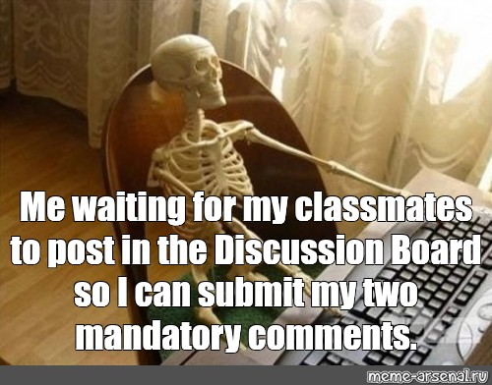
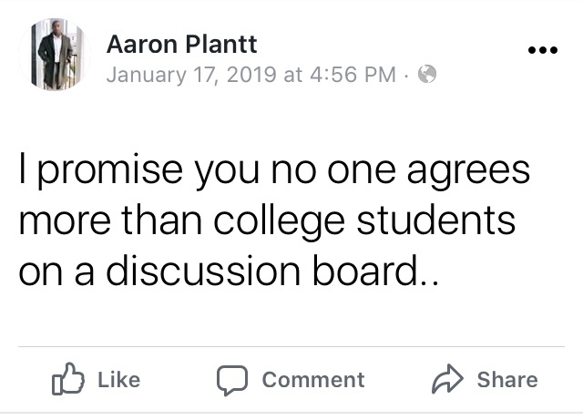
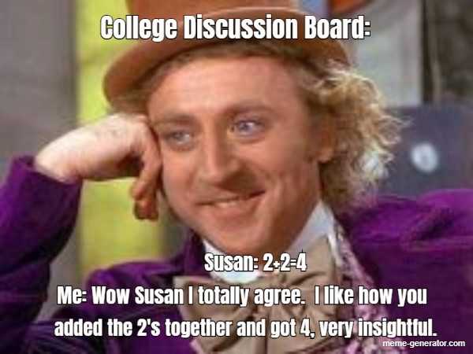
Discussion Board Pains
  Unengaged comments
      Posting on the final day
      Agreement without insight
  Heavy load of grading
      Length requirements
      Posting and commenting guidelines
      Credit awarded for completion, not competence
  Failure to integrate material
      Based on opinion without support
      Poor substitute for in class discussion

Slide 3

But does it have to be?
  Social media shows us we can engage meaningfully online
  Medium gives introverted and shy students an opportunity to contribute
  Unmoderated discussions allow for the free flow of ideas necessary to critical thinking

Slide 4

Alternative
Programmed conflict – the devil’s advocate approach
Student autonomy – foster independence and curiosity

Slide 5

Presentation
Discussion
Reflection
Each week a few students present their topic to the discussion board.
All students view the presentations and discuss the topic.
Course exams include reflection questions regarding the topics presented.

Slide 6




Assignment Instructions
Sign-up for Presentation
Detailed How-To
Create a course wiki with a schedule and description of topics. Students enter name next to available topic.
A complete manual, with screen shots, is available for how to create the video and post to Blackboard.
Presentation Reminder Email
Example Videos
Due dates will not really work in Blackboard, so I email the student who are presenting a few days prior.
Sample student videos (with permission) are posted to show expectations.

Slide 7
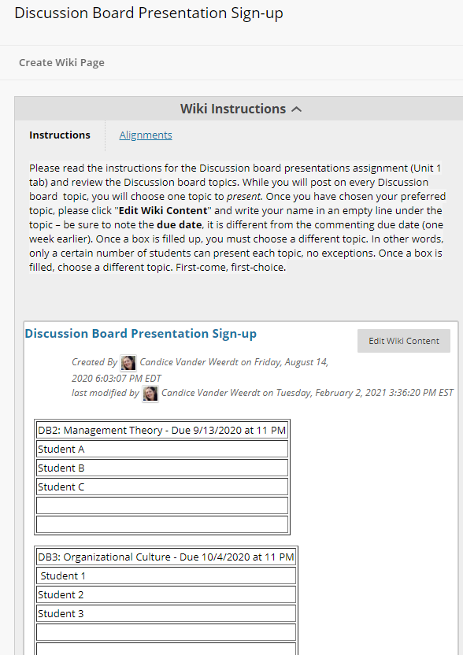
Sign-up Wiki
Open immediately
Graded – zero points but allows for a due date
Close to editing once everyone has signed up (or been assigned)

Slide 8

Reminder Email
Good Afternoon DB3 Presenters,
This is a friendly reminder your DB3 presentation is due this Sunday, 2/23 at 11 PM. Please refer to the attached instructions and be sure all elements are included in your video. Thank you to Students A, B, and C for already submitting.
Also, please be sure to still make 2 comments to the discussion board next week. You are still required to comment, even if you presented.
Have a good weekend,
Dr. Vander Weerdt

Slide 9
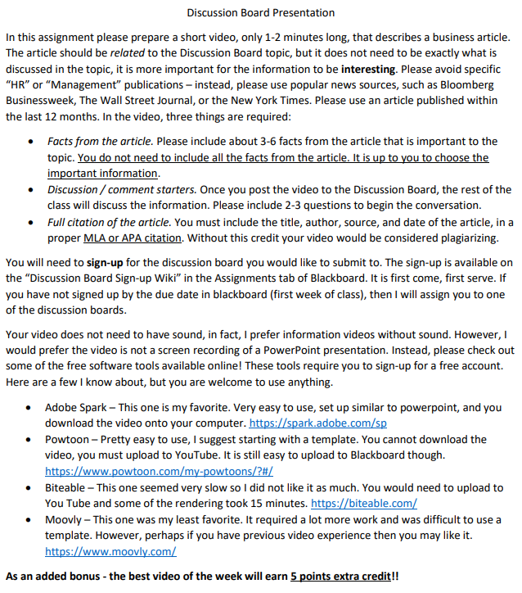
Instructions
Document available upon request

Slide 10
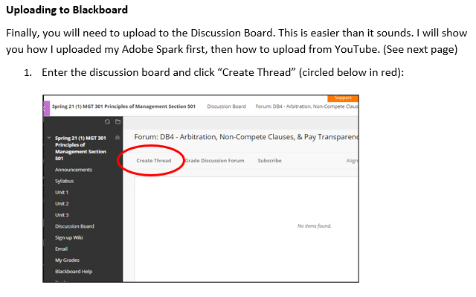

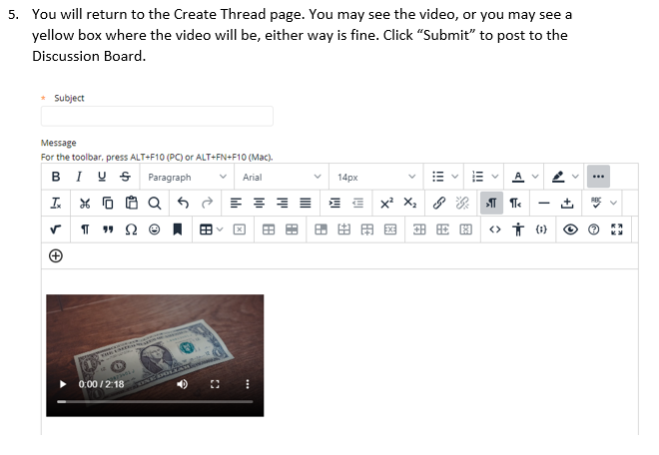
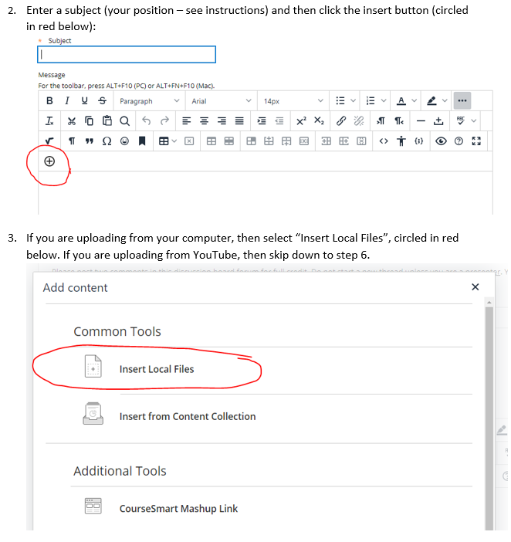
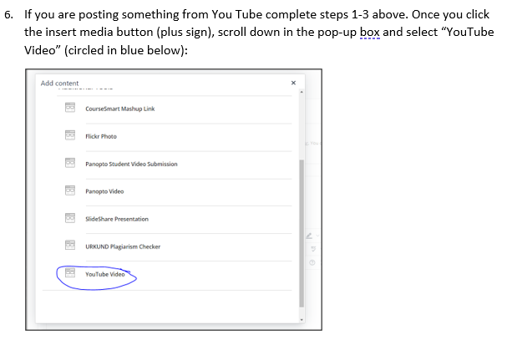
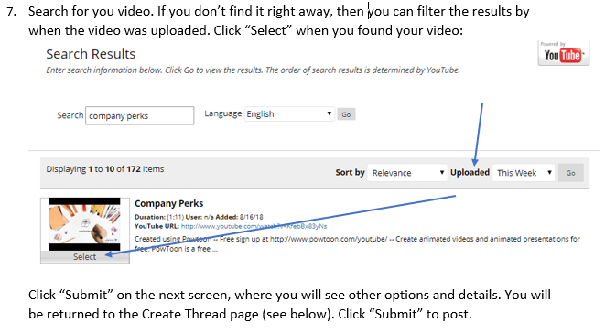
More Instructions

Slide 11


Example Videos
Create one yourself!
Ask students from previous semesters

Slide 12

Some Issues
Article Quality
Lack of Facts
Misunderstanding
Some student will “google” their topic and choose a low-quality article
Presentations will include “tips” not hard facts or reliable information
Some will record themselves, or find a video online and attach it, or create a webpage instead of a video

Slide 13

Be clear on expectations
Sources
Give a list of approved publications – do not allow blog posts
Describe a Fact
Explain how facts are not tips. Facts likely include numbers or a specific company
Provide a Rubric
I award points for Length/Speed, Style, Organization of material, and Interacting with audience

Slide 14

Allow for Mistakes
“Oops” Token
“Get-out-of-jail-free” card - You may redeem a token for a no-questions-asked deadline extension or an opportunity to revise and resubmit an assignment.
  Extension deadline –email within 48 hours of the due date – get a short extension
  Revise and resubmit an assignment –email within 48 hours - resubmit the assignment.
Explain in syllabus

Slide 15

Extension
Instead of allowing for a broad topic, have students sign up for a position.

Slide 16

Position Presentation
The instructor chooses the topic and posts an article introducing the dilemma
Students sign up for opposing arguments
Presentations include well researched and thought-out arguments, including support and counter arguments
Improves the discussion and quality of topics, but lowers student autonomy

Slide 17
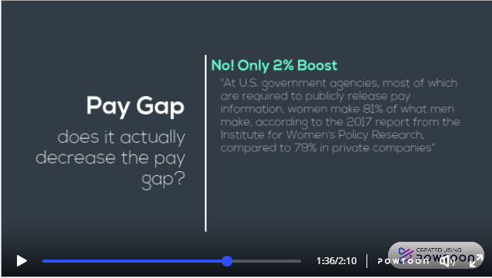
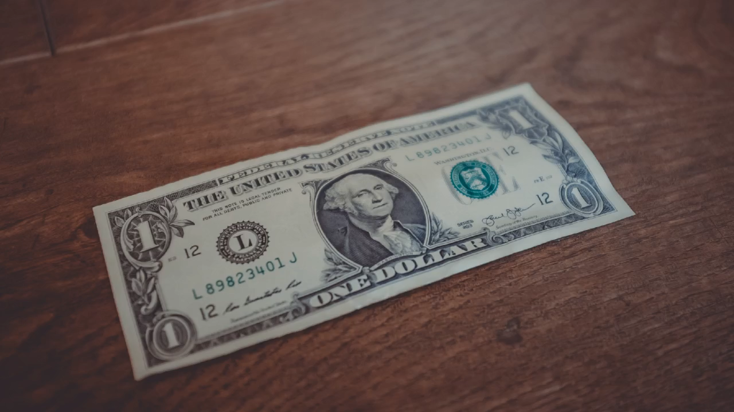
Example
Pay transparency is good/bad for business owners and shareholders.

Slide 18

Opportunity for Reflection
Exam question – Please reflect on the discussion board presentations. Describe one presentation where the position was different from your own. What was one piece of evidence that you found convincing? How will this affect your behavior or opinions after graduation.

Slide 19

Questions?
Resources (instructions and other documents) available

