Slide 1
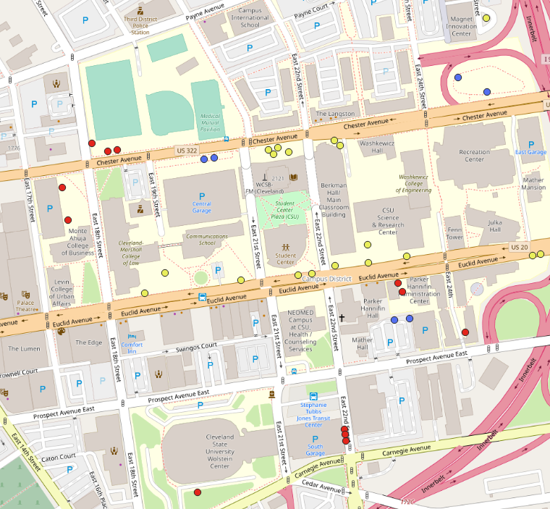
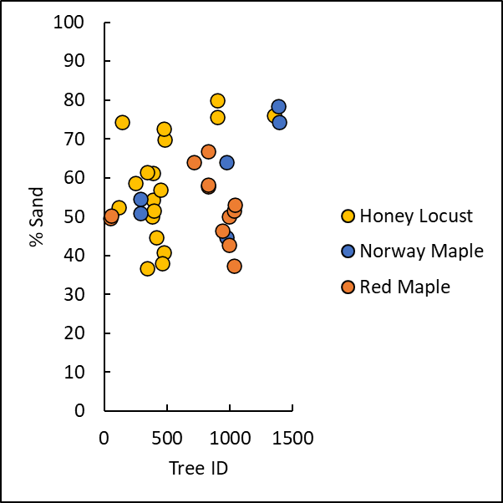
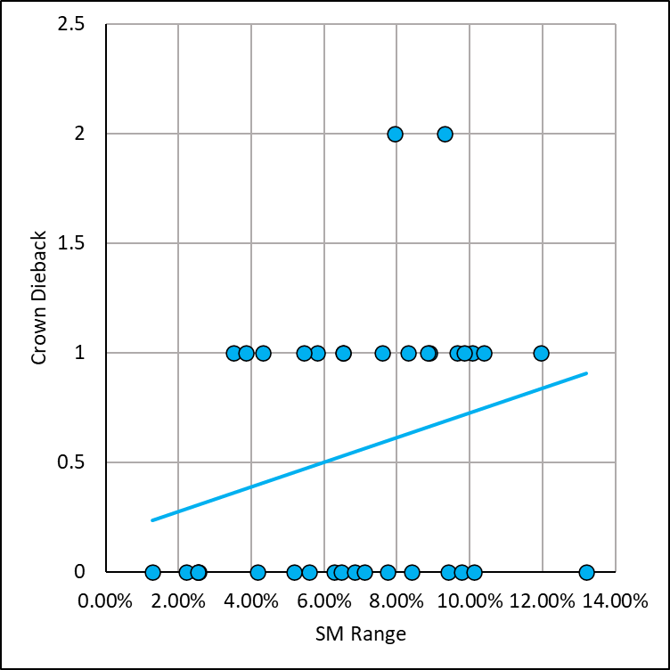
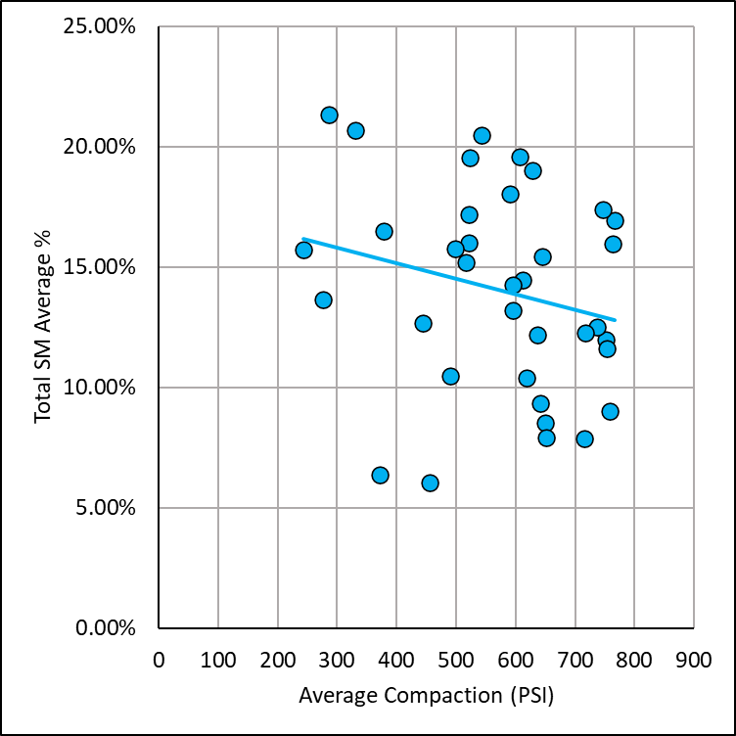
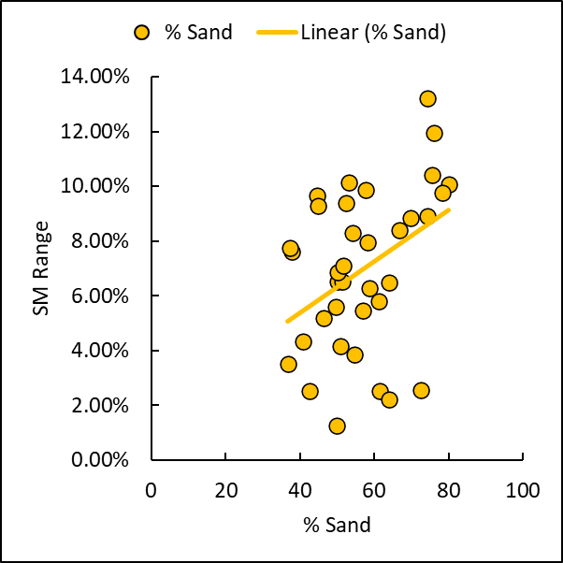
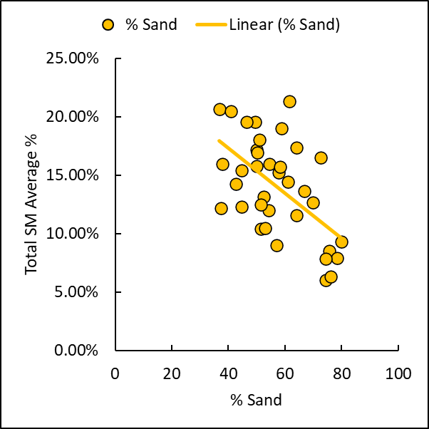
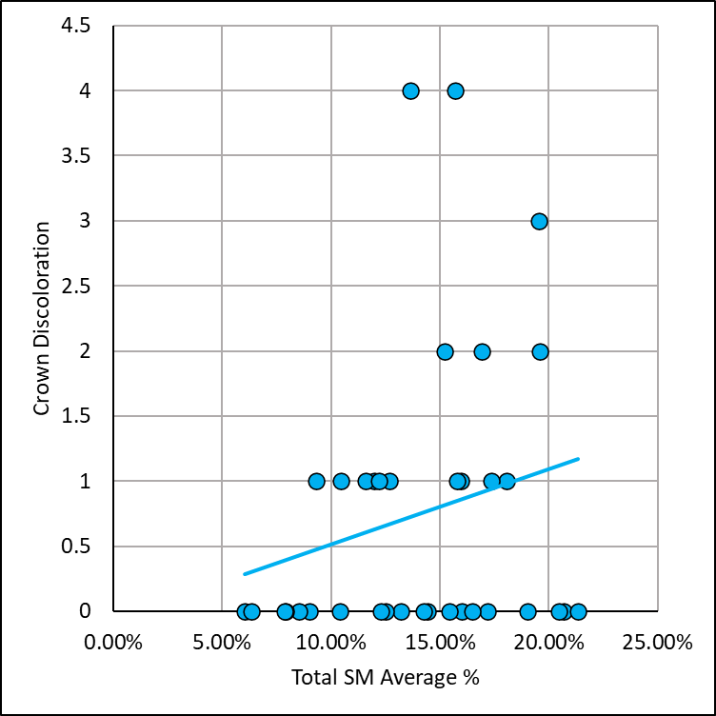
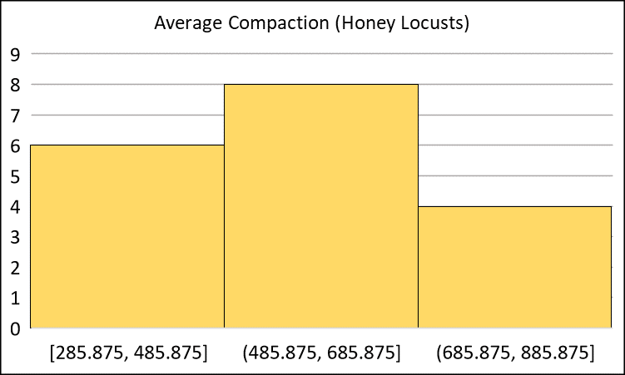
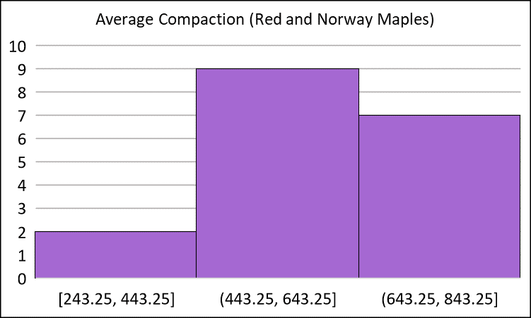
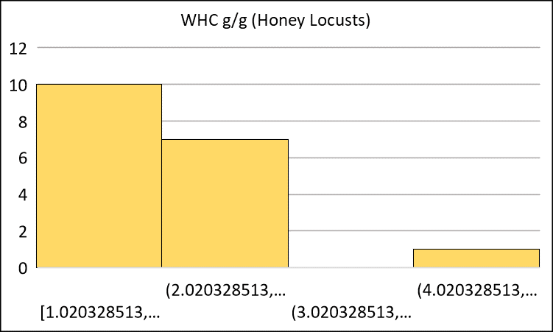
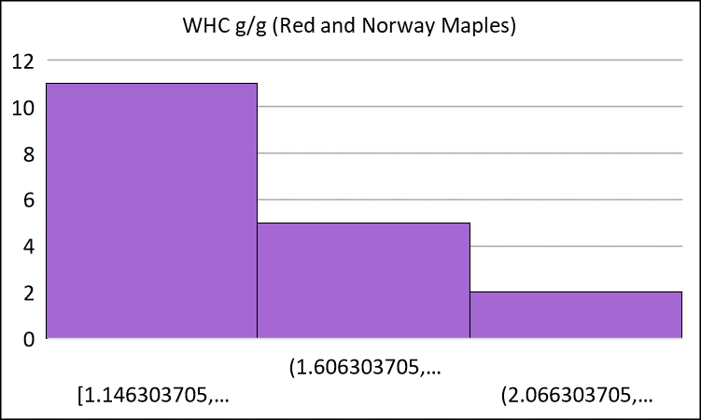
The Impact of Soil Compaction on Soil Moisture Dynamics of Honey Locust, Red Maple, and Norway Maple Trees in an Urban Environment
Ulrich-Cech, Cyenna; Mueller, Kevin
Department of Biological, Geological, and Environmental Sciences, Cleveland State University, Cleveland, OH
Abstract
Soil compaction, a result of urbanization, may be detrimental to soil moisture dynamics and the health of urban trees which subsequently limits their ecosystem services. This study hypothesizes higher compacted soils will negatively affect soil moisture dynamics of honey locusts, red maples, and Norway maples on campus; and there will be a difference in soil moisture dynamics between honey locusts and maples considering varying tree traits. A preliminary survey was conducted to gather health data, and soil compaction, soil texture, and water holding capacity (WHC) were measured. Additionally, 7 soil moisture events were measured throughout the duration of this study. Regarding the subset trees of interest, the lowest total soil moisture average measurement was 6.05% with the highest at 21.32% while the lowest soil compaction measurement was 243.25 PSI with the highest at 766 PSI, providing a range of variability. The average WHC was 1.828 g/g and the average percentages of sand, silt, and clay were 56.92%, 27.30%, and 15.77% respectively. Analysis of the data suggests a negative relationship between average soil compaction and total soil moisture averages. Honey locusts had lower compaction values compared to higher values of red and Norway maples. Additionally, honey locusts had a higher average WHC g/g compared to red and Norway maples; however, statistics suggest no substantial difference in soil moisture dynamics between honey locusts and maples. Future studies should look more closely at how soil compaction and soil moisture dynamics indicate tree health and which tree species better mitigate stormwater in urban environments.
Methods
Hypotheses:
Higher compacted soils will negatively affect soil moisture dynamics of honey locusts, red maples, and Norway maples on campus.
There will be a difference in the soil moisture dynamics between honey locust trees and red and Norway maple trees due to varying tree traits like bark texture, branching angles, and perceived canopy density.
A preliminary survey was conducted on all trees of interest on campus in which various health data and soil compaction measurements were collected. A subsequent group of 36 trees of interest, 18 honey locust, 12 red maple, and 6 Norway maple, were then selected for further study. Throughout the duration of the study, soil moisture was measured before and after rain events and a total of 7 soil moisture events were recorded. Soil core samples were collected, prepped, and used in the lab to measure WHC g/g and soil texture in terms of % sand, % silt, and % clay using the hydrometer method.
Results
Figure 1. Locations of Subset Trees of Interest (left): Figure 1 depicts a zoomed-in map of the locations of all 36 subset trees of interest in relation to CSU’s campus. Honey locusts are denoted by a yellow marker, red maples are denoted by a red marker, and Norway maples are denoted by a blue marker.
Figure 3. Multiple Regression P-Value Results (above): Figure 3 depicts the p-value results after multiple regression analyses for soil moisture dynamic components. Statistically significant p-values are highlighted.
Introduction
Urban forestry, an example of green infrastructure, is a viable solution to the negative impacts of urbanization that protects ecosystem services trees provide while improving the quality of life (Konijnendijk et al., 2005, p. 93). With an expected increase in intensity and frequency of storms predicted for northeast Ohio, Lake Erie faces serious consequences of pollution from Cleveland by stormwater runoff (“Water and Green…,” n.d., par. 1). Urban forestry is a necessary tool in effective mitigation of excess stormwater by use of trees without harming the natural environment. In urban environments like Cleveland, soil compaction is more common and the more compacted soils where trees are planted contribute to poor physical soil properties and subsequently harms the health of trees (Jim and Ng, 2018, pp. 1-3). The aim of this study is to determine how soil compaction affects potentially varying soil moisture dynamics of honey locust, red maple, and Norway maple trees on CSU’s campus and its relation to tree health to further understand the implications of urban forestry as effective green infrastructure. With a better understanding of soil moisture dynamics and tree health in an urban environment, and any potential influences like soil compaction, cities may better utilize the ecosystem services that urban forestry offers.
Figure 2. Soil Texture Percentages (above): Figure 2 depicts the graphed percentages of sand measured per subset tree of interest.
Figure 4. Soil Texture versus Soil Moisture Dynamics (right): Figure 4 depicts two graphs showing the positive relationship between % sand and SM range as well as the negative relationship between % sand and total SM averages.
Figure 5. Soil Moisture Dynamics in Relation to Compaction and Health Data (above and right): Figure 5 depicts the statistically significant relationships of soil moisture dynamic components to average compaction and two health variables: crown dieback and crown discoloration.
Figure 6. Honey Locusts Versus Maples (below): Figure 6 depicts histograms comparing honey locusts to maples. The top two histograms compare the average compaction values measured for the two species while the bottom two histograms compare the WHC g/g measured for the two species, which a paired t-test showed to be statistically significant.
Conclusions
Higher compaction values are associated with lower total soil moisture averages (see Figure 5).
There is a negative relationship between average soil compaction and total soil moisture averages.
There is a positive relationship between soil moisture dynamics and health variables, crown dieback and crown discoloration (see Figure 5).
Honey locusts typically had lower compaction values compared to the higher values of red and Norway maples (see Figure 6).
Honey locusts had a higher average WHC at 2.075 g/g compared to the average WHC of 1.581 g/g for red and Norway maples.
The WHC values for honey locusts contain one outlier, which measured at 4.510 g/g.
Overall, honey locusts and red and Norway maples report differing results; although, statistics suggest no substantial difference in soil moisture dynamics.
Acknowledgments
I would like to extend thanks to my advisor, Dr. Kevin Mueller, for his support, guidance, and expertise throughout this project. I would also like to thank the McNair Scholars Program and Dr. Ángel Reyes-Rodríguez for providing the funds and research opportunity.
Funding: McNair Scholars Program

Slide 2
The Impact of Soil Compaction on Soil Moisture Dynamics of Honey Locust, Red Maple, and Norway Maple Trees in an Urban Environment
Ulrich-Cech, Cyenna; Mueller, Kevin
Department of Biological, Geological, and Environmental Sciences, Cleveland State University, Cleveland, OH
Introduction
Urban forestry, an example of green infrastructure, is a viable solution to the negative impacts of urbanization that protects ecosystem services trees provide while improving the quality of life. With an expected increase in intensity and frequency of storms predicted for northeast Ohio, Lake Erie faces serious consequences of pollution from Cleveland by stormwater runoff. Urban forestry is a necessary tool in effective mitigation of excess stormwater by use of trees without harming the natural environment. In urban environments like Cleveland, soil compaction is more common and the more compacted soils where trees are planted contribute to poor physical soil properties and subsequently harms the health of trees. The aim of this study is to determine how soil compaction affects potentially varying soil moisture dynamics of honey locust, red maple, and Norway maple trees on CSU’s campus and its relation to tree health to further understand the implications of urban forestry as effective green infrastructure.
Figure 2. Soil Texture Percentages (above): Figure 2 depicts the graphed percentages of sand measured per subset tree of interest.
Figure 3. Multiple Regression P-Value Results (above): Figure 3 depicts the p-value results after multiple regression analyses for soil moisture dynamic components. Statistically significant p-values are highlighted.
Figure 6. Honey Locusts Versus Maples (below): Figure 6 depicts histograms comparing honey locusts to maples. The top two histograms compare the average compaction values measured for the two species while the bottom two histograms compare the WHC g/g measured for the two species, which a paired t-test showed to be statistically significant.
Methods
Hypotheses:
Higher compacted soils will negatively affect soil moisture dynamics of honey locusts, red maples, and Norway maples on campus.
There will be a difference in the soil moisture dynamics between honey locust trees and red and Norway maple trees due to varying tree traits like bark texture, branching angles, and perceived canopy density.
A preliminary survey was conducted on all trees of interest on campus in which various health data and soil compaction measurements were collected. A subsequent group of 36 trees of interest, 18 honey locust, 12 red maple, and 6 Norway maple, were then selected for further study. Throughout the duration of the study, soil moisture was measured before and after rain events and a total of 7 soil moisture events were recorded. Soil core samples were collected, prepped, and used in the lab to measure WHC g/g and soil texture in terms of % sand, % silt, and % clay using the hydrometer method.
Conclusions
Higher compaction values are associated with lower total soil moisture averages (see Figure 5).
There is a negative relationship between average soil compaction and total soil moisture averages.
There is a positive relationship between soil moisture dynamics and health variables, crown dieback and crown discoloration (see Figure 5).
Honey locusts typically had lower compaction values compared to the higher values of red and Norway maples (see Figure 6).
Honey locusts had a higher average WHC at 2.075 g/g compared to the average WHC of 1.581 g/g for red and Norway maples.
The WHC values for honey locusts contain one outlier, which measured at 4.510 g/g.
Overall, honey locusts and red and Norway maples report differing results; although, statistics suggest no substantial difference in soil moisture dynamics.
Figure 4. Soil Texture versus Soil Moisture Dynamics (right): Figure 4 depicts two graphs showing the positive relationship between % sand and SM range as well as the negative relationship between % sand and total SM averages.
Results
Figure 1. Locations of Subset Trees of Interest (left): Figure 1 depicts a zoomed-in map of the locations of all 36 subset trees of interest in relation to CSU’s campus. Honey locusts are denoted by a yellow marker, red maples are denoted by a red marker, and Norway maples are denoted by a blue marker.
Figure 5. Soil Moisture Dynamics in Relation to Compaction and Health Data (above and right): Figure 5 depicts the statistically significant relationships of soil moisture dynamic components to average compaction and two health variables: crown dieback and crown discoloration.
Acknowledgments
I would like to extend thanks to my advisor, Dr. Kevin Mueller, for his support, guidance, and expertise throughout this project. I would also like to thank the McNair Scholars Program and Dr. Ángel Reyes-Rodríguez for providing the funds and research opportunity.
Funding
McNair Scholars Program

