Slide 1
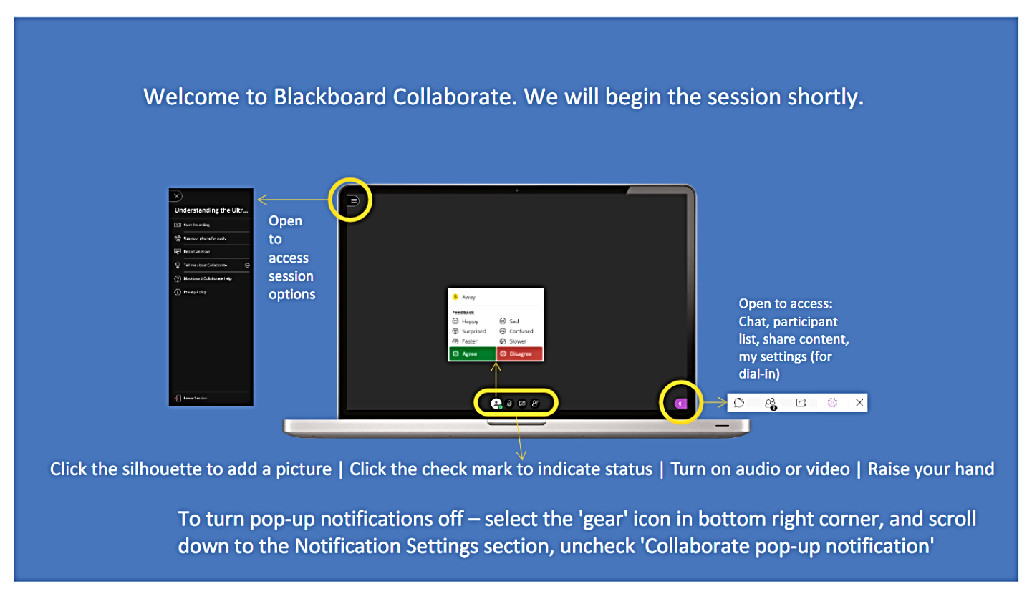

Slide 2
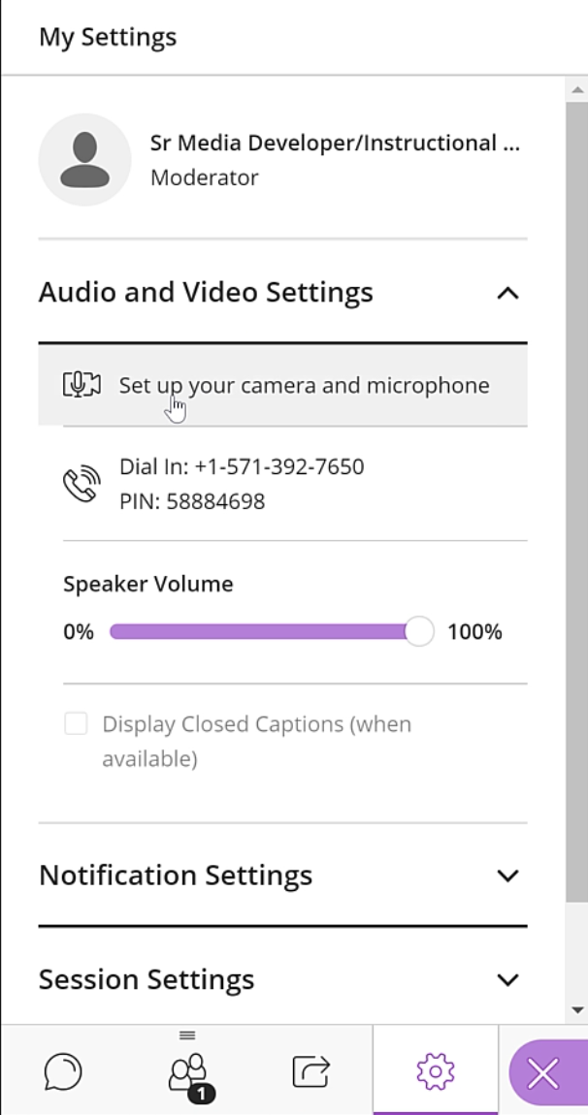
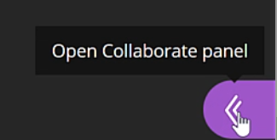
Setup Microphone

Slide 3
Bb Collaborate Ultra
Heather Caprette
Sr. Media Dev/Instructional Designer
email: h.caprette@csuohio.edu
phone: 216-802-3142
Sam Diomede
Sr. Instructional Designer
email: s.diomede@csuohio.edu
phone: 216-802-3142

Slide 4
Links to Video Tutorials On Collaborate
Intro to Collaborate Ultra – Part 1
https://csuohio.hosted.panopto.com/Panopto/Pages/Viewer.aspx?id=091b42c4-e690-4c69-b6fa-ab8001277a47
Creating A Session – Part 2
https://csuohio.hosted.panopto.com/Panopto/Pages/Viewer.aspx?id=519e4a7f-69ee-4714-8b9d-ab800107b4e2
Working with the Session Interface – Part 3
https://csuohio.hosted.panopto.com/Panopto/Pages/Viewer.aspx?id=5939c8af-f98c-4232-8d85-ab800110e106
https://help.blackboard.com/Filter/Collaborate_Ultra
Notes:
I’ve pre-recorded instructions on how to use Collaborate Ultra within 3 video tutorials. Enter the links into a browser to playback instructions.

Slide 5
Synchronous Web Conferencing Tool
Blackboard Collaborate Ultra will allow you to:
  Present a class presentation, such as a lecture
  Record that lecture and set it to be downloadable as an .mp4 file
  Hold office hours
  Host guest speakers via a Guest Link sent through email – make a Presenter or Moderator
  Hold general meetings via the shared Guest Link
You can share:
  Audio, PowerPoint Slides, your screen or an application window, a blank whiteboard, and video if you and your audience have the bandwidth for it

Slide 6
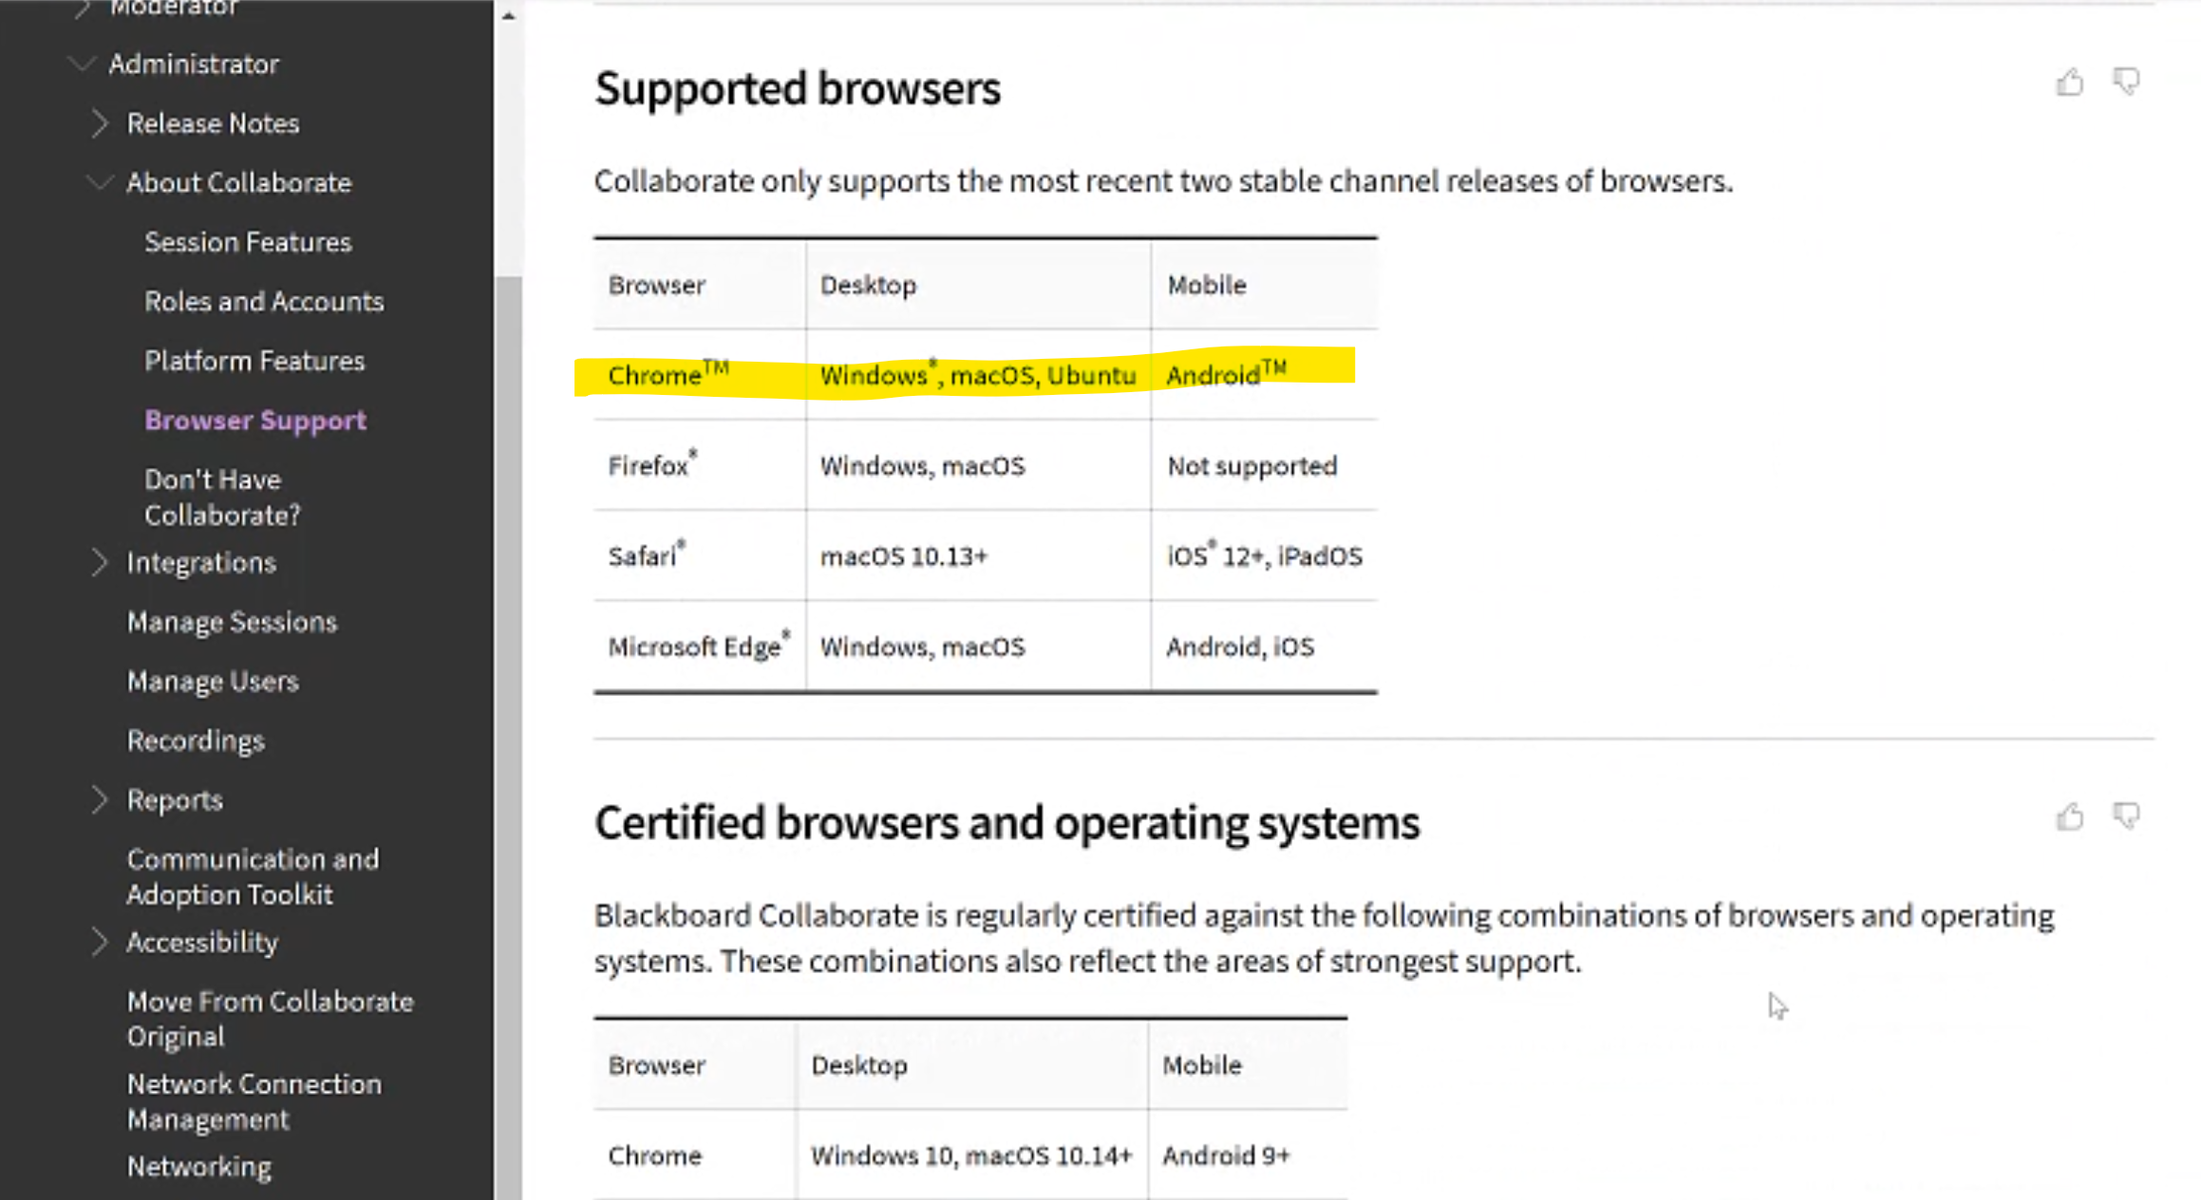
Browser support for Collaborate Ultra

Slide 7
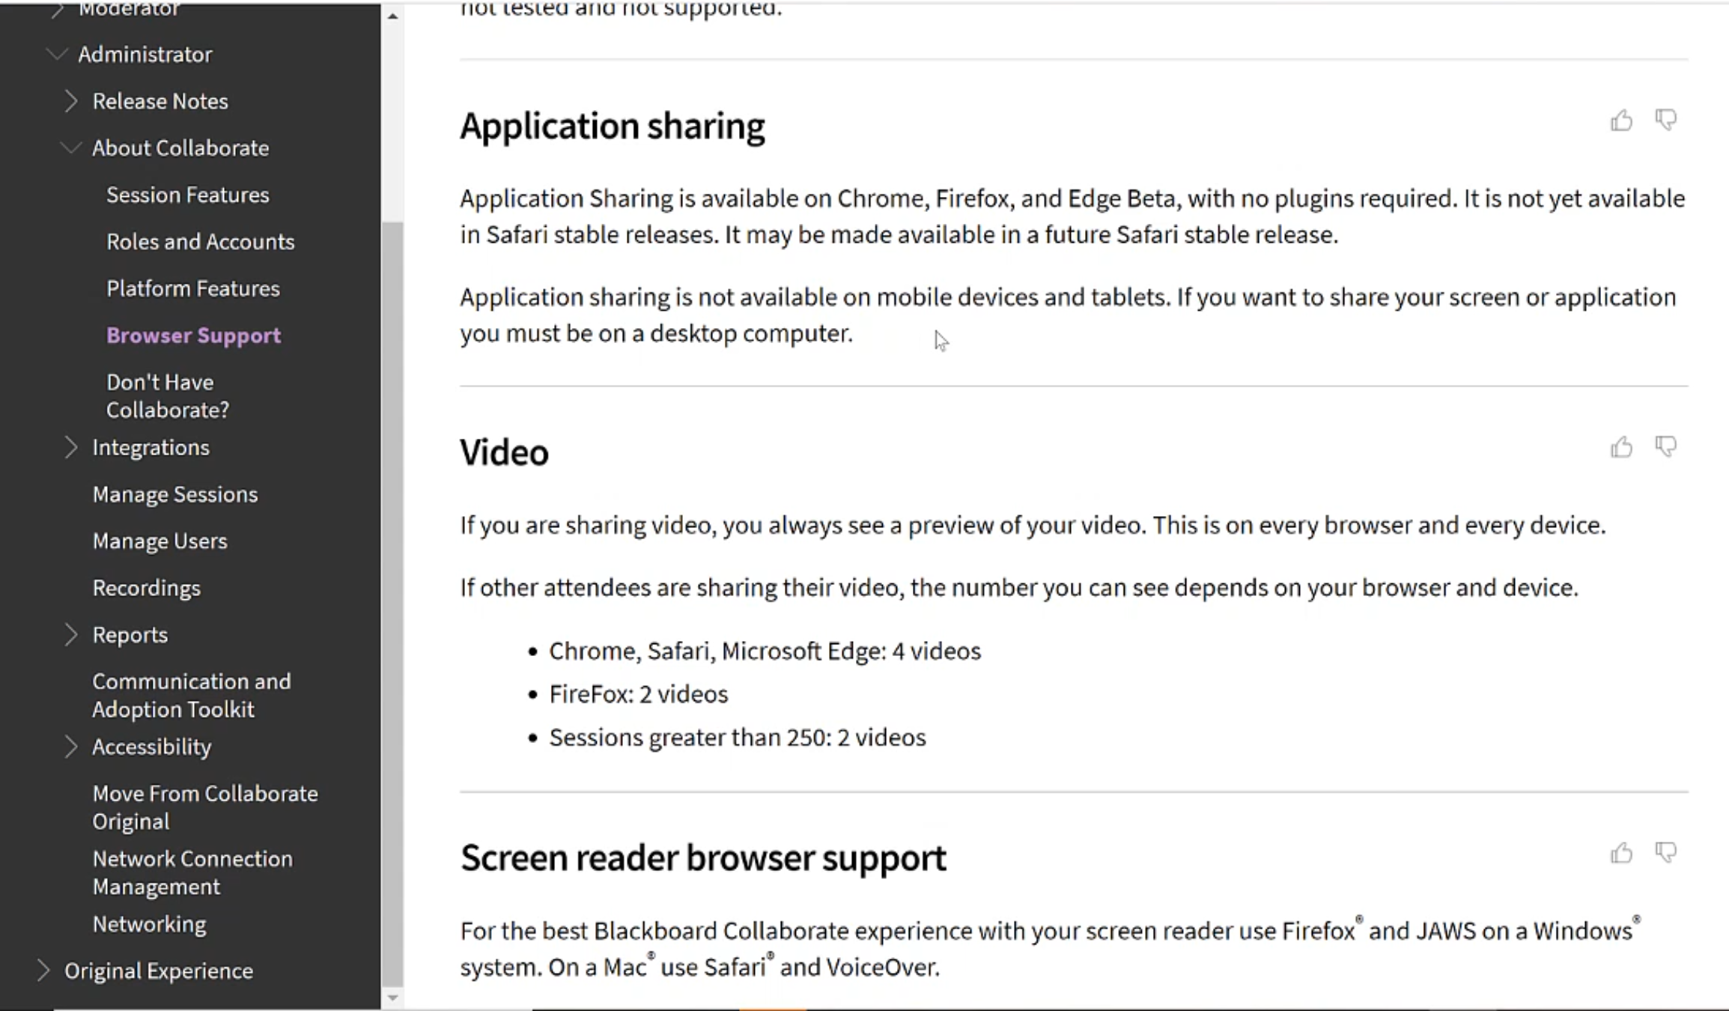
Application Sharing and Video Support

Slide 8
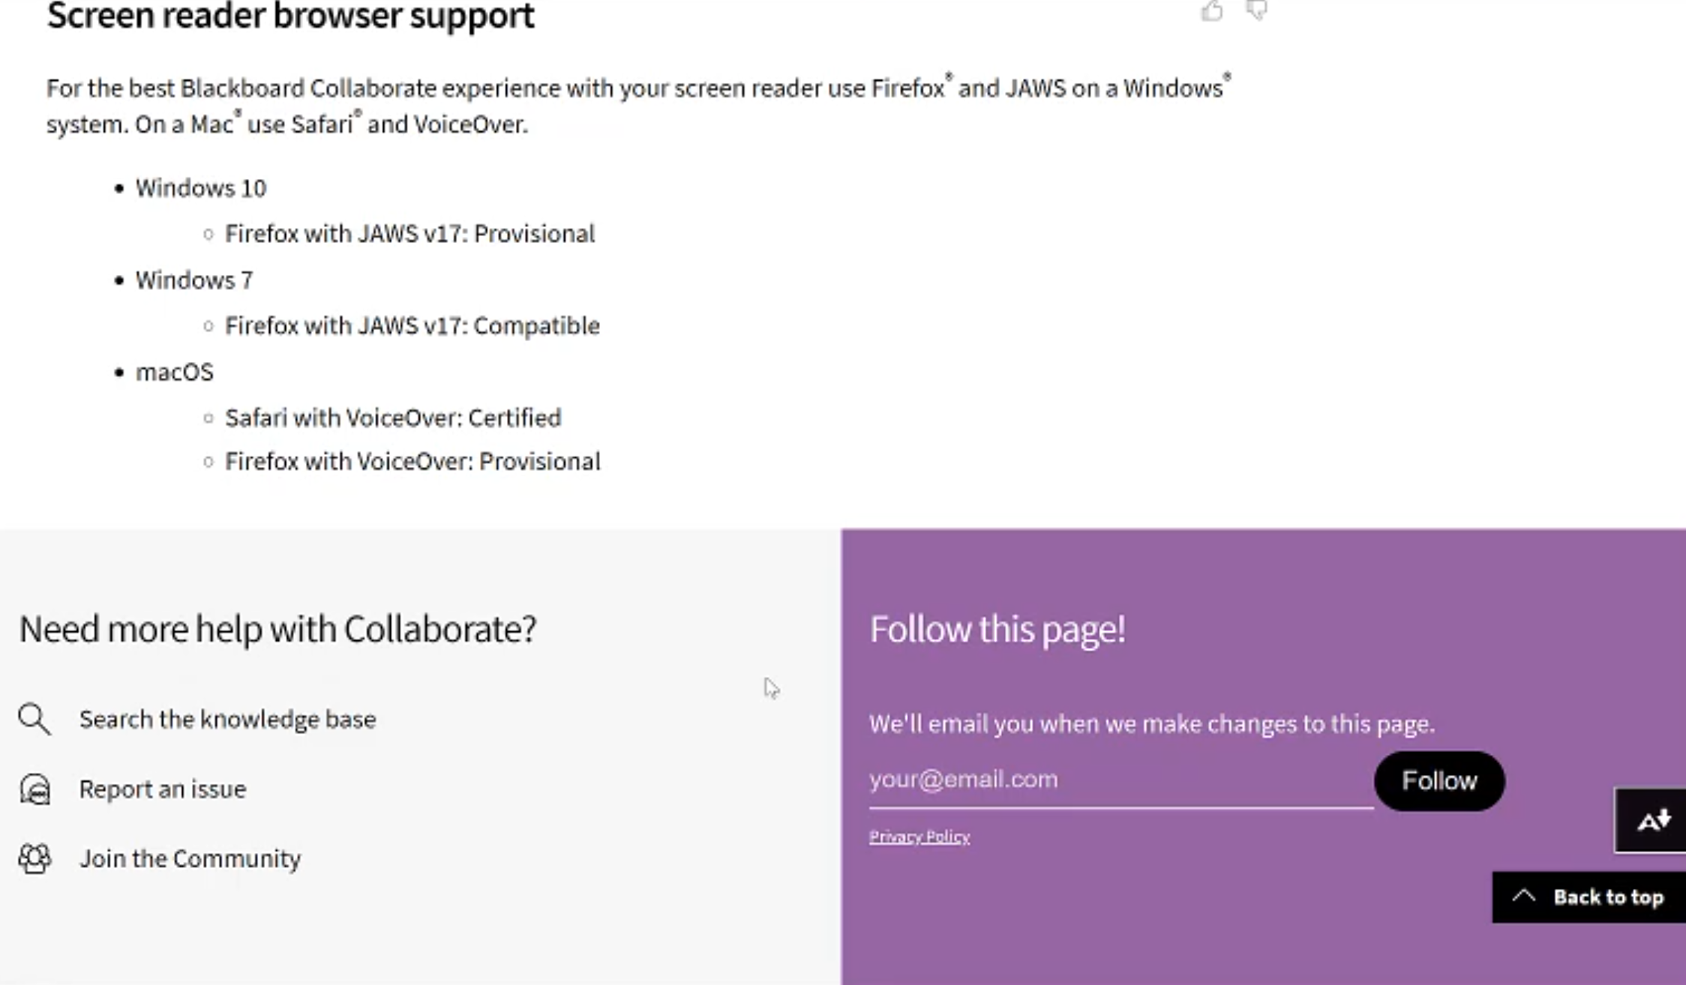
Screen Reader Support

Slide 9
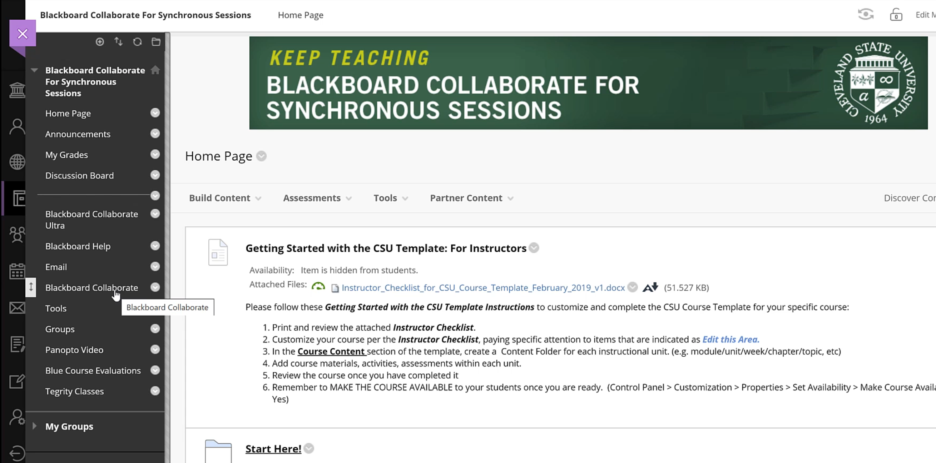
Location On Menu

Slide 10
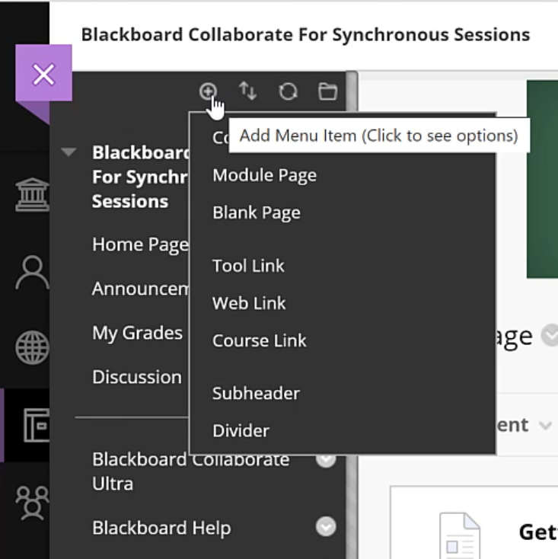
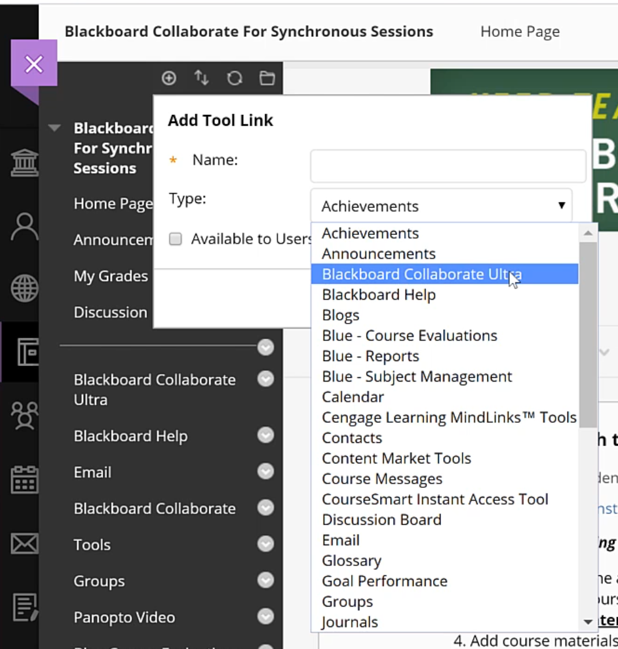
Adding the Bb Collaborate Link to Course Menu

Slide 11
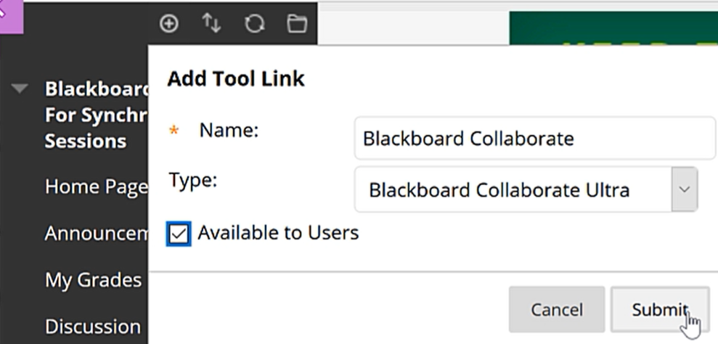
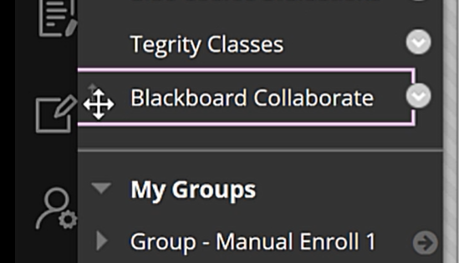
Adding the Bb Collaborate Link to Course Menu

Slide 12
Large Session Requests
If you need a session that supports over 250 people, please email elearning@csuohio.edu because we will need to make a large session request to Blackboard.

Slide 13
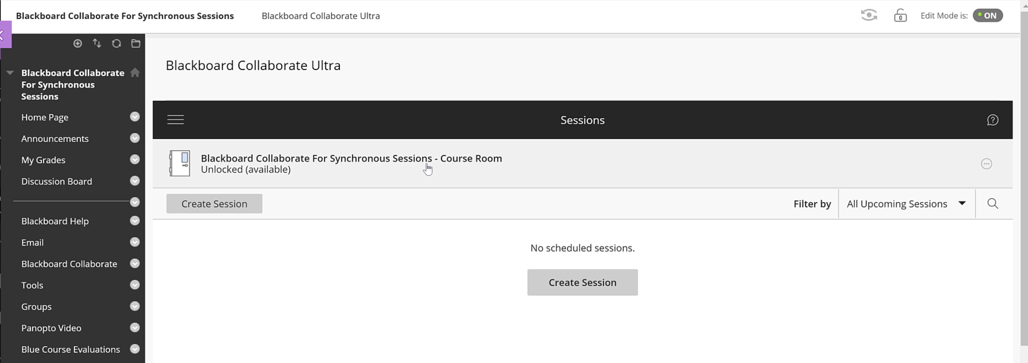
Bb Collaborate Sessions Area
Notes:
Every course has a general course room which is an open session that anyone can enter at any time to collaborate.

Slide 14
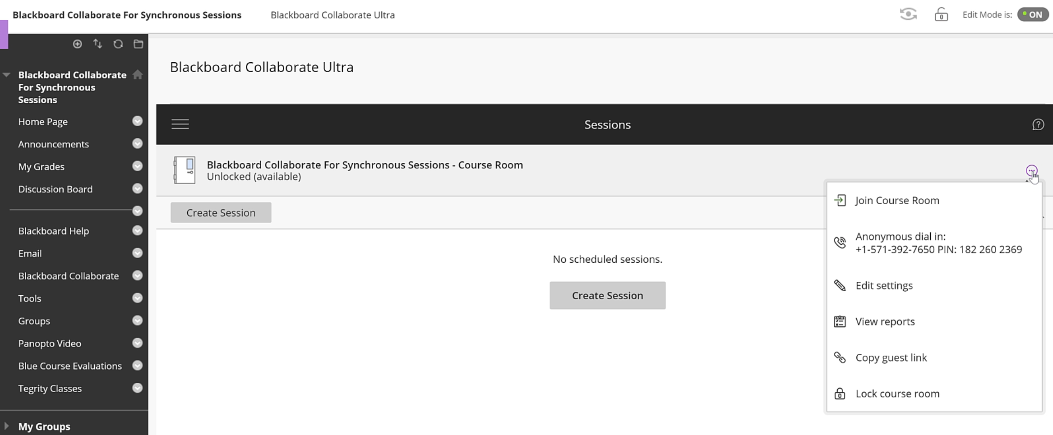
Locking the Course Room – Settings button
Notes:
You can turn off the open course room by selecting Lock Course Room under the Sessions Settings button on the right.
You can create new sessions with Create Session button and give these a unique title, such as for a lecture topic, so that students can locate them under Recordings later when you record them.

Slide 15
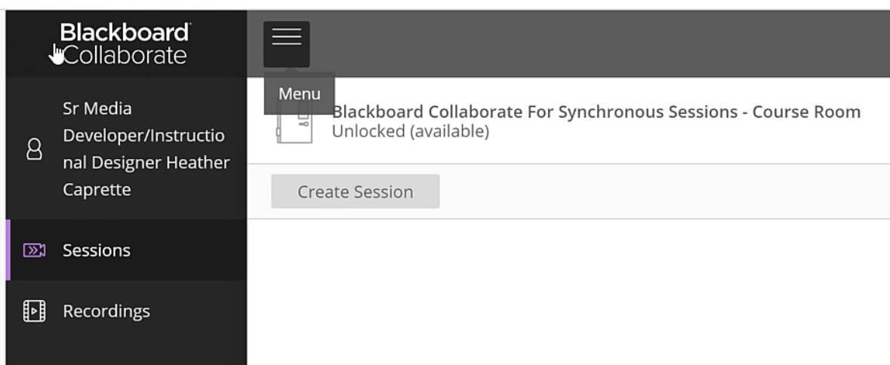
Sessions Menu
Notes:
The Sessions Menu pops open on the left and you can select Recordings to get to the area where the list of recorded sessions are. There is a filter you may need to enter a date range to find older recordings.

Slide 16
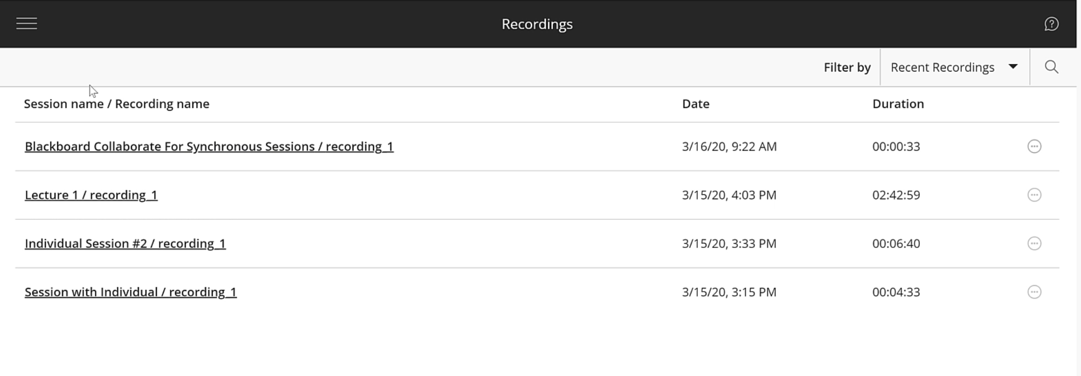
Recordings Area
Notes:
The default course room titles the sessions with Bb Collaborate for Synchronous Sessions/recording #. Your created sessions will show with their unique names, as seen below the default naming convention.

Slide 17
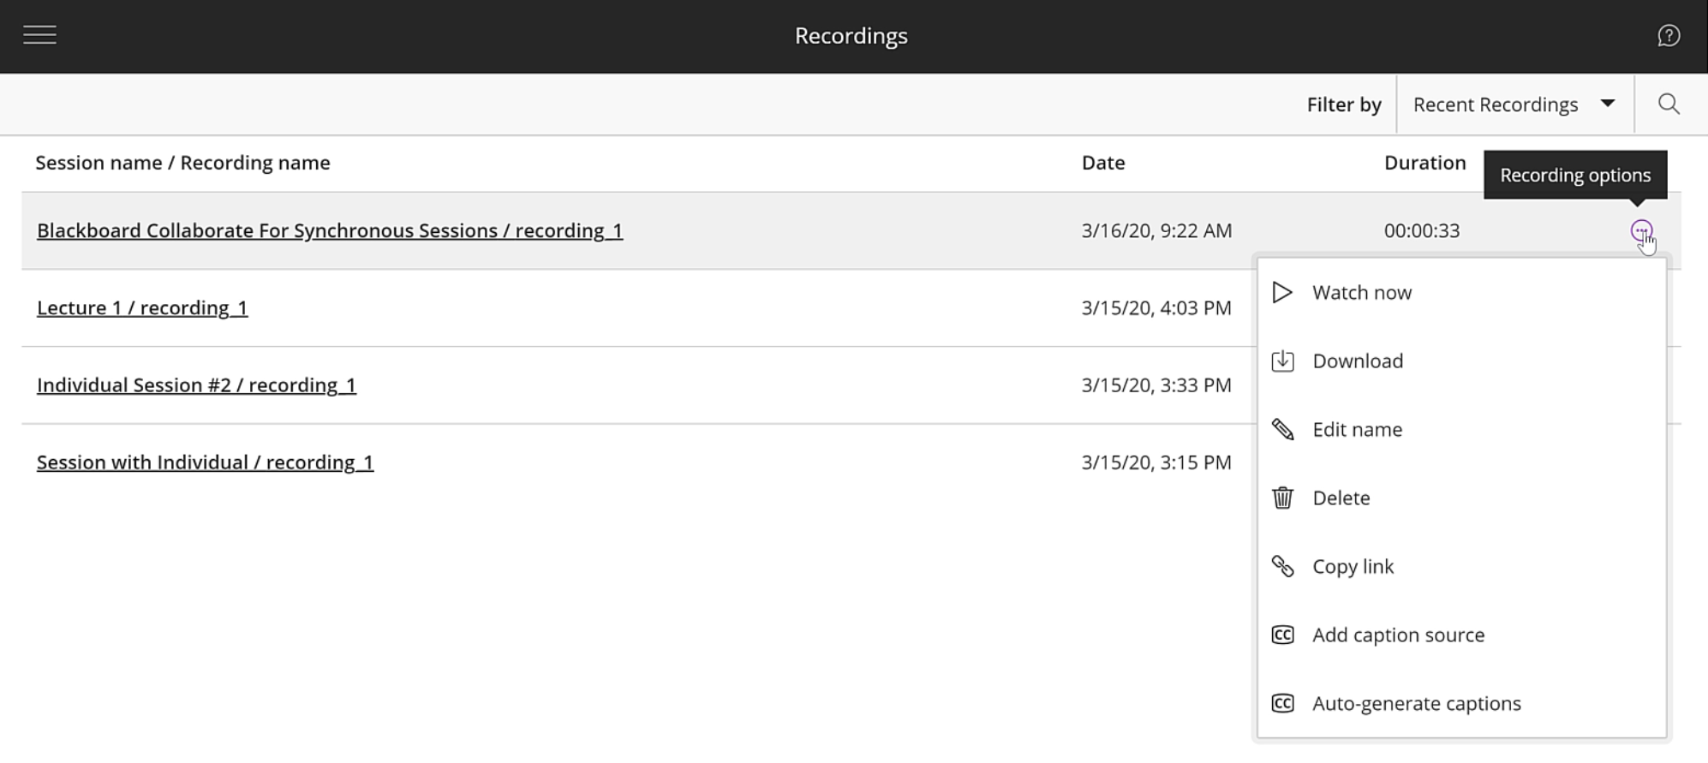
Download link- for .mp4
Notes:
Clicking on the Recording Options menu button gives a pop up window that will allow you to select to view or Download the recording if you’ve check the session setting to allow for downloads by students. This is recommended.

Slide 18
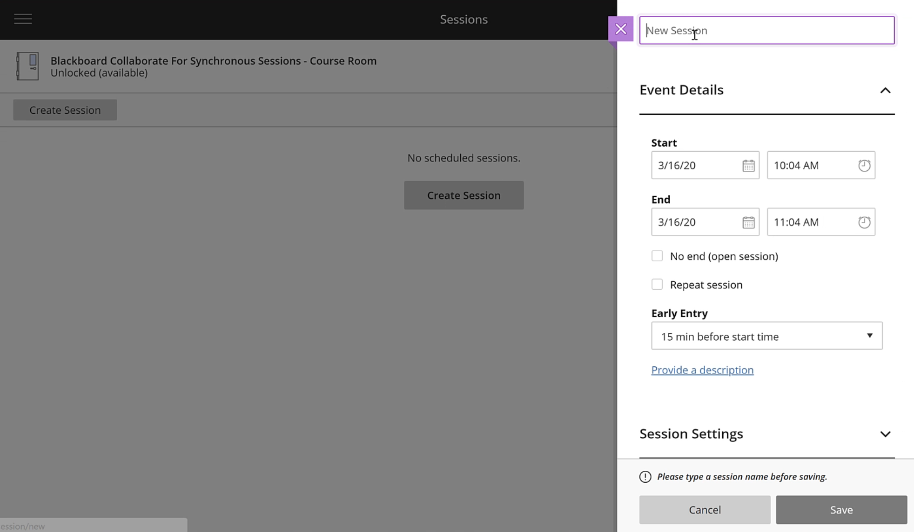
Creating a Session – Session settings
Notes:
Click the Create Session button under the Sessions area. A panel for settings opens on the right. Give it a unique name associated with the topic of the presentation. You can adjust start and end times with the calendar and clock buttons to the right of the Start and End entries. Default is for participants to be able to join 15 minutes before the session starts. You can adjust. Can add a decription of the session.

Slide 19
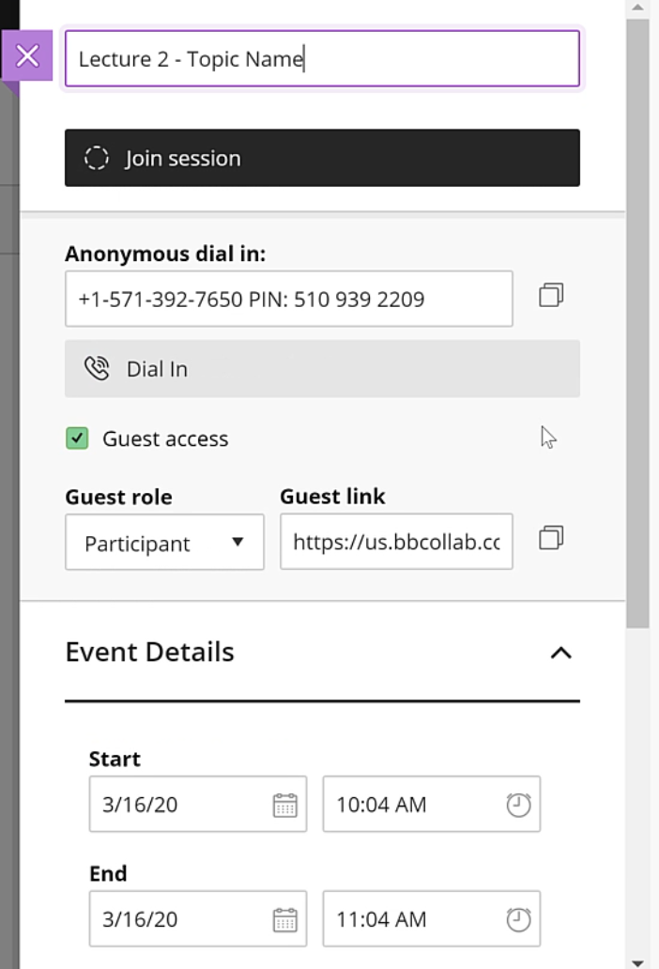
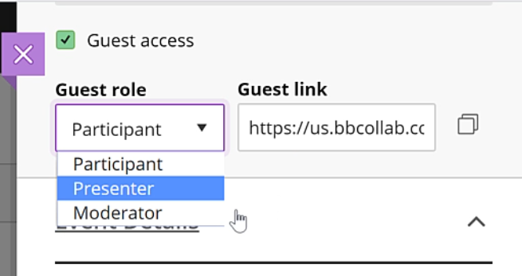
Session Settings – Dial In and Guest Link
Notes:
Once you enter the unique name for the session, a dial in number to hear audio and a guest link will appear. There is a drop down menu that will allow you to set the role of the guest that joins through the link which you copy to the clip board and paste into an email to them. They can be a participant, or if they are a presenter, you can give them the Presenter or Moderator role.

Slide 20
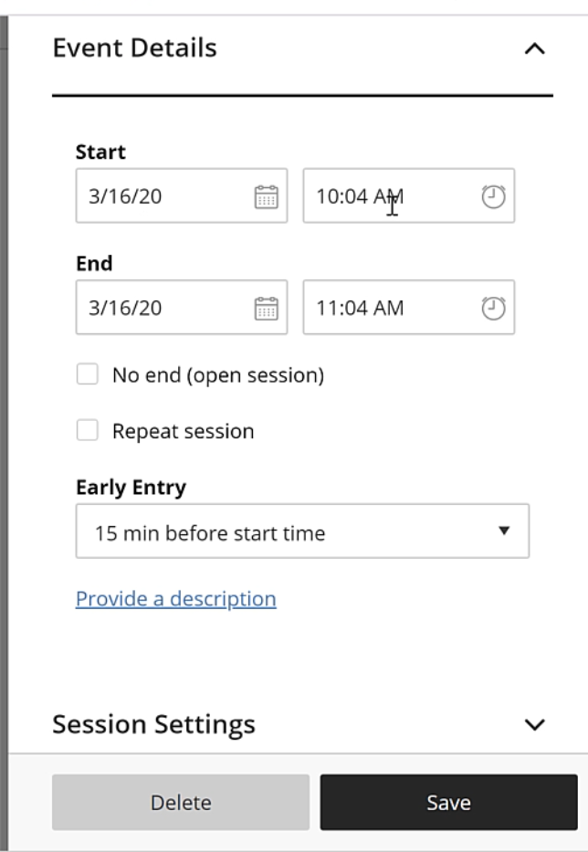
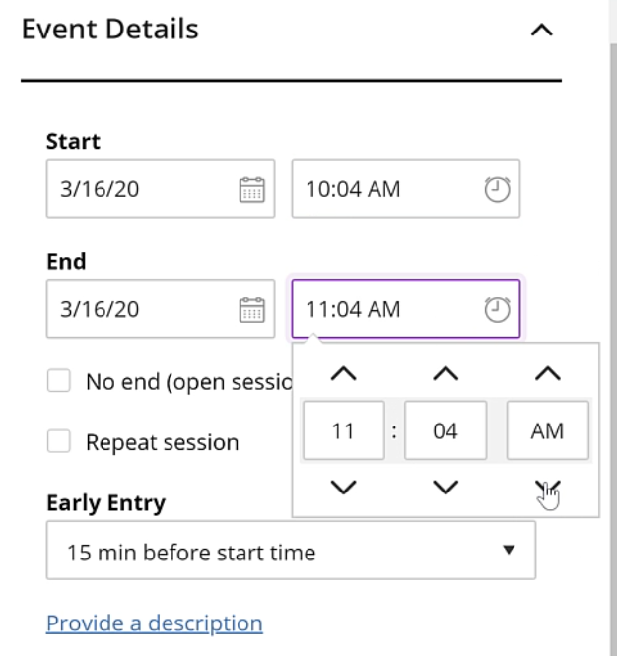
Setting timing
Notes:
Click clock to expand menu. Click up and down arrows to set the time.

Slide 21
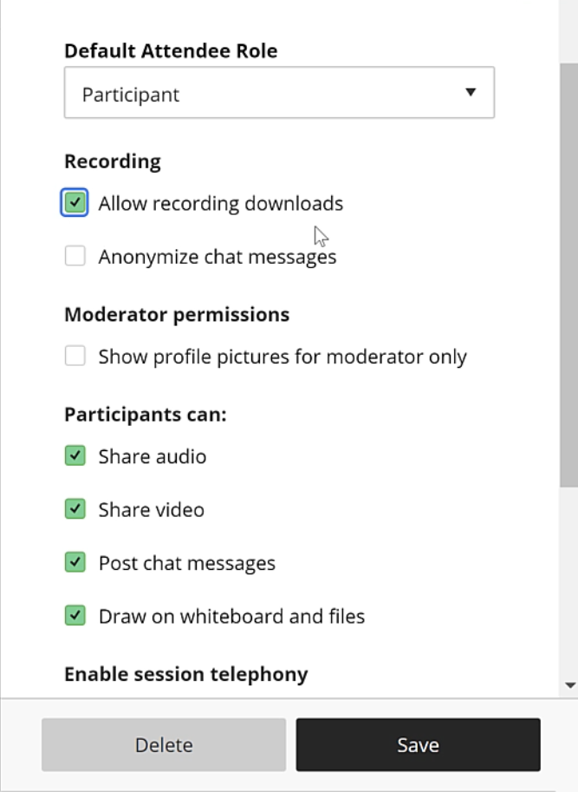
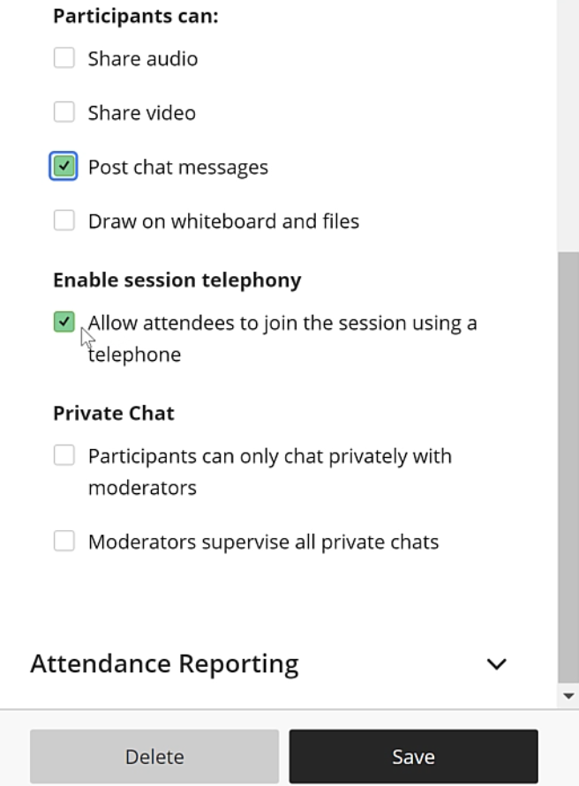
Participant Permissions
Notes:
Click on Allow Recording Downloads in case students keep getting dropped from sessions due to bandwidth issues. Uncheck sharing of audio, video and writing on whiteboard initially so that you don’t get background noise from the audience’s environment while you are speaking. You can turn these on while you are in session when you need them to ask questions. Students can chat privately among themselves unless you check off thebutton for “Participants can only chat privately with moderators.” You can also check off to see all private chat conversations.

Slide 22
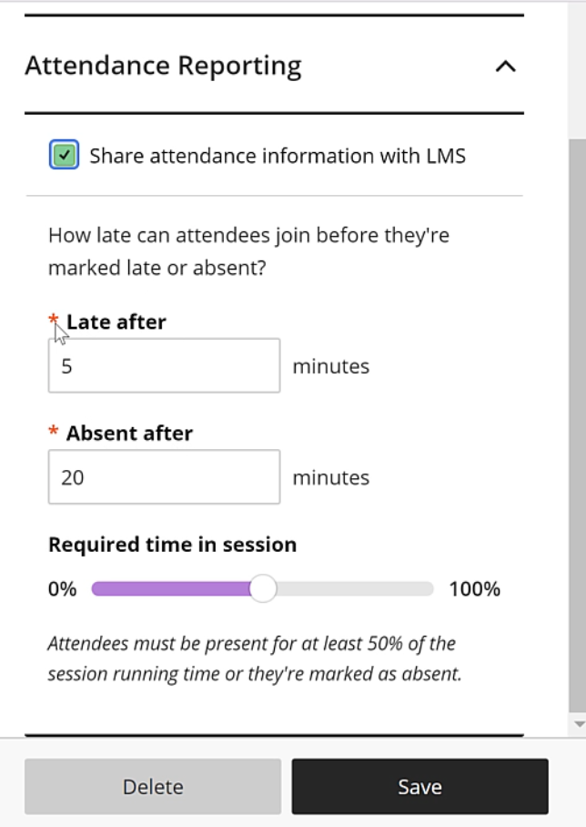
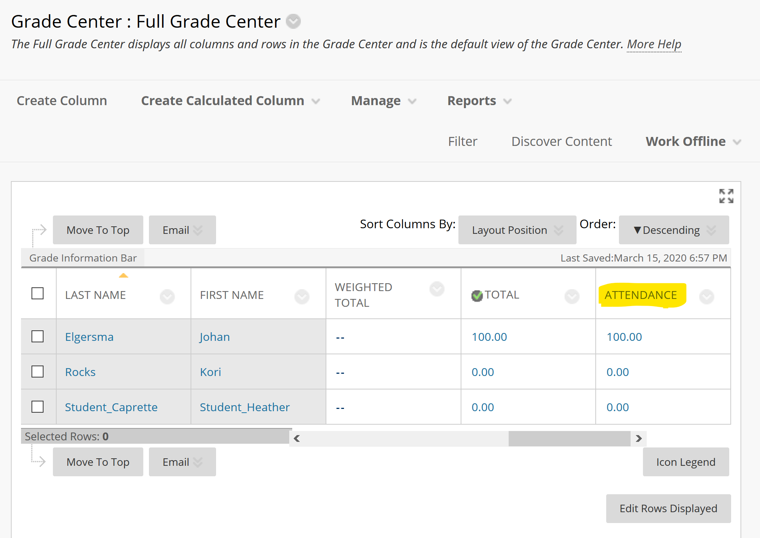
Attendance Recording option
Notes:
You can check the option to record attendance to a column in the Grade Center within Blackboard learn. If you check this off, you can set how many minutes would be considered late for starting the session, how many minutes before they are considered absent, and set the amount of the session they need to be present for to get full points (100 points). Click Save when done.

Slide 23
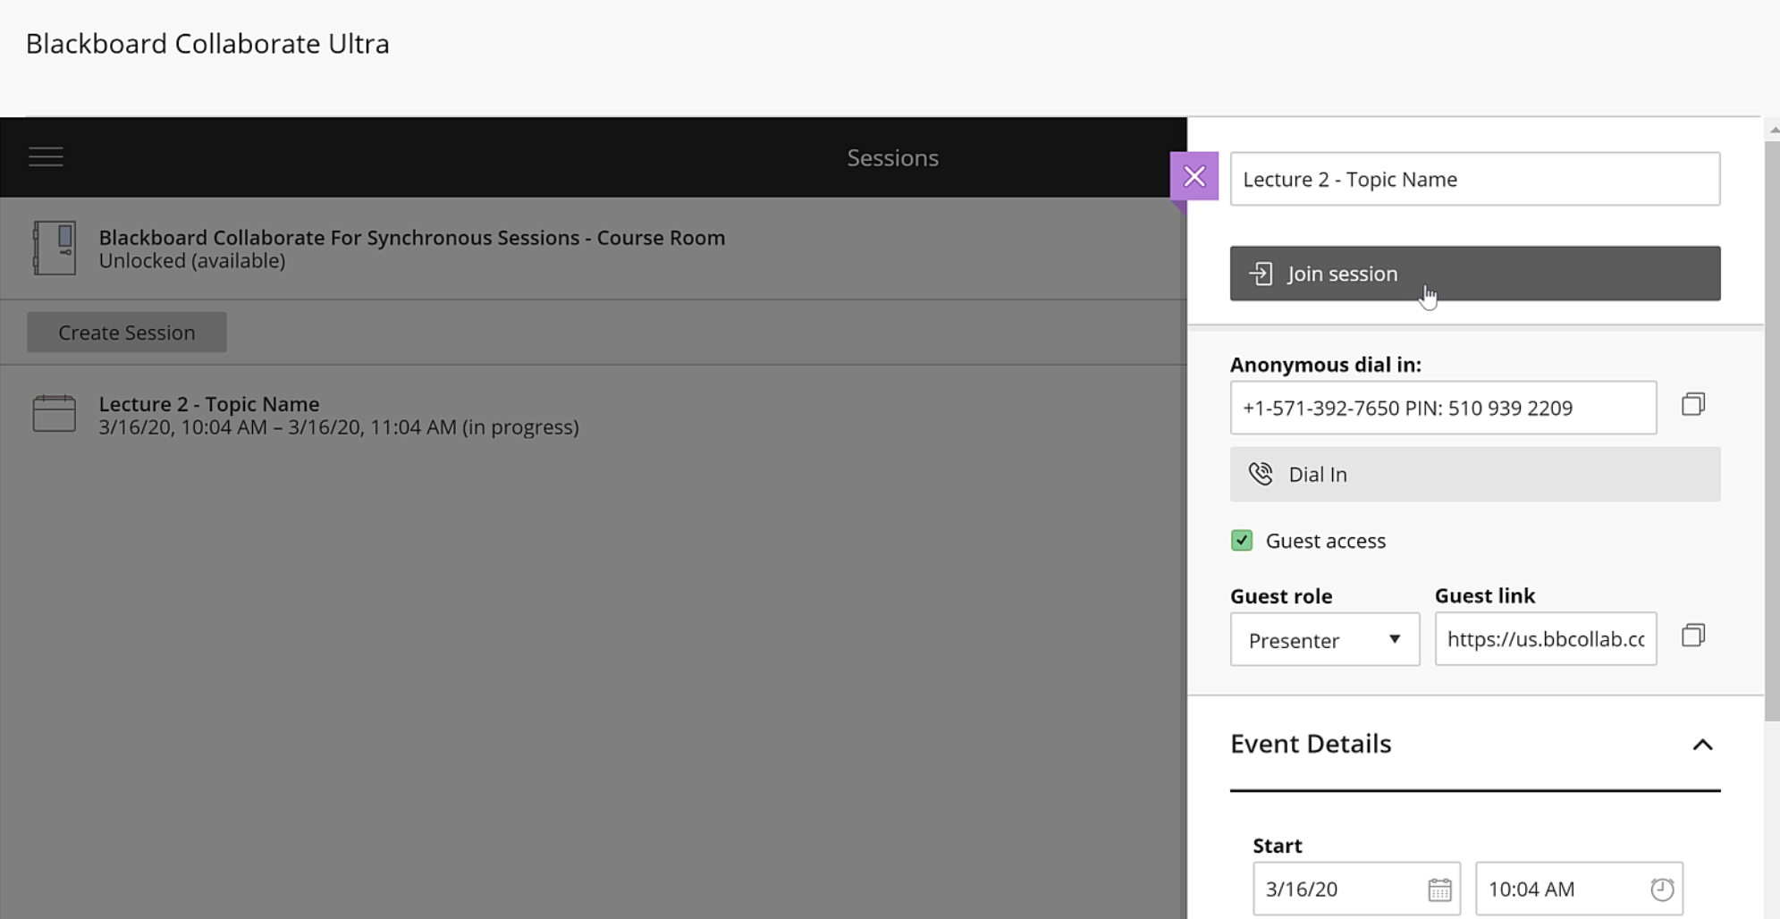
Join Session
Notes:
After you save your settings. Click the name of the session in the list on the left. When the panel pops open, click Join Session. You may see “Get Secure Session Link” If so, just click it and then click Join Session when it comes up.

Slide 24
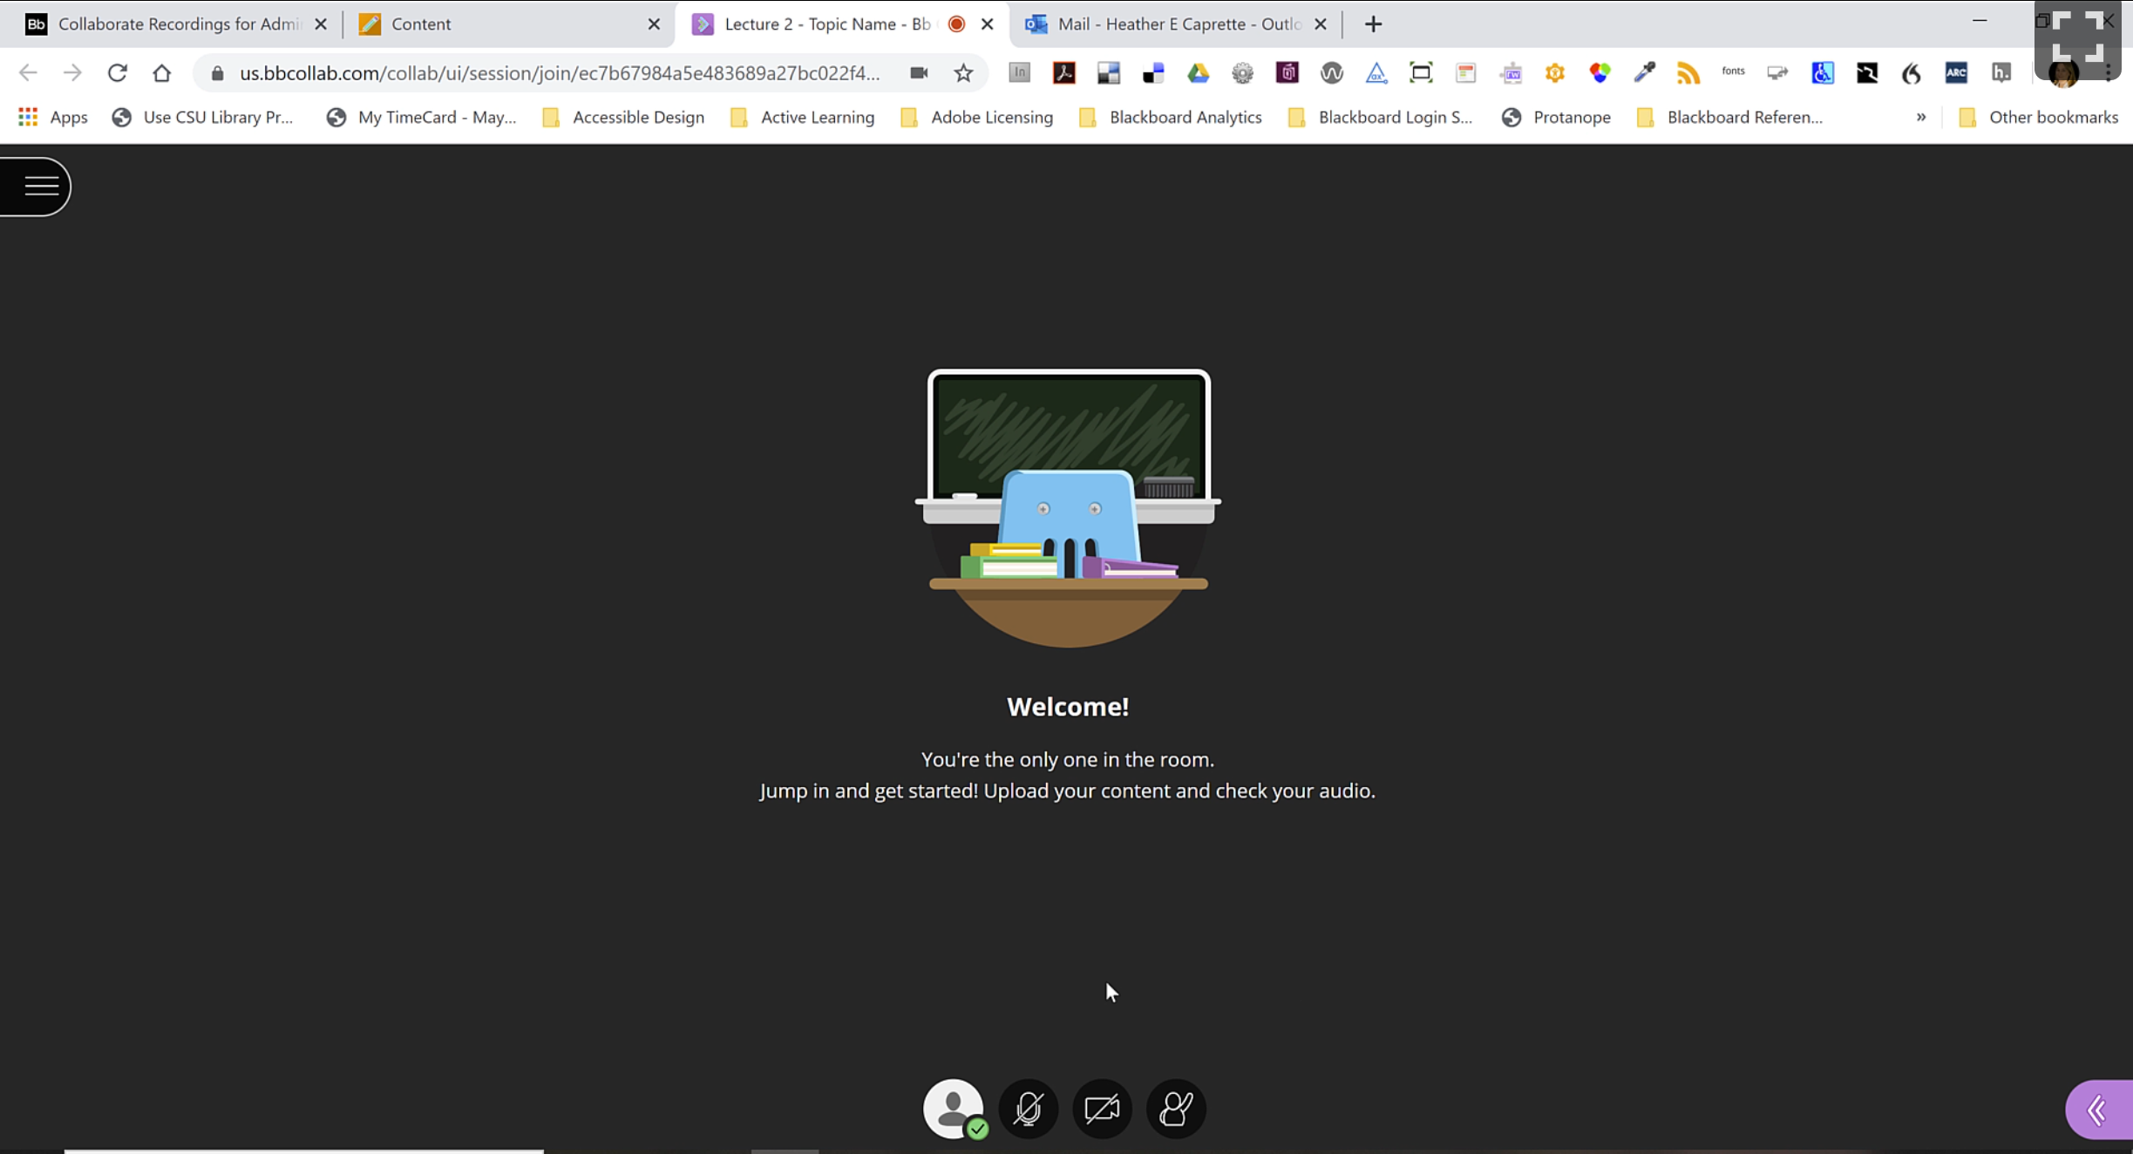
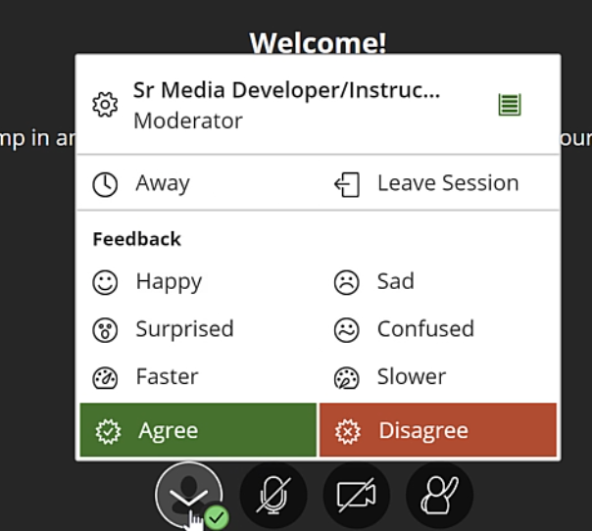
Session Interface - Initial
Notes:
This is the initial view you see when you Join the session. At the bottom are buttons to turn on your audio, video, or a raise hand button for students to click which will set a purple hand raised symbol to the left of their name in the attendee panel. When you click on the face button, you can see emoticons to express how you feel, a button to show you stepped away, and a button to leave the session. Once faculty answer a question, they should click the purple icon next to someone’s name to lower their hand.

Slide 25
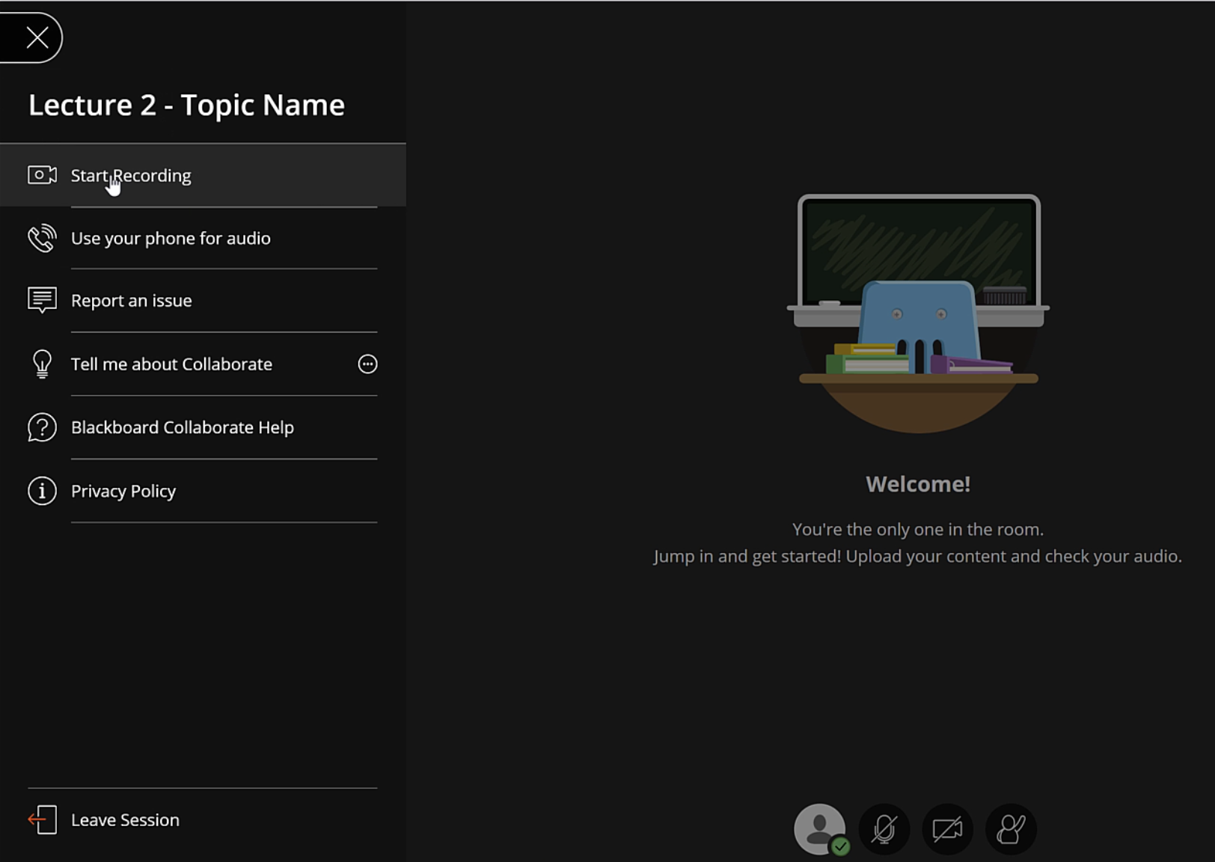
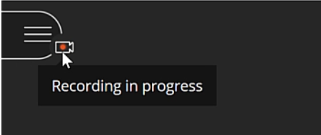
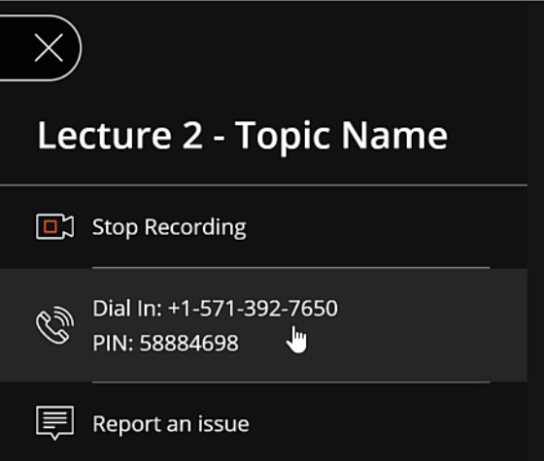
Open Session Menu Panel
Notes:
Click on the button that looks like three horizontal white lines to open the Session Menu panel. If you click Start A Recording, attendees will receive a notification that the session is being recorded and they will see a Recording in Progress red camera icon in the upper left. There is a link to report an issue to Bb, give them feedback on your experience, learn about how to use Collaborate on help.blackboard.com, read their privacy policy and a link at the bottom to leave the session when finished.

Slide 26
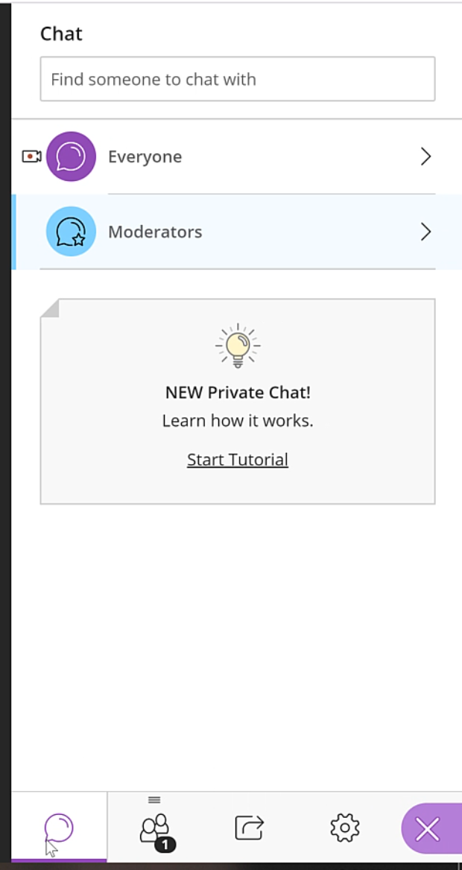
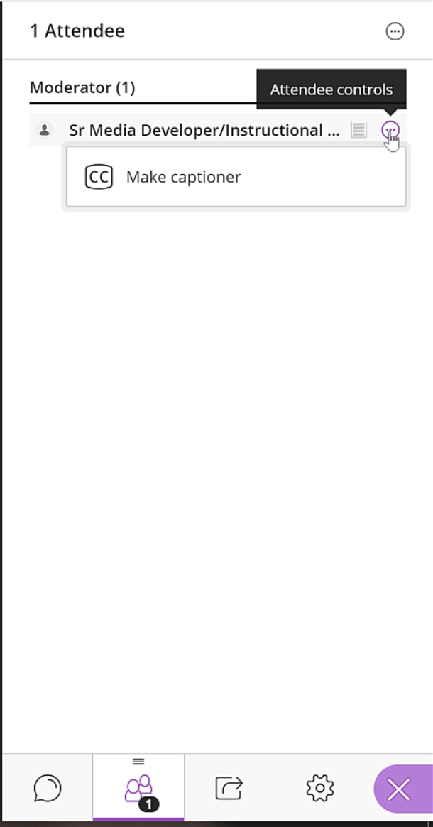
Bb Collaborate Panel on Right
Notes:
The first button opens the chat panel. You can select who you would like to send chat messages to. You can also send private messages to a moderator. The second button is where you can see the attendees. To the left of their name is a Attendee Control button that will allow you to change their role from participant to Moderator, Presenter, or Captioner. I’m the only one in this session, so I can only make myself a captioner. Once this is assigned, the captioner will get a text entry box at the bottom where he or she can type what is said in the conference.

Slide 27
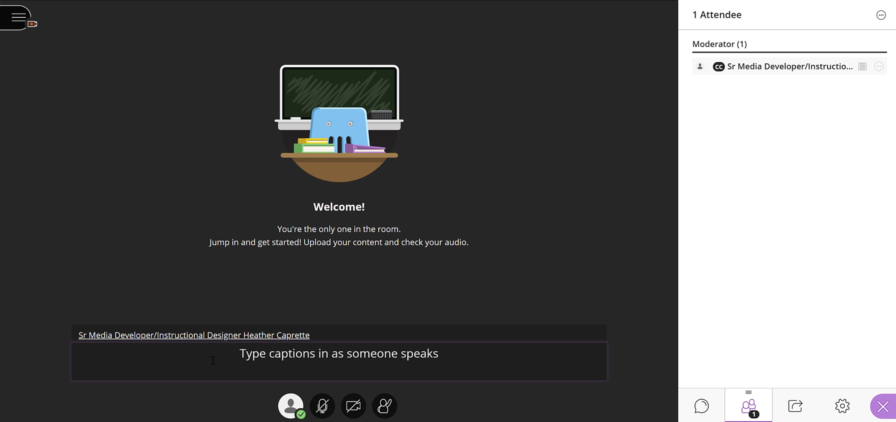
Captioner’s View
Notes:
See the black captioning text entry box at the bottom.

Slide 28
Setup Microphone and Camera

Slide 29
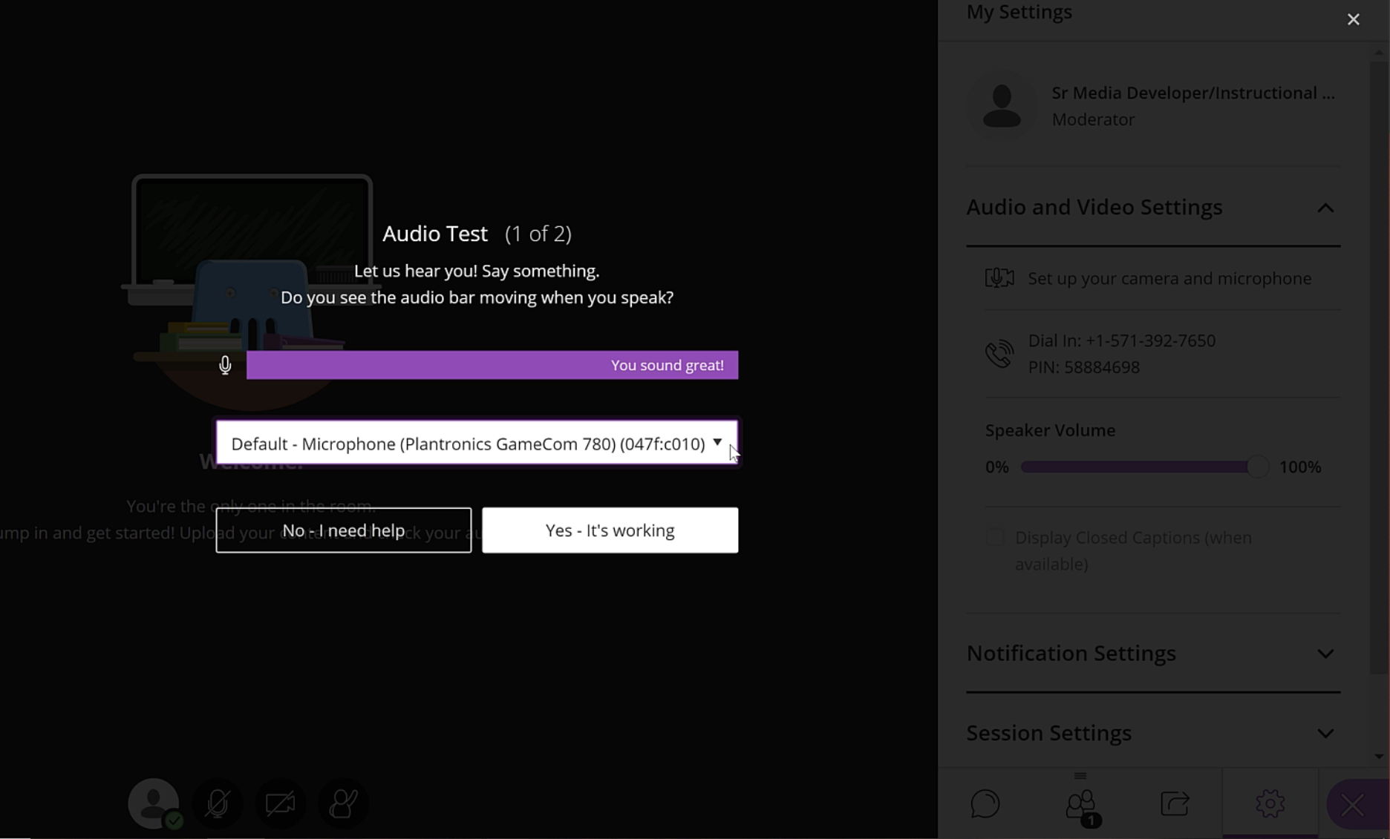
Speak and adjust Mic
Notes:
You’ll setup your mic first. Speak and watch for a message that I can hear you. Click Yes-It’s working.

Slide 30
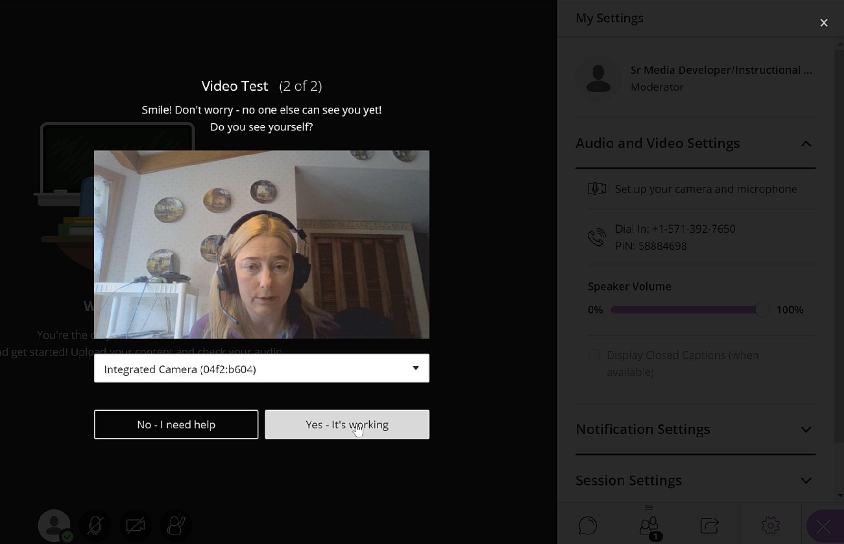
Setup a Webcam
Notes:
Next, collaborate will test your video camera that is either integrated with your laptop, or a webcam attached via USB. I don’t recommend sharing video because it is going to be a problem for those with weaker internet connections. Uses up bandwidth.

Slide 31
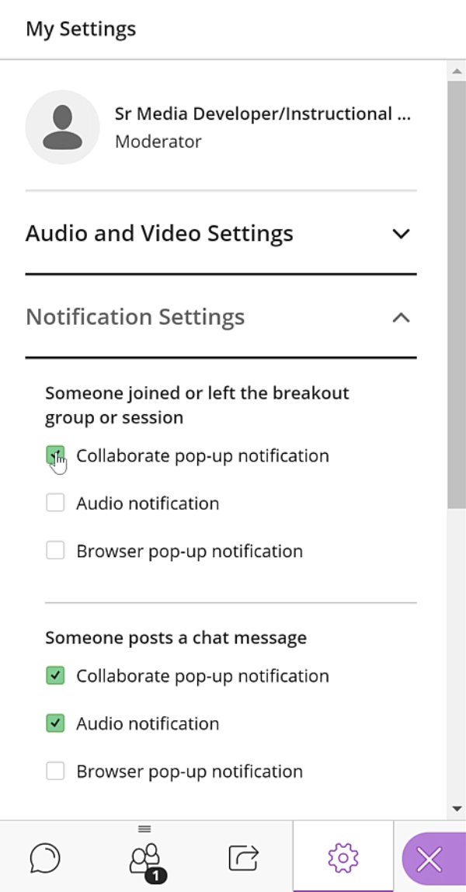
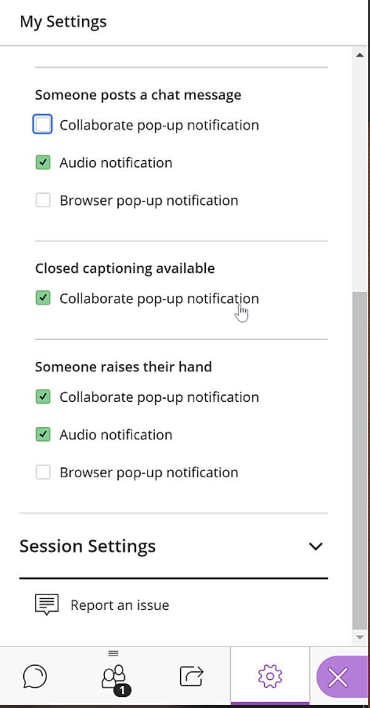
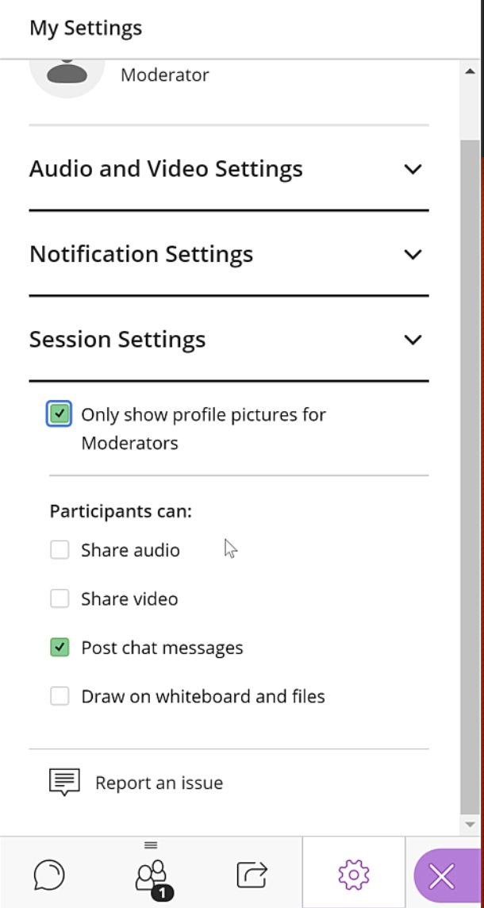
Other Settings
Notes:
Turn off notifications for when someone joins or leaves the session. May want to turn off chat notifications until you take a break to look at chat and answer any questions. Notifications are visual and auditory. Uncheck both. Leave notice for Captioning available on in case someone needs them for accommodation. You can also receive an audio and pop-up notification when someone raises their hand. Session Settings are where you can set the permissions that the participants will have. I recommend turning off audio and video and possibly whiteboard. You don’t want to hear background noise from the attendees environment when you are speaking. Video will take up bandwidth and don’t use it unless you need it.

Slide 32
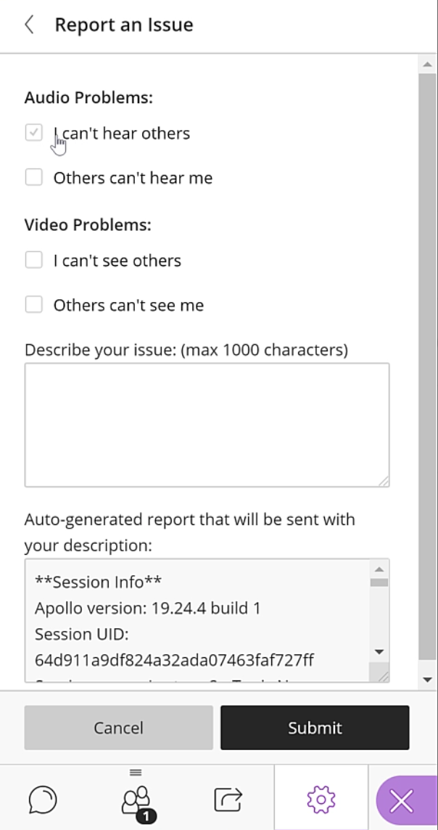
Report an Issue to Blackboard
Notes:
You can expand Report an Issue to Blackboard if you need to report a problem with the application. Click submit after you check off or describe what went wrong.

Slide 33
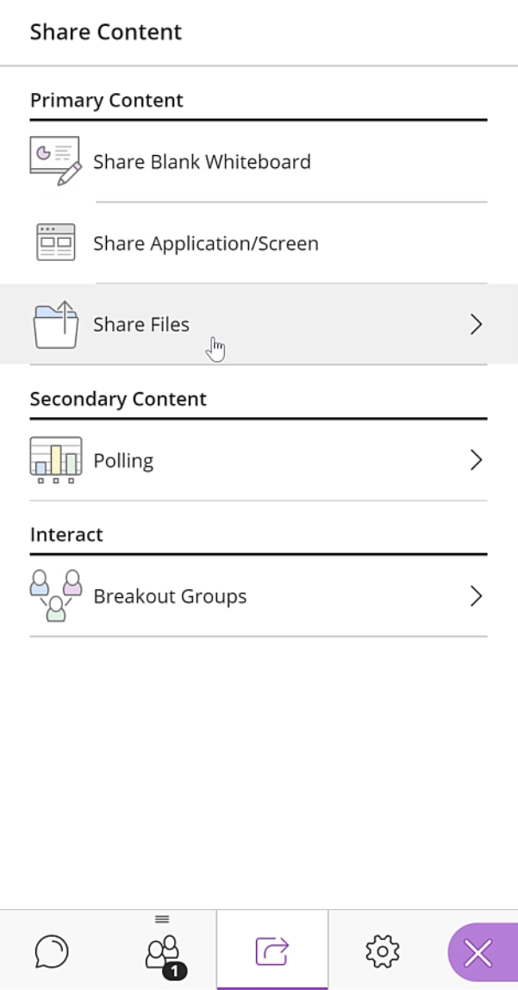
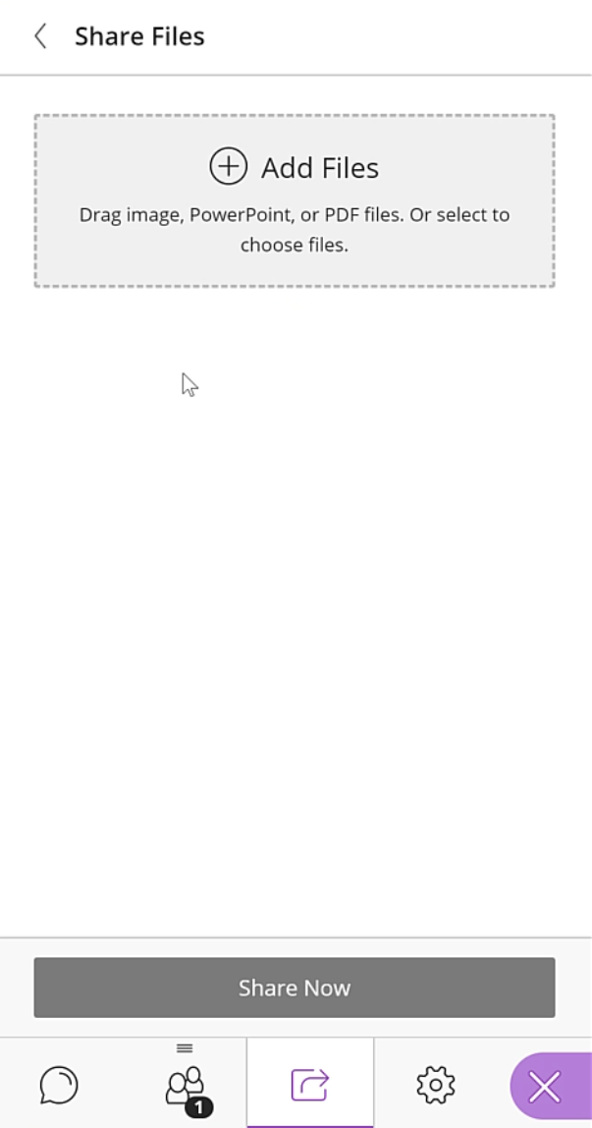
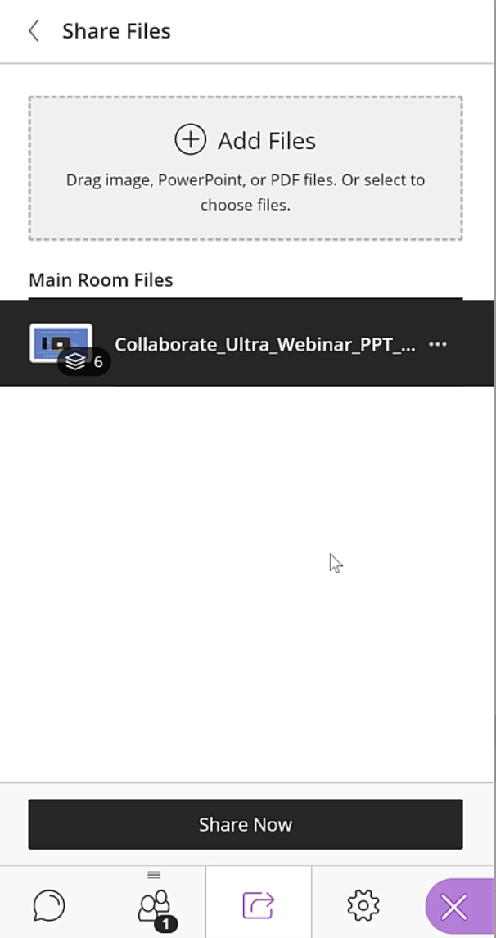
Sharing Content Panel View
Notes:
Next we will move on to Sharing Content. You first click the Sharing content button at the bottom that looks like a square with a bent arrow in it. You can share PowerPoint, PDF and image files under Share Files. You can share your screen, or an application, such as a browser with the Share Application/Screen button. You can share a blank whiteboard on which you draw or type out ideas. There is polling available. It offers multiple choice and true/false questions. There are also Breakout Groups which pulls attendees away from the main session and into separate sessions in which they can share ideas before being brought back to the main session room.
When I click on Share Files, I can click the plus symbol to upload a PowerPoint file. Once loaded, it will be selected in black. Click Share Now.

Slide 34
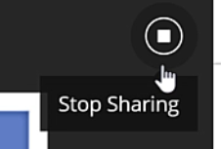
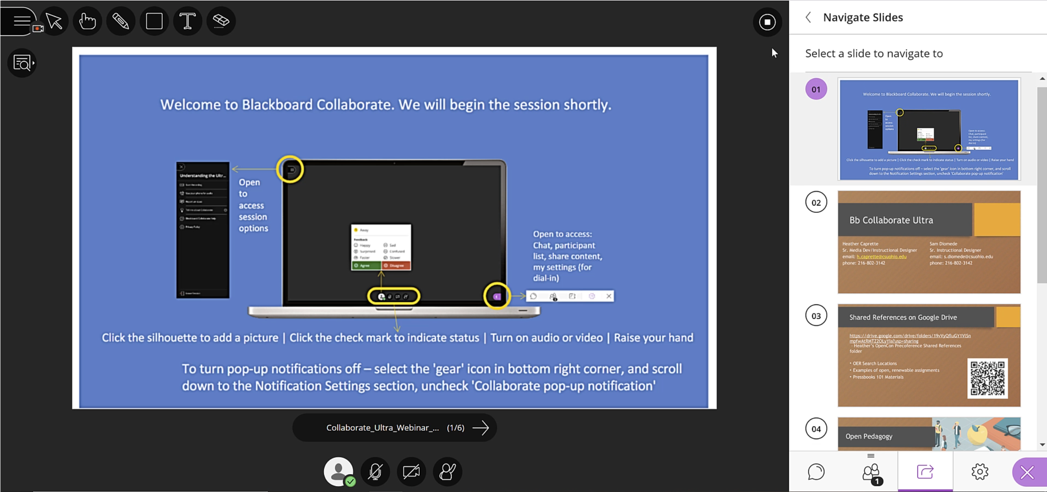
Slides Presented
Notes:
Click on the first slide to present in the main area to the left. The slides all appear in the panel on the right. You can scroll and jump several slides ahead. Or, you can click the arrow to advance the slides. The Stop Sharing button is in the upper right corner. It will stop sharing the PowerPoint.
Annotation tools are located at the top. You can draw freehand on the slide with the pencil, change its color, draw shapes such as rectangles, circles and lines, enter text, use the hand pointer to point at something on the slide and use the arrow tool to select an annotation you want to delete. The eraser will then only erase that line. If nothing is selected, the eraser will erase all annotations.

Slide 35
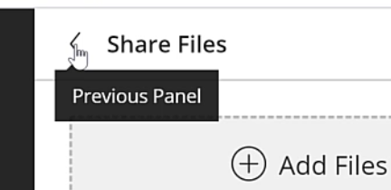
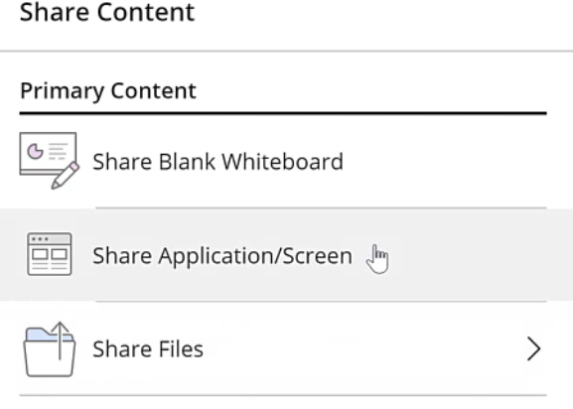
Previous Panel Button
Notes:
Click the Previous Panal button to go back to your sharing options. You can click the Share application/screen button to share your entire screen, or an application such as Word, or a browser tab playing back a Youtube video.

Slide 36
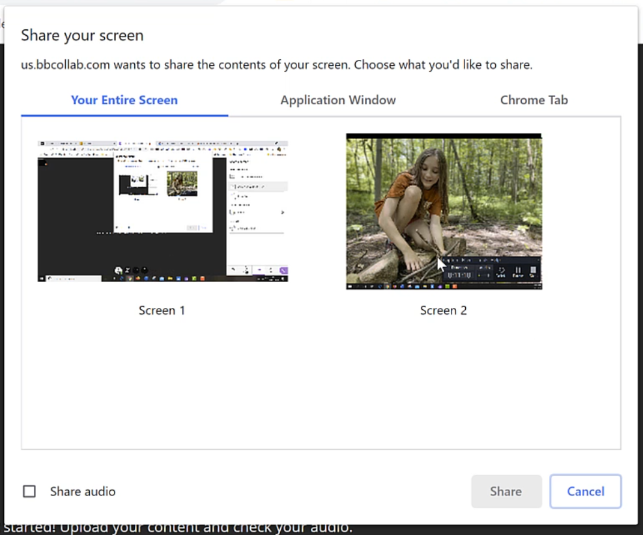
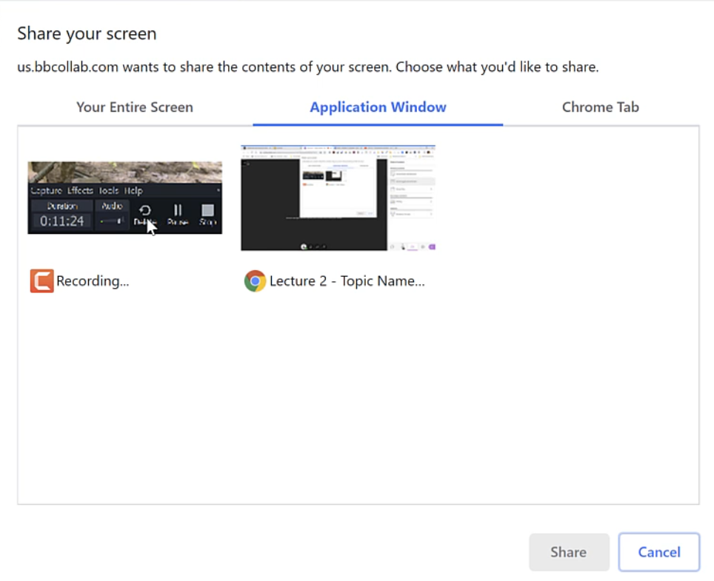
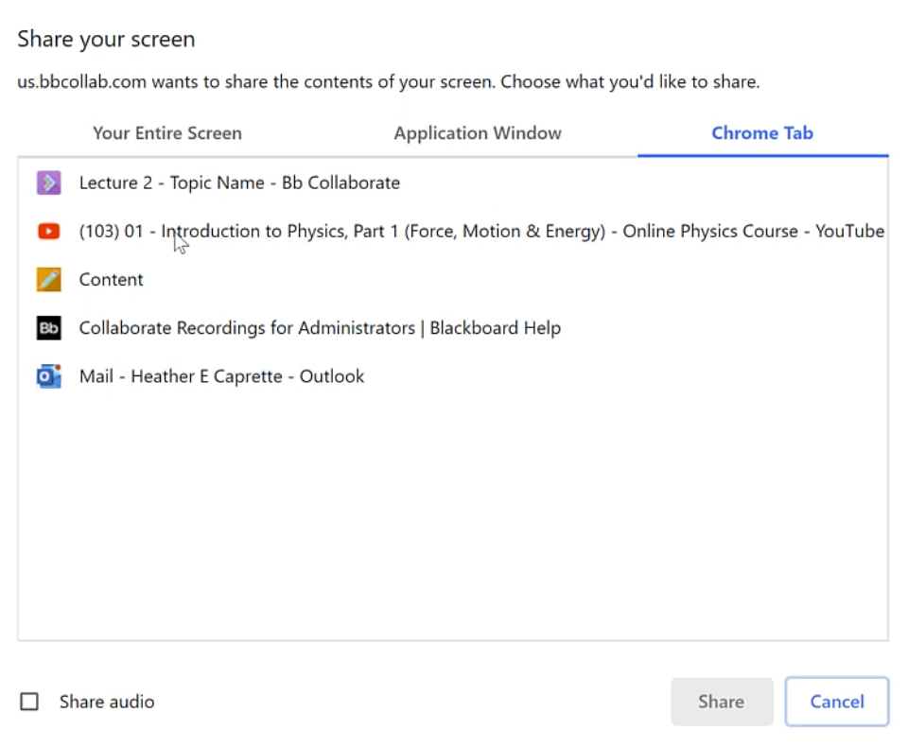
Sharing Choices

Slide 37

Playback the Youtube – lag but plays w audio

Slide 38

Share Blank Whiteboard
Notes:
When you’re back on the Sharing options panel, select Share Blank Whiteboard. You can write problems with a mouse, or use a tablet with a tablet pen.

Slide 39

Notes:
Click into Settings to check off to allow students to draw or use their audio.

Slide 40

Notes:
You can draw freehand with the pencil or use a tablet with tablet pen.

Slide 41

Creating Poll questions
Notes:
Click on Polling on the Share options, then enter your question with answers. Click Start. The poll will show to everyone.

Slide 42


Poll in Progress
Notes:
The poll shows to attendees and they select answers. The numbers appear to you immediately. When done, click Lock Poll and the results will show to attendees. When you want to clear the poll from the interface, click the stop sharing button in upper right.

Slide 43



BreakOut Groups
Notes:
If you click Breakout Groups in the share panel, you’ll have a view where you can drag individuals into groups. They will be taken out of the main session room and can collaborate in their own private rooms together. Then, you can bring them back to the main session room.
On the right is the view of BreakOut Groups in Session. The

Slide 44


Slide 45

Lower Hand
Notes:
After someone has their question answered, click the Attendees Control button to the right of their name to Lower their Hand.

Slide 46

Leave Session
Notes:
When done, expand the Sessions Menu on the left and stop the recording and click on Leave Session.

