Slide 1
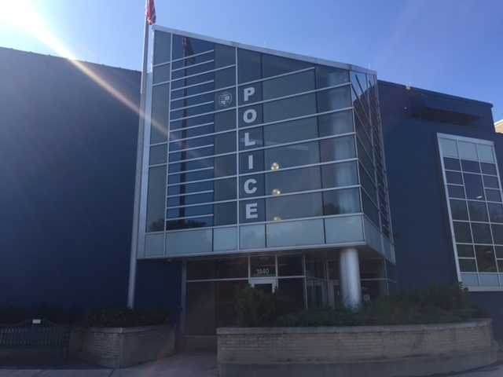
Cleveland State University
Police Department
Safe Transaction Zone
Revised 9/14

Slide 2
What is a Safe Transaction Zone?
A designated area where people meet to exchange personal items either sold or purchased online such as Craigslist or Facebook Marketplace.
By allowing CSUPD to have a Safe Transaction Zone, we would be providing the campus a safe environment to meet other parties and purchase items.
This will enhance our communities safety and further our police department’s mission.

Slide 3
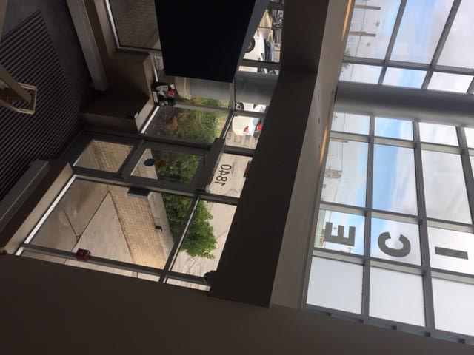
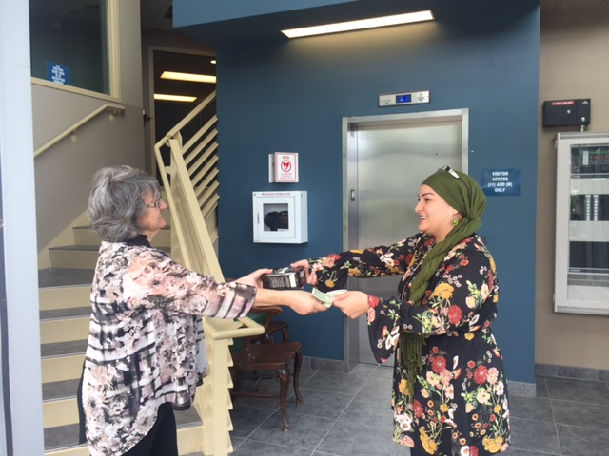
Locations of the Safety Transaction Zones
MAIN ENTRANCE LOBBY- A sign will be posted in the front lobby door that will show people can utilize the front lobby to safely buy and purchase items.

Slide 4
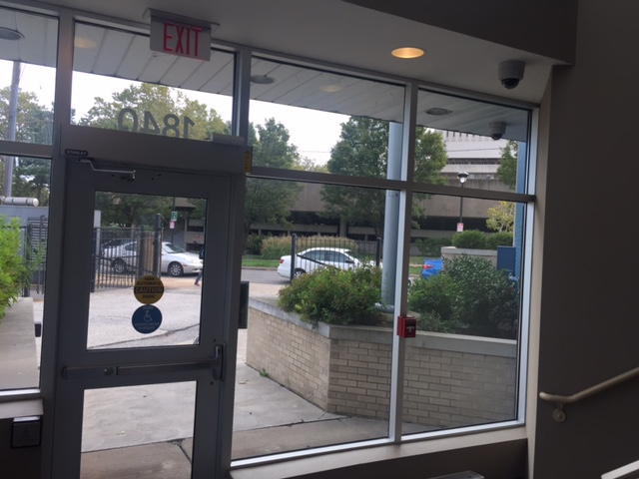
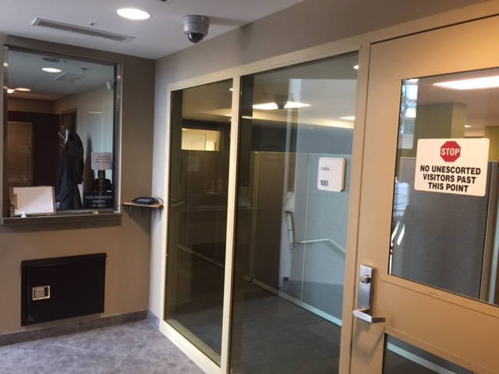
Camera footage and audio recordings are continuously running in the main lobby. There is no need for an officer’s presence during a transaction.

Slide 5
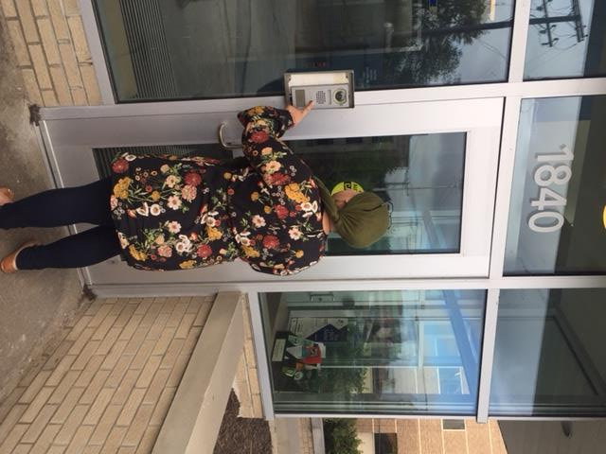
Are there any day or time restrictions?
Yes, it’s suggested you limit meeting during the daylight hours. There are no day restrictions. After business hours, press the front lobby button to speak to dispatch and request entry into the front lobby.
Notes:
Zero Hour Video- Play video before we introduce ourselves.

Slide 6
Restrictions and Additional Information
CCW permit holders are NOT permitted to bring weapons on campus on our police department.
The legal sale of a firearm or other weapons will not NOT be permitted on the police department’s property or anywhere on campus.
We offer no other service associated with the transaction, such as notary services, country money, change, checking for fake/counterfeit money, or verifying money amounts, etc…
You are discouraged from loitering in the department parking lot or lobby for unnecessary lengths of time.

Slide 7
Do I have to make an appointment to use the front lobby or the parking lot for transactions?
No, its not required. Your transactions are recorded.
If I have an expensive transaction, or the other person I’m meeting seems suspicious, can I have a police officer stand by and observe the transaction?
Yes this is possible, but it will be addressed on a case-by-case basis. This will not be apart of Cleveland State University Police Department’s normal procedure for Safe Transaction Zones.
Can a police officer check an item before purchasing to ensure its not stolen?
This is possible under rare circumstances, but generally the burden is on you to make sure the transaction is in your own best interest. Cleveland State University can not be held for liable for providing information if an item is or not stolen before you purchase it.

