Slide 1
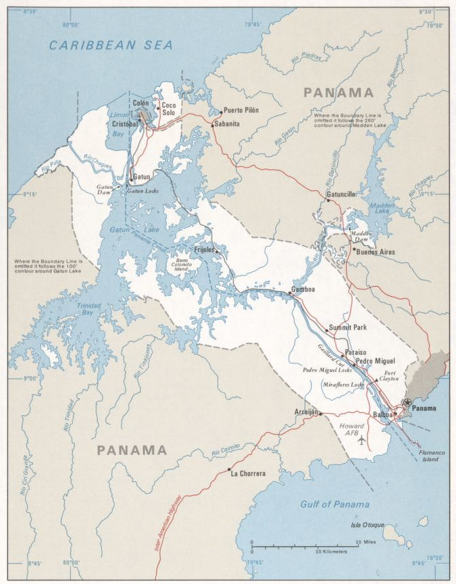
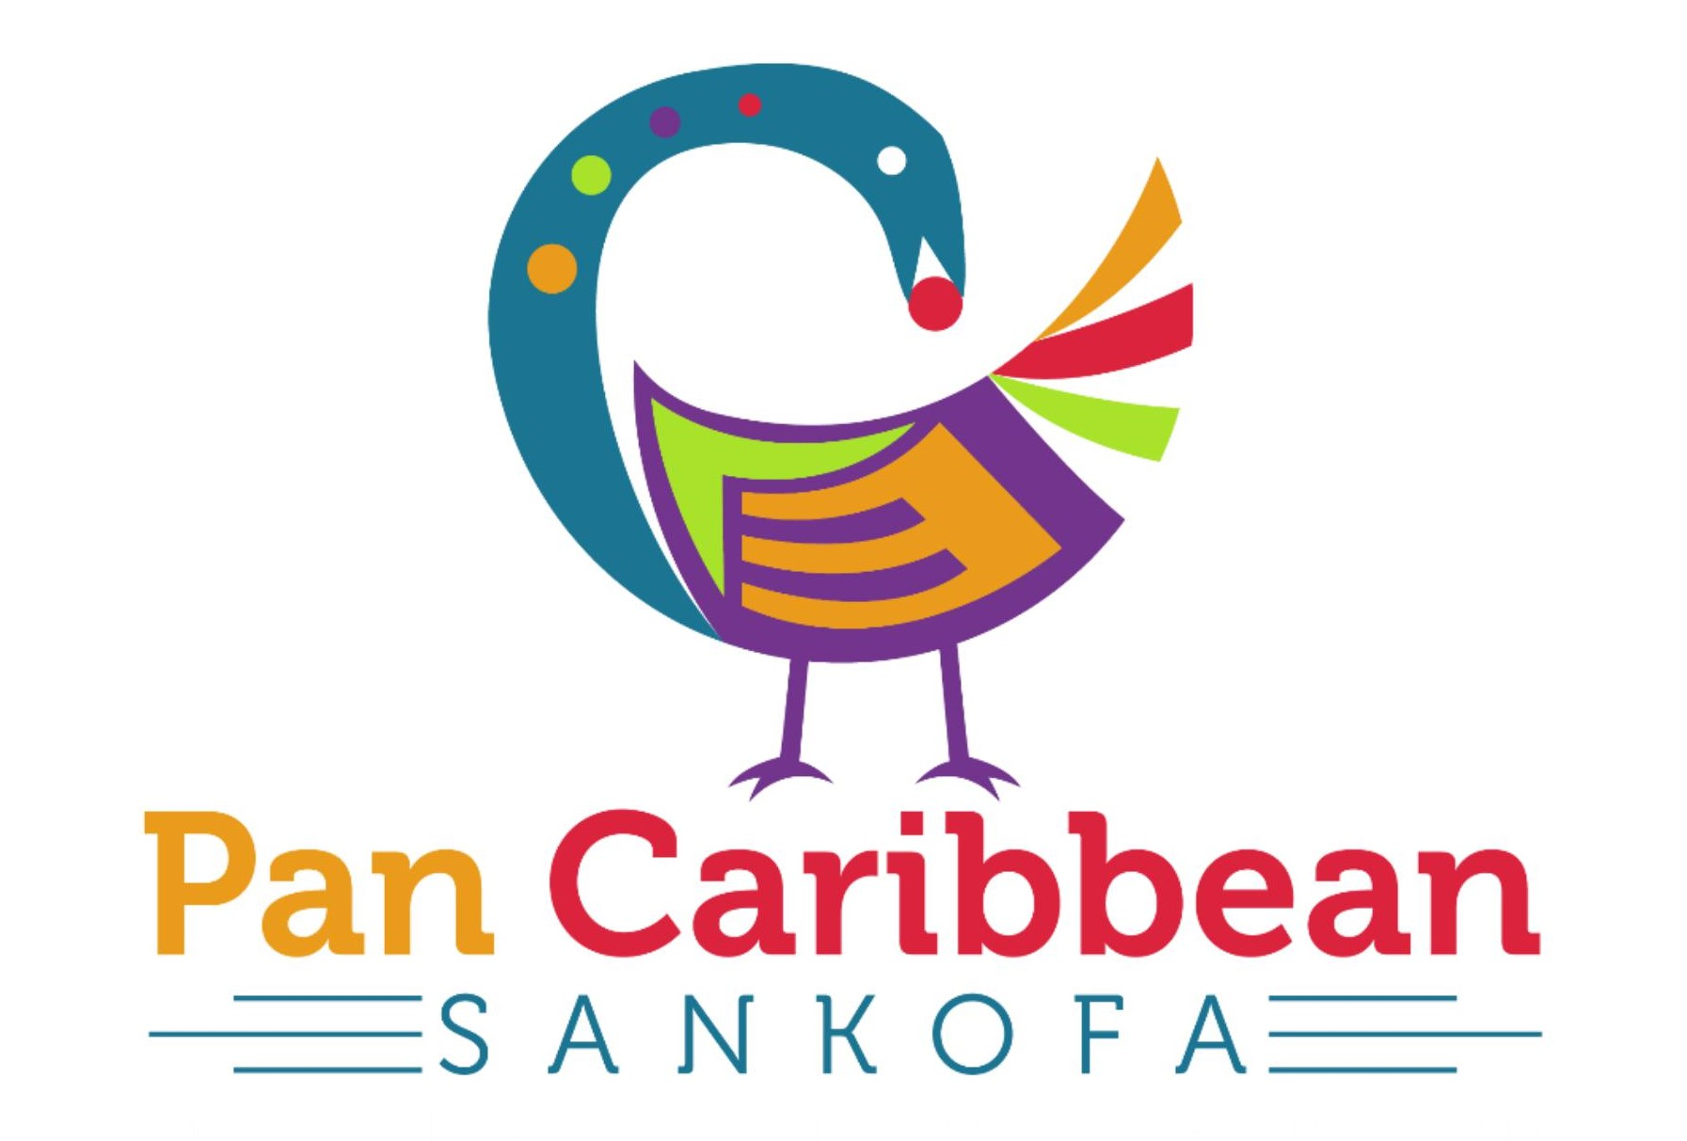
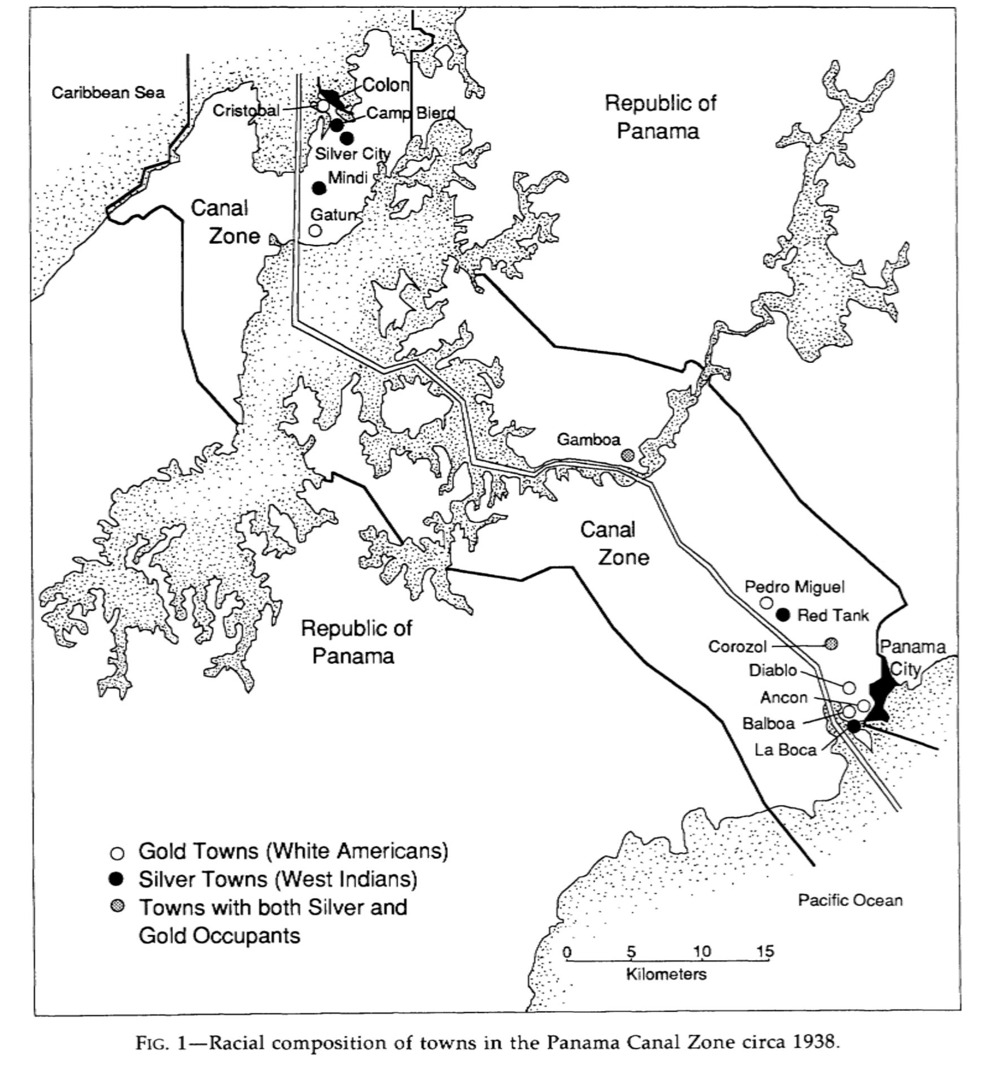
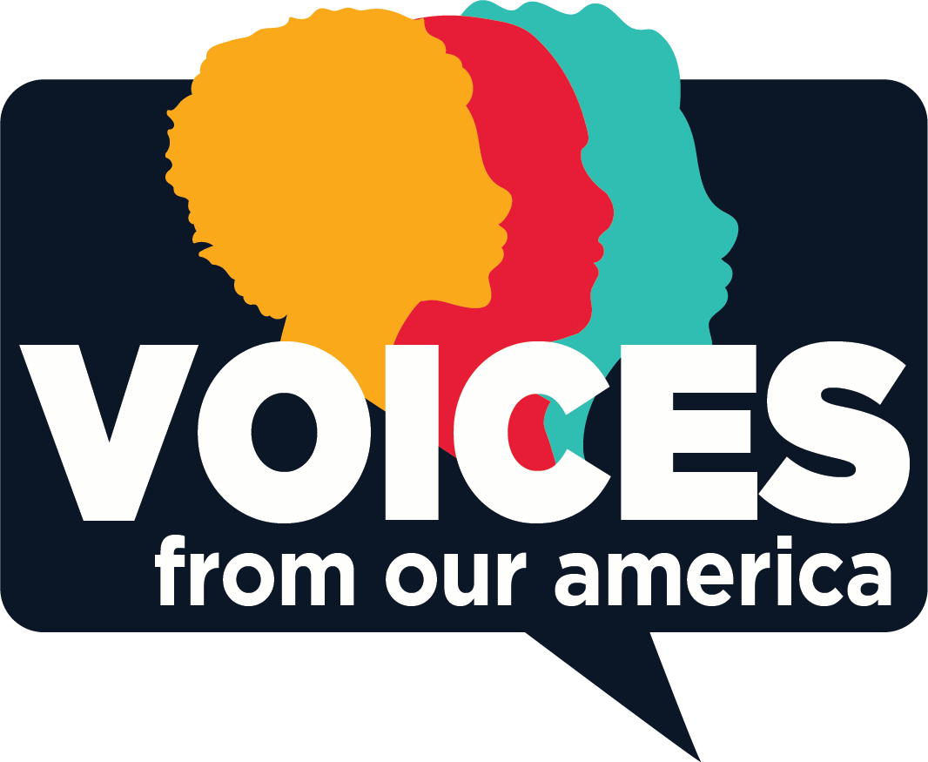
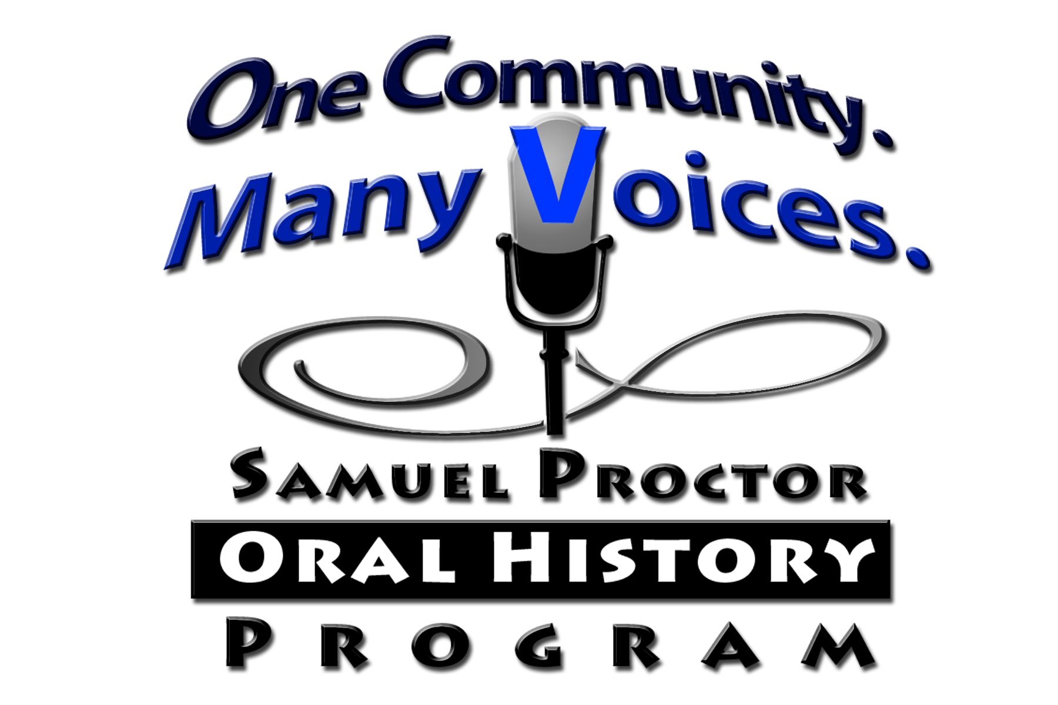
Ground Level Interactions in the Panama Canal Zone
King, Benjamin; Dr. José O. Solá
History Department, Cleveland State University, Cleveland, OH
Abstract
The prevailing academic consensus in the United States of the relationship between the countries of Panama and the United States has shifted during the last two decades. The idea that the relationship between the two nations was based on the United States acting as a beneficent "big brother" to a fledgling democracy is no longer the commonly accepted version of history. Instead, the consensus has moved towards a more unvarnished and nuanced view in which the United States did offer many benefits to the young nation of Panama; the relationship between the two countries was also less nurturing and more imperial and neo-colonial than previously accepted. This research project aims to answer the following question, what were relations like in and around the Canal Zone? Using oral histories of the residents and neighbors of the Canal Zone that were conducted by the Panama Canal Historical Association and Archive at the University of Florida, this research project examines the thoughts, opinions, and feelings of those who lived in the imperial borderland during the US occupation of the Canal Zone. The analysis of these oral histories has led to the conclusion that the United States routinely took advantage of the young country under its dominion while importing a discriminatory and racially segregated system of government into the ten-mile-wide swath of land bisecting the country of Panama. This research project helps to give voice to previously ignored or unheard local voices.
Panama Canal Zone
Summary
United States became an overseas empire after the Spanish-American War.
  Orchestrated Panama’s independence from Colombia.
  Threatened Panama after its independence for concessions to build the canal.
Over 150,000 West Indian laborers arrived to help build the Panama Canal.
These West Indians were discriminated against by US due to race and discriminated against by Panamanians because lack of assimilation.
United States had total control of a 10-mile-wide zone following the path of the canal, completely bisecting Panama.
The zone was strictly segregated until Brown v Board of Education in 1954
White Americans living in the Canal Zone were called Zonians.
Conclusions
Panama Canal operated as a US colony from 1903-1979 when control was given to the Panamanians.
United States treatment towards Panamanians and West Indians fueled resentment, subsequent rise in nationalism after WWII.
Canal Zone police treated the zone as a “sundown town” and made it difficult to cross the zone.
Acknowledgements
Special thanks to Dr. José O. Solá for his invaluable advice throughout the research and the Cleveland State McNair Scholars Program for funding.
Map of the American controlled 10-mile-wide Canal Zone bisecting Panama. United States Central Intelligence Agency. Maps of the World's Nations. [Washington: Central Intelligence, U.S. Govt. Print. Off., (1976) Map. https://www.loc.gov/item/76602171/.
Oral History Collections
Towns designated for Black and White residents of the canal zone

