Slide 1
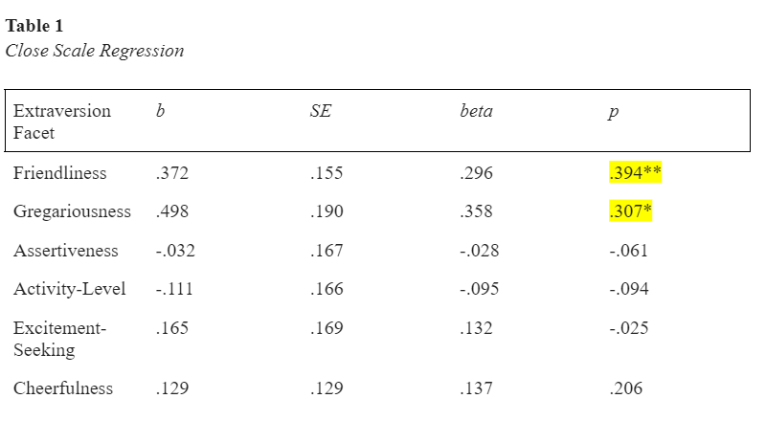
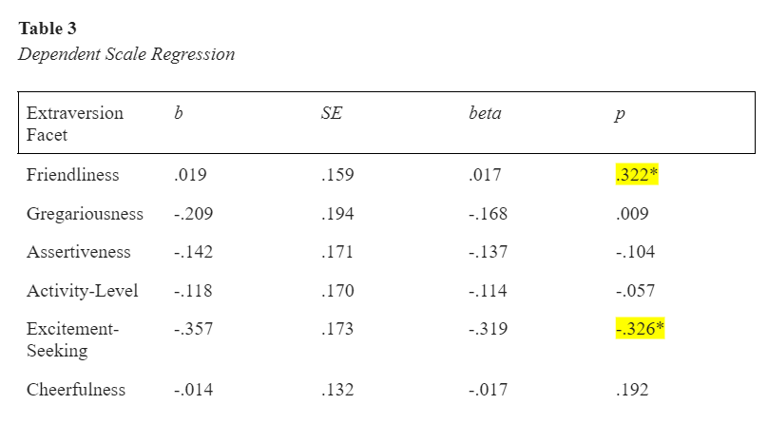
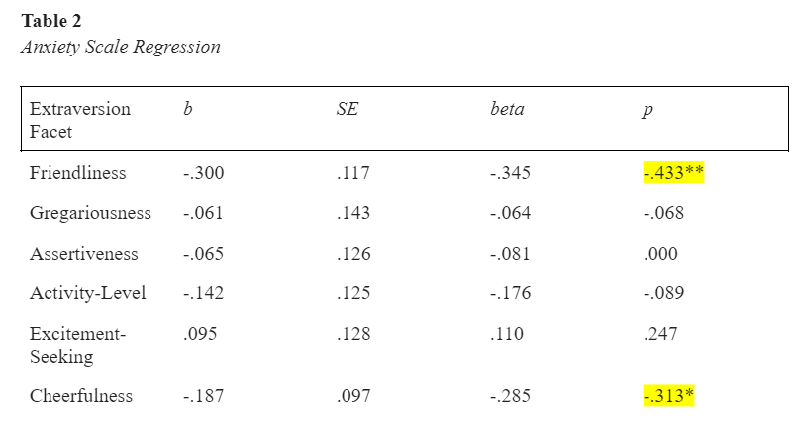
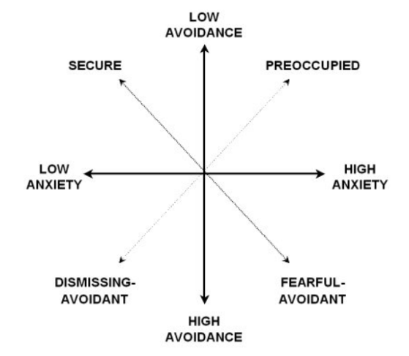
The Relationship Between Attachment Styles and Extraversion
Ciccarelli, Angel; Naser, Shereen
Department of Psychology, Cleveland State University, Cleveland, OH
Abstract
Attachment styles and personality are important parts of one’s identity and may influence future attitudes towards close relationships. An understudied expression of personality that attachment may influence is extraversion. In this study, we examine the relationship between attachment and extraversion by testing the hypothesis that participants with secure and anxious attachment styles are more likely to be extroverted compared to participants with an avoidant attachment (fearful and dismissive). Sixty-nine participants were recruited from Cleveland State University’s SONA Systems online recruitment tool, Research Match, Instagram, CSU Facebook Groups, GroupMe, and email. Participants were asked to complete a self-report survey, which measured their attachment style and extraversion by using the Revised Adult Attachment Scale and the IPIP-NEO 120. Data from sixty-one participants was analyzed by doing a correlation and linear regression analysis. Results found significant correlations between closeness, anxiety towards relationship, dependency, friendliness, gregariousness, cheerfulness, and excitement-seeking. Furthermore, positive correlations were found between friendliness and closeness, closeness and gregariousness, and friendliness and being dependent. Negative correlations were found between friendliness and anxiety, cheerfulness and anxiety, and excitement-seeking and being dependent. These correlations may demonstrate how extraverted specific attachment styles may be and expand the knowledge of the relationship between attachment and personality.
Results
Table 1. Close Scale Regression. Data was collected from 61 participants via online self-report survey followed by regression and correlation analysis. This table shows the regression and correlation between each subscale of attachment (Close, Anxiety, and Depend) and each facet of Extraversion (Friendliness, Gregariousness, Assertiveness, Activity-Level, Excitement-Seeking, and Cheerfulness). * indicates p < .05, ** indicates p < .01. b represents unstandardized regression weights. SE represents the coefficient standard error. beta indicates the standardized regression weights.
Table 3. Dependent Scale Regression. Data was collected from 61 participants via online self-report survey followed by regression and correlation analysis. This table shows the regression and correlation between each subscale of attachment (Close, Anxiety, and Depend) and each facet of Extraversion (Friendliness, Gregariousness, Assertiveness, Activity-Level, Excitement-Seeking, and Cheerfulness). * indicates p < .05, ** indicates p < .01. b represents unstandardized regression weights. SE represents the coefficient standard error. beta indicates the standardized regression weights.
Introduction
Summary
Significant positive correlations between:
- Friendliness and Closeness
- Gregariousness and Closeness
- Friendliness and Dependency
Significant negative correlation between:
- Friendliness and Anxiety
- Cheerfulness and Anxiety
- Excitement-Seeking and Dependency
Conclusions
- Secure Attachment = more likely to be extraverted (more comfortable with being close, friendly, and social with others)
- Fearful-Avoidant Attachment = less likely to be extraverted (because of relationship anxiety, less likely to be friendly and cheerful)
- Dismissive-Avoidant Attachment = less likely to be extraverted (since they are less dependent, have relationship anxiety, and are avoidant, they are less likely to be friendly, cheerful, and social)
- Anxious Attachment = further analysis is needed to understand its potential meaning
Table 2. Anxiety Scale Regression. Data was collected from 61 participants via online self-report survey followed by regression and correlation analysis. This table shows the regression and correlation between each subscale of attachment (Close, Anxiety, and Depend) and each facet of Extraversion (Friendliness, Gregariousness, Assertiveness, Activity-Level, Excitement-Seeking, and Cheerfulness). * indicates p < .05, ** indicates p < .01. b represents unstandardized regression weights. SE represents the coefficient standard error. beta indicates the standardized regression weights.
Acknowledgements
Dr. Naser (Mentor)
Dr. Reyes-Rodriguez (McNair Director)
Members of the C.A.R.E Lab
Funding
McNair Scholars Program
Figure 1. Attachment Styles. There are 4 attachment styles: Secure, Anxious (preoccupied), Dismissing-Avoidant, and Fearful-Avoidant. The image shown above demonstrates each attachment style’s anxiety and avoidance towards relationships. In other words, how worried one is about being rejected or unloved and how comfortable one is with being close to others.

