Slide 1
Active Learning Techniques in Online Classes
Sam Diomede, M.Ed.
LeAnn Krosnick, M.Ed.

Slide 2
Goals
Relate active learning to Bloom's Taxonomy
Describe various active learning instructional strategies for online learning
Identify technology that supports active learning techniques

Slide 3
Agenda
What is active learning?
Reflect on your practice
Examples in online courses

Slide 4
Active Learning Definitions
"The student actively participates in the learning process and takes responsibility for their learning. (Machemer & Crawford, 2007)"
Bonwell and Eison describe Active Learning strategies as those that involve "students doing things and thinking about the things they are doing (Bonwell and Eison, 1991)."

Slide 5
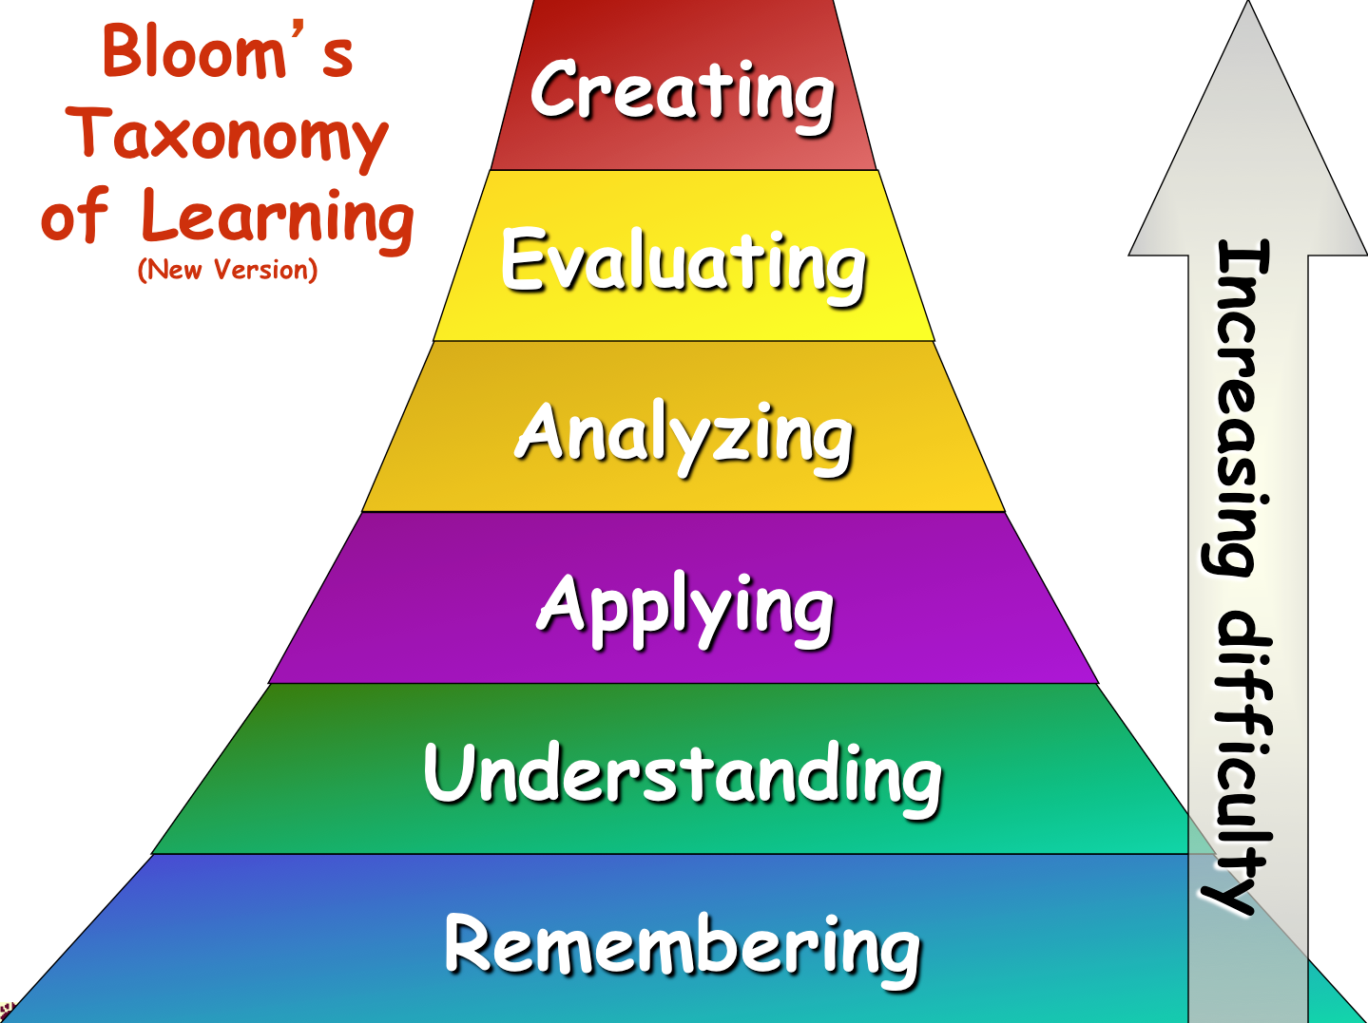
Bloom's Updated Taxonomy

Slide 6
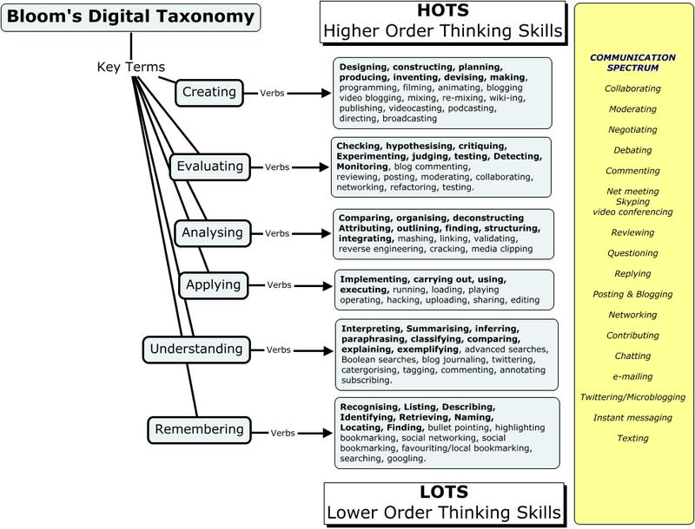
Bloom's Digital Taxonomy

Slide 7
Active Learning Key Features
Invites students to IDENTIFY, EVALUATE, or APPLY ideas contained in new sources
Focuses on CONSTRUCTING, SHARING, and REFINING knowledge
Designed for COLLABORATIVE, INTERDEPENDENT learning: PEER INPUT key to learning
Includes MULTIPLE ITERATIONS for practice: REFLECTION and FEEDBACK are integral part
May be SEVERAL possible CORRECT ANSWERS/SOLUTIONS
Potential for HIGHLY CREATIVE CONTRIBUTIONS
(Salmon, 2013)

Slide 8
Reflect on Your Practice
Reflect on your own teaching practice:
What is one instructional strategy that you have found to be highly effective in helping students meet learning objective(s)?
Why was this strategy effective?

Slide 9
Think About
Did your teaching strategy…
Invite students to IDENTIFY, EVALUATE or APPLY ideas contained in new sources?
Focus on students CONSTRUCTING, SHARING and REFINING knowledge
Have students working in COLLABORATIVE, INTERDEPENDENT groups, was PEER INPUT key to learning
Include MULTIPLE ITERATIONS for practice and include REFLECTION and FEEDBACK.
Have SEVERAL possible CORRECT ANSWERS/SOLUTIONS
Have the potential for HIGHLY CREATIVE CONTRIBUTIONS
(Salmon, 2013)

Slide 10
Categories
Categories of Active Learning Online
Individual learning activities are types where the learner applies course content that is read either online or through course materials through writing and other projects.
Cooperative learning can be defined as a structured form of group work where students pursue common goals while being assessed individually. (Discussions, Blogs)
Collaborative learning refers to any instructional method in which students work together in small groups toward a common goal. (Wikis, Group Work)

Slide 11
Promote active learning using online discussions …

Slide 12
Example from medical ethics course
Online Discussion
Use Case Study/Scenario
Case studies are an ideal way to illuminate the practical consequences of different concepts and discuss opposing viewpoints with classmates.
A 72-year-old man is admitted to the hospital for a kidney transplant. His daughter is brought in as the best available match as a donor. As the man’s doctor, you discover from the pre-op lab work that the daughter is not a suitable donor because she is not his biological daughter. What, if anything, do you tell the man, his wife, or the daughter?

Slide 13
Online Discussion
Promote Controversy
Select a recent ‘hot’ news topic, prompt students to take one ‘side’, explain his or her position, and then respond to a classmate with an opposing viewpoint.
Example from information security course
A fundamental tenet of information security is that you must force the user to periodically change his or her password. But this practice actually undermines security. With constantly changing passwords, users are forced to write them down in an easy-to-find location or use an easy-to-guess algorithm (my street address followed by a ‘1,’ then changed to a ‘2,’ then changed to a ‘3,’ etc.). We are better off letting users keep the same password indefinitely. Do you agree?

Slide 14
Online Discussion
Use Student Moderators to Facilitate Discussion
Facilitator/Encourager: This student gets discussion moving and keeps it moving, often by asking the other group members questions, sometimes about what they've just been saying.
Timekeeper: This student makes sure that the class stays on track within the given time period.
Summarizer: This student provides a summary of the discussion for other students to approve or amend.
Reflector: This student will listen to what others say and explain it back in his or her own words, asking the original speaker if the interpretation is correct.
Elaborator: This person seeks connections between the current discussion and past topics or overall course themes.

Slide 15
Promote active learning using online journals …

Slide 16
Online Journals
can be used for…
Observations: Students write about what they actually saw or their viewpoint on a particular event.
Speculations: Students write a conclusion/opinion after contemplation
Self-awareness: Students place themselves in a situation by considering the ramifications.
Critique: students self-reflect on or “critique” a situation

Slide 17
Promote active learning using online groups…
“In a traditional physics course, two months after taking the final exam, students are back to where they were before taking the course,” Mazur notes. ‘It’s shocking.’
Peer-instructed students who’ve actively argued for and explained their understanding of scientific concepts hold onto their knowledge longer.”
Eric Mazur, Harvard Physics Professor

Slide 18
Online Groups I
Strategies for effective group work…
At beginning of semester, all students introduce themselves in discussion forum
Ask students to add a photo to their Blackboard profile.
Announce group work at beginning of semester
Limit group size to 3 – 4 students
Include a peer review and make students aware up-front

Slide 19
Online Groups II
Strategies for effective group work…
Build in a small-scale group assignment as a starter activity
Include a purpose and detailed & specific instructions for each group assignment
Encourage teams to explore the use of collaborative tools such as Google Docs, Dropbox, Skype
Have group members evaluate contribution of each individual (make them aware of this up-front)

Slide 20
Promote active learning using wikis…
Blackboard feature for online writing collaboration
Saves each iteration of an edit so you can revert back if you need.
Logs who made edits and when.
This is good tool for a group writing project, where it is east for students to build and strengthen previous entries.

Slide 21
References
Bonwell, C.C. & Eison, J.A. (1991). Active learning; Creating excitement in the classroom. ERIC Digest.
Salmon, G. (2013). E-tivities: The key to active online learning. New York, NY.

