Slide 1


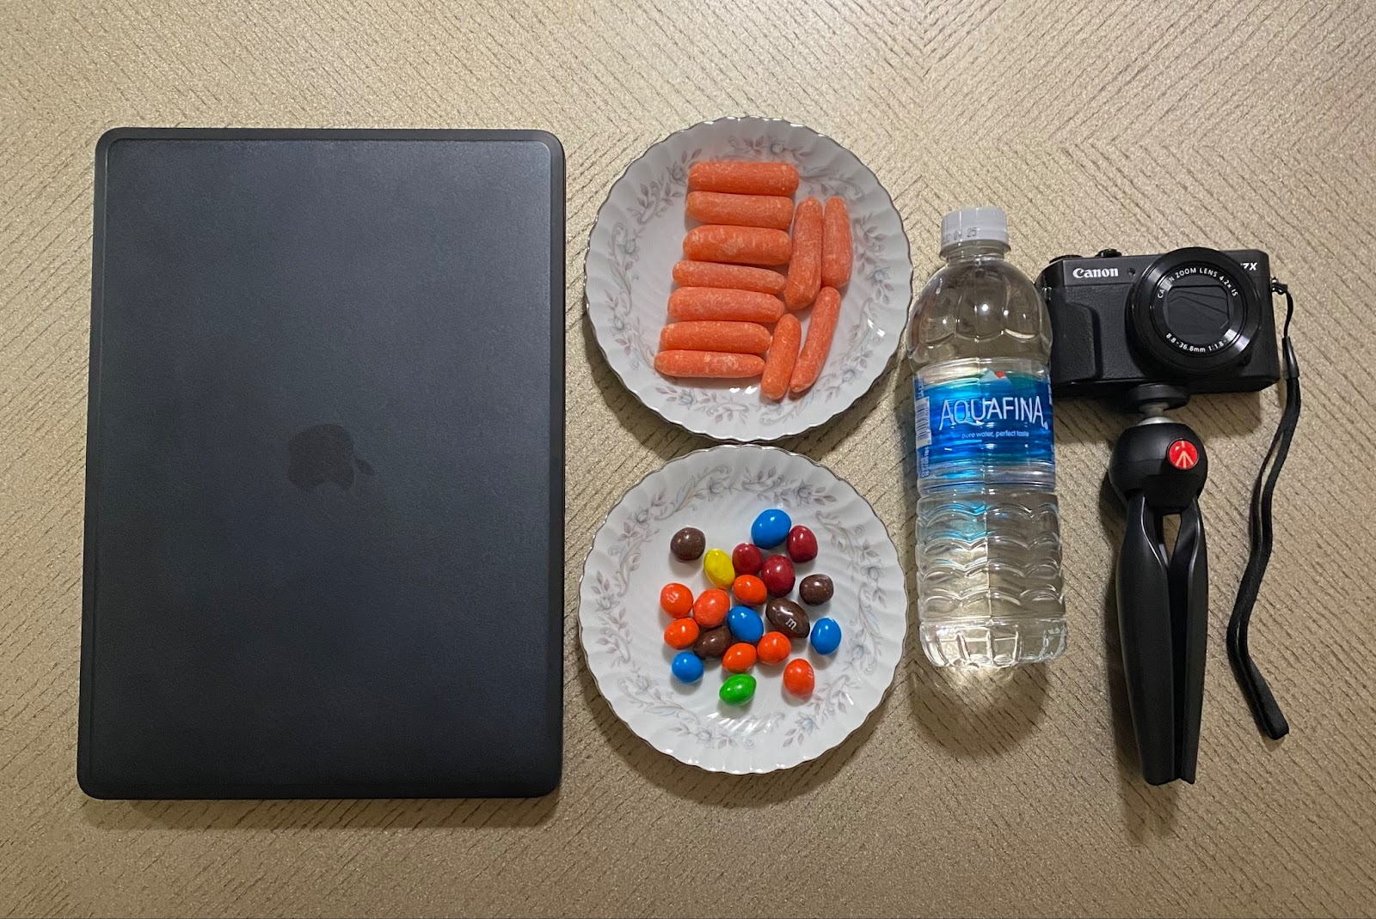
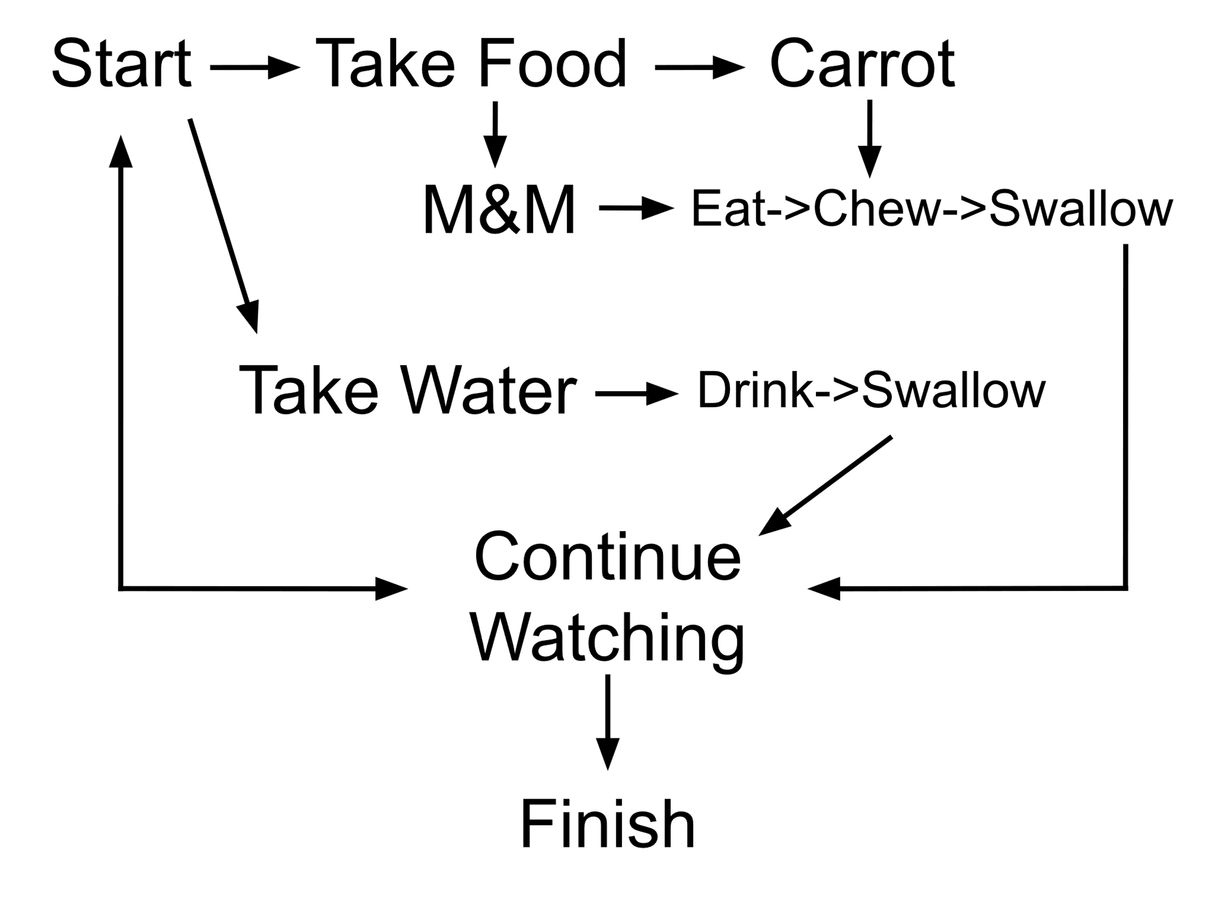
Robotic Assistance Units are giving the Disabled a Helping Hand
ABSTRACT
Warren Turner – Electrical Eng. – CSU
Brett Gucker – Biomedical Eng. – CSU
Jaxon Riley – Mechanical Eng. – CSU
Joel Chavez – Biology – CSU
ANALYSIS
As we patiently observed our participants reactions and behavior during the show, we noticed some very intriguing trends:
Two out of 12 total participants chose not to eat or drink at all, notably within the 18-20 age range. (it is unclear if this is causation or correlation).
Two more participants only ate a couple of carrots and drank water.
A clear preference for the sweet M&M's was shown among all remaining participants, some leaving the carrots completely untouched.
Many participants drank consistently after taking M&M’s.
Typically, participants would start with a much higher consumption level and slowly taper off throughout the course of the episode, although a few did not eat until later in the episode. While this behavior would be very difficult to account for in code, most robotic systems require an initial input to signal for, in this instance, an M&M to be retrieved. We are simply trying to decipher what should come after words. In addition, a higher sample size and closer analysis possible with an A.I. learning model would be useful for facial recognition and patterns as well as recognizing tricky trends in the data.
A lot of people in our world suffer from different types of disabilities that limit their body movement.
These individuals struggle to do normal tasks that able-bodied people often take for granted and rely heavily on the help of others to complete them.
This can cause significant health, psychological, and social consequences related to being confined and needing assistance from others.¹
Modern-day research is trying to give disabled people a chance to regain their independence.
By combining robotics and health, robotic devices that initiate movement for disabled people are being made.²
By creating these types of robots to help people with disabilities, we hope to give them back something they lost and regain their independence once more.
Each participant was given identical bowls of M&M's and carrots. They were also given a bottle of water. (See figure 1)
The same episode of the show "Seinfeld", season one episode one, was presented and participants were told to snack at their leisure.
They were then left alone for the entirety of the episode and recorded via webcam or GoPro.
12 people total were a part of this study, each conducted individually.
After the conclusion of testing, the footage was rewatched by us and a logical behavior diagram was created. (See figure 2)
PROCEDURE
INTRODUCTION/OBJECTIVES
Leading research in assistive robotics and artificial intelligence seeks to fill this exact space in the life of diagnosed paraplegics.
With further research into human behavior, robotics can be used to be assistive in a way that is not intrusive or overbearing.
Our research seeks to study the habits of able-bodied people and answer questions like the following:
  How often will a person get a snack?
  How much of it?
  When will they get a drink?
  What will they choose to consume?
These are the questions we seek to learn more about human behavior and the complexities of it.
The diverse areas of study each member has allows us to show that this experiment encompasses different fields.
This also allows us to bring different knowledge that contributes to the experiment as a whole, allowing us to see the impact it has on different levels.
CONCLUSIONS
After completing our research, our findings provide useful information on the average habits of what people will decide to consume given a couple snacks and a drink. With this information, a robotic arm could be programmed to automatically give its user a certain food or drink without the user having to manually signal the robot to retrieve it; making this system more convenient and easier to use. This method can be the baseline of how the robot will function when it is first used, but also have a program on top of it to adapt to the user’s manual inputs to further improve ease of operation and reduce the need for any manual inputs. A possible input would be to select a food and use A.I. to recognize a desire for more through facial expression and nonverbal/hand signals depending on the affliction of the user. We believe an A.I. model capable of learning from footage such as this is truly the next step in this battle for independence and robotics.
Figure 1. Experiment materials
Acknowledgments
Eric Micheal Schearer, Ph.D., P.E.
Cleveland State University Associate Professor- Mechanical Engineering
References
Schrearer, Eric. “A Robotic Assistance Platform for Self-Feeding.” 2022, https://chms-raf.github.io/
¹ P. D. Neuhaus, J. H. Noorden, T. J. Craig, T. Torres, J. Kirschbaum and J. E. Pratt, "Design and evaluation of Mina: A robotic orthosis for paraplegics," 2011 IEEE International Conference on Rehabilitation Robotics, Zurich, Switzerland, 2011, pp. 1-8, doi: 10.1109/ICORR.2011.5975468.
² Mekki , Marwa, et al. “Robotic Rehabilitation and Spinal Cord Injury: A Narrative Review.” Neurotherapeutics, Elsevier, 9 July 2018, www.sciencedirect.com/science/article/pii/S1878747923010474.
Figure 2. Logical Behavior Diagram

