Slide 1
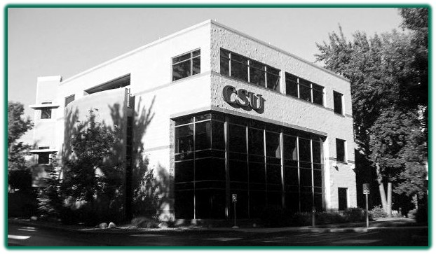
Welcome to Our Virtual Tour

Slide 2
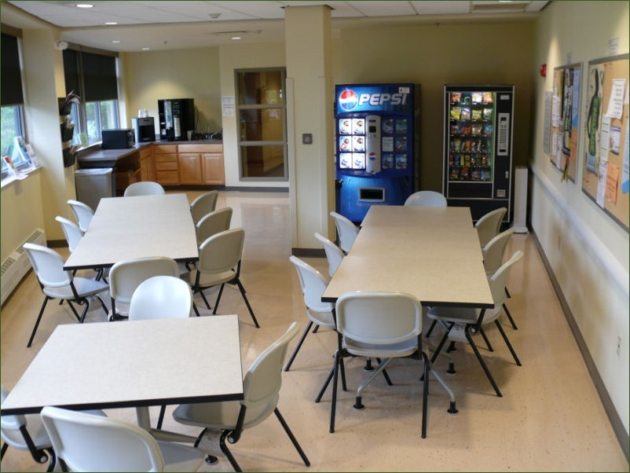
Student Lounge
Second Floor

Slide 3
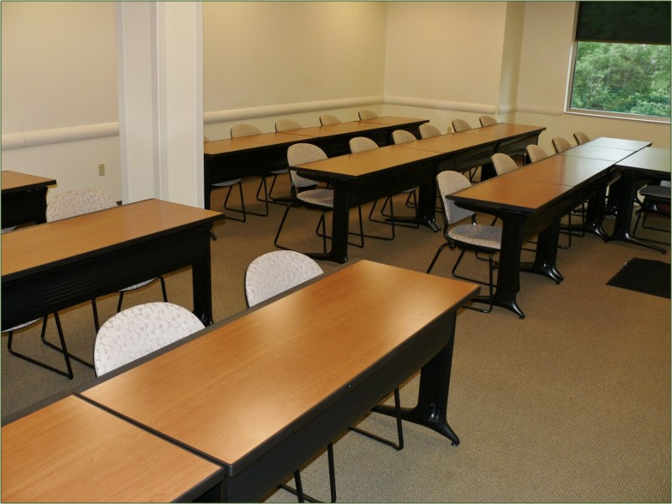
Classroom 211
Seats 28
Whiteboard, projector

Slide 4
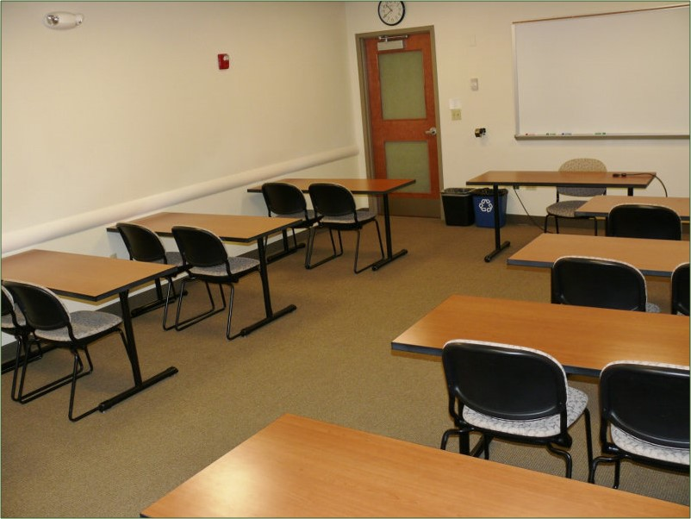
Classroom 212
Seats 16
Whiteboard, projector

Slide 5
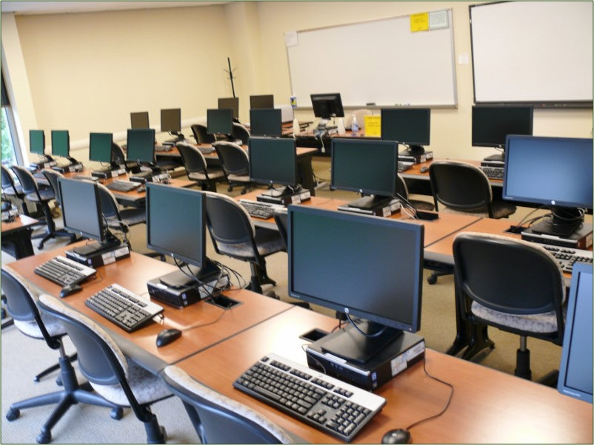
Computer Lab 213
Seats 26
Computers, smart board, whiteboard, projector

Slide 6
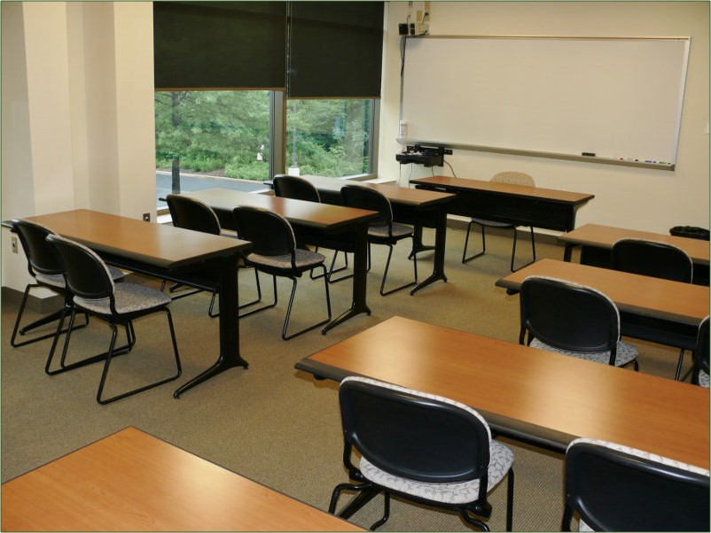
Classroom 214
Seats 16
Whiteboard, projector

Slide 7
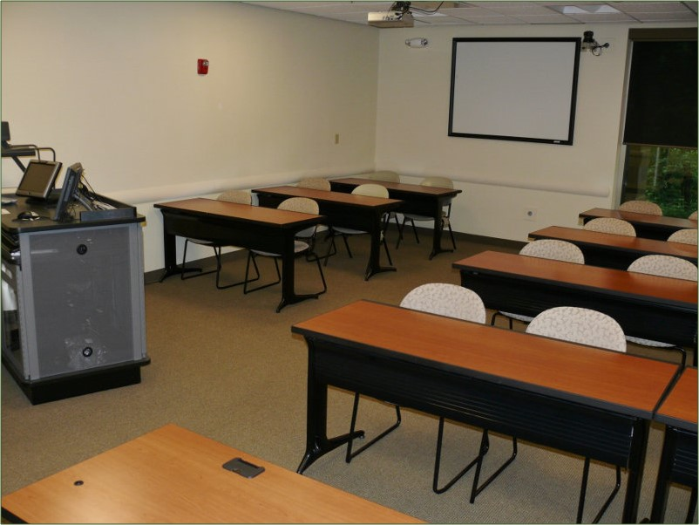
Interactive Video Distance Learning
Room 215
Seats 22
Whiteboard, projector

Slide 8
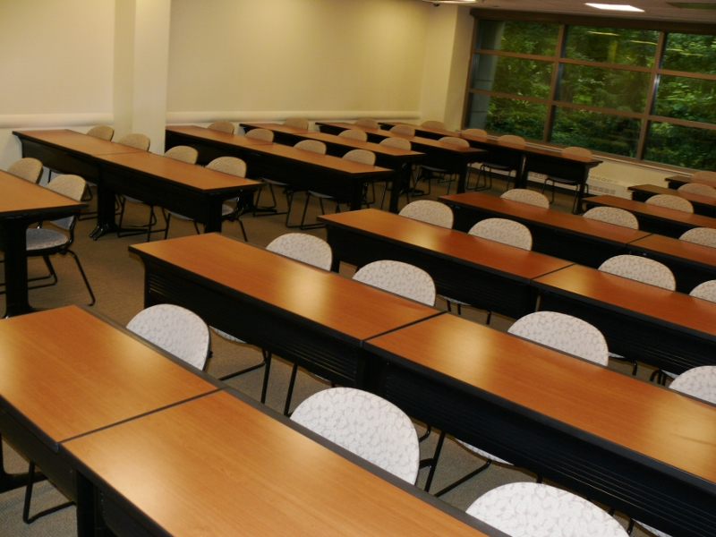
Classroom 216
Seats 46
Whiteboard, projector

Slide 9
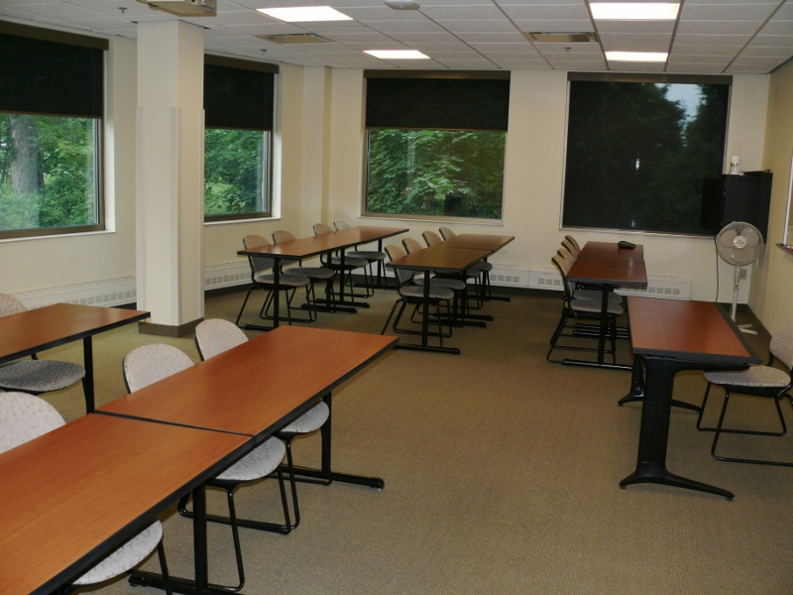
Classroom 217
Seats 30
Whiteboard, projector

Slide 10
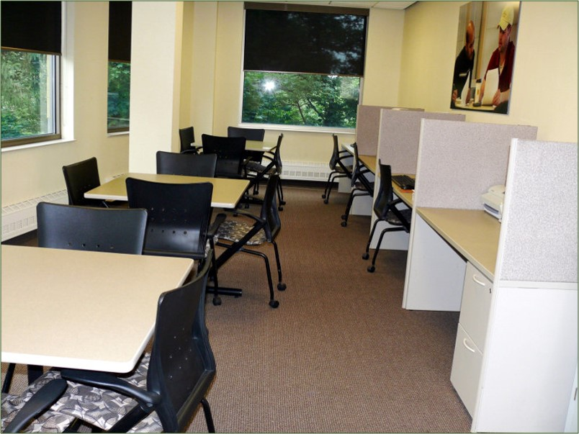
Faculty work area
Third Floor

Slide 11
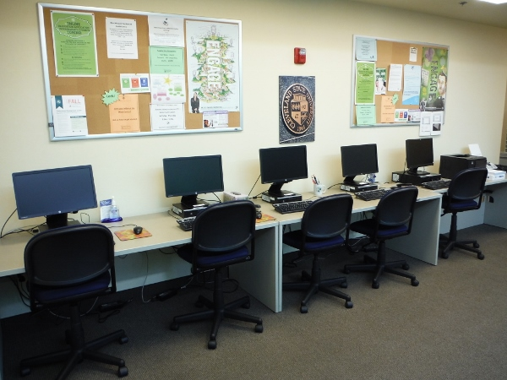
Student Work Area
Third Floor

Slide 12
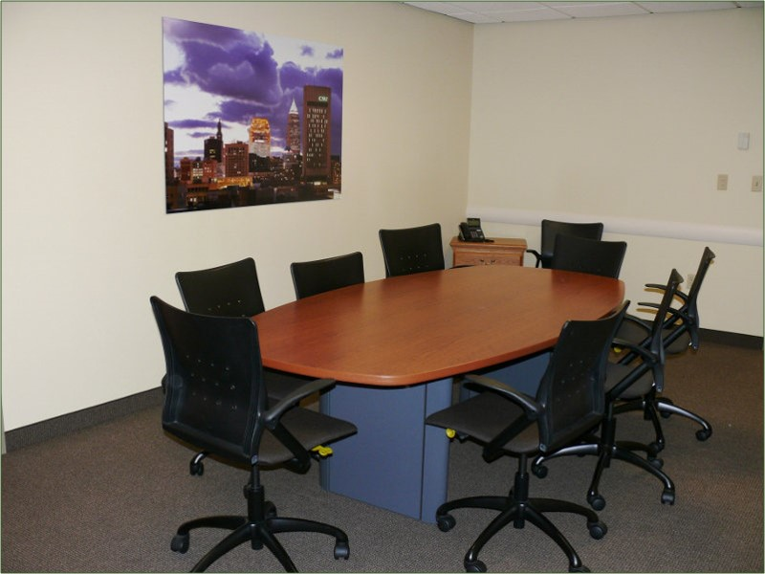
Conference Room
Third Floor
Seats 8 to 10

Slide 13
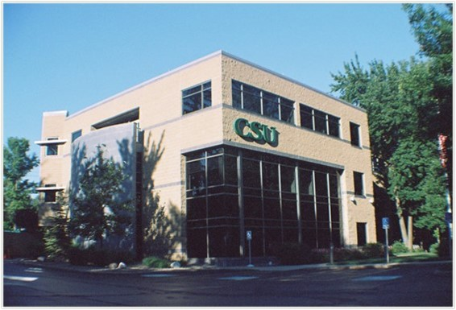
Faculty: Hold classes and workshops here for no added cost of holding them on Main Campus!
Community organizations can hold meetings, retreats and workshops here!
We are here to help you from 8 a.m. to 5:30 p.m., Monday through Thursday, this summer.
The third floor work areas for students and faculty are open Monday though Thursday, from 8 a.m. to 8 p.m.
Thanks for viewing our virtual tour!

