Slide 1
Cleveland State University
Research Posters
Dan Simon

Slide 2
Important Dates
Tuesday, August 1, advisors email Joy Yard:
The title and authors of your poster
The times between 11 am – 2 pm that you will be present at the poster session on Thursday, September 7
Tuesday, August 15, advisors email Joy Yard:
The abstract of your poster
Tuesday, August 15, advisors email the CSU library:
The electronic version of your poster
Thursday, September 7
Undergraduate Research Poster Session
11 am – 2 pm
Student Center Ballroom (3rd floor)
Notes:
Additional details (e.g., email addresses) are available in memos to your advisors and they will be reminded in the coming weeks.

Slide 3
Overview
Posters can be better publicity than papers or presentations
Personal interaction with interested people
The poster can live for years
PowerPoint can be used for any size poster Design → Slide Size → Custom
Many other options besides PowerPoint – Adobe Illustrator, InDesign, Canvas, Publish-It, Corel Draw, LaTeX, etc.
Typical size is usually 3 feet × 4 feet, or 3 feet × 2 feet
Typical orientation is landscape

Slide 4
Poster Size
Make sure that the smaller of the two dimensions of your poster is no more than 42 inches
36” x 48” – good
48” x 42” – good
44” x 44” – no good! If the smallest dimension is greater than 42” the library (and most other print shops) will not be able to print it!
The library appreciates posters that have one of the dimensions exactly equal to 42 inches – no trimming needed!

Slide 5
Outline
What are the important elements for a good poster?
What are important considerations for poster style, printing, and Presentation?
What’s right or wrong with these posters?
What are some final tips for the preparation of a great poster?

Slide 6
1. Poster Elements
Title
Authors
Abstract
Sections
Brief Explanatory Text
References
Acknowledgments

Slide 7
Title
Eye-catching, professional, succinct, clear
Use a results-oriented title, or a question-based title
Between 84 point and 96 point
Good Examples:
Temperature Determines the Sex of Flounder
Can Temperature Determine the Sex of Flounder?
Bad Example:
Studies on the Relationship between Temperature and the Sex of Flounder

Slide 8
Authors
Check with your advisor to get the correct authors in the correct order
Between 30 point and 56 point
Abstract
Typical section headings – between 30 and 48 point Use standard headings for a smooth flow San serif font (Calibri, Arial, Helvetica, etc.)
Introduction (optional)
Objective
Methods
Results – the majority of your poster
Conclusions
Acknowledgments
References
But you can be creative with your section headings

Slide 9
Explanatory Text – between 24 point and 32 point
Serif font (Times Roman, Century, Palatino, etc.)
References and Acknowledgments – about 18 point
Figure and Table Captions – about 18 point

Slide 10
Outline
Poster Elements
Poster Style, Printing, and Presentation
Poster Critiques
Fun Poster Tips

Slide 11
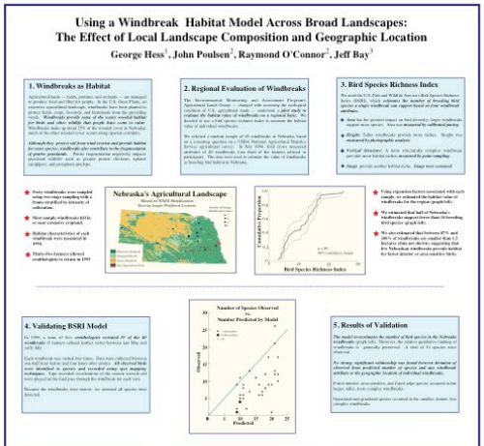
Use bullet points, like in presentation slides
But some researchers like to create their posters using full sentences
The average person spends 90 sec. at your poster
Use dark text on white or very light background
Put your sections in boxes that are nicely aligned

Slide 12
Graphics: make sure you have enough resolution for the full poster size – 300 dpi or greater
Make sure the poster will be intelligible even if you are not there to explain it
It might (hopefully) hang in a hallway for years
Printing
Create a PDF of your poster for printing – you may need to try different ways (export, print as PDF, …)

Slide 13
Common mistakes on research posters:
Too much detail
Too much text
Not enough white space
Text boxes too wide or too narrow
Aim for around 40 characters per line
Poor contrast (for example, dark text on a dark background)

Slide 14
When you’re all done with your poster …
Get some feedback from colleagues before your print it
Evaluate the focus of your poster – will the main points jump out to the viewer?

Slide 15
At the poster session:
Be approachable but not over-bearing
Be prepared to give a 30-second overview
Practice
Find out who you’re talking to first
Start with a question to pique interest and to gauge background knowledge
You should have one version of your overview for novices, another version for experts
Ask your audience questions about their interests – make it a conversation rather than a monologue (yawn)

Slide 16
So, here’s my poster on transfemoral prosthetics. We’re using nonlinear correntropy filters to estimate the system states, and then we feed the system states into a function approximation technique-based controller. We use Lyapunov methods to prove the stability of the estimator and the controller, and also the closed-loop system. We show that we can achieve effective control even without the use of ground reaction force sensors! This is a great advantage because amputees expend up to 60% more energy than normal. So our technology could enable longer prosthesis use and near-normal walking impedance, even without energy regeneration.

Slide 17
So, here’s my poster on transfemoral prosthetics. A prosthesis is an artificial body part, and the femur is the thigh bone, so a transfemoral prosthesis is an artificial leg that is connected to an amputated thigh. One of the problems that amputees have is that they need to expend much more energy than able-bodied persons just to walk across campus. This is because their prosthesis doesn’t perform as well as the natural leg. So our research goal is to control the motors in the prosthetic knee so that the amputee can walk more naturally and with less energy use. This could be a great benefit to amputees because if walking is more natural and more easy, then they will become more active, which will benefit them both physically and psychologically.
Notes:
How many amputees in the US? What is the rate of increase? Why?
How much more energy do you think it requires an amputee to walk compared to an able-bodied person?

Slide 18
Outline
Poster Elements
Poster Style, Printing, and Presentation
Poster Critiques
Fun Poster Tips

Slide 19
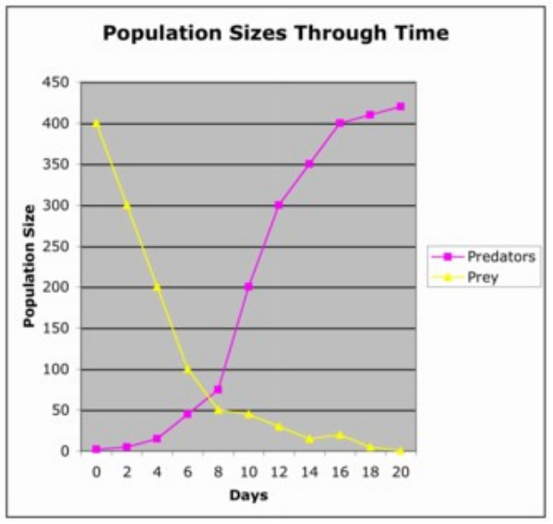
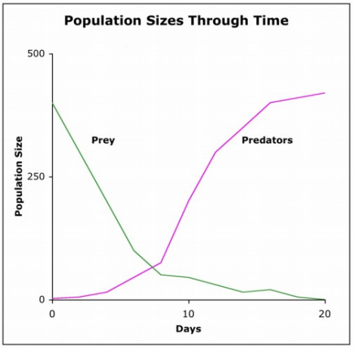
Which graphic is better?

Slide 20
Bad Good
You need to customize your graphics!

Slide 21
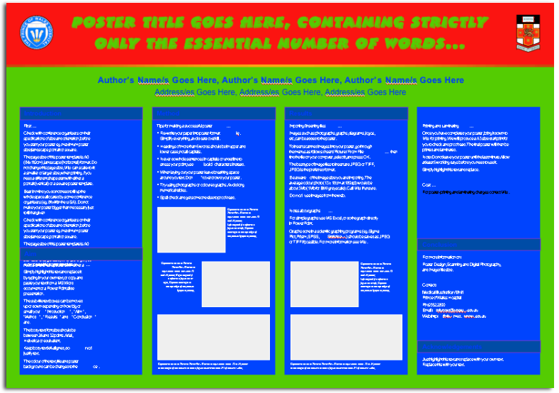
Which poster is more visually appealing?

Slide 22
Which poster is more visually appealing?
Don’t use too many colors
Make sure the text contrasts well with the background
Don’t use busy backgrounds

Slide 23
Notes:
Good, but maybe too much text, not enough graphics

Slide 24
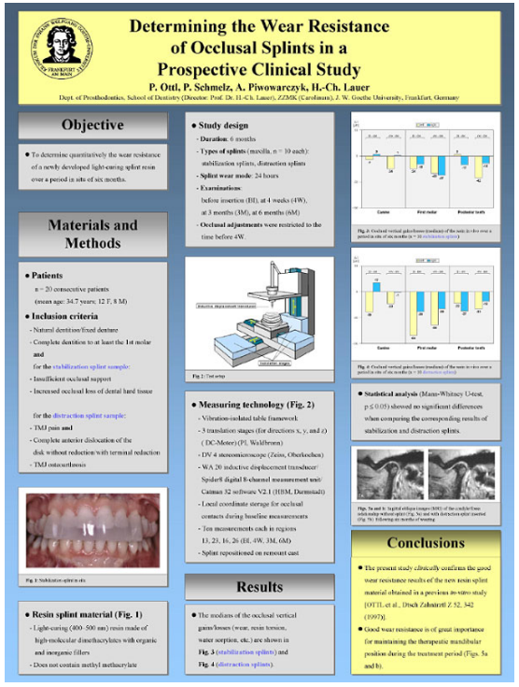
Notes:
Pretty good – is the yellow a little overbearing?

Slide 25
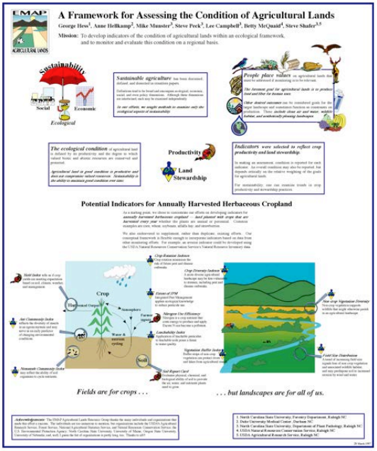
Notes:
Elements are not aligned – sections are not well-connected - where should I begin? What order should I read?

Slide 26
Notes:
Too dark

Slide 27
Notes:
Very nice

Slide 28
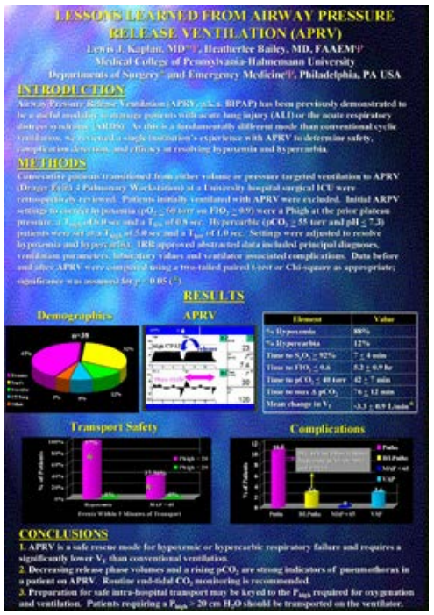
Notes:
Too dark and gaudy

Slide 29
Notes:
Very good – I kind of like the photo of the author at the lower right

Slide 30
Notes:
Too bright, too hard to read, font is too small

Slide 31
Notes:
Very good – too much text?

Slide 32
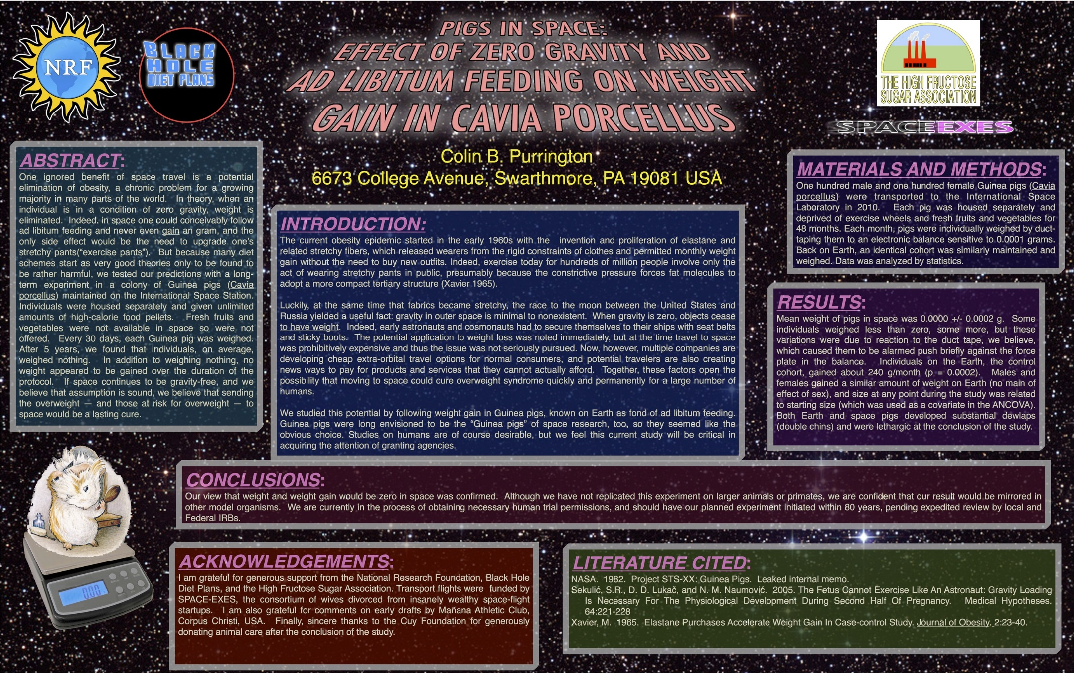
Example by Colin Purrington
Notes:
1. Background image is distracting, wastes ink.
2. Text box backgrounds are dark, which makes text hard to read (and wastes ink).
3. Text box backgrounds are all different colors, for no reason (thus annoying).
4. Text boxes are different widths (and annoying).
5. Text boxes not separated from each other by pleasing “white” space.
6. Text box edges not aligned, which is annoying.
7. Text justified, which causes bad inter-word spacing. Also makes reading harder (brain uses jaggedness of left-justified text).
8. Logos are pretentious (true of any logo).
9. Logos crowd the title.
10. Title perspective is annoying (unless you like Star Wars).
11. Title is in all caps, which is harder to read and obscures Latin name).
12. Title is italicized, which obscures Latin name.
13. Author font color is too loud relative to other text.
14. Too much text.
15. Results are presented in sentences instead of visually with charts.
16. Section headers have more than one type of formatting (big font, bolded, italicized, underlined, and colored — ack!). Choose one. [Note: I forgot to number the sections...that would have been even worse.]
17. Terrible graphic of Guinea pig on scale. Need one of the actual set up (pigs eating while weightless, for example).
18. Inclusion of an Abstract gobbles up space needlessly. Abstract section should be banned from posters.

Slide 33
Problems with poster on previous page:
Background image is distracting, wastes ink.
Text box backgrounds are dark, which makes text hard to read (and wastes ink).
Text box backgrounds are all different colors, for no reason (thus annoying).
Text boxes are different widths (and annoying).
Text boxes not separated from each other by pleasing “white” space.
Text box edges not aligned, which is annoying.
Text justified, which causes bad inter-word spacing and makes reading harder.
Too many logos are pretentious.
Logos crowd the title.
Title perspective is annoying (unless you really like Star Wars).

Slide 34
Title is in all caps, which is harder to read and obscures Latin name.
Title is italicized, which obscures Latin name.
Author font color is too loud relative to other text.
Too much text.
Results are presented in sentences instead of visually with charts.
Section headers have more than one type of format – big font, bold, italics, underlined, and colored – choose one. [Note: Numbering the sections would have been even worse.]
Terrible graphic of Guinea pig on scale. Need one of the actual setup (pigs eating while weightless, for example).
Inclusion of an Abstract gobbles up space needlessly. Abstract sections should be banned from posters.

Slide 35
Outline
Poster Elements
Poster Style, Printing, and Presentation
Poster Critiques
Fun Poster Tips

Slide 36
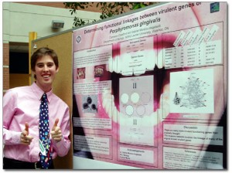
Fun Poster Tips from Colin Purrington
Use hidden panels
Have business cards available
Have hand-out versions of your poster available
Wear clothes that match your poster
Notes:
“Effect of colour coordination of attire with poster presentation on poster popularity,” by D. Keegan, and S. Bannister

Slide 37
Fun Poster Tips from Colin Purrington
Attach a clear plastic cup of candy to your poster
Print your poster on a t-shirt that you can wear – or wear the poster itself (sandwich board)
Pretend someone else’s poster is yours and try to explain it to visitors

Slide 38
Important Dates
Tuesday, August 1, advisors email Joy Yard:
The title and authors of your poster
The times between 11 am – 2 pm that you will be present at the poster session on Thursday, September 7
Tuesday, August 15, advisors email Joy Yard:
The abstract of your poster
Tuesday, August 15, advisors email the CSU library:
The electronic version of your poster
Thursday, September 7
Undergraduate Research Poster Session
11 am – 2 pm
Student Center Ballroom (3rd floor)

Slide 39
References
www.honors.umaine.edu/files/2009/07/make_posters.pdf
www.utexas.edu/ugs/our/poster
http://hsp.berkeley.edu/sites/default/files/ScientificPosters.pdf
http://colinpurrington.com/tips/academic/posterdesign
www.nature.com/naturejobs/science/articles/10.1038/nj7387-113a

