Slide 1
The Lightboard
Center for Instructional Technology and Distance Learning
Chris Rennison – Sr. Instructional Technologist

Slide 2
What is it?

Slide 3
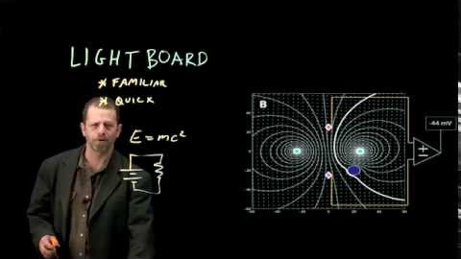
Why Does it Exist?
Micheal Peshkin
Professor of Engineering
Northwestern University

Slide 4
How does it Work?
Pieces and Parts
Where does the information go?

Slide 5
Demonstration
HTML 5
Something simple

Slide 6
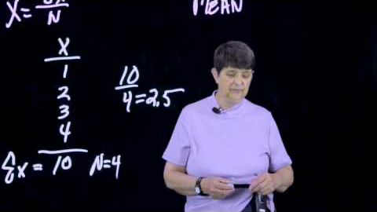
Success Story 1
Win Wizer

Slide 7
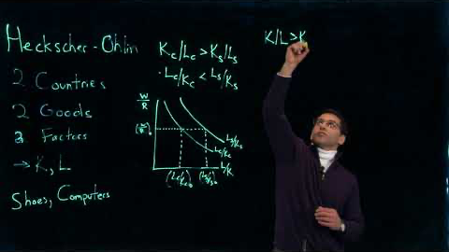
Success Story 2
Bill Kosteas

Slide 8
Questions?

Slide 9
How Do I get started?
Contact Alex Barni
a.barni@csuohio.edu
216.687.5219

