Slide 1
Bringing a Guest Speaker to Class through Videoconferencing
Center for Instructional Technology and Distance Learning

Slide 2
Why Videoconferencing?
Connect with anyone who has an Internet connection
Removes constraints
Cost
Time
Distance

Slide 3
More on Videoconferencing
It’s “in the wild”; it’s ubiquitous
The hardware is cheap
The software is free
It’s easy to do
So why work with CIT&DL?

Slide 4
Webcams as Advertised
Big “head & shoulders” shots
Clear expressions
Eye-contact

Slide 5
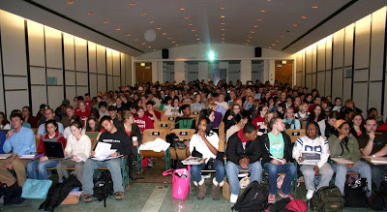
Webcams in Reality
Small, distance shots
Difficult to see expressions
Odd angle, no eye-contact

Slide 6
Using Webcams in the Classroom
A webcam can’t zoom in on who is speaking or produce a shot like the one shown in “as advertised” slide.
Unless the participant is sitting right in front of the camera and screen, People off to the sides or across a table will appear much smaller.
Identifying the body language, expressions, etc. is difficult.
Unless the participant is sitting near the camera/mic, the participant will not be clearly heard.

Slide 7
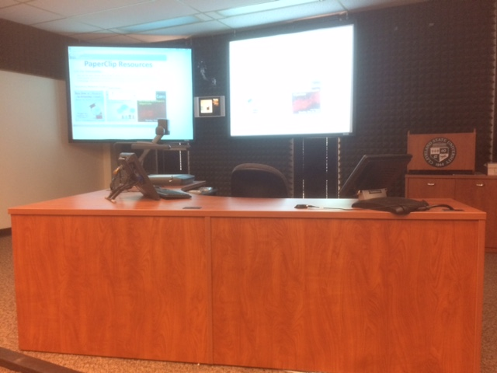
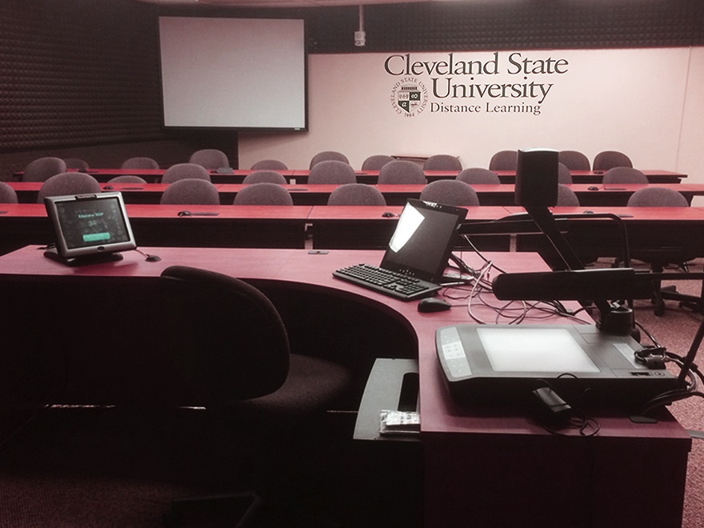
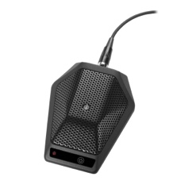
Interactive Video Distance Learning
Creates interactivity through tested equipment
Standards-based conferencing
Push-to-talk microphones

Slide 8
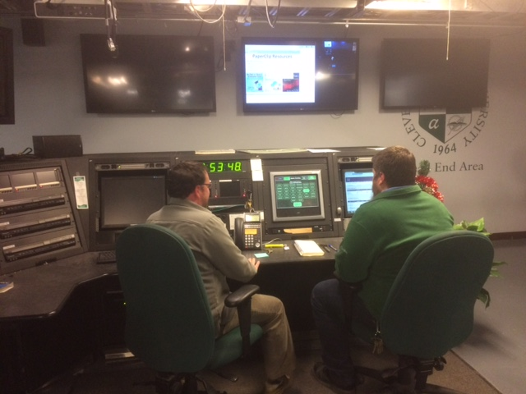
Interactive Video Distance Learning
Reliability of the conference
Hands-on staff
Conferences are monitored at the Head End
We can record it

Slide 9
Recent IVDL Room Activities
Psychology of Language
Search Committees
Dissertations
Brown Bags between Cleveland State and the University of Akron

Slide 10
Where do I get started?
Mark Hackett Audio/Visual Videoconferencing Specialist
RT 705A (216) 687-5270 m.r.hackett@csuohio.edu

