Slide 1
FLIPGRID for
Flipped
Instruction
www.flipgrid.com
Molly Buckley-Marudas, Ph.D.
Assistant Professor, Teacher Education
m.buckley67@csuohio.edu

Slide 2
FLIPGRID EXPERIENCES: A QUICK POLL
I HAVE:
Never heard of Flipgrid (except for this presentation title)
Heard of Flipgrid, but never tried it (as instructor or participant)
Used it once or twice
Used it. Love it

Slide 3
FLIPGRID
The BASICS

Slide 4
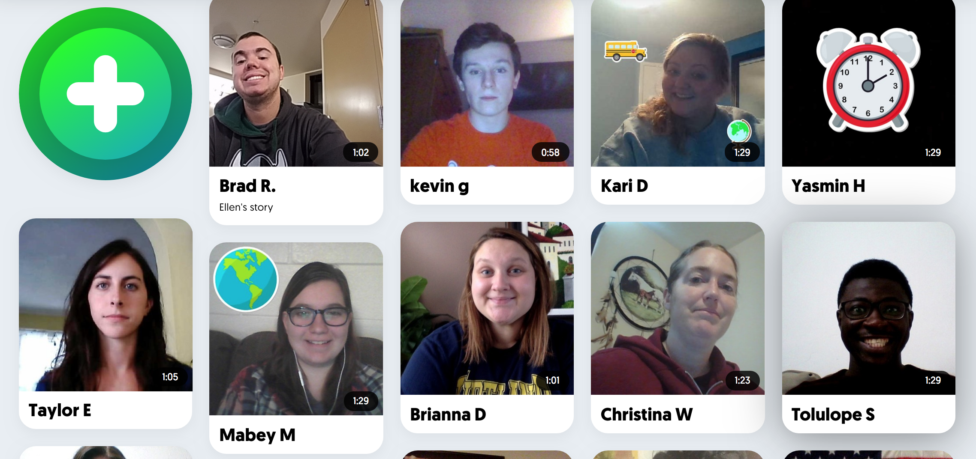
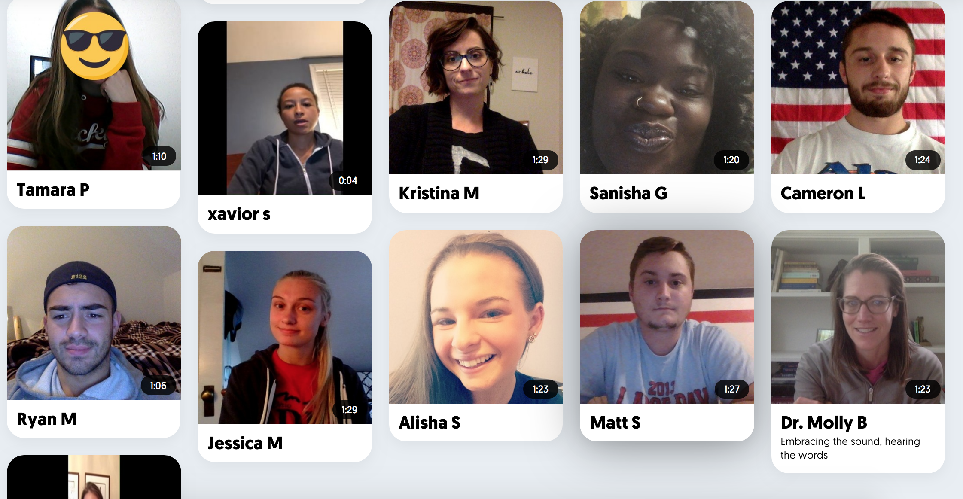
WHAT IS FLIPGRID?
What it is
2. How it works
3. What it’s great for
Notes:
-Allows you to set up a site (a GRID) around a focal topic and pose a question or charge to students. Students respond, via video. You can set the maximum length for the video. All responses become part of a threaded video conversation.
-Participants can respond with text or video to their peers.
-Students can add sticky notes, have fun personalizing their image
-There are built in tools for teacher feedback, rubrics.
-There are many ready to go topics
-There are ideas for flip grid pals (connect with others around a topic).
https://admin.flipgrid.com/manage/grids/720411/topics/2059119?ns

Slide 5
WHAT IS FLIPGRID?
What it is:
  An online platform with easy-to-use video recording tools
  A video discussion board
  Supports student interactions and social learning.
  Basic model: Record > Share> Discuss
Notes:
-Allows you to set up a site (a GRID) around a focal topic and pose a question or charge to students. Students respond, via video. You can set the maximum length for the video. All responses become part of a threaded video conversation.
-Participants can respond with text or video to their peers.
-Students can add sticky notes, have fun personalizing their image

Slide 6
WHAT IS FLIPGRID?
2. How it works:
  Create account
  Set up “grid” around topic
  Pose a question, task, or prompt
  Participants record and share video response (15 seconds – 5 minutes)
  Participants watch videos and reply (in symbols, words, and/or videos)
Notes:
-Allows you to set up a site (a GRID) around a focal topic and pose a question or charge to students. Students respond, via video. You can set the maximum length for the video. All responses become part of a threaded video conversation.
-Participants can respond with text or video to their peers.
-There are built in tools for teacher feedback, rubrics.
-There are many ready to go topics

Slide 7
WHAT IS FLIPGRID?
3. What it’s great for:
  Introductions
  Community Building
  Presentations
  Practicing or rehearsing a presentation
  Check-Ins
  Discussion & Cross-talk
  Feedback
  Sharing Ideas & Resources
Notes:
-There are built in tools for teacher feedback, rubrics.
-There are many ready to go topics
-There are ideas for flip grid pals (connect with others around a topic).
https://admin.flipgrid.com/manage/grids/720411/topics/2059119?ns
Collaborative knowledge-building
Content application
Create community
Critical thinking
Constructivist learning
Allow individualization without isolation
Stimulate participation
Encourage reflection
Summarize key ideas
Create an environment conducive to learning
Pose meaningful questions and problems

Slide 8
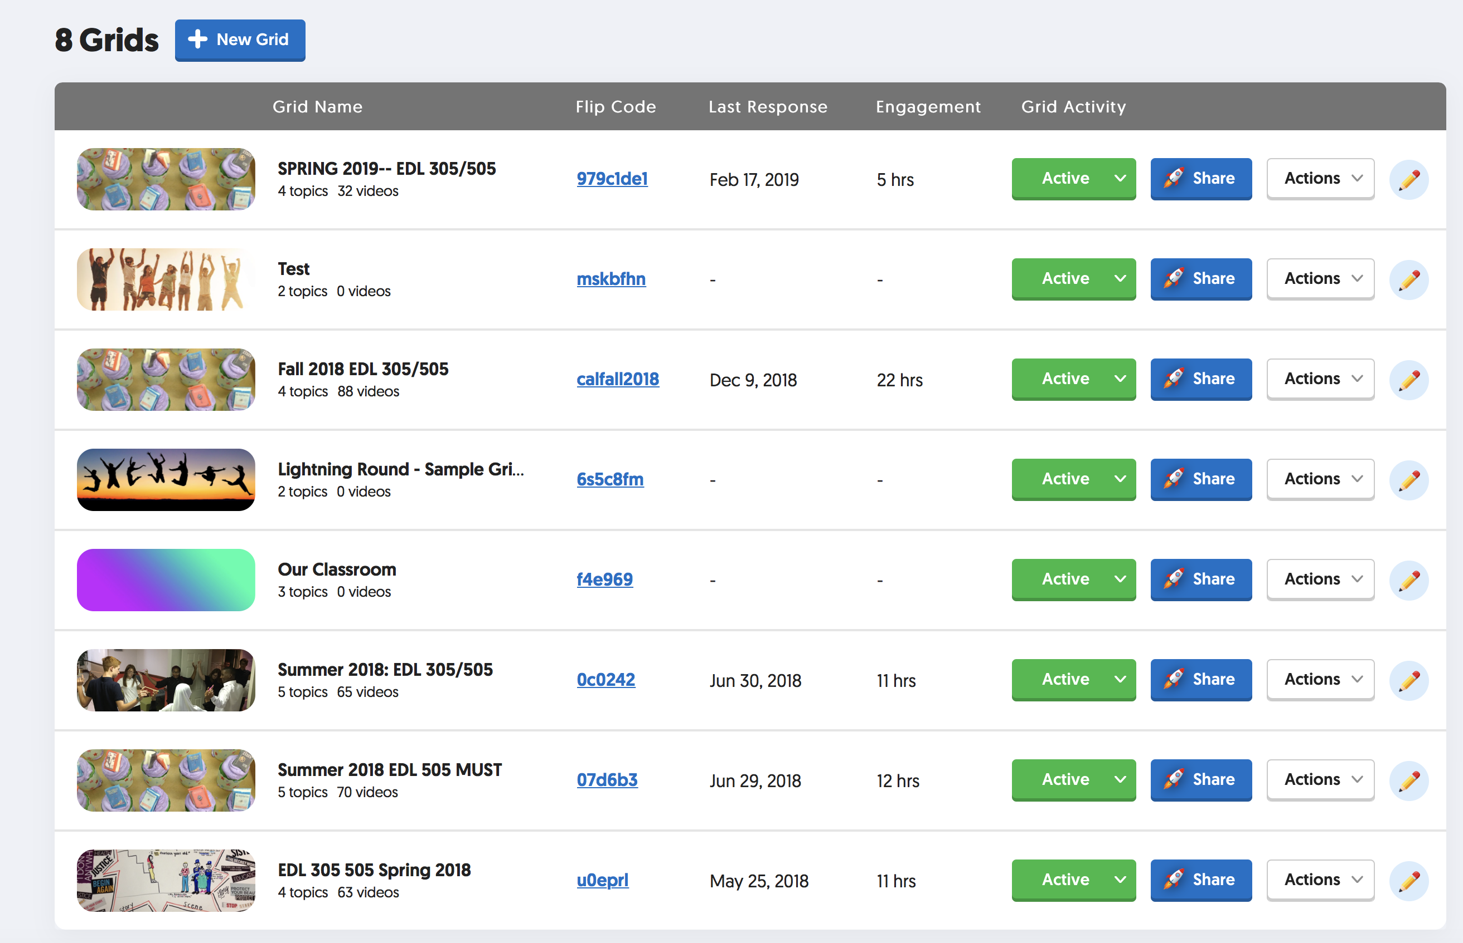
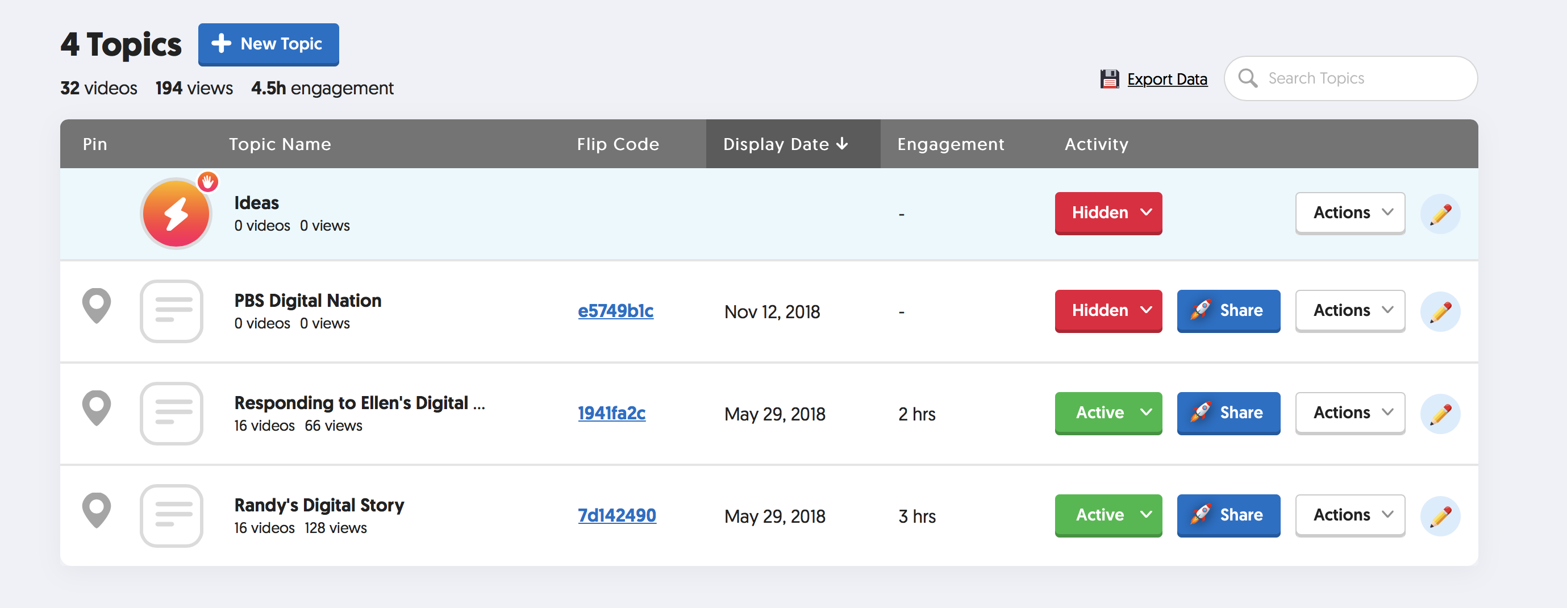
GRIDS VS TOPICS
GRIDS
TOPICS

Slide 9
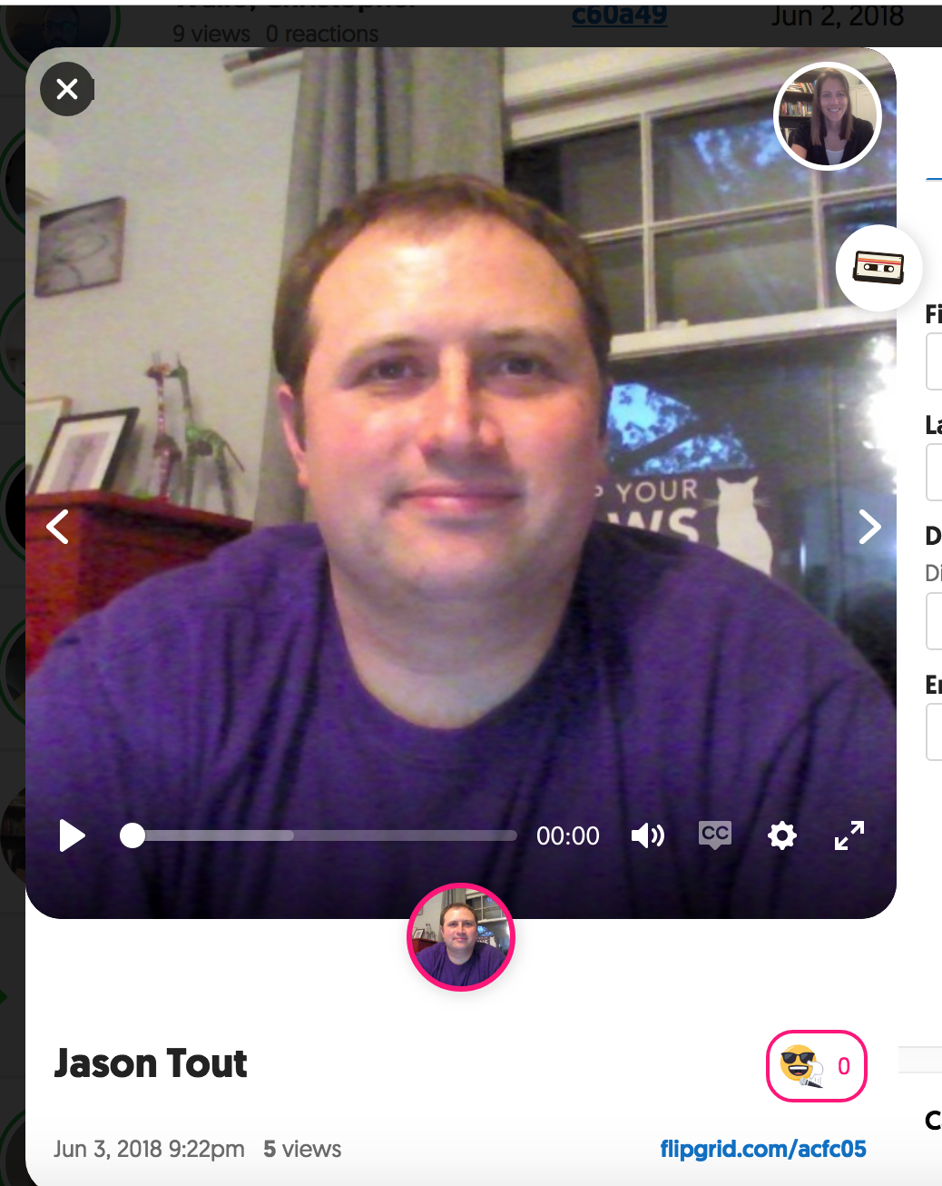
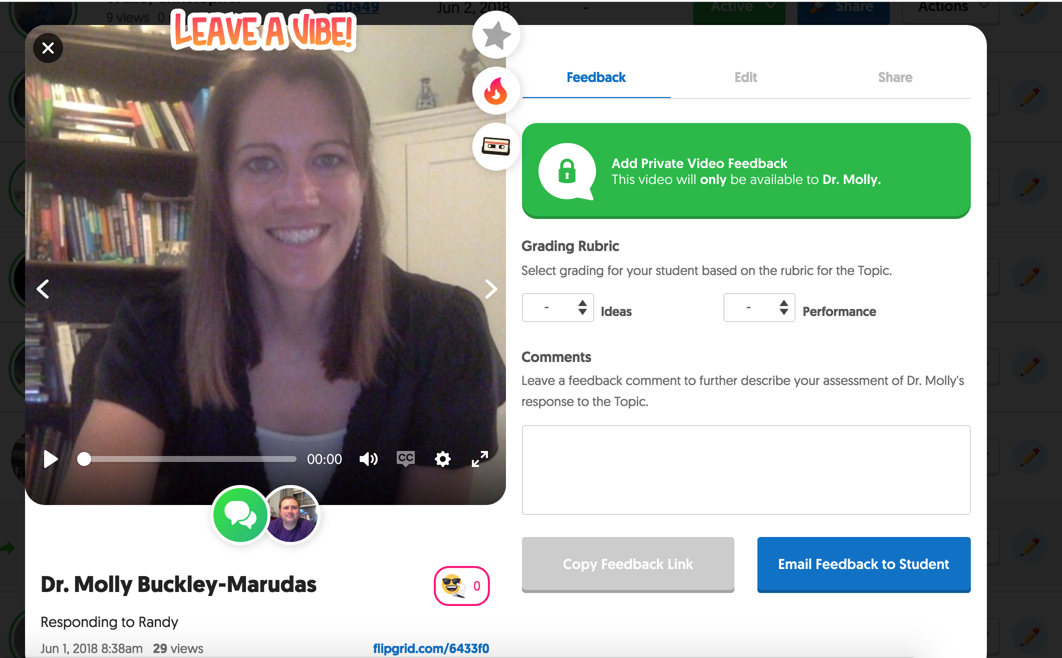
A CloseR LOOK: Sample Flipgrid
Notes:
As of Summer 2018, platform is free for educators
Spend some time setting it up and familiarizing yourself with the various settings (private, public, school)
Some things to point out: see your students. Let students interact with one another. Practice with video recordings. Increase comfort with various digital literacies
Quick “in the moment” responses or longer responses
Builds on and leverages attributes of Connected learning framework

Slide 10
Let’s Try It
PRACTICING WITH FLIPGRID

Slide 11
Using FLIPGRID
Go to Flipgrid: https://flipgrid.com/7c24f6b3
Password: Viking2019!
[If needed: Code: 7c24f6b3]
Introduce yourself
  Name
  Department, Office, and/or Center
  Why did you come to this session?
  What’s your “top” tech tool or tip?

Slide 12
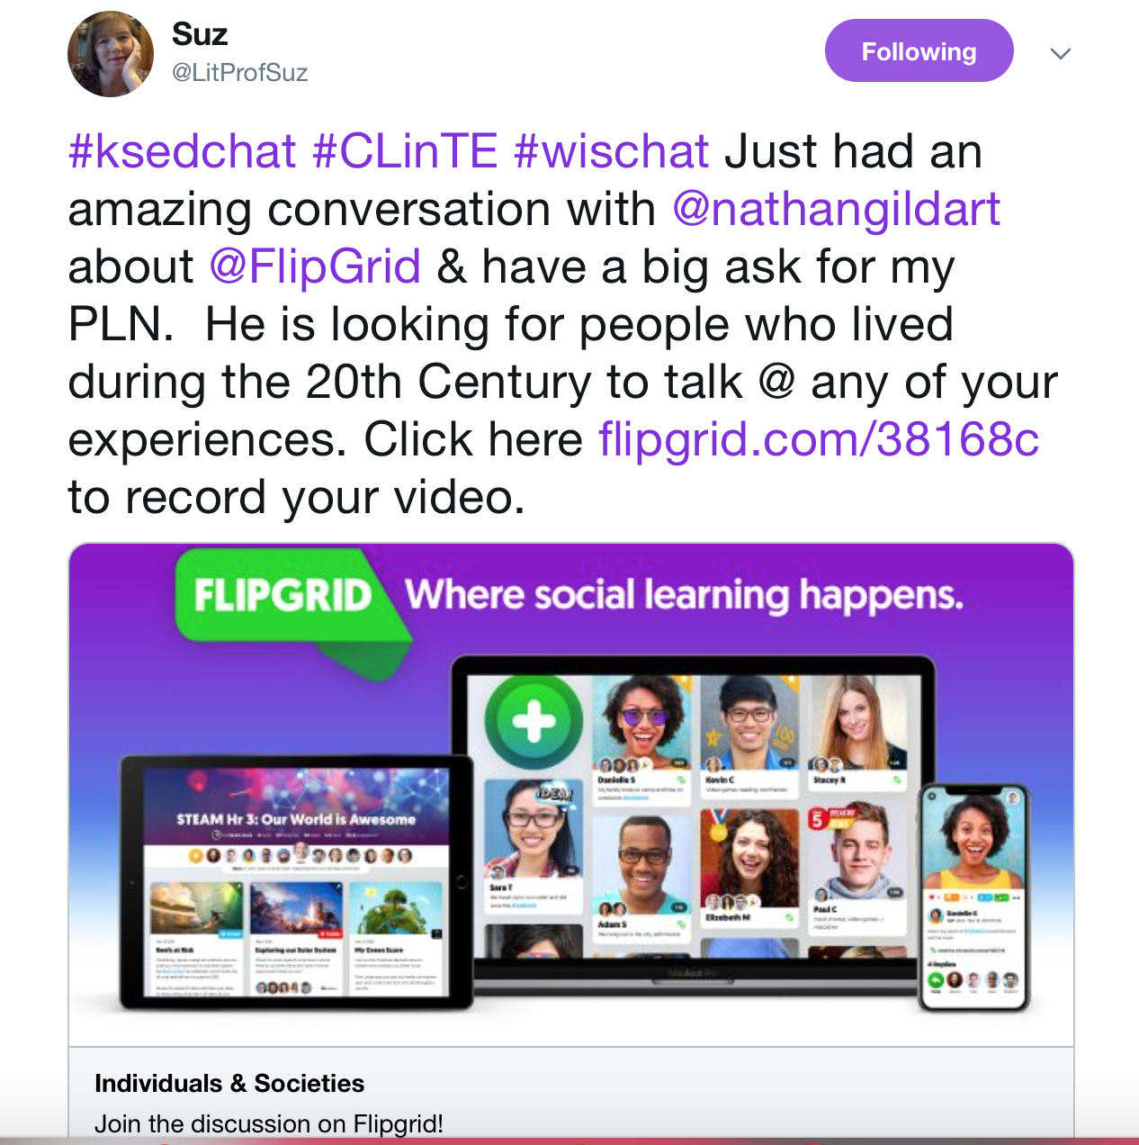
JOIN a GRID & RESPOND TO a TOPIC
https://flipgrid.com/30e2b097
Password: Viking2019!
OR: Join a “Live” Grid:
Choose and Skim ONE Resource:
10 Reasons Why I Have Flipgrid Fever: http://www.hollyclark.org/2017/05/28/10-reasons-i-have-flipgridfever/
https://ww2.kqed.org/education/2017/06/15/flipgrid-the-global-classroom-connections-maker/
Respond: What stood out to you from what you read? What is one way you are thinking about using Flipgrid in your teaching?
Just had an amazing conversation with ‪@nathangildart about ‪@FlipGrid & have a big ask for my PLN. He is looking for people who lived during the 20th Century to talk @ any of your experiences. Click here ‪https://flipgrid.com/38168c to record your video.

Slide 13
SETTING UP EDUCATOR ACCOUNT
PRACTICING WITH FLIPGRID

Slide 14
SET UP Educator ACCOUNT
  Go to Flipgrid.com
  Click: Create account (Educator)
  Set up “grid”: thic could be a course, a workshop
  Make a topic: “Add topic”: Pose a question, task, or prompt
  Enter preferred settings: moderation, length of video, approval, password
  Participants record and share video response (15 seconds – 5 minutes)
  Participants watch videos and reply (in symbols, words, and/or videos)

Slide 15
If you want to LEARN more
Flipgrid Website: www.flipgrid.com
Flipgrid on Twitter: @flipgrid https://twitter.com/Flipgrid
Flipgrid Hashtag: #flipgridfever: https://twitter.com/hashtag/FlipgridFever?src=hash
A Teacher’s Reflection: Flipgrid: The Global Classroom Connections Maker
A Teacher’s Collection of Ideas: 17 Ways to Infuse #Flipgridfever into your Classroom
Contact me: m.buckley67@csuohio.edu
Notes:
-various tutorials on YouTube
-directions for students

Slide 16
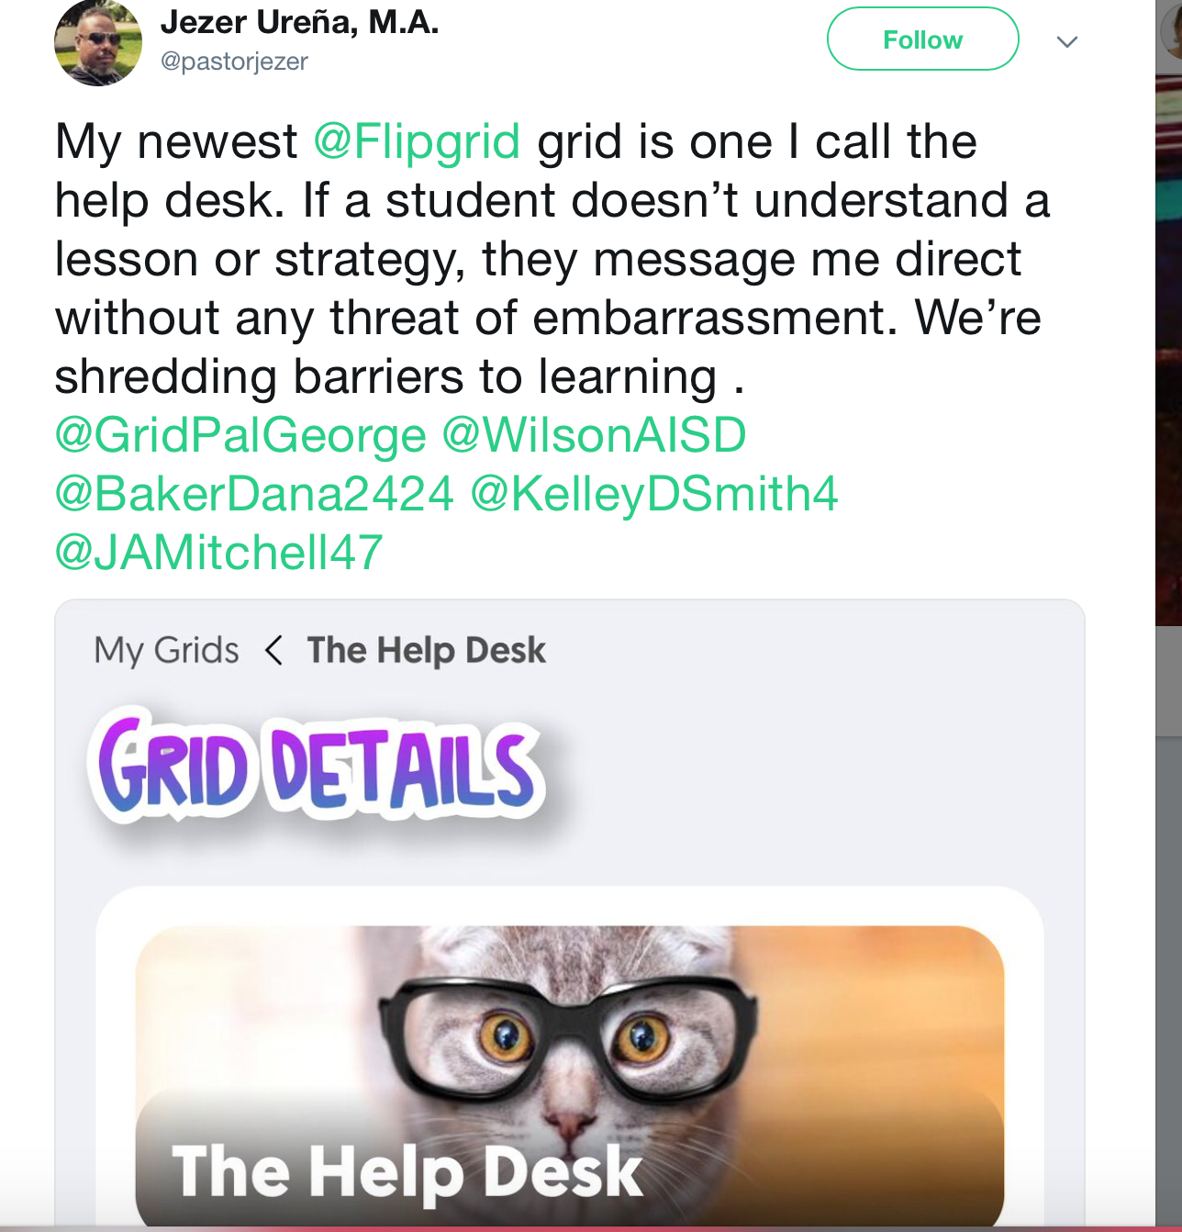
BRAINSTORMING: Ideas for USING in the Classroom
Notes:
Collaborative knowledge-building
Content application
Create community
Critical thinking
Constructivist learning
Allow individualization without isolation
Stimulate participation
Encourage reflection
Summarize key ideas
Create an environment conducive to learning
Pose meaningful questions and problems

